Slide 1
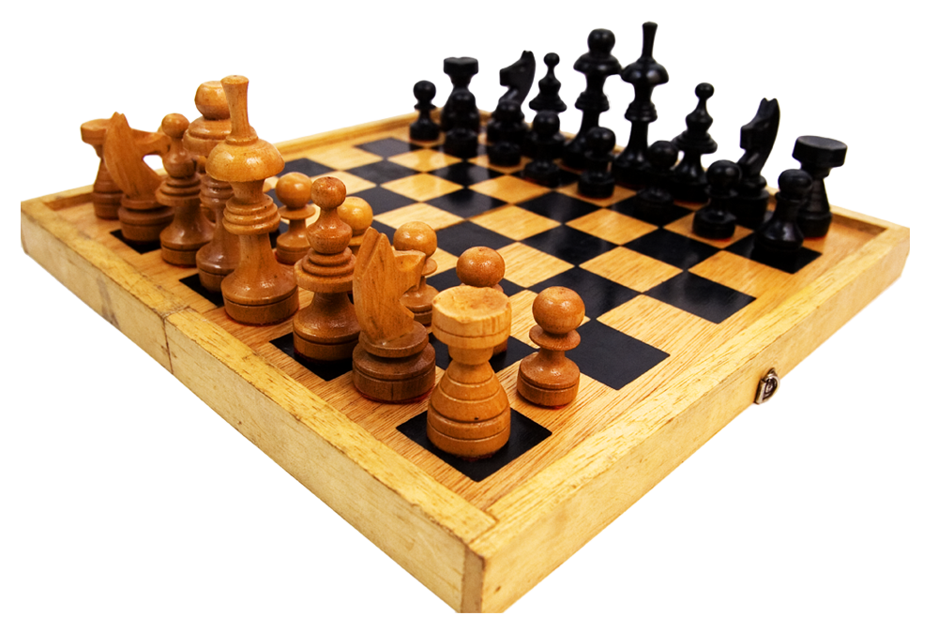
30 – Day Basic Chess Learning Challenge
Sybil Kate Meriveles

Slide 2
Goal
Before I did the thirty days of chess learning challenge, I set a goal to develop my critical thinking through the process.
Notes:
At that time, I believed that playing chess pushes you to think out of the box, especially in circumstances wherein a vital piece, like the King, needs protection from a possible checkmate.

Slide 3
Time Management

Slide 4
What Happened?
1. Play against computer at beginner level
Notes:
I started by playing against the computer, and it only took me a couple of losses to win a chess game.

Slide 5
Then…
I improved my chess game understanding
Ex. Recognizing moves of each chess pieces.
3. I started to experience difficulty…
Notes:
The more I gained knowledge properly to play chess...
The more I struggled to play chess at a beginner level.

Slide 6
It was unexpected…
4. I developed overthinking…
It became my chess gameplay weakness
Notes:
It was unexpected because I’m supposed to acquire more wins than losses. Additionally, my gameplay winning time increased over time.
Although learning basic chess heightened my critical thinking and awareness of my opponent's moves, I later realized that I also developed overthinking, which distracted me from playing defensively.

Slide 7
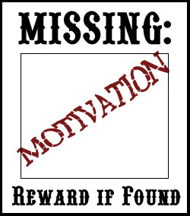
I played less chess games…
I lost the motivation to practice chess.
Notes:
Due to the growth of my game losses, I decreased my number of chess practices.
Additionally, I lost the motivation to play and learn chess.

Slide 8
7. I watched inspiring chess players in YouTube.
Misha Osipov - Youngest Pro Chess Player
Hikaru Nakamura – Rank 19 (according to chess.com) Chess Grandmaster
Carlsen Magnus – Rank 1 (according to chess.com) Chess Grandmaster
8. I slowly gained motivation (again).
9. I learned to ignore time and pressure.
10. I finished the 30-Day Challenge despite my high number of losses.

Slide 9
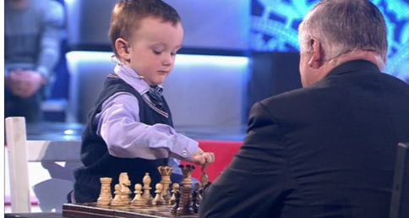
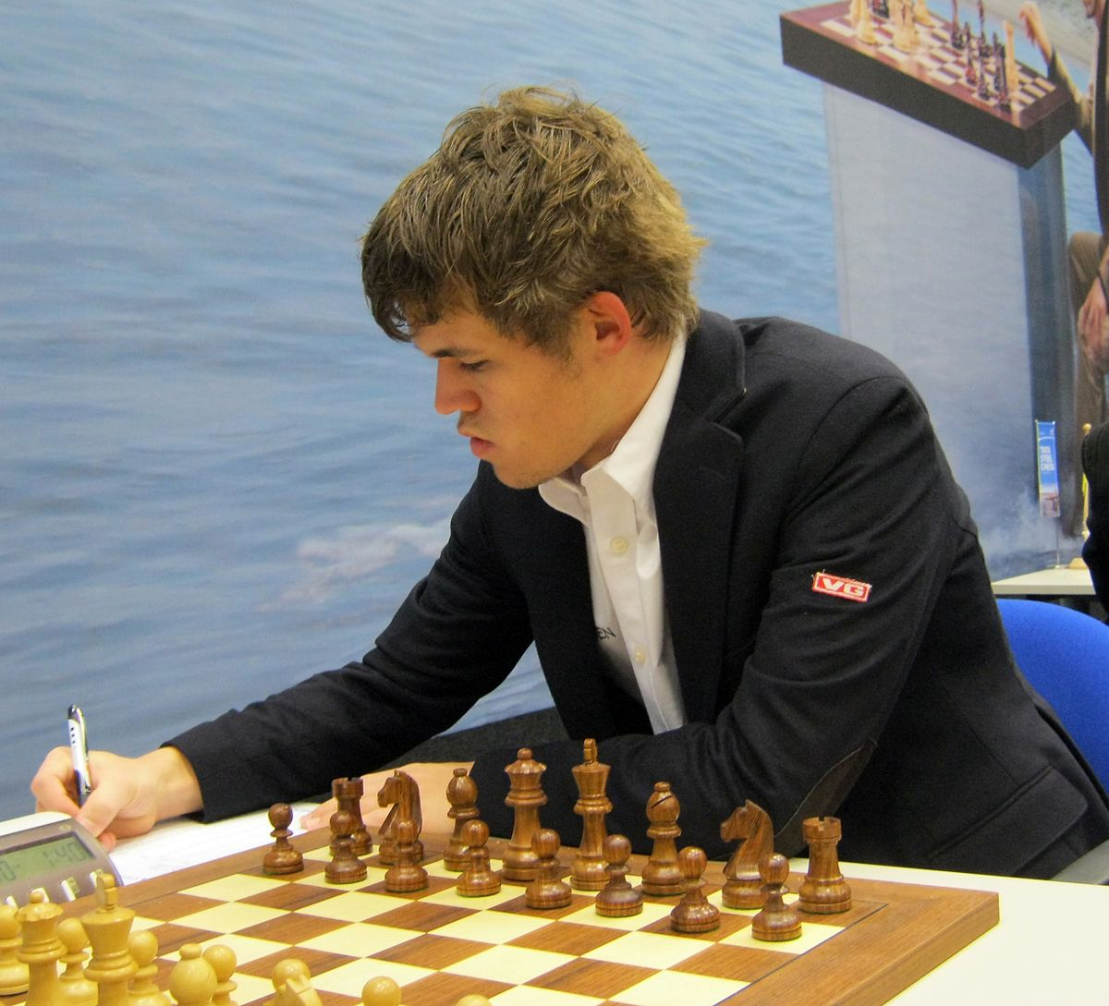
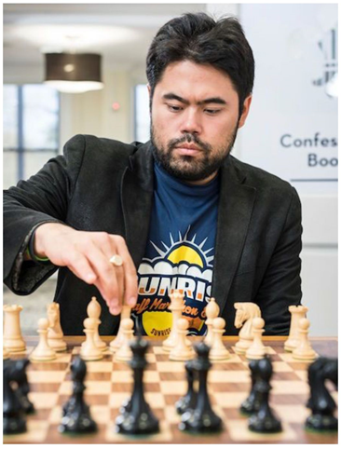
This Photo by Unknown Author is licensed under CC BY-SA
Notes:
Image 1: Mikhail “Misha” Osipov vs Anatoly Karpov - grandmaster and world champion from 1975 to 1985
Image 2: Carlsen Magnus
Image 3: Hikaru Nakamura

Slide 10
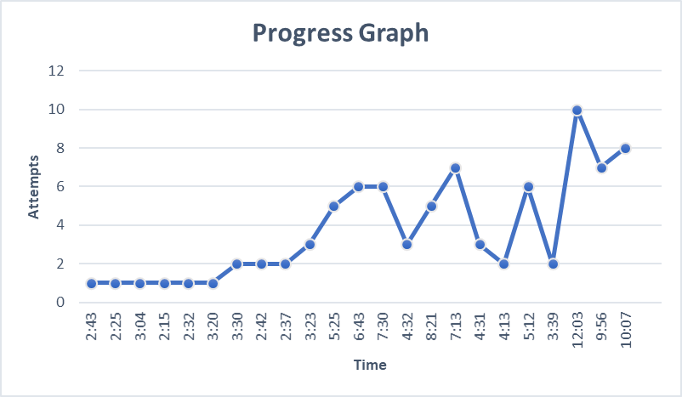
Notes:
Overtime, my winning time increased along with my number of chess game attempts to win.

Slide 11
Journal Reflection
Overall, my 30-Day Challenge experience was difficult yet beneficial. Throughout the process, I journaled what I learned: types of chess end games, openings, chess pieces & their moves, parts of the chessboard, and special rules like castling. In my opinion, journaling was a lengthy process. To gain efficiency, I wrote some of them in my notebook and transferred them to my OneNote Journal Notebook. On the other hand, I also encountered issues in journaling my experience. First, I sometimes have forgotten to transfer my written journals to my OneNote Journal Notebook on time. Second, I'm mildly slow at typing. However, I was successful in achieving my goal, which is to improve my critical thinking. I became more aware of my gameplay and used recommended chess strategies.
Notes:
Show a short clip of journal

Slide 12
Notes:
This is a snippet of my journal
Posted the link of my journal to the shared Google Docs Page

Slide 13
What I Need to Improve?
Overcome Overthinking
Learn to manage pressure
Patience
Following Schedule

Slide 14
Extra Question
Based on my experience, will I continue to learn chess?

Slide 15
Thank you for your time…
Notes:
And I hope that you all learned something from my 30 – Day Basic Chess Learning Challenge..

