Slide 1
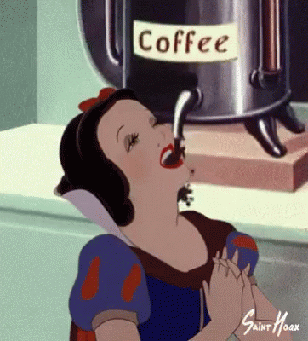
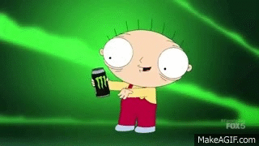
Coffee
Energy Drinks
Vs.
Jefferson Mateo
EN202-02
Dr. Kimberly Bunts - Anderson
Research Proposal

Slide 2
Coffee and energy drinks are popular stimulants that many college students choose to drink after staying up all night stressing on loads of assignments.
This research will expose the differences between consuming coffee and energy drinks. The purpose is to educate and present new, interesting information to NMC college students.

Slide 3
Research Question
Coffee or Energy Drinks :
“Which beverage helps a college student stay awake in class?”

Slide 4
Other Questions
What are NMC student’s choice ?
What are the health hazards (side effects) of both beverages?
What are other alternatives?
Which is a better choice?

Slide 5
Academic Sources
Articles/Journals
(Google Scholar, EBSCOhost)
Interview with Expert(s)
Dr. Erin Angela Camacho
REGISTERED DIETITIAN/NUTRITIONAL PROFESSIONAL
Secondary Sources
Student Surveys (20 participants)
Online Articles
Notes:
20 participants – narrow
All of NMC - wide

Slide 6
Research Schedule

Slide 7
Date/Week | Description
February 12-16 | Survey 1 Conduct a survey to students of NMC about what coffee and/or energy drink brand they prefer.
February 19- March 2 | Research Collect results and begin research on the beverages. Begin reading and taking notes from online articles and scholarly journals.
March 5-15 | Survey 2 Conduct a survey to the students about questions I need answers from.
March 15 | Interview with Expert Schedule an interview with a nutritionist, and interview that person about both beverages.
March 17-23 | Research Read and gather information from my notes and begin on final research report.
March 26-April 2 | Revise and submit

Slide 8
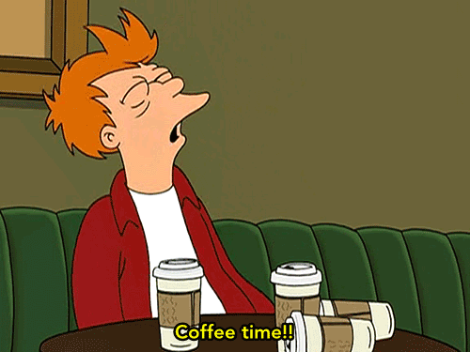
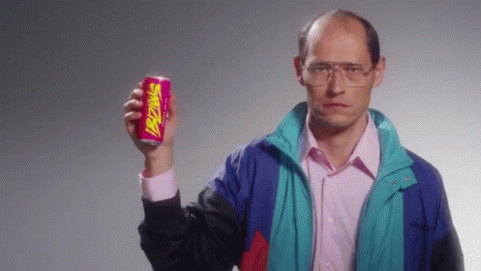
In conclusion, NMC college students will be able to know the differences between both beverages. Consuming one of the two may have its pros and cons. After this research, students will be knowledgeable about which is healthier and which is effective. Also, what other options they have to keep up during lectures.

