Slide 1
30-Day challenge
By: Preston Saralu

Slide 2
What is my goal?
My goal is to improve my writing skills and To have a better understanding of my writing skills, by improving my grammar, correct punctuations and to incorporate critical vocabulary into my writing.

Slide 3
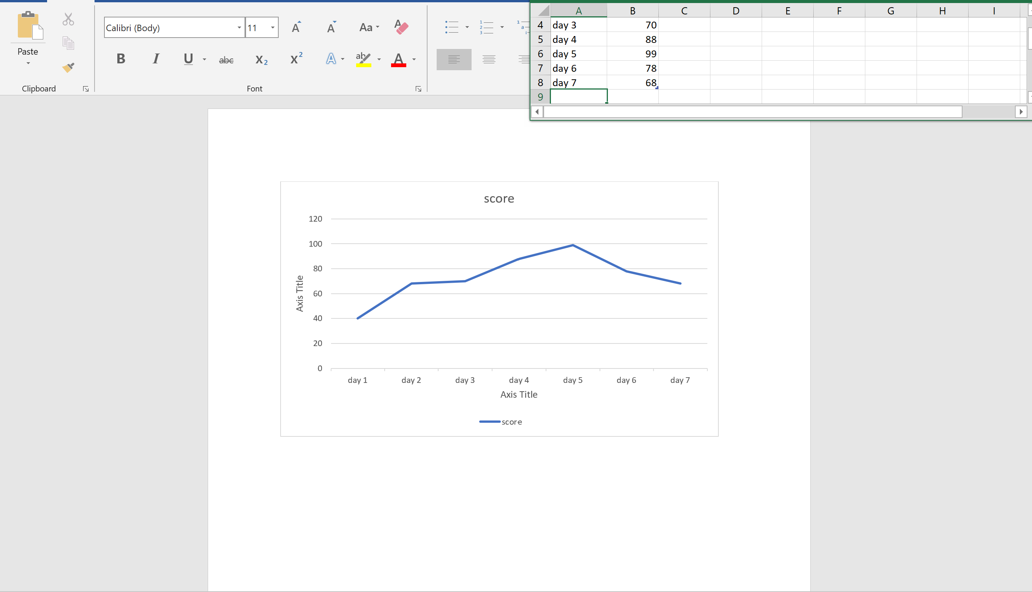
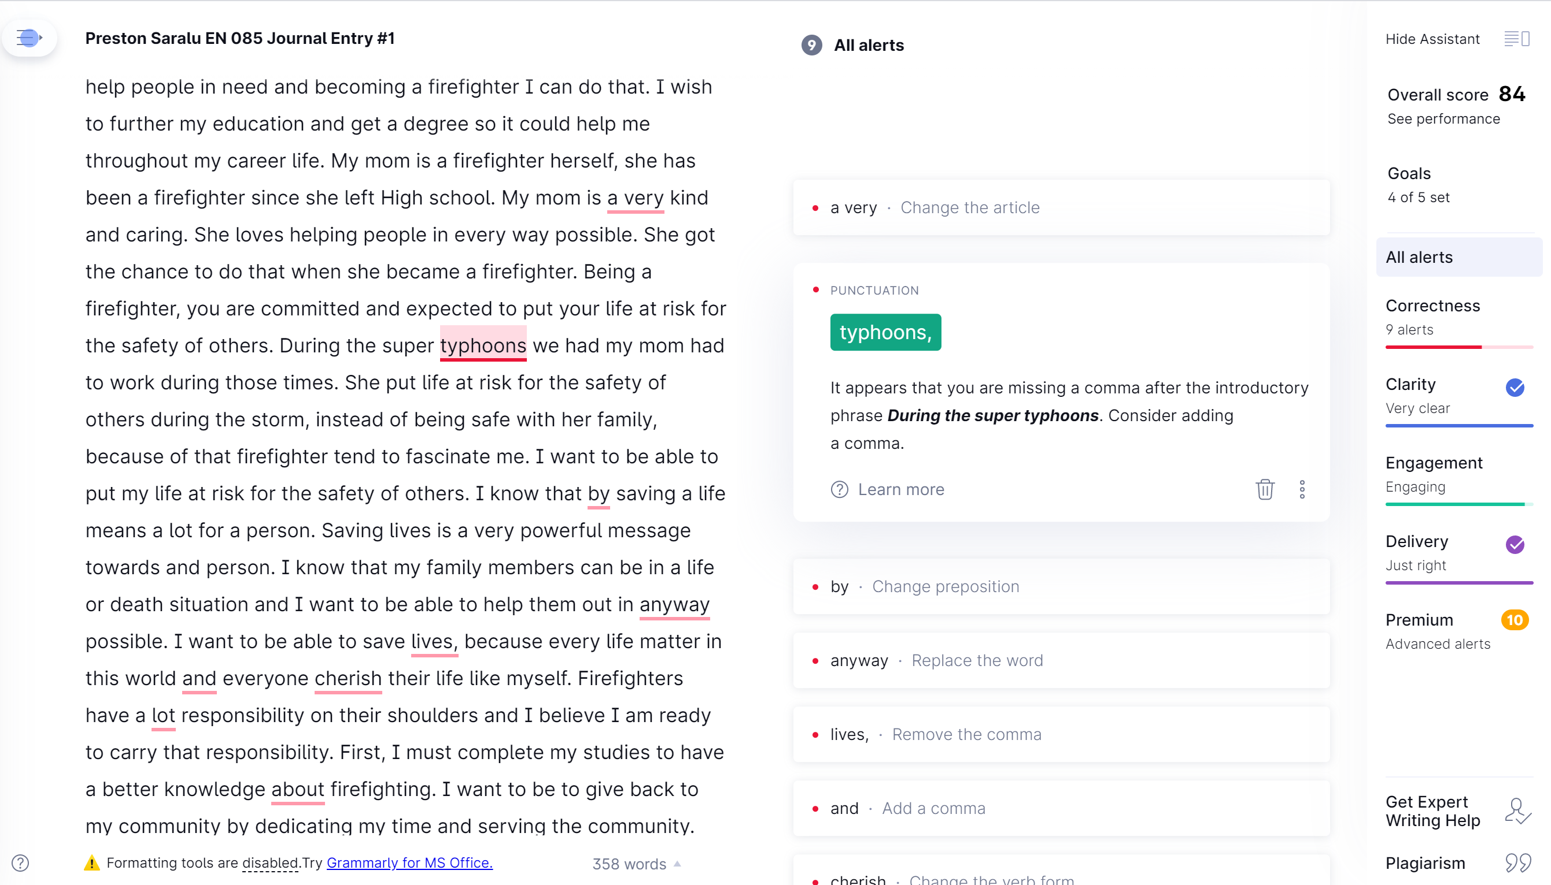
Measurements of my goal
I would write at least 30 minutes every day. And by using the online app Grammarly I would be able to calculate overall score from my writing. At the start of my challenge I am going to write a page journal and calculate my score on Grammarly and throughout the process and the end I am going to put my scores on a line graph to see if I progressed in my writing.

Slide 4
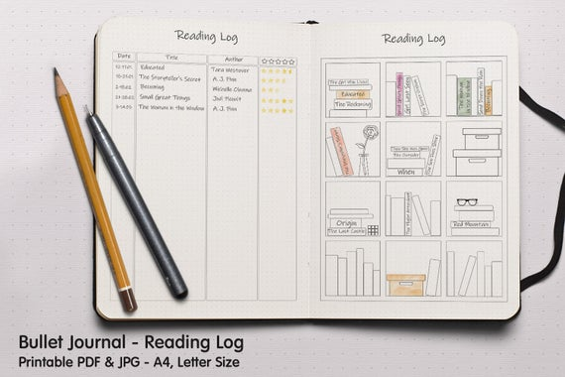
Journaling methods
For my journaling methods I am going to write down on a journal book my overall scores for the day and I am going to also write down the misspelled words and try to find critical vocabularies to use in my writing.

Slide 5
Flexibilities
To be able to be flexible with my goal I am going to keep a hand written journal or narrative essay. when the problem has been resolved, like a power outage I have a already prepared journal writing in hand to transfer in word document to be corrected on Grammarly.

Slide 6
Evaluating my goal
How I am going to able to evaluate my goal is that I would see through my line chat if I have improved or not throughout the 30- days of my challenge. I would also be writing after my 30-days to see if my grammar had improved or not

