Slide 1
30 Day ASL challenge
Aaron Diaz
Mrs. Bunts-Anderson
BE111

Slide 2
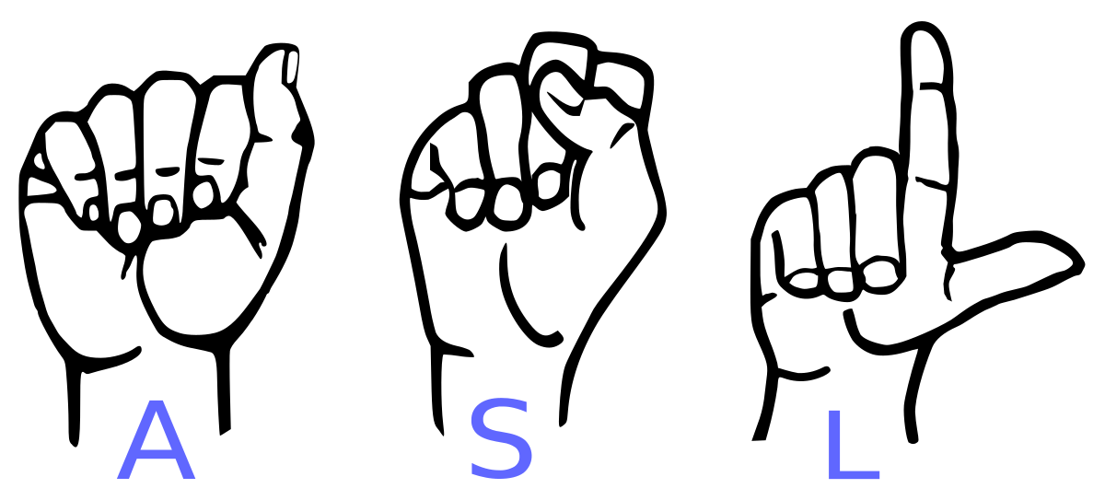
ASL challenge
Yes, this is my 30 day challenge, American sign language(ASL). ever since I worked in a summer camp in 2018. there was a child with a hearing impairment there and he would be alone because it was hard for him to interact with the other kids. I thought, why not learn or teach myself how to sign or ASL. So I would watch videos about asl or the alphabet and just follow what there doing. I got more interested and liked it. Then when I got a little better I would talk to him but of course, he was fast at signing so I would be a little bit slower but he and I would laugh. when the assignment was something we could choose I said why not ASL but because it’s been two years since then, And I kind of forgot the basic. so what I plan to do, is have a month schedule of things I’m going to do for learning ASL like watching videos, doing the alphabet and other more things to help.

Slide 3
What is ASL
American sign language or also know as ASL. People use this way of communicating through the expression of hands and face. Mostly used by deaf or people who are hard of hearing. This is a great skill to learn if your looking for a job or just trying to learn a new skill. I just want to learn how to sign just to have an extra skill. And if someone in need of a translator I try my best to help.

Slide 4
Plan
Learn as much ASL as I can in 30 days and track my journey of self taught ASL
I plan to use the monthly schedule to have a big picture of my data
Learn alphabet first then earn basic words and phrases
Track it down on the schedule and see what needs improvement

Slide 5
Schedule Monthly
Sunday | Monday | Tuesday | Wednesday | Thursday | Friday | Saturday
1. ASL Alphabet | 2. ASL Alphabet. Phrase | 3. ASL Alphabet. | 4. ASL Alphabet. Phrase | 5. ASL Alphabet. | 6. ASL Alphabet. Phrase | 7. ASL Alphabet.
8. ASL Alphabet. | 9. ASL Alphabet. Phrase | 10. ASL Alphabet. | 11. ASL Alphabet. Phrase | 12. ASL Alphabet. | 13. ASL Alphabet. Phrase | 14. ASL Alphabet.
15. ASL Alphabet. | 16. ASL Alphabet. Phrase | 17. ASL Alphabet. | 18. ASL Alphabet. Phrase | 19. ASL Alphabet. | 20. ASL Alphabet. Phrase | 21. ASL Alphabet.
22. ASL Alphabet. | 23. ASL Alphabet. Phrase | 24. ASL Alphabet. | 25. ASL Alphabet. Phrase | 26. ASL Alphabet. | 27. ASL Alphabet. Phrase | 28. ASL Alphabet.
29. ASL Alphabet. | 30. ASL Alphabet. Phrase

Slide 6
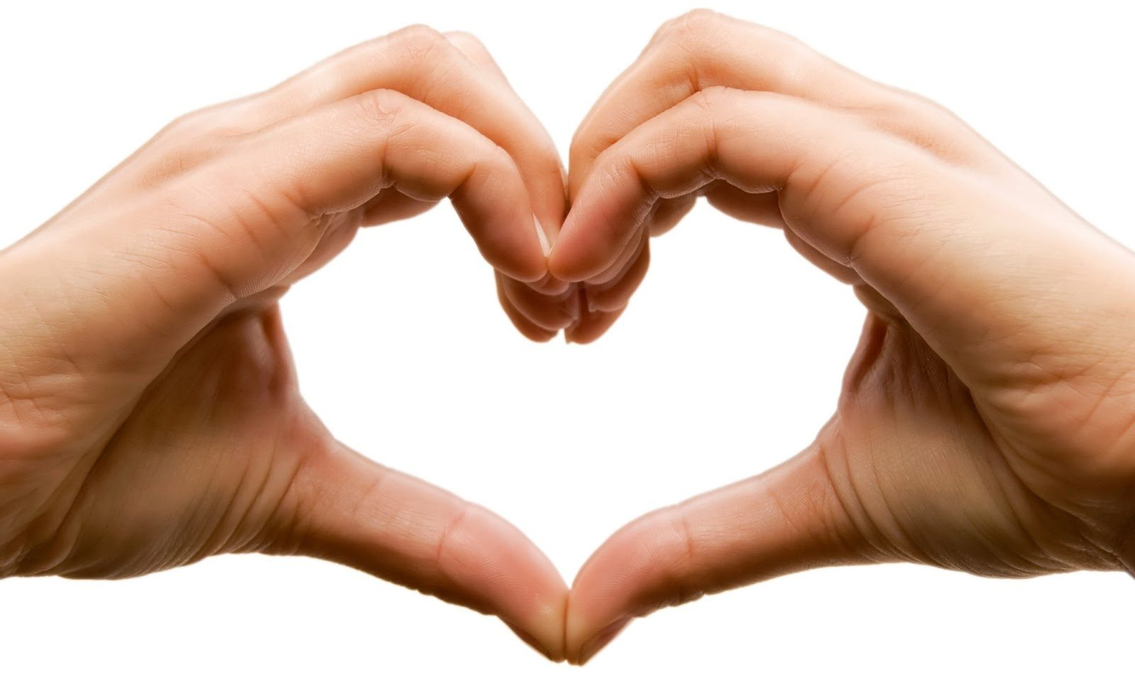
Progress
For progress on my ASL challenge is going well, Right now I Know the entire alphabet and know a bunch of phrases. Some for example are how are you, my name is, and where you’re from. There's so much more that I know and am only getting better at understanding. Also including that I taught myself how to count. So progress is going pretty good and I’m enjoying myself, this is actually pretty fun.

Slide 7
conclusion
In the end I found out that it wasn’t as hard as I thought. But the only thing that was a little complicated was how fast I sign and how fast I read some one else's signs. Yes, I can sign but it’s just not that fast and for reading other people. Those who were born or grow up deaf or hard of hearing are fluent in signing. But for me its just a little more hard to do all of this quickly cause of course I’m self taught. So Ill keep it up and continue teaching me self Asl.

Slide 8
Tutor feedback
Hi Aaron,
I have looked over your presentation and speech. Teaching yourself ASL is something really good to learn. I like how you found a way to communicate with your friend. One thing I would suggest is on using "a child with a hearing impairment," instead. Overall, I am glad you were able to accomplish your goal and gain a very important skill. Hope this helps!
Regards,
Kayziel Mojica

