Slide 1
30 Day Challenge
Alex Relatado
BE 111-02
Dr. Kimberly Bunts-Anderson

Slide 2
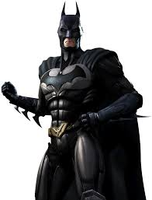
1. Batman
Debut Year: 1939
Creators: Bob Kane, Bill Finger
Company: DC Comics
Town: Gotham City
Alias: Bruce Wayne

Slide 3
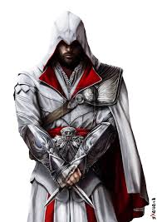
2. Ezio Auditore
Debut Year: 2009
Creator: Ubisoft
Game: Assassin’s Creed II
Town: Firenze (Florence), Italy

Slide 4
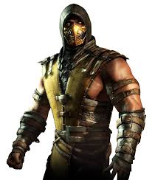
3. Scorpion
Debut Year: 1992
Creator: Ed Boon, John Tobias
Game: Mortal Kombat
Lives: The Netherrealm
Alias: Hanzo Hasashi

Slide 5
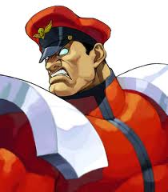
4. M. Bison
Debut Year: 1991
Creator: Akiman Yasuda
Game: Street Fighter II
Occupation: Dictator
Organization: Shadaloo

Slide 6
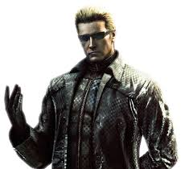
5. Albert Wesker
Debut Year: 1996
Creator: Kenichi Iwao
Game: Resident Evil
Organization: Umbrella Corporation

Slide 7
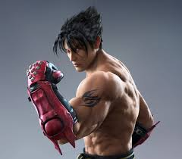
6. Jin Kazama
Debut Year: 1997
Creator: Aya Takemura
Game: Tekken 3
Occupation: CEO Mishima Zaibatsu

Slide 8
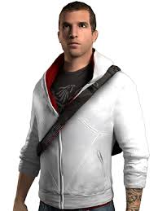
7. Desmond Miles
Debut Year: 2008
Creator: Ubisoft
Game: Assassin’s Creed I
Occupation: Bartender
Affiliations: Assassin Brotherhood

Slide 9
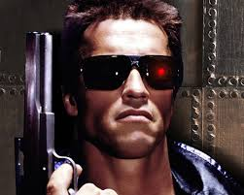
8. Terminator
Debut Year: 1984
Creator: James Cameron
Movie: Terminator 1
Portrayed by: Arnold Schwarzenegger
Model: T-800 Model 101

Slide 10
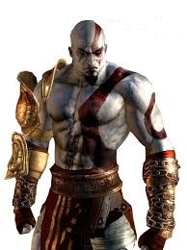
9. Kratos
Debut Year: 2005
Creator: David Jaffe
Game: God of War
Status: Demigod, Antihero
Rank: Spartan General

Slide 11
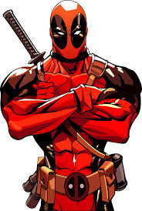
10. Deadpool
Debut Year: 1991
Creator: Fabian Nicieza
Company: Marvel
Nickname: Merc with a Mouth
Status: Antihero

Slide 12
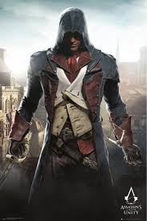
11. Arno Dorian
Debut Year: 2014
Creator: Ubisoft
Game: Assassin’s Creed Unity
Ethnicity: French
Rank: Novice

Slide 13
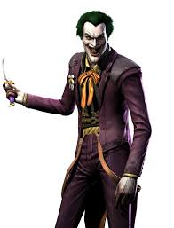
12. The Joker
Debut Year: 1940
Creator: Jerry Robinson
Company: DC Comics
Status: Greatest Villain

Slide 14
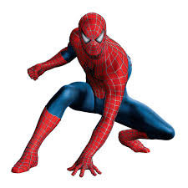
13. Spider-Man
Debut Year: 1962
Creator: Stan Lee
Company: Marvel
Alias: Peter Parker
Town: NYC

Slide 15
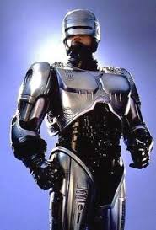
14. RoboCop
Debut Year: 1987
Creator: Edward Neumeier
Movie: RoboCop
Alias: Alex J. Murphy
Occupation: Police Officer
Town: Detroit, Michigan

Slide 16
15. Jason Voorhees
Debut Year: 1980
Creator: Victor Miller, Ron Kurz
Movie: Friday the 13th
Portrayed by: Kane Hodder
Weapon: Machete
Lives: Crystal Lake

Slide 17
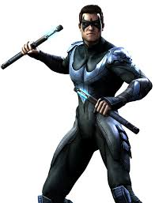
16. Nightwing
Debut Year: 1940 (as Robin), 1984 (as Nightwing)
Creators: Bob Kane, Bill Finger
Company: DC Comics
Alias: Dick Grayson
Town: Bludhaven

Slide 18
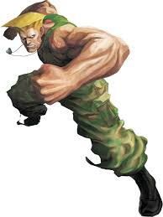
17. Guile
Debut Year: 1991
Creator: Akiman Yasuda
Game: Street Fighter II
Occupation: USAF Soldier

Slide 19
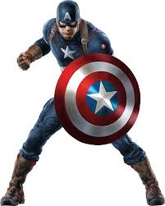
18. Captain America
Debut Year: 1941
Creators: Joe Simon, Jack Kirby
Company: Marvel
Occupation: U.S. Army Soldier
Portrayed by: Chris Evans
Member of The Avengers

Slide 20
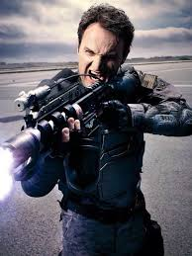
19. John Connor
Debut Year: 1991
Creator: James Cameron
Movie: Terminator 2: Judgment Day
Leader of the Human Resistance
Portrayed by: Jason Clarke

Slide 21
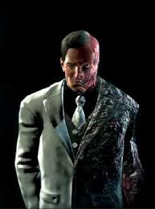
20. Two-Face
Debut Year: 1942
Creators: Bob Kane, Bill Finger
Company: DC Comics
Alias: Harvey Dent
Occupation: District Attorney
Town: Gotham City

Slide 22
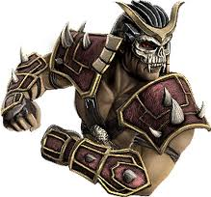
21. Shao Kahn
Debut Year: 1993
Creators: John Tobias, Ed Boon
Game: Mortal Kombat II
Emperor of Outworld

Slide 23
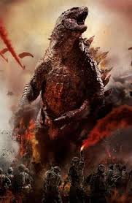
22. Godzilla
Debut Year: 1954
Creator: Tomoyuki Tanaka
Movie: Godzilla
Species: Kaiju

Slide 24
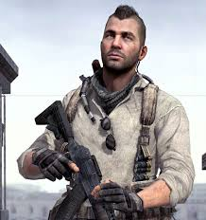
23. John Mactavish
Debut Year: 2007
Creator: Infinity Ward
Game: Call of Duty 4: Modern Warfare
Alias: Soap
Affiliations: SAS Task Force 141

Slide 25
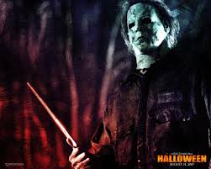
24. Michael Myers
Debut Year: 1978
Creators: John Carpenter, Debra Hill
Movie: Halloween
Weapon: Kitchen Knife

Slide 26
25. Sonic the Hedgehog
Debut Year: 1991
Creators: Yuji Naka, Naoto Ohshima
Company: Sega
Game: Sonic the Hedgehog
Sega’s Mascot

Slide 27
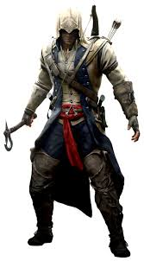
26. Connor Kenway
Debut Year: 2012
Creator: Ubisoft
Game: Assassin’s Creed III
Native Name: Ratonhnhake:ton

Slide 28
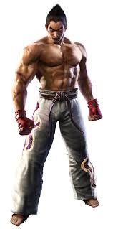
27. Kazuya Mishima
Debut Year: 1994
Creator: Aya Takemura
Game: Tekken 1
Harness the Devil Gene
Father of Jin Kazama

Slide 29
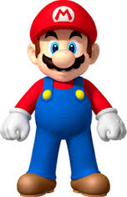
28. Mario
Debut Year: 1981 (Donkey Kong)
Creator: Shigeru Miyamoto
Company: Nintendo
Nintendo’s Mascot
Brother: Luigi

Slide 30
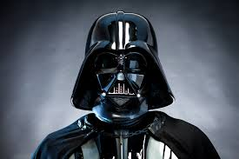
29. Darth Vader
Debut Year: 1977
Creator: George Lucas
Movie: Star Wars
Affiliations: Dark Side
Name: Anikan Skywalker

Slide 31
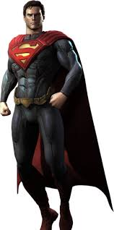
30. Superman
Debut Year: 1938
Creators: Jerry Siegel, Joe Shuster
Company: DC Comics
Name: Kal-El/Clark Kent
Lives: Krypton/Metropolis

Slide 32
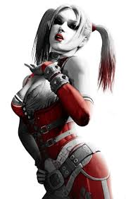
31. Harley Quinn
Debut Year: 1993
Creators: Paul Dini, Bruce Timm
Company: DC Comics
Name: Harleen Quinzel
Occupation: Psychiatrist

Slide 33
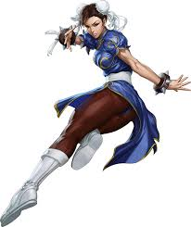
32. Chun-Li
Debut Year: 1991
Creator: Akiman Yasuda
Game: Street Fighter II
Interpol Officer

Slide 34
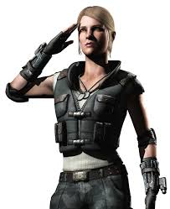
33. Sonya Blade
Debut Year: 1992
Creator: John Tobias, Ed Boon
Game: Mortal Kombat
Member of the U.S. Special Forces

Slide 35
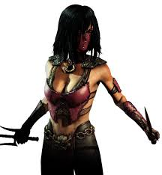
34. Mileena
Debut Year: 1993
Creators: John Tobias, Ed Boon
Game: Mortal Kombat II
Evil twin sister of Kitana
Heir to Shao Kahn’s throne

Slide 36
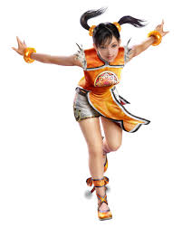
35. Ling Xiaoyu
Debut Year: 1997
Creator: Aya Takemura
Game: Tekken 3
Love interest of Jin Kazama

Slide 37
3 Bonus Characters
I made a survey and I asked my friends which characters will be on the presentation, and these are their choices.

Slide 38
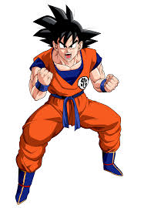
36. Son Goku
Debut Year: 1984
Creator: Akira Toriyoma
Manga/Anime: Dragon Ball Z
Superman’s Eastern Counterpart

Slide 39
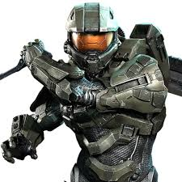
37. Master Chief
Debut Year: 2001
Creator: Bungie
Game: Halo
Name: John-117

Slide 40
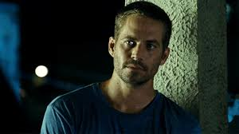
38. Brian O’Connor
Debut Year: 2001
Creator/Distributor: Universal Pictures
Movie: The Fast & The Furious
Portrayed by: Paul Walker

