Slide 1
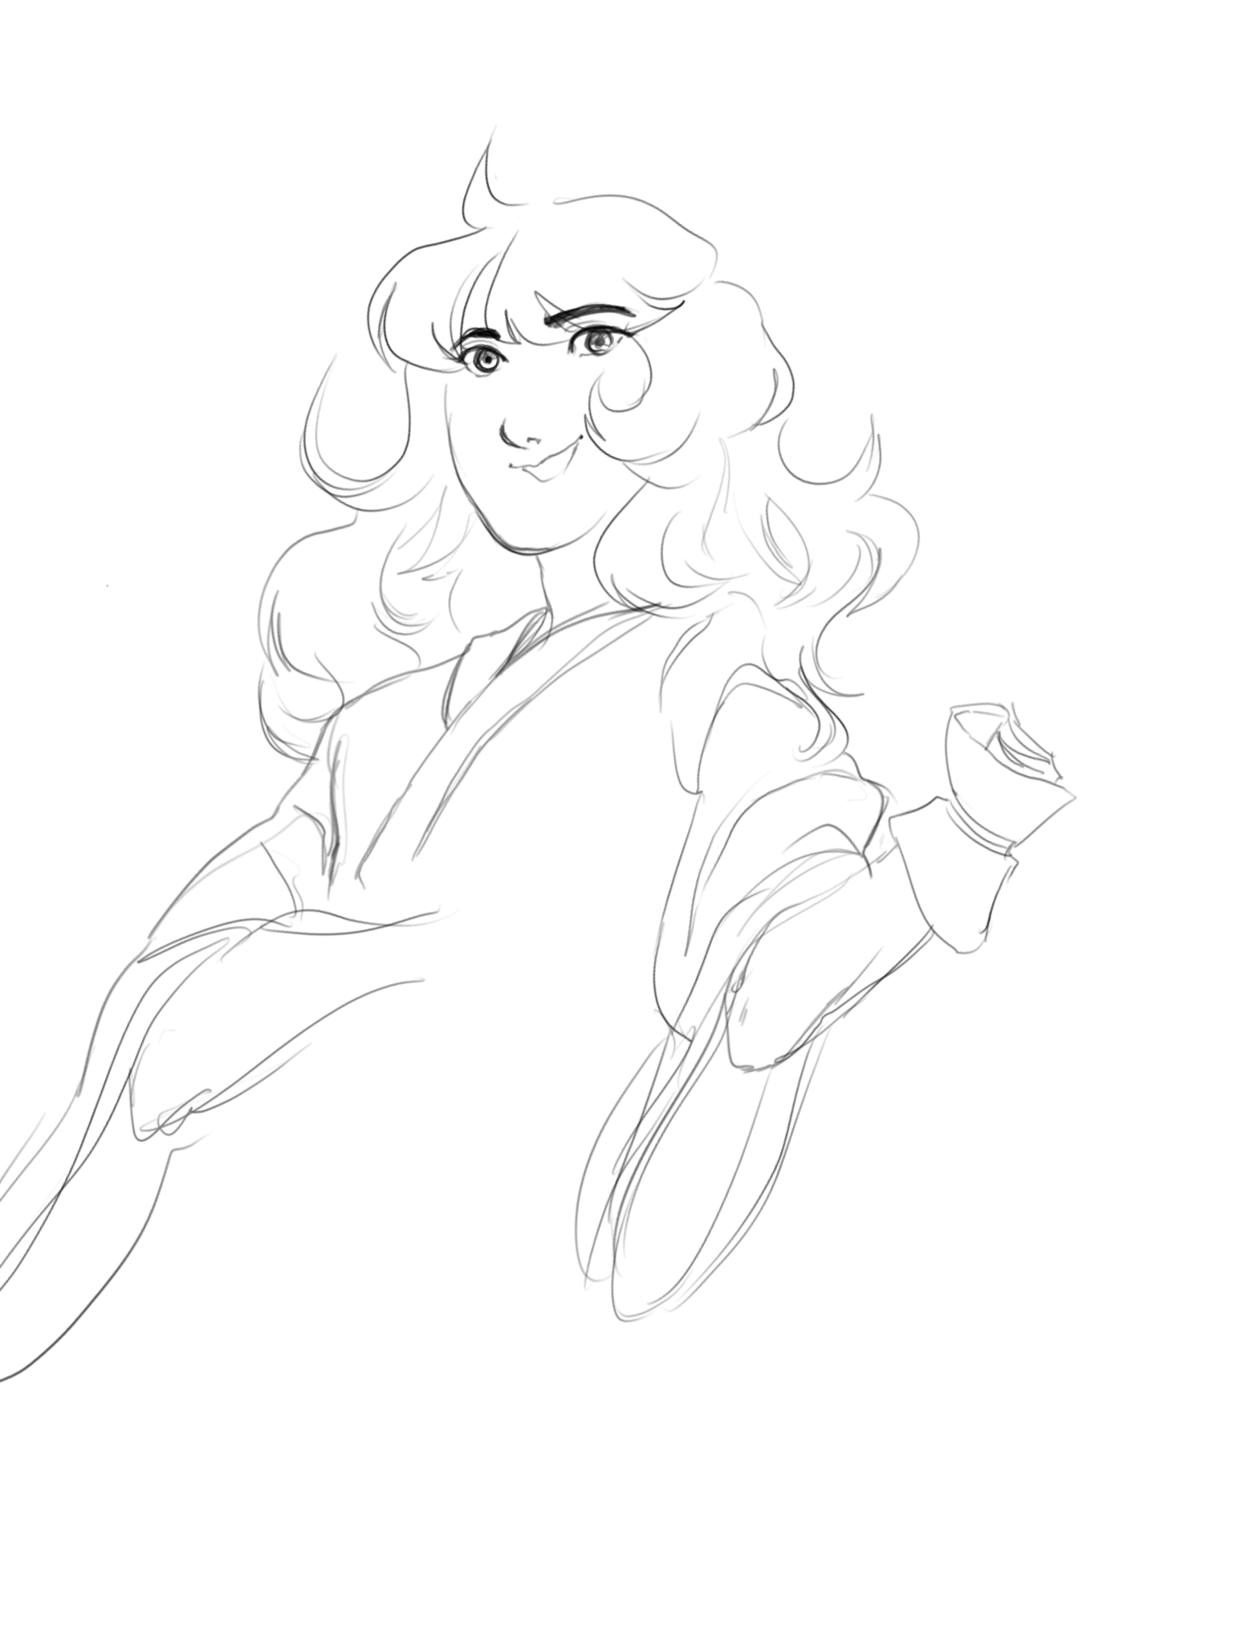
My 30 Day challenge
Marian Danga | BE 111 | September 2018

Slide 2
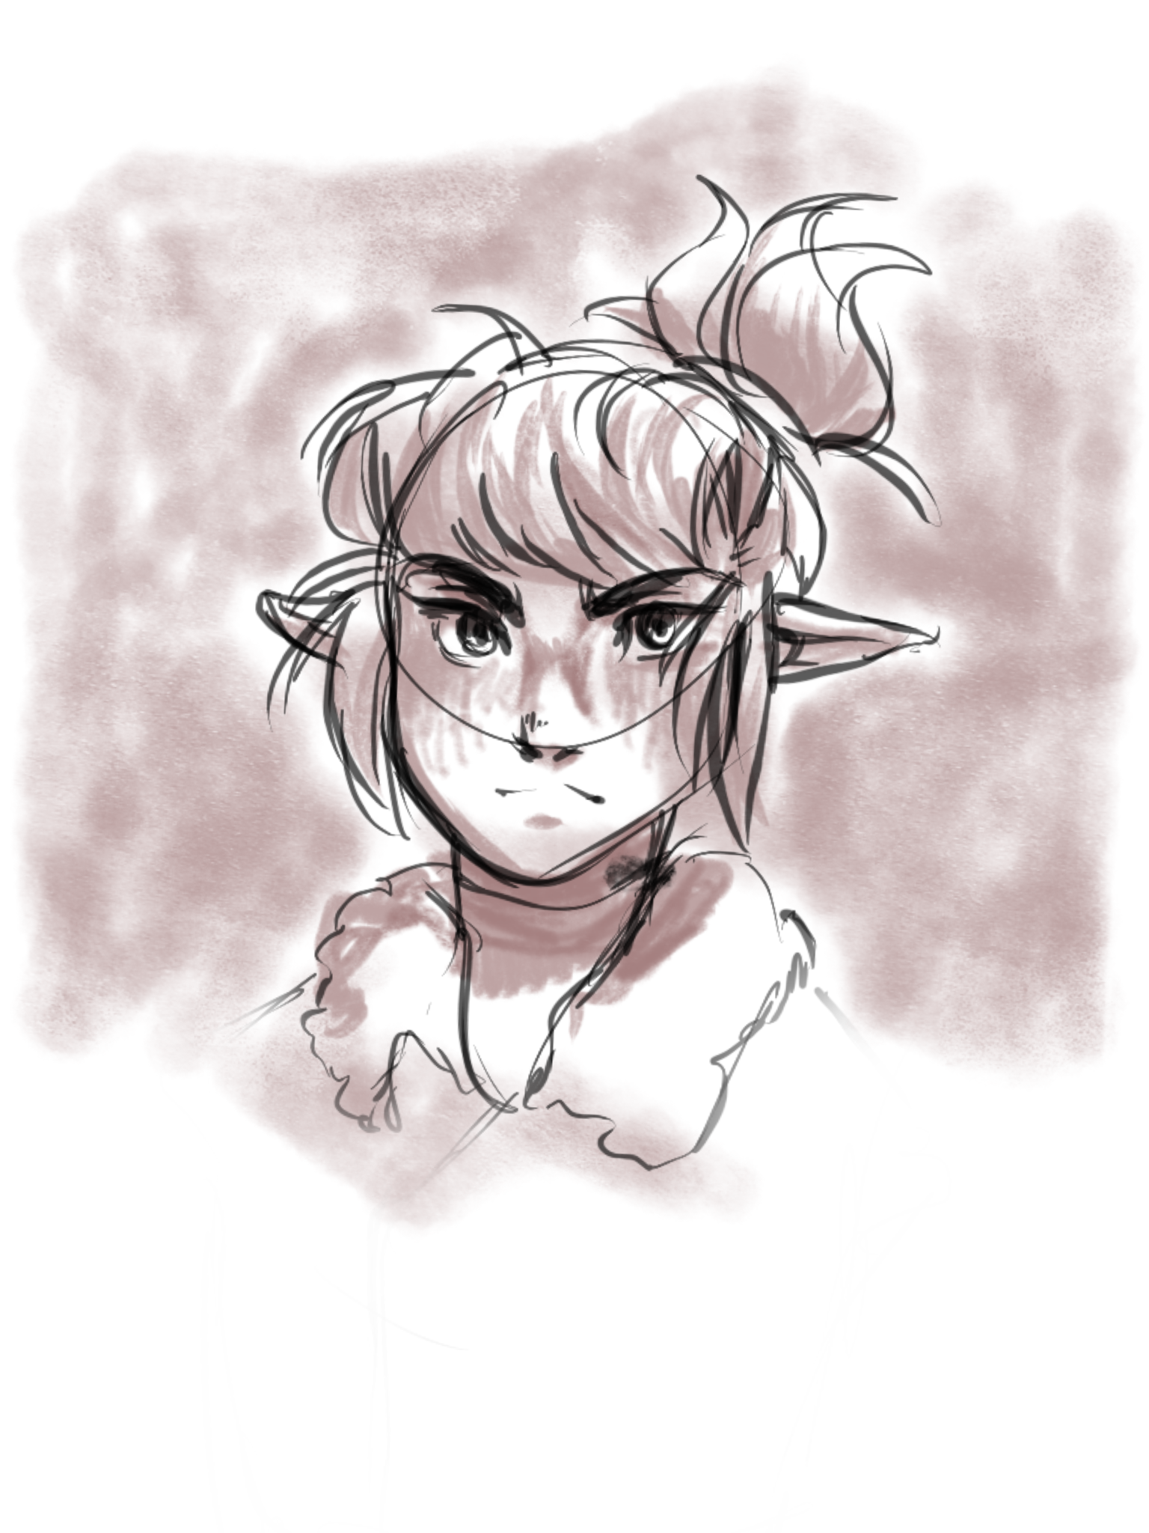
What:
For each day for 30 days, I will work on a painting/sketch/animation for at least 3 hours.

Slide 3
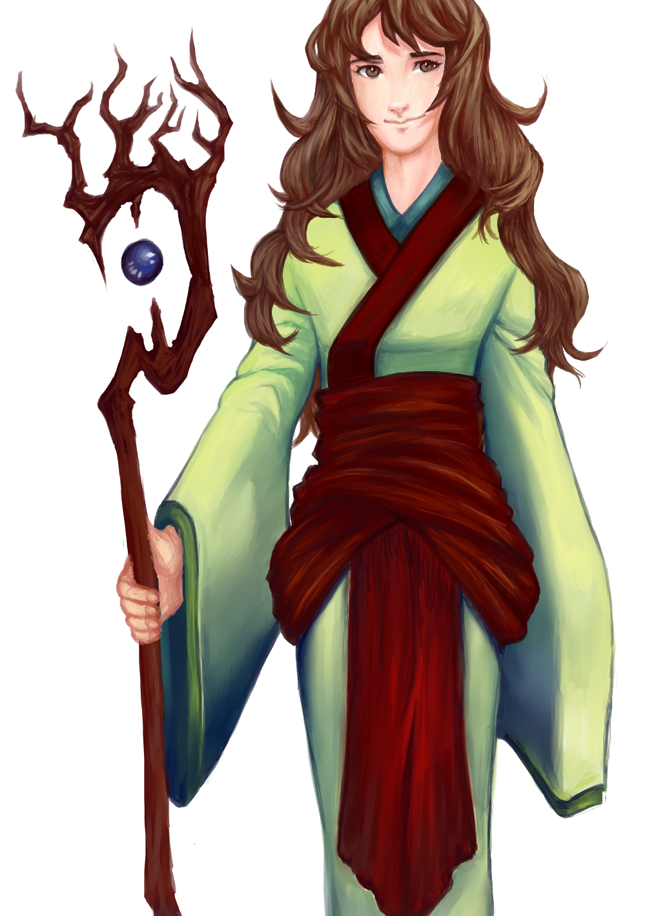
How:
Although 3 hours sounds like a lot of time out of each day, my schedule does allow for it. Even on the occasional day where I may have a small amount of free time in between classes and work, I can work on a pieces little bit at a time throughout the day until it eventually totals about 3 hours.

Slide 4
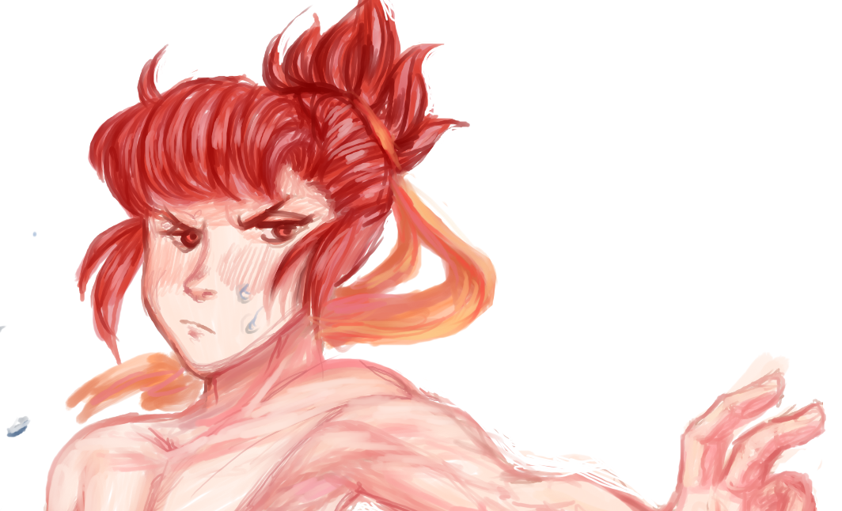
Why:
Digital art means a lot to me, and I’ve always put time into developing my skills. It’s just this time, the amount of practice will be a little more condensed and rigorous. I don’t think I’ve ever finished a piece every single day for 30 days. It will be quite intense, at least for me.

Slide 5
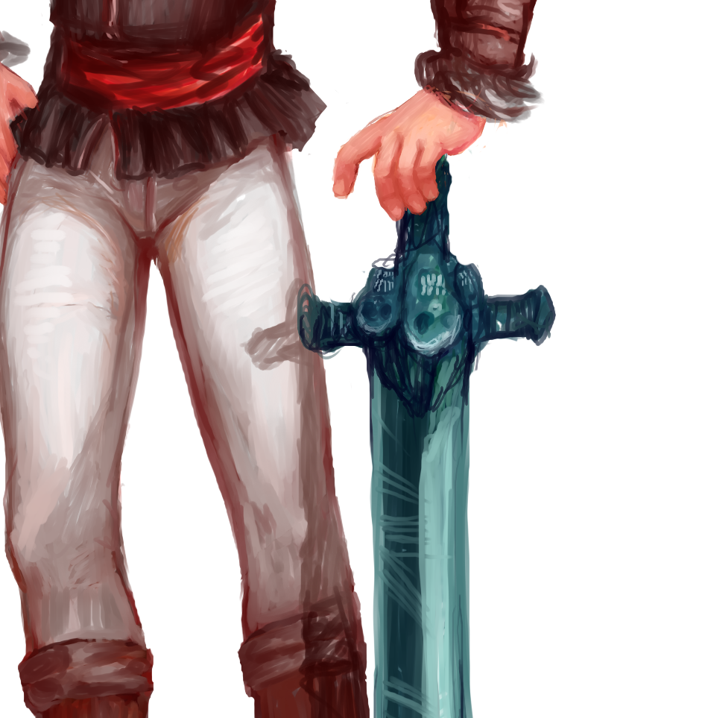
Goal:
My goal is to see a clear improvement in my art at the end of 30 days. I want to have developed a more solid understanding of human anatomy, color theory, and I want to develop my animation skills so that my animations look more fluid.

