Slide 1
30 Day Weight loss Challenge
Elvira Manglona
BE111
Kimberly Bunts Anderson

Slide 2


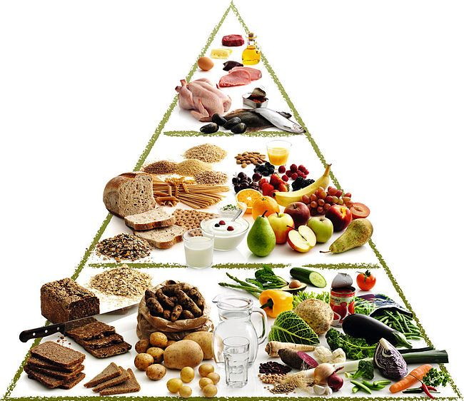
I plan to record my journey using videos and pictures. I also plan to write a journal on the days that falls on break time. I will journal how much weight I’ve lost and if I was able to overcome the challenge.

Slide 3
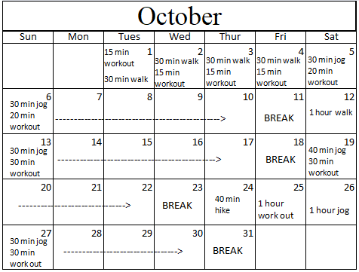
Schedule

Slide 4
Food
Breakfast
Cereal
Yoghurt
Fruits
Wheat bread sandwich
Dinner
Salad
1 Scoop rice with meat
Sandwich
Lunch
Lemai
Salad
Fried tofu
1 scoop rice with meat

Slide 5



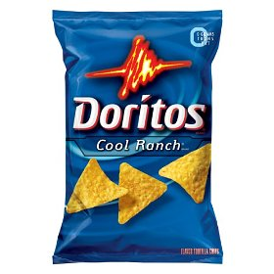

GIVE UP
Soda
Sweets
Junks
Salty food
Fast food

Slide 6
