Slide 1
30 day yoga challenge
By: Allan Calangi

Slide 2
Purpose
I haven’t take the time to manage my physical appearance so I decided to do something new to me and that I need to find something to relieve all stress and anxiety that always heads in my way.

Slide 3
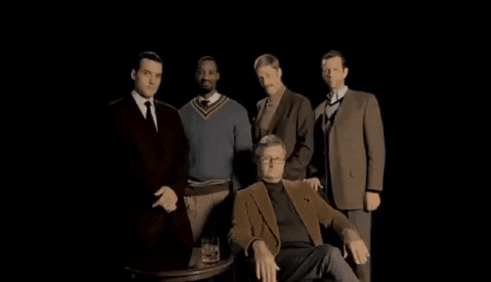
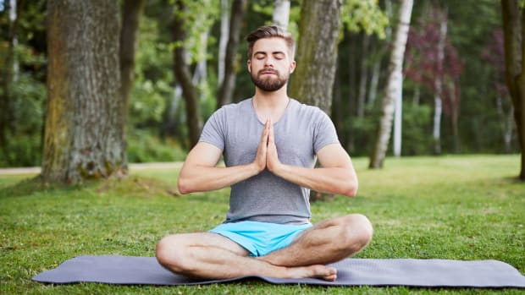
How?
Each day I will spend at least 2 hours on the Yoga Exercises. Each week I will move on to a set of different yoga poses to test and push my limitations. I will log each day the time I have spent on my yoga exercises and the different poses and if possible some pictures to document my experience.

Slide 4
Poses I’ll be using
- Downward Facing Dog
- Upward Facing Dog
- Child’s Pose
- 3 Legged Downward Dog
- Different Variations Of the Warrior
- Tree Pose
- Lizard Pose
- FireLog Pose

Slide 5
Resource
Youtube Channel where I will use as a guide for Yoga Poses: https://www.youtube.com/channel/UCGb34D3ThpmjLNn-FLv2_yQ

