Slide 1
My 30-Day Run Challenge
John Michael Laborce
BE 111
October 2020

Slide 2
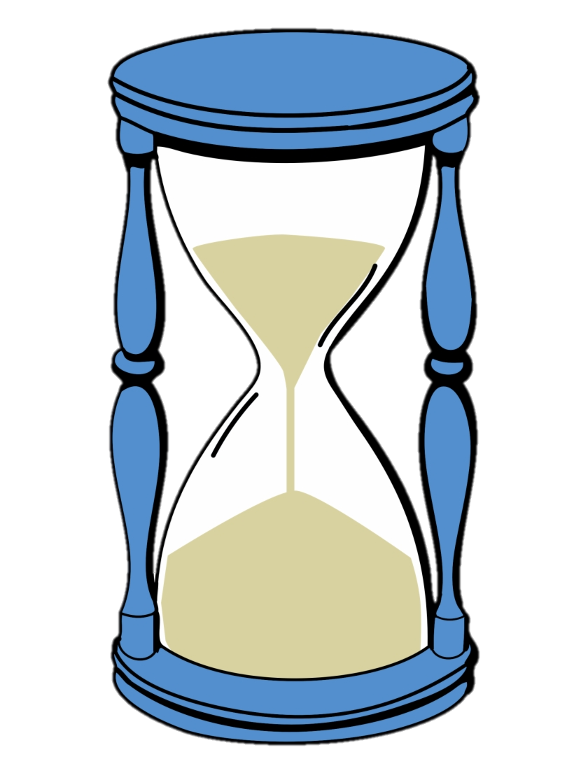
What is the challenge?
At the end of the 30 days given, I will hopefully be able to run 2 miles in under 15:50 (15 minutes and 50 seconds) or beat my old 2 mile run of 19:30.

Slide 3
How will I do it?
1st week: I will run 3-9 miles the first week, running at least 3 miles a day for 3 days.
2nd Week: I will run at least to 6-9 miles, running at least 3 miles a day for 4 days.
3rd Week: I will run 6-9 miles, running at least 3 miles a day for 3 days.
4th Week: I will run 3-6 miles, running 1 mile, 3 miles, then finally 2 mile test. I will do this every other day.
I will measure my progress with my phone!
I will also perform more cardio-related exercises at the gym and track. I will also reduce my heavy lifting for better recovery.

Slide 4
Why am I doing it?
I am going to commission in the US Army after taking the ROTC course in college and the required 2-mile run time is 15:54 for males.
In addition, I would feel more fit and healthier after the 30 days. I also don’t mind losing a couple pounds.

Slide 5
Ultimate Goal:
My goal is to improve my athleticism (strength, fitness, agility) and to continue to live with this healthy lifestyle even after the 30 days.

