Slide 1
Stop smoking
Maile Aldrich

Slide 2
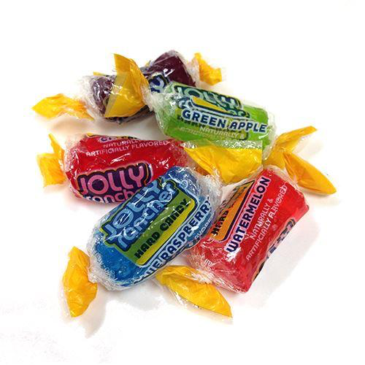
Week #1
I started the week off with one pack.
Usually, I wake up in the morning and get ready for work/school and smoke a stick before I leave the house. Today, instead of smoking in the morning I made breakfast. By the time I was done eating it was already time to go.
Instead of rolling down my windows and smoking, I decided to keep them rolled up.
I smoked one cigarette before I went into my shift.
Throughout the whole day I was craving a cigarette, so I decided to suck on hard candy to keep me distracted. This helped a little.

Slide 3
15 pieces of candy later and my shift was over.
I smoked 3 cigarettes after work and decided that was enough for the day and that I had to make my pack last the whole week.
It was challenging and it took a lot of self control to limit myself.
I learned that eating food, and sucking on candy will distract me. I will continue to use this method throughout the week.

Slide 4
By the end of the week, I found myself avoiding certain individuals to keep my mind off smoking.
I got into the habit of carrying a bottled drink around me at all times.
I smoked the whole pack on the 5th day of the week. Although I failed at making my pack last, I succeeded in cutting down the amount that I usually smoke.

Slide 5
Week #2
For this week my goal is to smoke only one stick a day.
It was easier this week than it was the first week because I’ve gotten better mentally. Every time I have the urge to smoke, I told myself that this is only for the better and I can do it.
I’ve been drinking more fluids and eating more candy.
I discovered taking walks and listening to music also helps. I’ve been repeating these methods daily.

Slide 6
By the end of the second week, I exceeded my limit and smoked 11 sticks that week. Again I failed, but it’s a process.

Slide 7
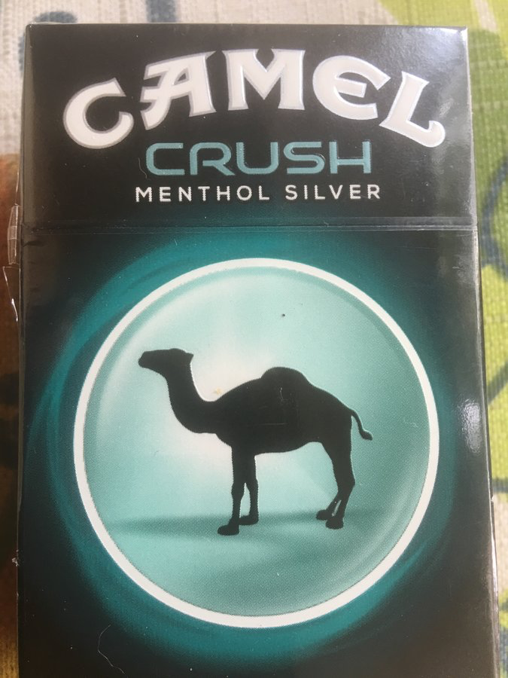
Week #3
My goal for this week is to limit myself to 5 sticks for the entire week.
On the first day it was really difficult. I smoked one pack today due to stress.

Slide 8
After yesterday, I reminded myself why this is important and why I chose this challenge in the first place.
It was really hard to limit myself to one cigarette per day but I succeeded and occupied myself with walks, music, and food.

Slide 9
Week #4
By the 4th week, I went back to my old habits. I don’t smoke as much, but I smoke a lot.
I’ve gained a few pounds from turning to food.
Although I failed to accomplish my goal, I’m proud of myself for even trying and learning how to deal with self control in these situations.

Slide 10
Thankyou

