Slide 1
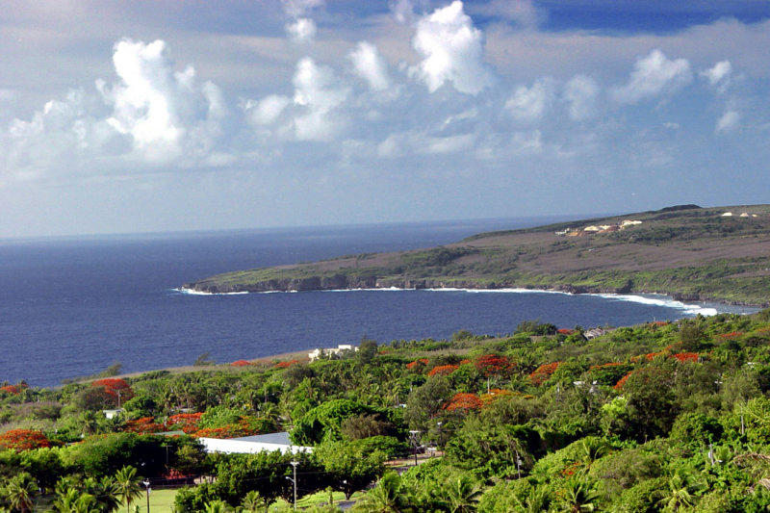
Amending Article 12, Section 4 of the CNMI Constitution
Chelsea Borja

Slide 2
What is Article 12, Section 4?
Persons of Northern Marianas Descent.
A person of Northern Marianas descent is a United States citizen who is at least one-fourth Northern Marianas Chamorro or Northern Marianas Carolinian blood or both. Another exception to a NMD would be a child adopted before the age of eighteen by a person of Northern Marianas descent. To determine a Northern Marianas descent, a person shall be considered full Chamorro or Carolinian blooded if that person was born by 1950, in the Marianas, and was a citizen of the Trust Territory of the Pacific Islands.

Slide 3
Research Question
Should the CNMI Legislature amend Article 12, Section 4 so that any persons with some degree of Chamorro blood or Carolinian blood would be considered a Northern Marianas descent?
What are people’s perspectives about Article 12: Section 4?
Who will be affected most by the amendment of Article 12?

Slide 4
Schedule
ACTION | DATE
Survey questions approved by instructor | July 15
Surveys distributed | July 17
Surveys collected | July 18
Attempted to interview government official | July 18
Analyze data/ Finalize paper | July 19-29
Presentation | Final day

Slide 5
APPROACHES
Surveys: Formal Surveys
20 responses:
4 land owners
3 non-land owners
3 lease owner
1 government official
3 between the ages 20-30
3 between the ages 30-50
3 between the ages and 50+
Questions were based on whether the amending of Article 12, Section 4 will affect the economy and culture in the CNMI

Slide 6
ANALYSIS/FINDINGS
The initial findings suggest that majority of the results are against Article 12, the most informed and the most affected by Article 12 was the age group twenty-thirty, and the remaining participants remained neutral to the subject.

Slide 8
TRENDS
Qualifications: Anyone born in the CNMI with at least some degree of NMI decent, lived here for more than ten years, learns the history, and knows of the culture
14 islands, only 3 islands are inhabited
Already pays NMI taxes
Provides economic growth

Slide 9
TRENDS
Does not affect economy
Long term lease is sufficient time for investors
Negative impact on culture (No pure NMDs)
Destroy natural resources

Slide 10
SUCCESS and FUTURE RESEARCH
Majority of the surveyees are for the amendment
Hard to determine the quantum of a NMD
Investments of economic growth
November 2014 Election will determine if the amendment will take effect

Slide 11
WEAKNESS
Lack of time
Only one form of data collection
Private/personal topic

