Slide 1
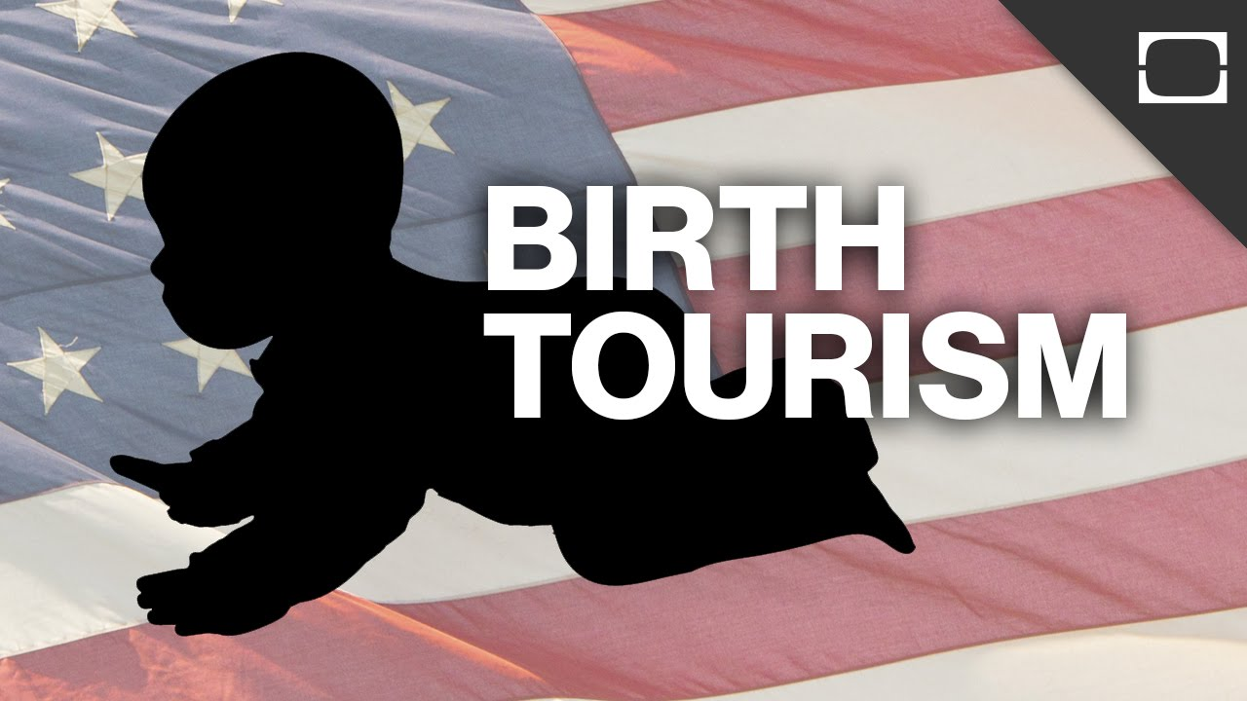
Birth Tourism – A Growing Problem in CNMI

Slide 2
Birth Tourism in the CNMI
Mostly pregnant women from China are highest rate giving birth here in the CNMI.
Most of these China tourism women leave the CNMI after the CNMI after childbirth and receipt of their baby’s U.S. passport.
Healthcare Corp. implementing a new policy of not processing the documents of newborn babies until all medical bills are settled by their parents.

Slide 3
Birth Tourism in the CNMI

Slide 4
Birth Tourism in the CNMI
Birth Tourism is Growing Problem in Saipan. Birth tourism has long been an underground profit-making operation in the CNMI.
Birth Tourism Defined traveling from one country to another for the purpose of giving birth in the second country.
Services Provided in Saipan pregnant chinese women are picked up from airport. And housed in an apartment already served for them.

