Slide 1
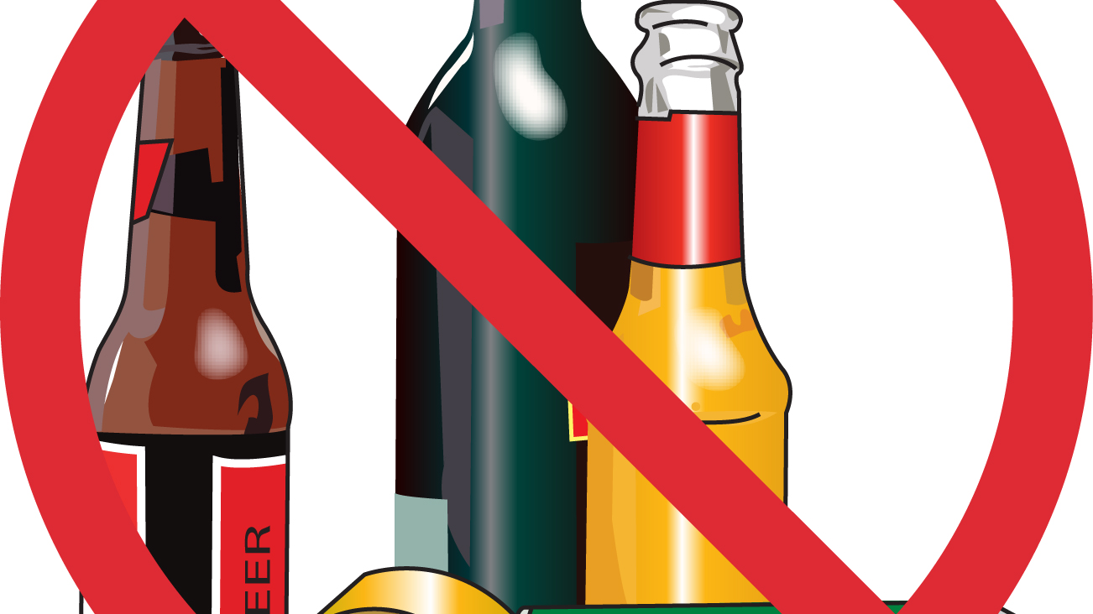
THE AFFECTS OF ALCOHOL IN THE CNMI
By Mariah Santos

Slide 2
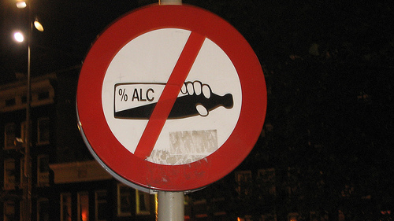
Importance of Topic: Alcohol has been around for many centuries and it has become a popular beverage internationally. This popular beverage has become the most deadliest thing you can consume. It is the leading cause to many deaths and accidents. People who are well aware can save themselves and others from the dangers of consuming alcohol. It’s better to be aware and save not only your life but the lives of others around you.
Primary Causes of Alcoholism in The CNMI
The Percentage of Men & Women Who Have Problems With Alcohol
The Importance of Preventing Alcoholism

Slide 3
Primary Q: What is the primary cause for alcoholism in the CNMI?
Gather background information from people who are/has been alcoholics.
Research online newspaper and try to find more facts about alcoholism.
Gather important booklets/readings and focus on the topic to obtain information that is relevant to the essay.

Slide 4
Secondary Q: What percentage of men and women have problems with alcohol? Why is the prevention of alcoholism important?
Research the percentage of men and women that have problems with alcohol in the U.S./CNMI
Know the risks that alcohol can potentially onset.
Gather more information about the damages alcohol has on the body physically/mentally.
Get back information on what people can do to prevent becoming alcoholics.

Slide 5
Plans for gathering more details of the questions
Primary Source
Contact someone who has first hand knowledge about alcohol and it’s potential risks.
Contact doctors/nurses who know more about the damages of alcohol.
Statistics/data that relates to alcoholism in the CNMI
Secondary Source
Online articles
Hospital Pamphlets
Contact counselor/police station for more information about staying away from alcohol.

Slide 6
Schedule
Dates: Jan.30-Feb.05, 2018 |  | Agenda
January 30th |  | Decision of Topic
February 1st | Find primary/secondary research | Brainstorm Outline
February 2nd |  | Submit Brainstorm/Outline PowerPoint
February 3rd-4th | Writing Schedule | First draft of essay
February 5th |  | Submit Persuasive Essay

Slide 7
Conclusion
As a result, alcohol has been the reason behind many tragic deaths and accidents in the U.S. and the CNMI. Where does it all end? Approximately 88,000 people have died from alcohol related causes which makes alcohol the third leading cause of death in the U.S. alone. (NIH, 2017, para. 7) Alcohol can turn into abuse, it can be mistreated, it brings potential harm to a person’s health and others, and it can become a habit. Alcohol is not an enjoyable beverage it’s a can closer to death but if we educate people about its harm it can change the minds of people. So, will the people of the CNMI help themselves? Will they continue to drink? Will they grow a better community?

