Slide 1
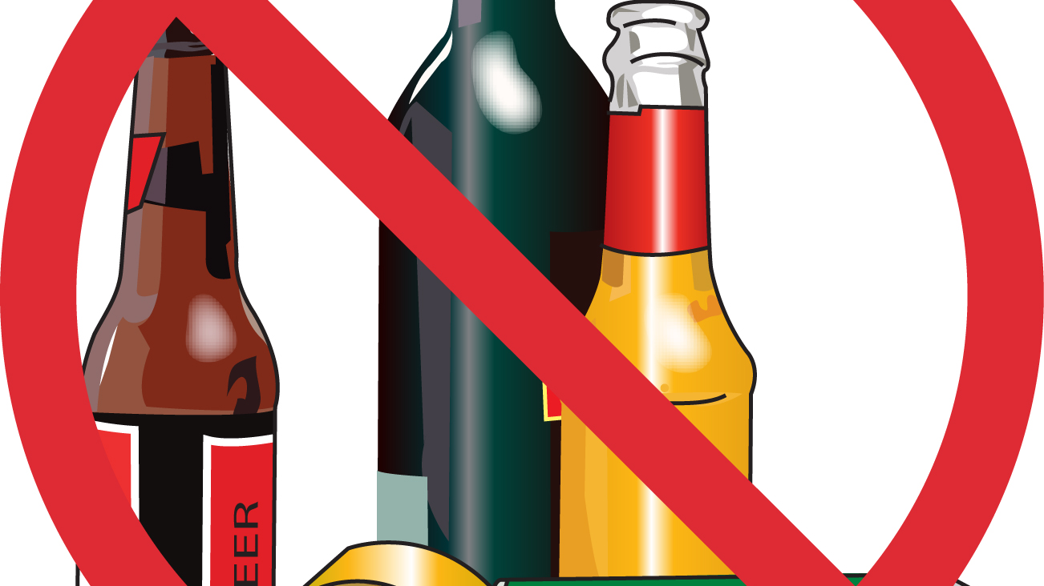
THE AFFECTS OF ALCOHOL IN THE CNMI
Presentation II
By Mariah Santos

Slide 2
Primary Q: What is the primary cause for alcoholism in the CNMI?
Gather background information from people who are/has been alcoholics.
Research online newspaper and try to find more facts about alcoholism.
Gather important booklets/readings and focus on the topic to obtain information that is relevant to the essay.
Interview people who have encountered health effects because of alcohol
Focus on topic.

Slide 3
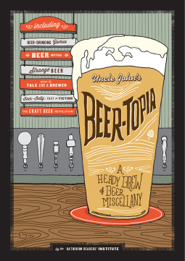
Secondary Q: What percentage of men and women have problems with alcohol? Why is the prevention of alcoholism important?
Research the percentage of men and women that have problems with alcohol in the U.S./CNMI
Know the risks that alcohol can potentially onset.
Gather more information about the damages alcohol has on the body physically/mentally.
Get back information on what people can do to prevent becoming alcoholics.

Slide 4
Third Q:
Why is the prevention of alcoholism important?
Gather data/ research on the percentage of men & women that have problems with alcohol. Who is more affected?
Understand the risks & reasons of why people encounter problems with alcohol?
Conduct interviews with people who experienced problems with alcohol.
Gather relevant literature information.

Slide 5
Interviews, Letters to Experts, Surveys
For the most part, 4 people were sent out emails regarding questions on the topic “The Effects of Alcohol in the CNMI.” One expert was able to respond and answer the questions.
A total of 4 people were interviewed when gathering data for solutions to certain questions. Each interview took about 5-10 minutes. The interviews were conducted on Rota.
Surveys were conducted using Google Form. A total of 13 responses from students at NMC and some RHI. There responses proved helpful to the research report.

Slide 6
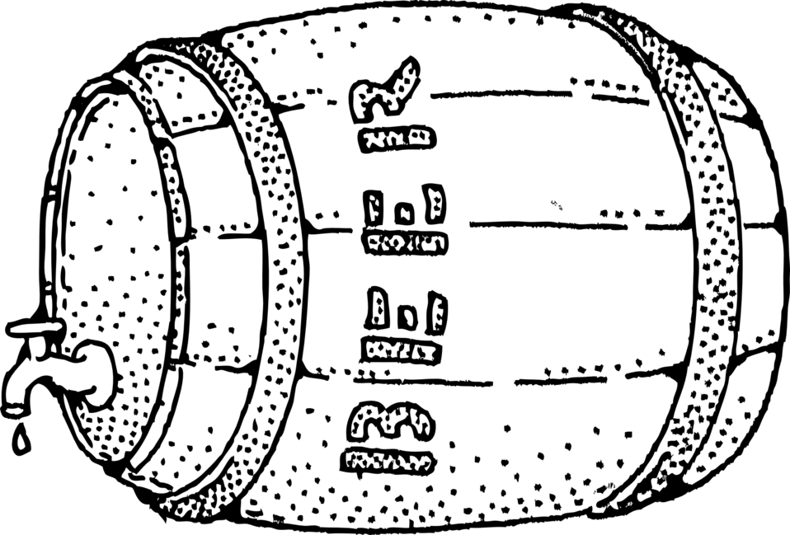
Question Types & Suggestion
Types of questions asked were multiple choice and short answer questions. The responses that came back proved helpful to the research project. A possible way that the project could of been more improved is not procrastinating your work and be organized. Overall, the research report was completed and submitted.

Slide 7
Analytical Process
English Composition Textbook
Sent letters to experts
Conducted surveys
Conducted interviews
Research article, observation, online sources, books, pamphlets, and newspaper

Slide 8
Strength & Weakness Suggestions
Weakness
Procrastination
I found myself procrastinating from my work with other activities or putting other things before my education.
Time management
I had poor time management and I never really had a scheduled day. It’s that a person write down their agendas.
SUGGESTIONS! Do NOT PROCRASTINATE! Schedule your days according so that you can get work done.

Slide 9
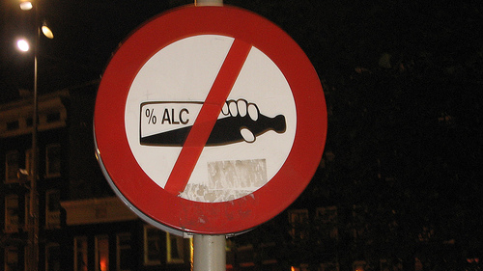
Summary of Process Research Project
Overall, the beginning of starting the semester it was simple until weeks went by the workload increased. I’ve learned throughout this course that I was able to write essays every week. It takes a lot of commitment and time to pull of a research project. So far, the research report has helped me better understand how alcohol can affect a person and how to help someone from alcoholism. The course has taught me more about essays, research reports/papers, presentation, etc. I was able to become a better writer than I was before. Begin my first time I’ve done a research project I believe I did pretty well and I am proud with what I was able to produced. If I could do things different I would better time manage my days.

Slide 10
Concluding Paragraph
As a result, alcohol has been the reason behind many tragic deaths and accidents in the U.S. and the CNMI. Where does it all end? Approximately 88,000 people have died from alcohol related causes which makes alcohol the third leading cause of death in the U.S. alone. (NIH, 2017, para. 7) Alcohol can turn into abuse, it can be mistreated, it brings potential harm to a person’s health and others, and it can become a habit. Alcohol is not an enjoyable beverage it’s a can closer to death but if we educate people about its harm it can change the minds of people. So, will the people of the CNMI help themselves? Will they continue to drink? Will they grow a better community?

