Slide 1
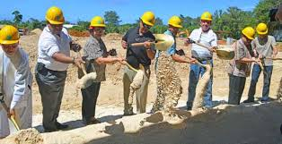
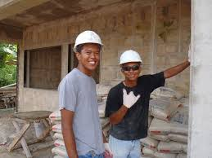
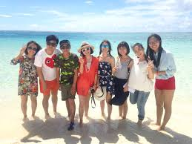
What Attracts People to Saipan?
Reydamellia Calibo
Northern Marianas College
English Composition II

Slide 2
What attracts tourists, contract workers and investors to visit, settle or immigrate on Saipan?
I chose this topic because of:
My work as loan and administration officer, which I get to deal with different people such as business owners, contract workers and sometimes tourists.
I wanted to learn more about our borrowers and their surrounding.
It is somewhat related to my course – Business Management

Slide 3
Methods that were used:
Surveyed
Interviewed Experts and Questionnaires
Literature Review

Slide 4
Survey We did Surveymonkey in our own time, I got 23 responds.
Participants are ages 18 – 38; 10 males and 13 Females
Demographic: Nationality, Gender, Age, last school completed, Village, etc.
2) As a student, what can you do to promote Saipan to other countries?
10 – social media
4 – be kind to tourists
9 – pictures and advertisement
Do you think Saipan should increase it's minimum wage to attract more contract workers and investors to immigrate here?

Slide 5
Continuation….
4) In your opinion, what kind of improvement can our government make/do to attract more tourists, workers and investors?
8 – beautify island and destroy all dilapidated building
4 - create more bigger businesses
2 create more jobs and higher salary
2 – work together, stop corruption, and spend money in important improvements.
1 - Amend Article 12
1 – build an Amusement Park and generate revenue
1 – Equip our police officers to keep our community safe
3 - All of the above
5) Positive impact of tourists, contract workers, and investors in Saipan…
Tourists and investors – generate income and employment
Contract workers – skills and hard working
6) Negative impact of tourists, contract workers, and investors in Saipan…
Tourists – reckless in driving or reckless
Contract workers – tend to not care about the island and they send money off-island
Investors – abandoned their businesses and make money here, but spend elsewhere
Notes:
ner

Slide 6
Letter to Expert - sent off
On March 10, 2015 -Emailed Mr. Mark Baldyga, chairman of Guam Visitors Bureau
The same day, Mr. Baldyga – answered the questionnaires:
1) In your opinion, what attracts tourists, foreign workers and investors to visit, settle and immigrate on Guam?
Answer: From my own experience, many people (including myself) come here for short term contracts and then falling in love with the islands and the warm friendly sense of community, seeing the opportunities and end up staying.

Slide 7
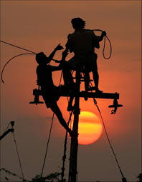
Interviewed/ Questionaires to Experts
Tour company/ investor – Questionnaire
In your opinion, what attracts tourists, foreign workers, investors to visit, settle and immigrate on Saipan?
Answer: Location - near to Asia - they want to be near where they originated from.
2) What are the programs in place that kept you here doing business?
Answer: Taxation – Business Gross Revenue Tax (BGRT) is unique and cost-wise. No real estate tax.
Contract worker – interviewed
What attracted you to work in Saipan?
Answer: He was influenced by a friend, who had good paying job.
Higher salary
2) What do you think the government should do to attract more contract workers to work in Saipan?
Answer: Higher salary and health benefits

Slide 8
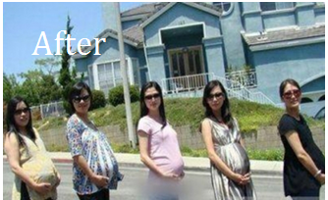
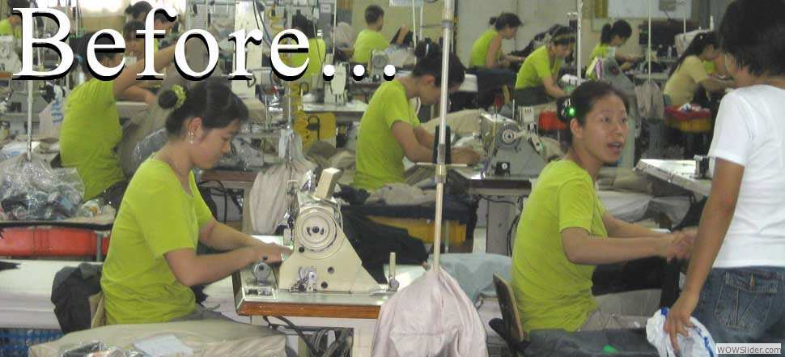
Literature Review
Literature review was very helpful, even though it was limited.
Article(s):
Patterson, Margot - American dream lures Saipan worker
Zach Coleman - 'Birth tourism' causes headaches in U.S. territory

Slide 9
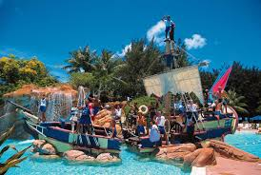
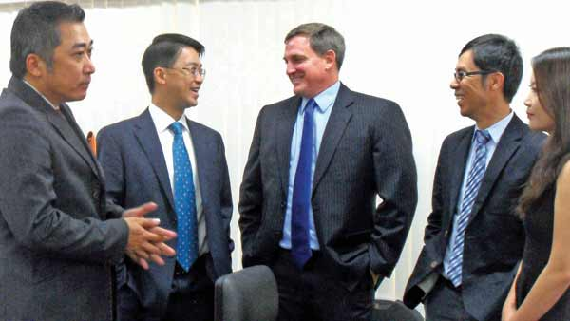
Findings What attracts tourists, contract workers, and investors to visit, settle or immigrate on Saipan?
Tourists
Tropical climate
Near to Asia
Beautiful beaches and sites
Contract workers
Incomes
Saipan being a Trust Territory/ Military presences
Opportunity – easy entry to Saipan in the 1990s
Investors
No real estates tax
CNMI independent - Self-governing
Location - near to Asia ( near to where they are from)

Slide 10
Pros & Cons
Lots of persons to interview
Available articles about tourists and contracts workers.
Resources from bosses, coworkers, and friends
Stay anonymous and prefer to be in group interview.
Limited/not Ebsco articles about Saipan investors
Short time to collect data.
Unexpected cancellation of interview
Busy interviewees

Slide 11
Thank you

