Slide 1
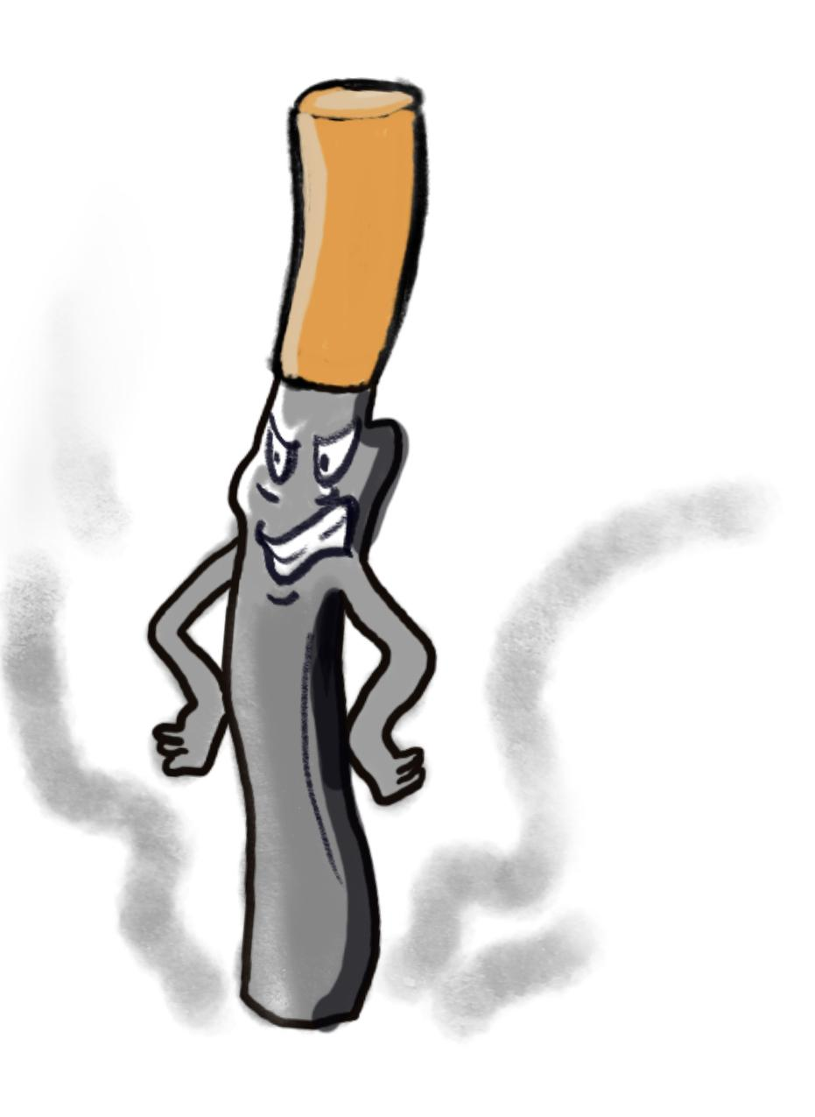
30 Day Challenge
BE111. Crystal Jang.

Slide 2
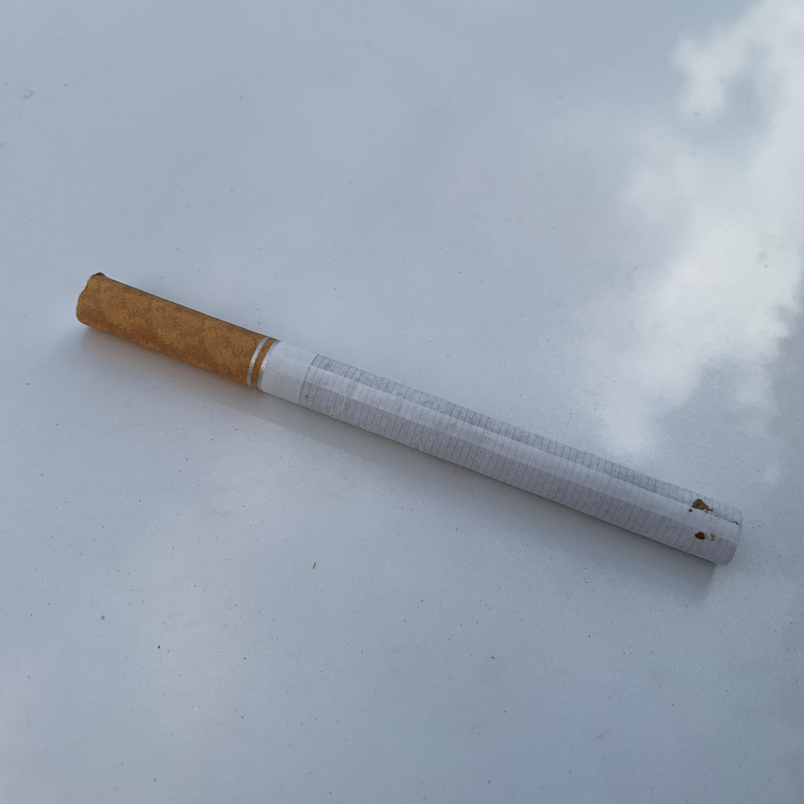
May 1. 2019
I only smoke 3 cigerattes sticks.
I smoked one stick right after class at 11pm.
At 4pm, I smoked one cig when I finished dinner.
At 1am, got up and smoke.

Slide 3
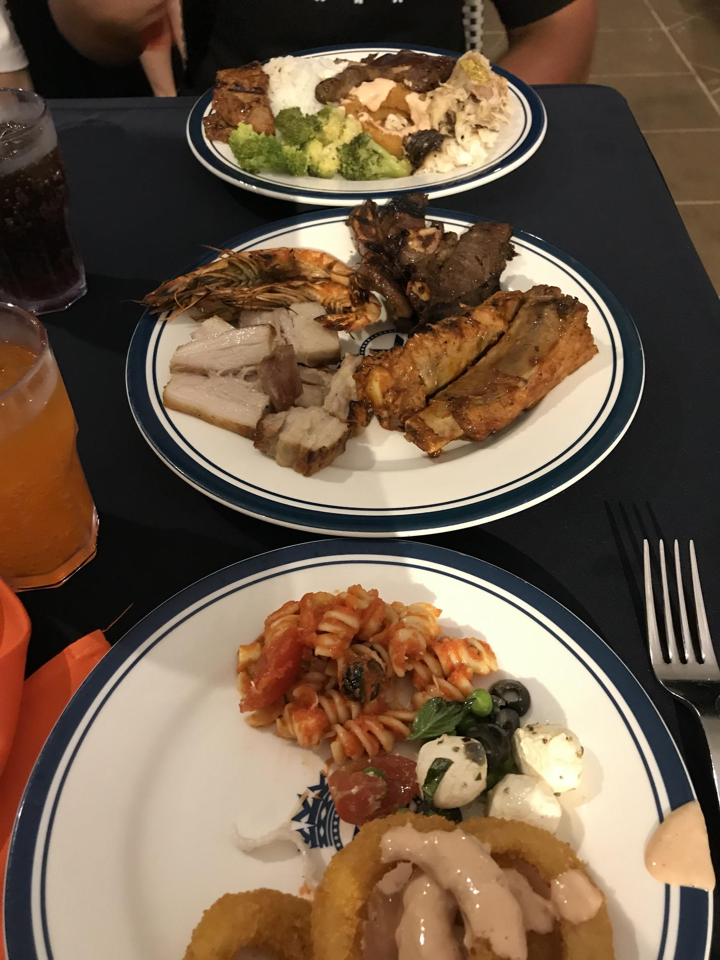
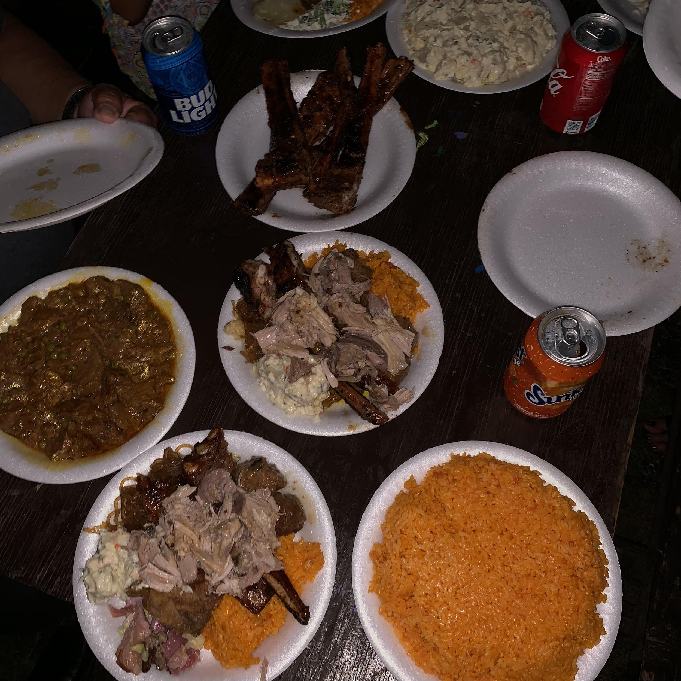
May 2. 2019
*totaly forgot to take pictures* But truthfully, I remember smoking 5 sticks that day. Reason is because I went to my boyfriends family party. And I remember being so full.

Slide 4
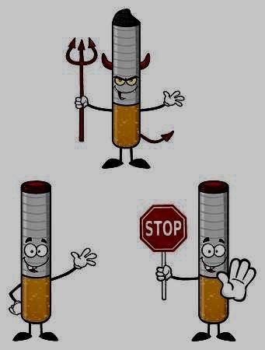
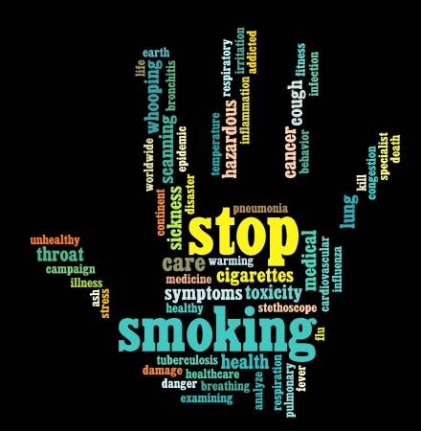
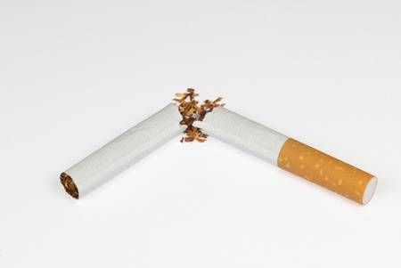
May 3-5, 2019
I did not smoke cigeratte because I ate something at the party that made me feel so sick. :(

Slide 5
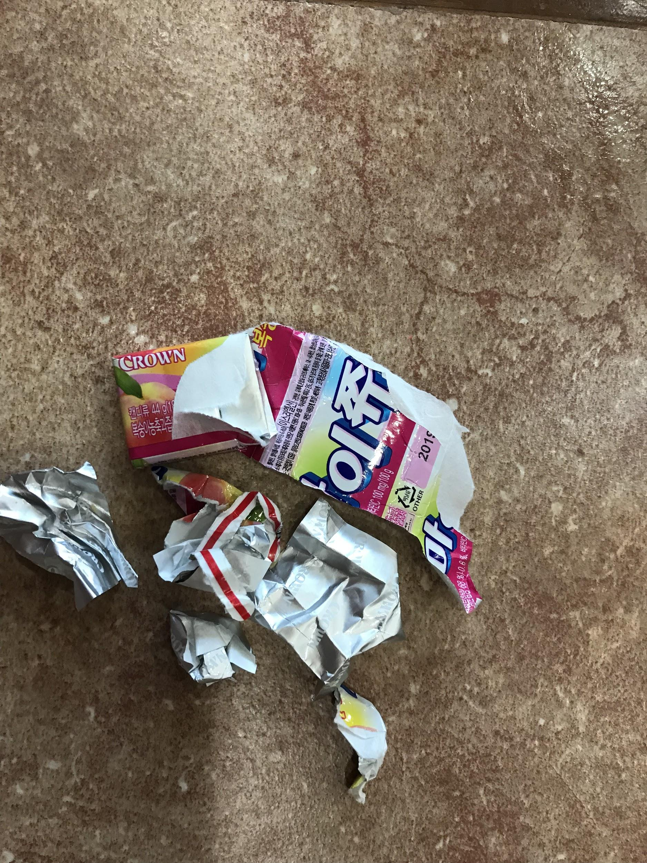
May 6, 2019
The picture in the right shows you what I did to substitute my smoking.
I was still recovering from my illness.
So I just chewed this instead and layed down .
Was the reason why I was also absent.

Slide 6
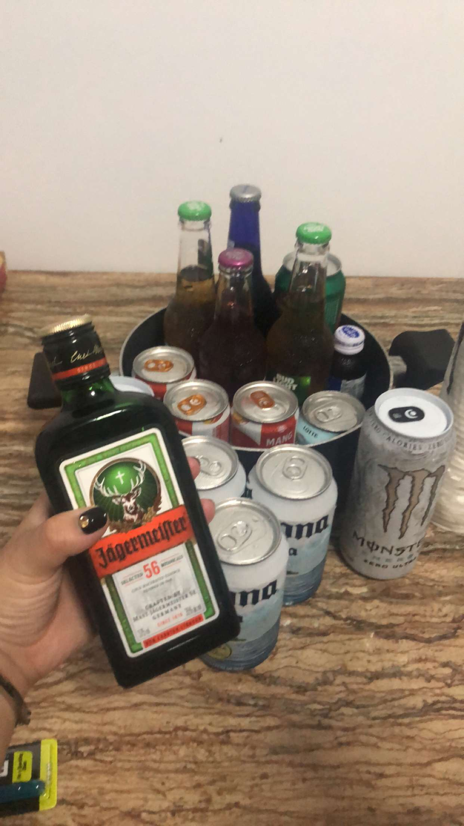
May 7, 2019
I felt better. I moved one cigarette right before my class.
Smoked one after.
*forgot about my 30 day challenge*
I know for sure that I smoked a lot this night
Because when I drink, I smoke.
Totally bad, I know :(

Slide 7
May 8, 2019
Went to class, but felt really drained.
I should’ve not drank because I had class the next day.
I did not smoke because right when I finished my first class, I went back home and sleep.
But when I got up for my next class at 2, I smoked before and after. That was just about it.

Slide 8
May 9, 2019
As I was thinking to myself, as a heavy smoker, I know I was doing a great job cutting down. Because I could finished my pack in 1 and half day. And for me to only smoke 5 sticks a day, is a huge thing.

Slide 9
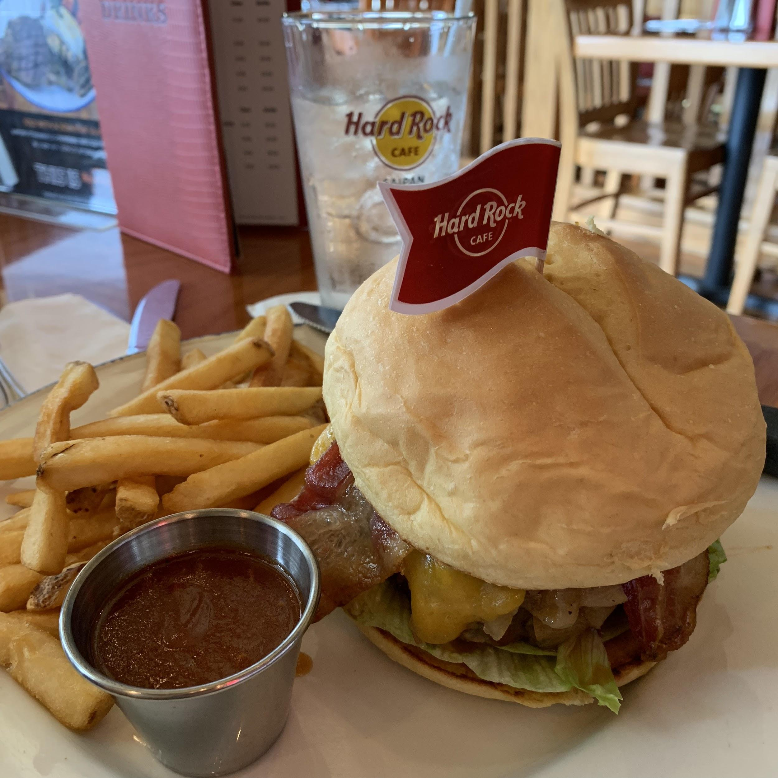
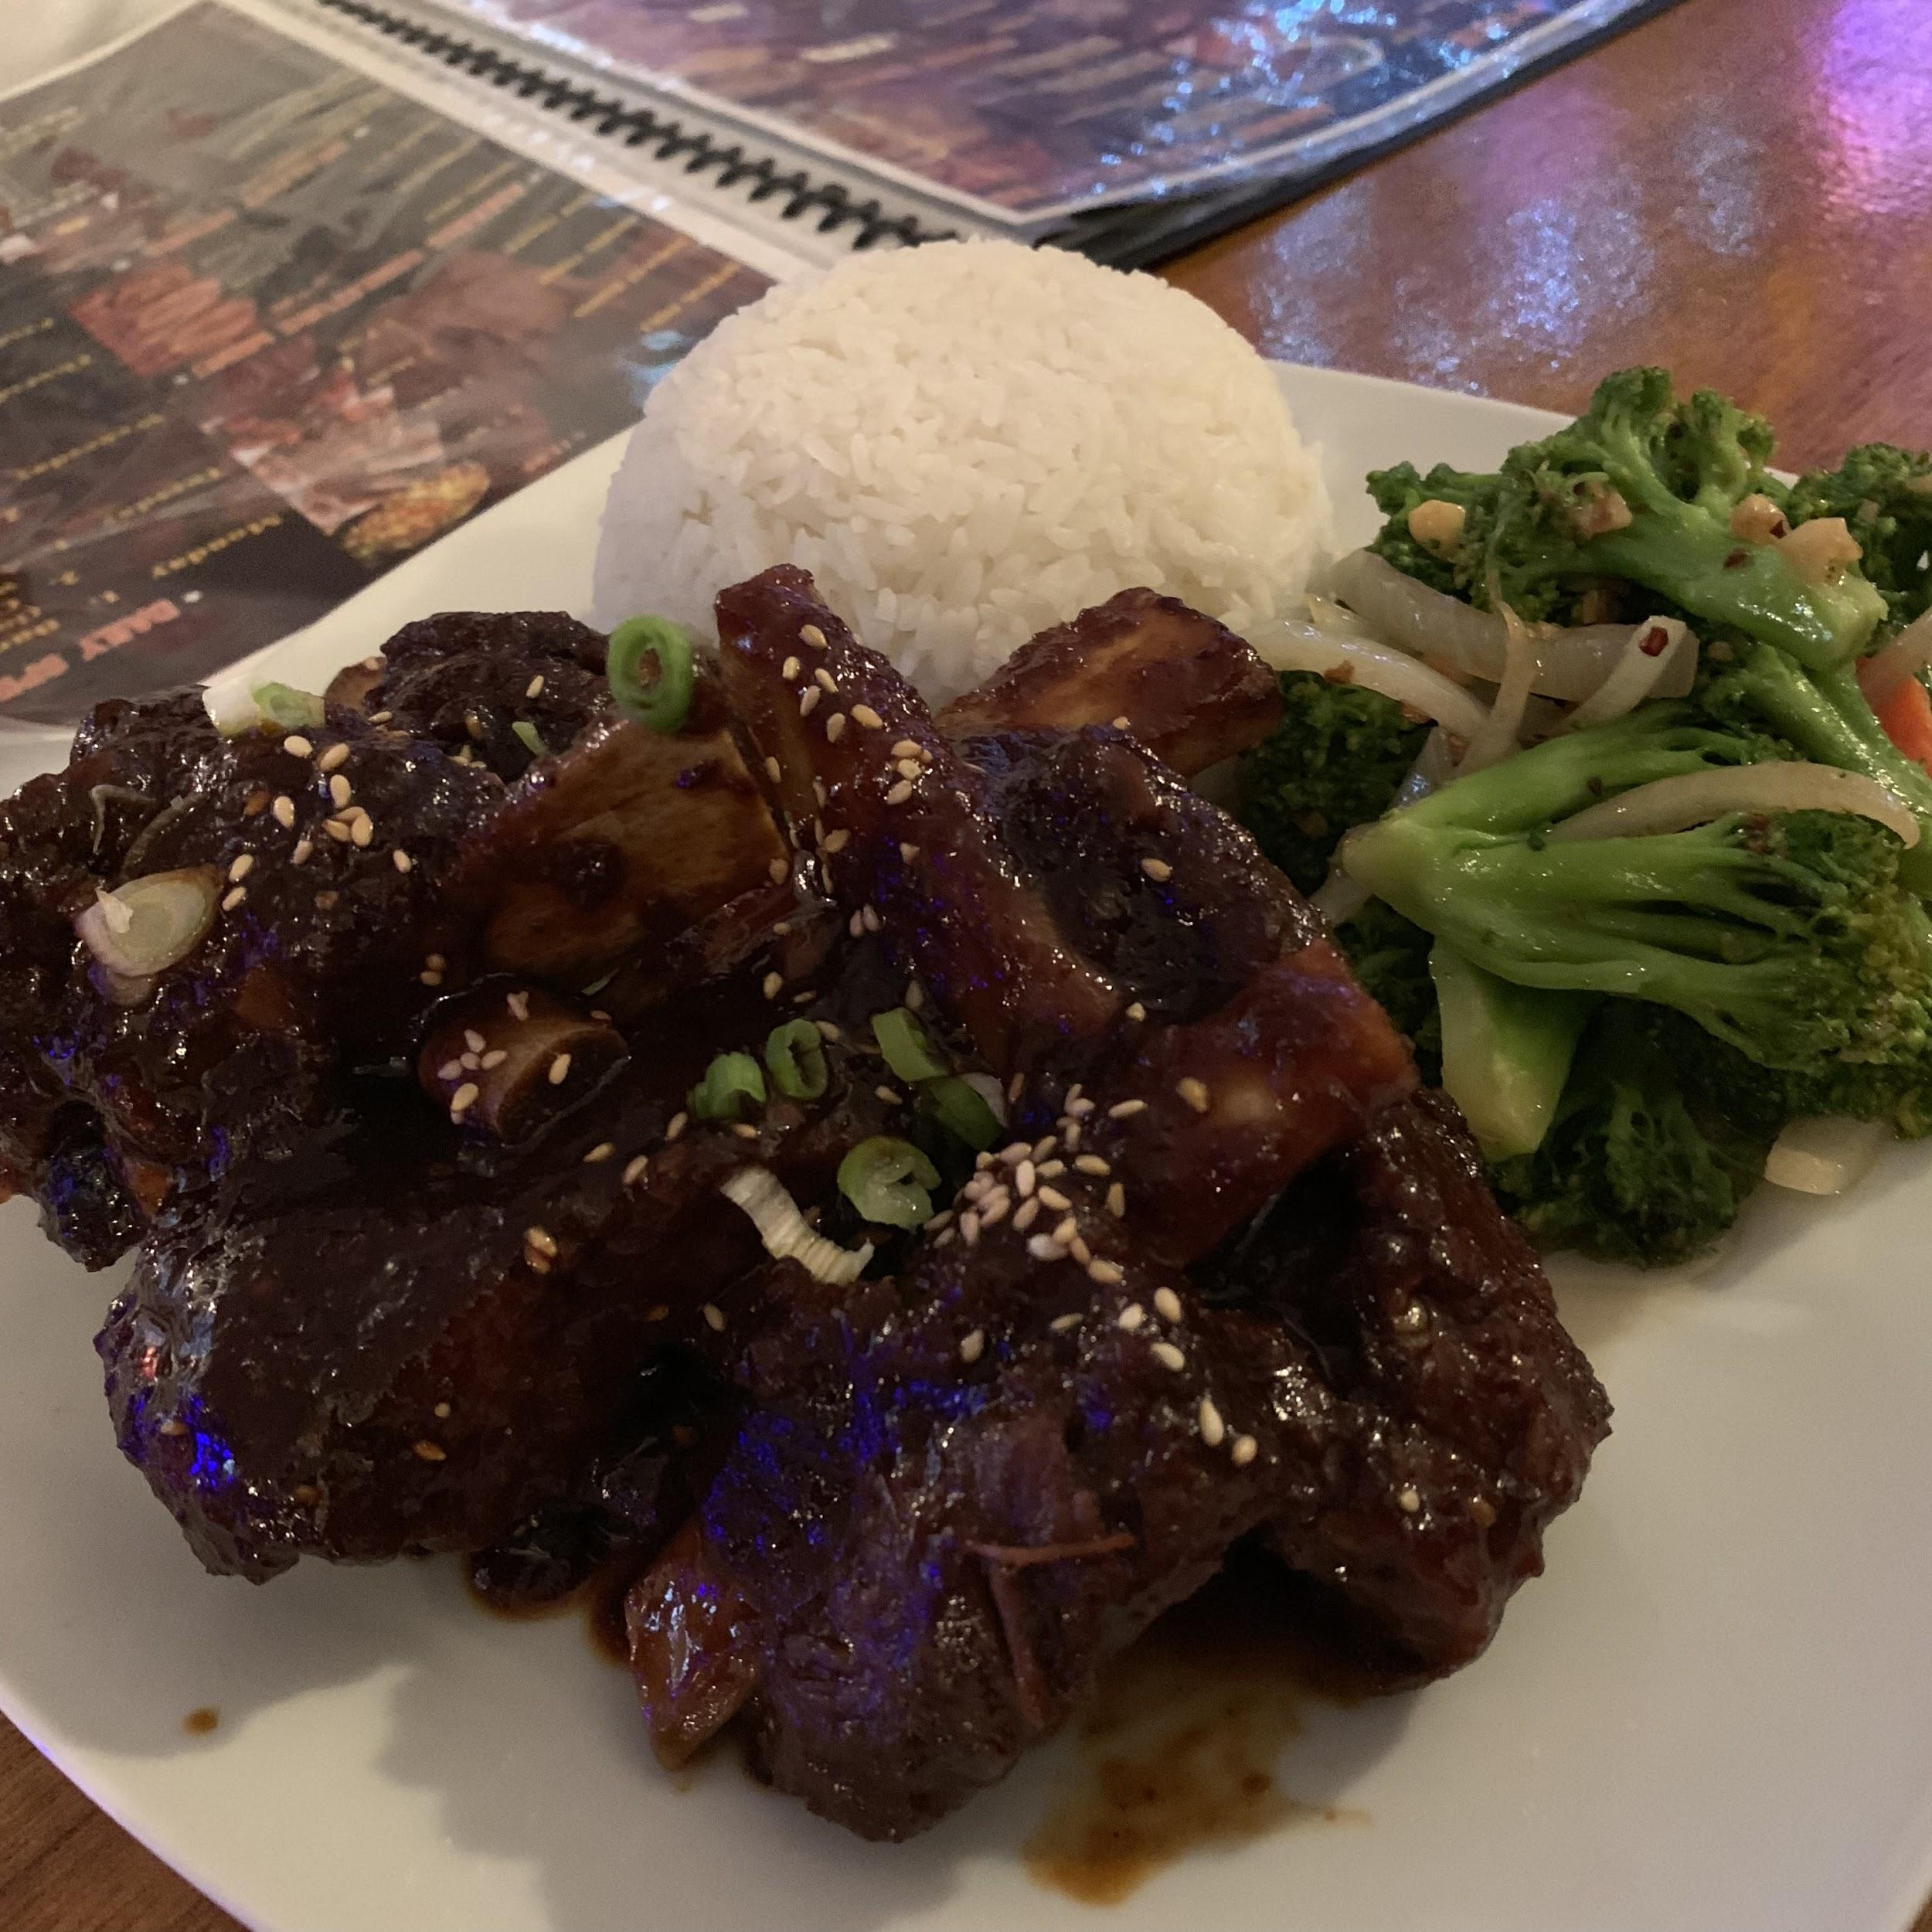
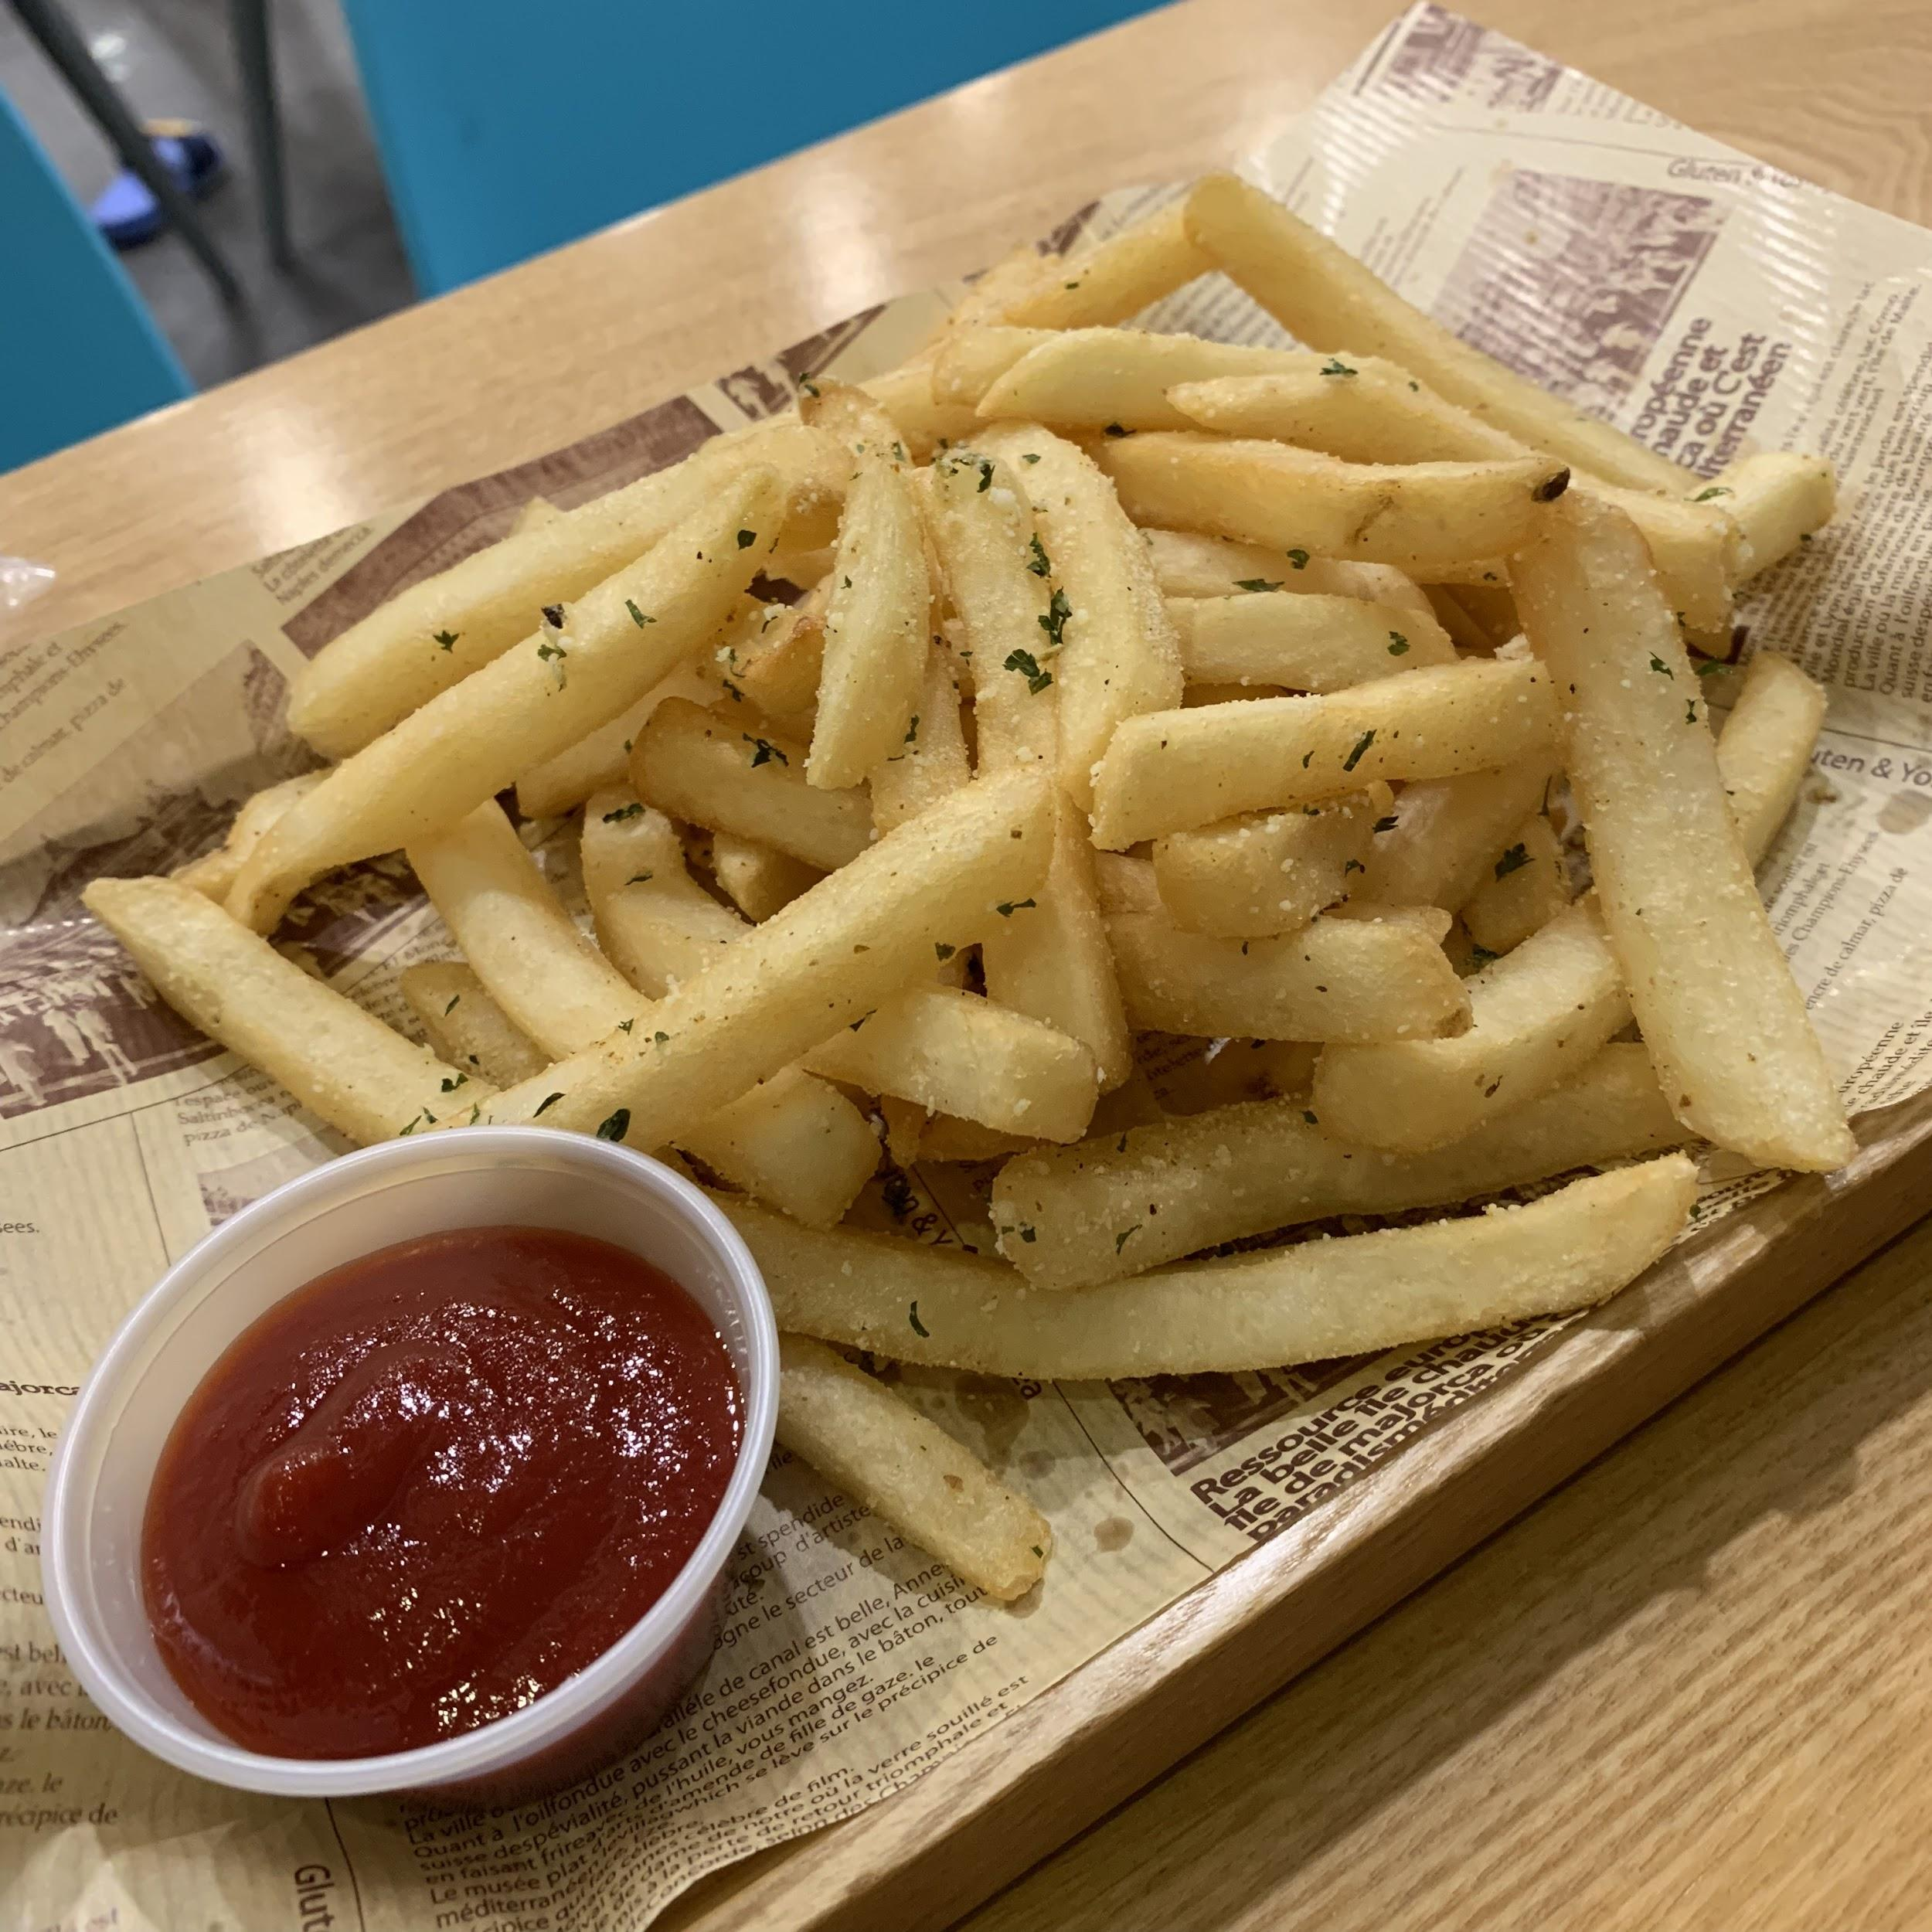
May 10, 2019
I went to eat out . And I really forgot how much I smoked.

Slide 10
May 11, 2019
I did not smoke a cigeratte cause I had stomach ache.

Slide 11
Thought it was from something that I ate.

Slide 12
But little did I know….

Slide 13
I was …..

Slide 14
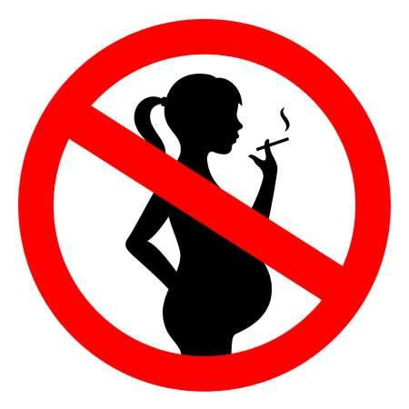
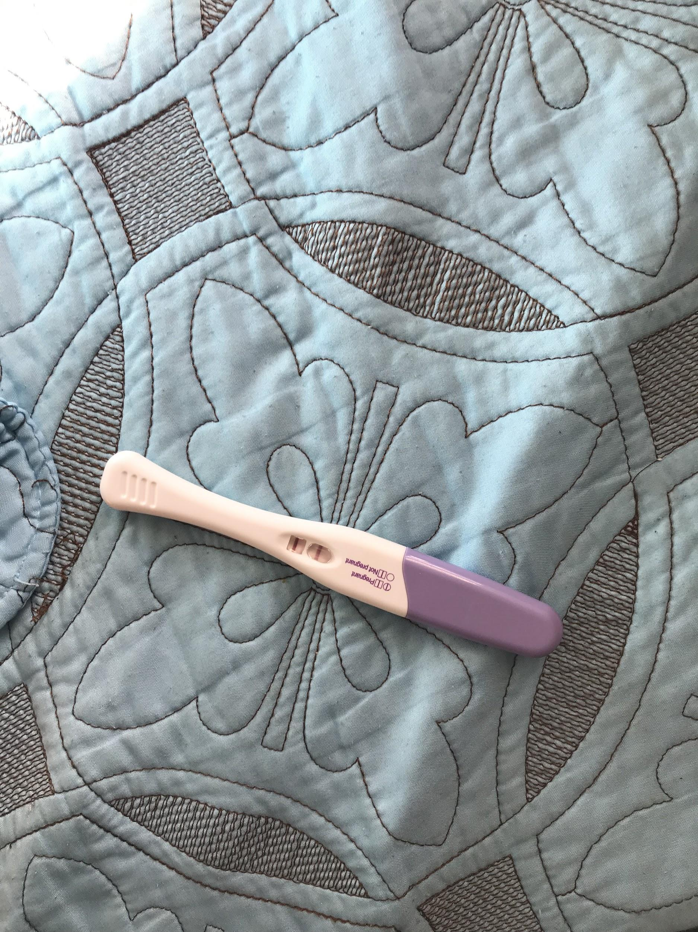
PREGNANT!!! May 13, 2019

Slide 15
As of this day, not a single stick or one can of beer did I picked up.
I am emotional about this.
I stopped everything for the health of my child.
I think it’s also a way of me not smoking or drinking

Slide 16
Thank You.

