Slide 1
Final Research Proposal Presentation

Slide 2
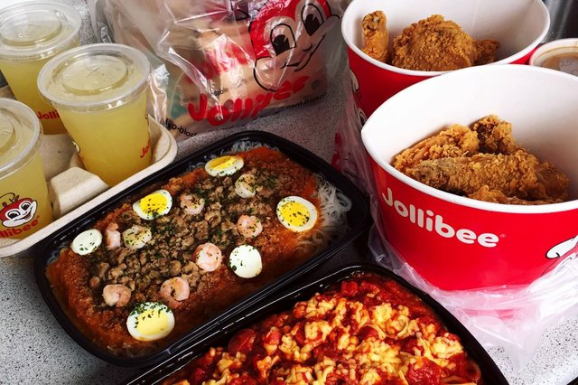
Bringing the Jollibee Corporation INC. back to our island of paradise, CNMI.
One chicken joy with a side of gravy please...
By: Eloise Rose E. Lopez
Dr. Kimberly-Bunts Anderson
EN202-01
Y5

Slide 3
What was used?
Survey Monkey
Ethnicity.
Age Ranking
Known/Unknown
2. Letters to Experts
Jollibee U.S.A - (Twitter, Instagram, Facebook, Email Communications)
Jollibee Philippines - (Twitter, Instagram, Facebook, Email Communications)
Jollibee Corporation Inc.
3. Interviews
Sammy Perez - (Exployee at Jollibee, Garapan: Cashier/Cook)
Shirley Dalantinao - (Ex-employee at Jollibee, Garapan: Cashier)

Slide 4
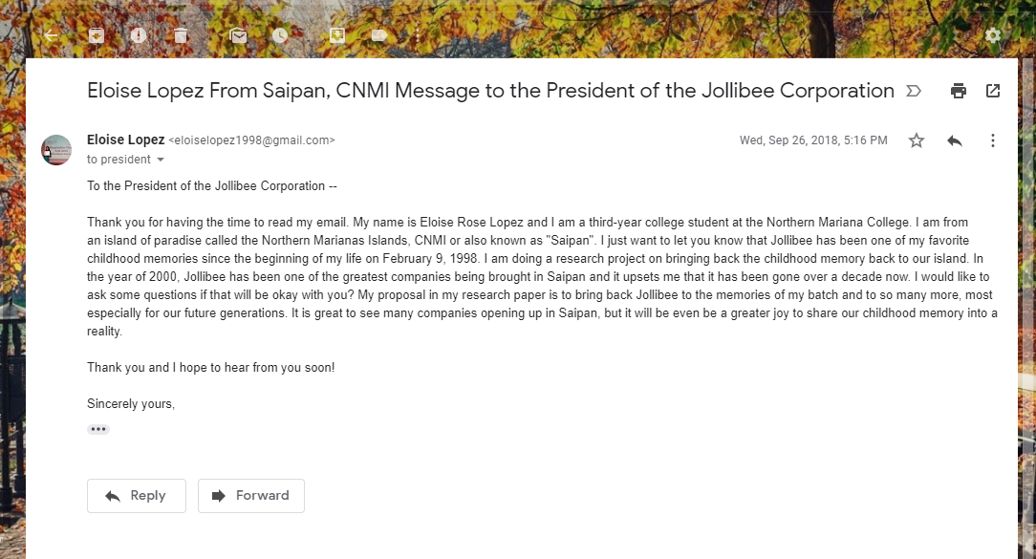
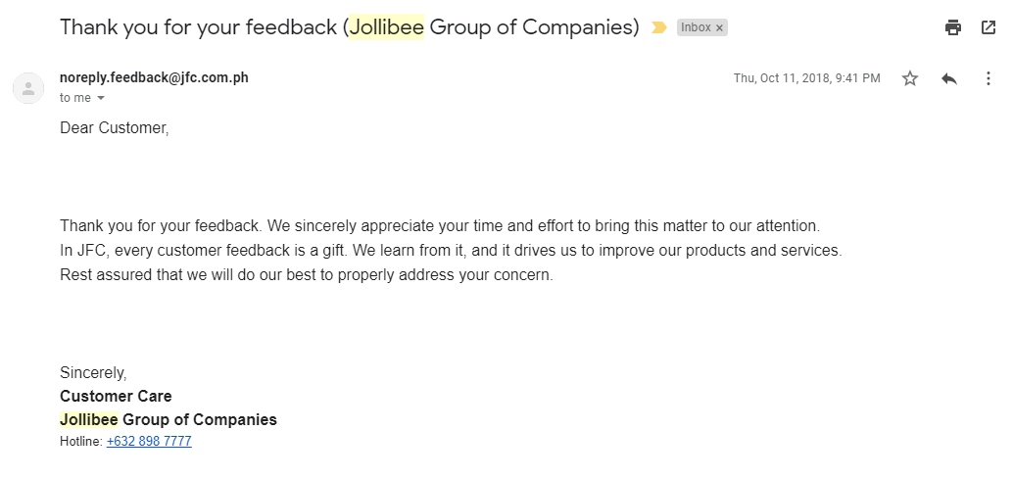
Letters to Experts
There were responses that was made right after my Letter to Experts project. However, the responses were mainly Customer Feedback replies, and usually never got back to me after three follow-up email communications.

Slide 5
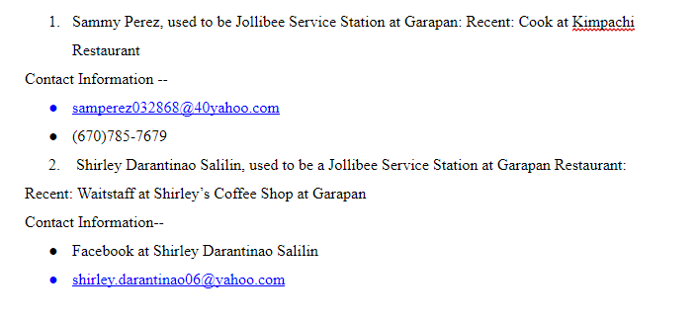
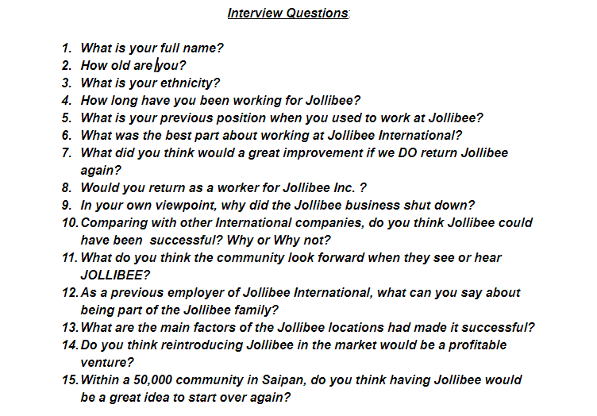
Interviewing Process & Findings
These two are ex-employees of Jollibee Saipan which resides before at Garapan.
Shirley Darantinao Silalin
Sammy Perez
These are the questions shared with them both in regards to their experience at the Jollibee Saipan.

Slide 6
Survey Monkey & Final Findings
With my survey questions, I have not approve much of all the question I applied right before Typhoon Yutu came due to the fact that I was still brainstorming what are the fit questions to ask when it comes to the community and to the students. After the Typhoon Yutu experience, I had an exact of 7 responses from students of NMC. I was doubting so hard on my topic. I did not know what to say when it comes to the final exam presentation. So on, I made a second try in making another survey with a little touch of my personal questions, and sent it to all my teachers and to the community as my way to help me get more answers if bringing the Jollibee Corporation Inc. back on our island of paradise, the Commonwealth of the Northern Mariana Islands.

Slide 7
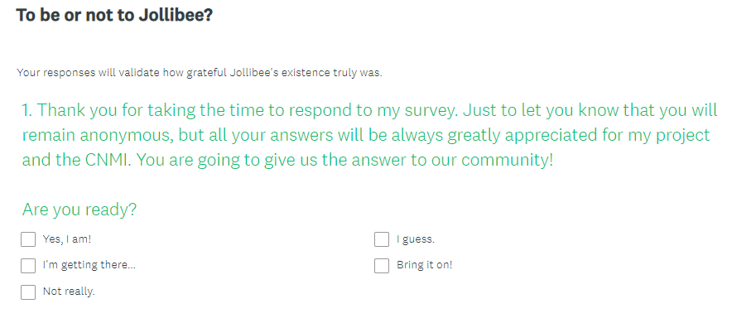
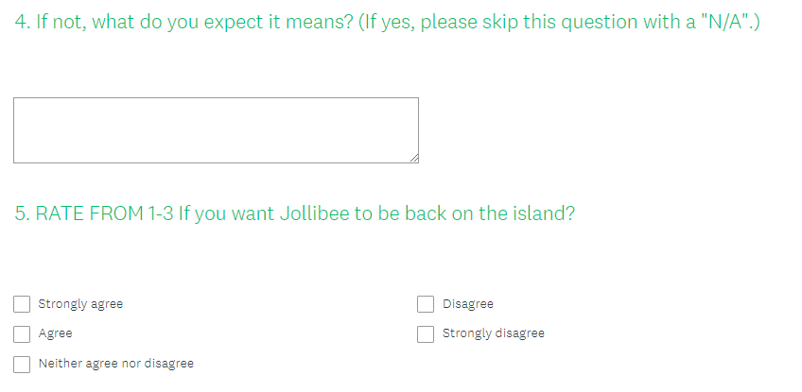
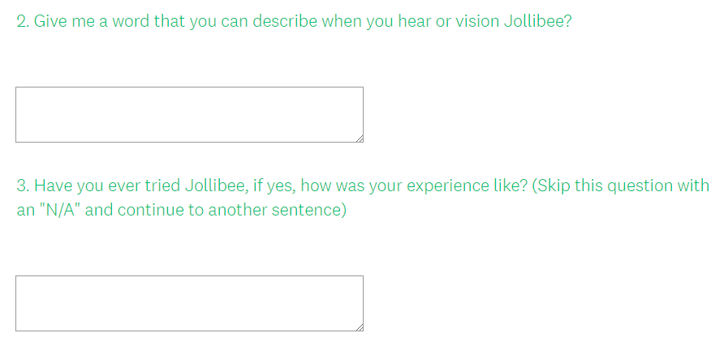
Survey Monkey Questionnaires

Slide 8
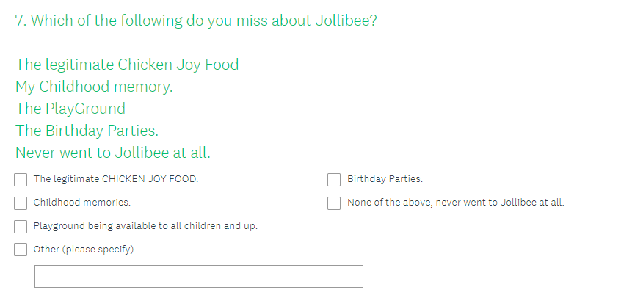
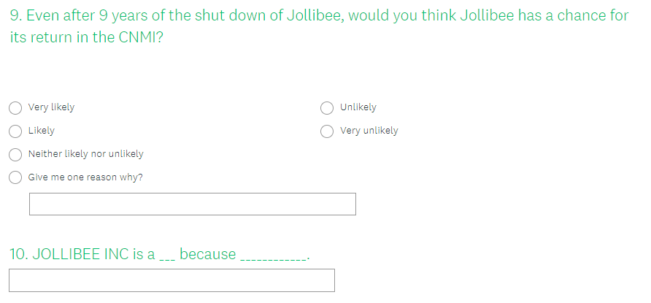
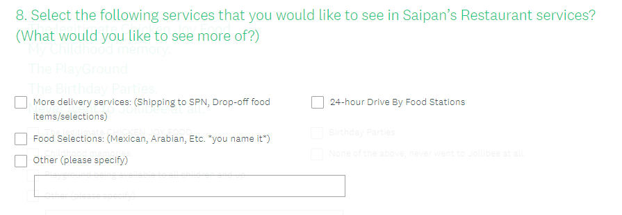
Continuation of Survey Monkey & Findings

Slide 9
Final Essay after Yutu
Here was the second final survey that made it all happen!
Improvement
I used questions such as “How old are you?” and “What is your ethnicity?” as part of my survey to show the collective data who are known and unknown about the Jollibee Enterprise.
I sent it all to my teachers, colleagues, friends and family to take my survey and also these Social MEDIA’s as my way to connect the dots.
You can finally say, I have actually collected data in a matter of two weeks!

Slide 10
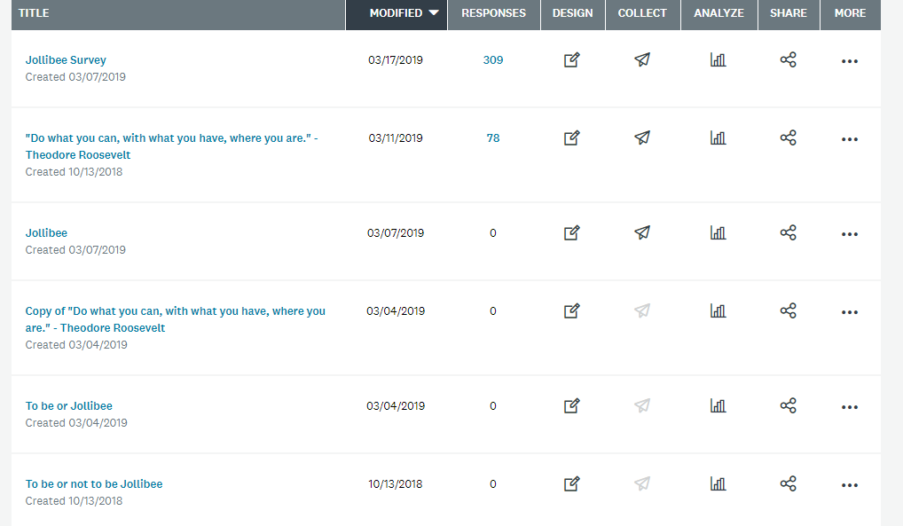
The Final Results of my Survey Questionnaires
Are you seeing this right now?! 78 RESPONSES TO 309.

Slide 11
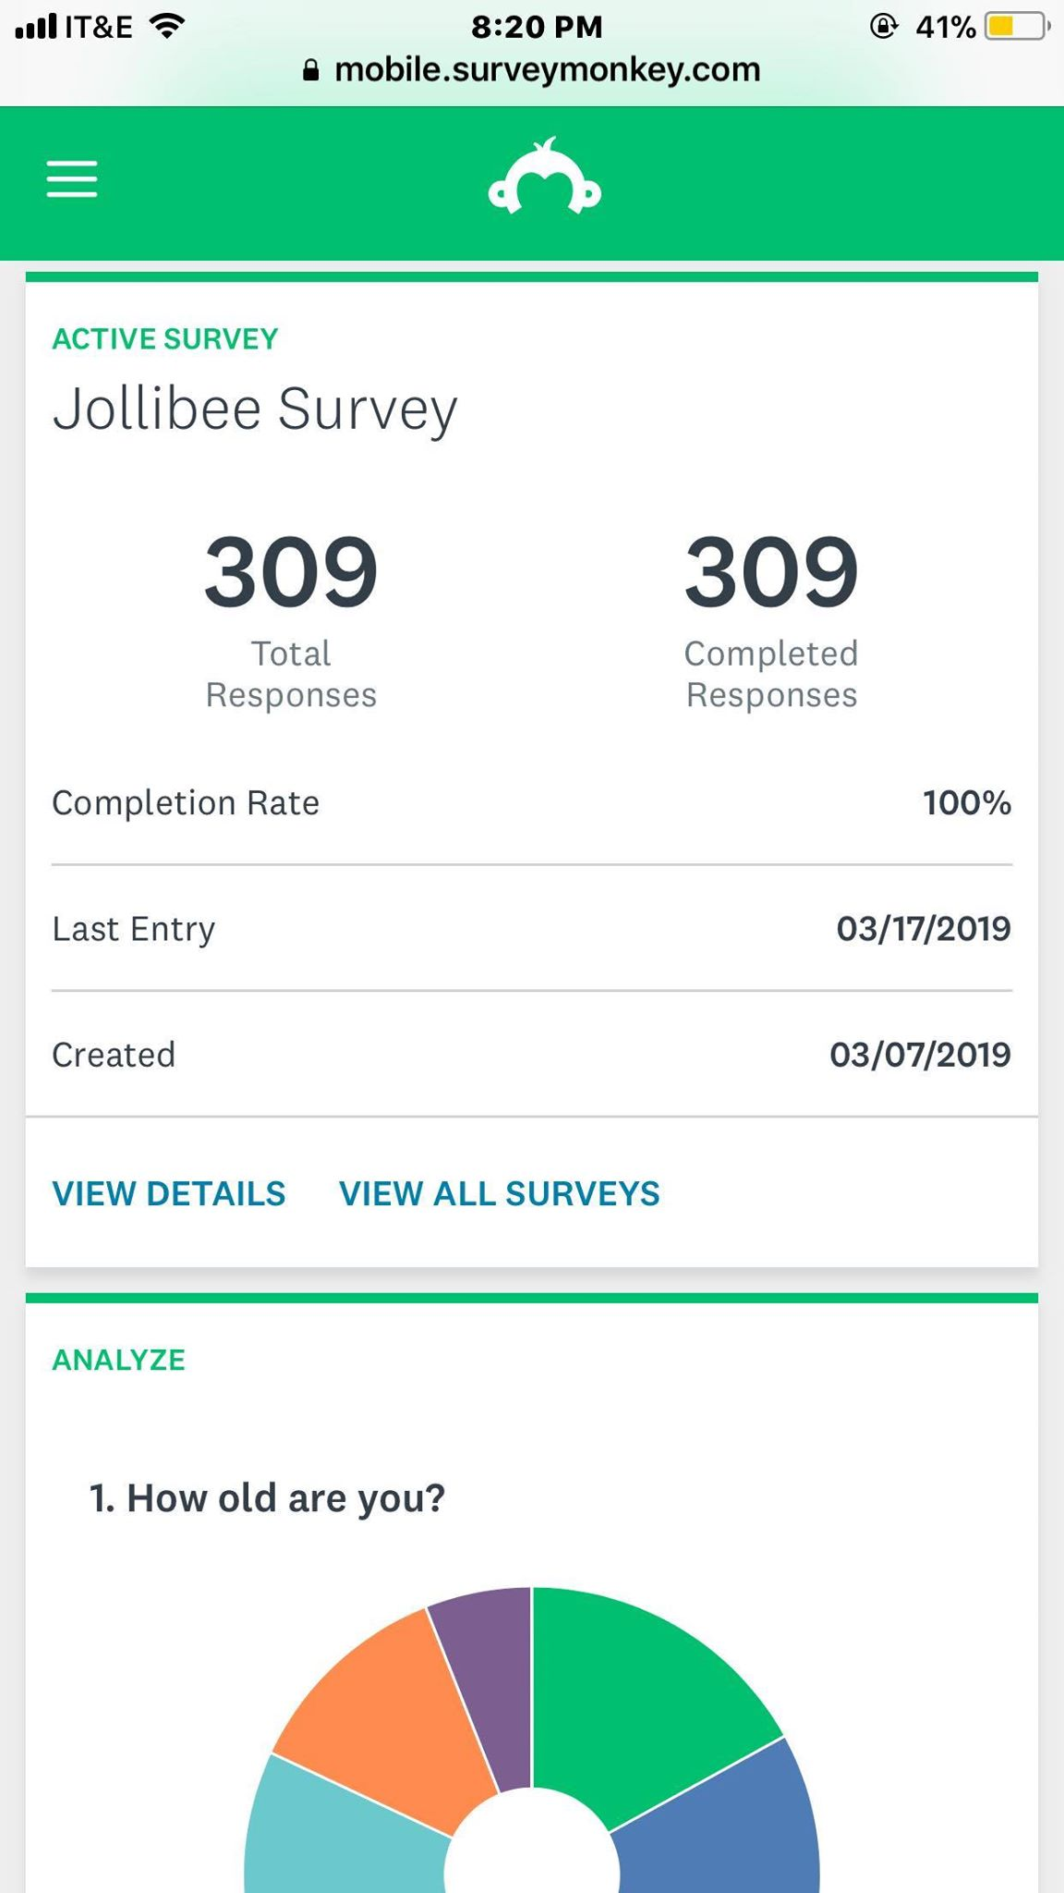
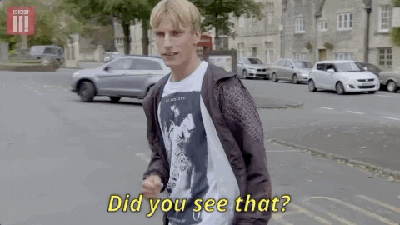
You have no idea how happy I am to see these results, I am beyond excited to keep this project going!

Slide 12
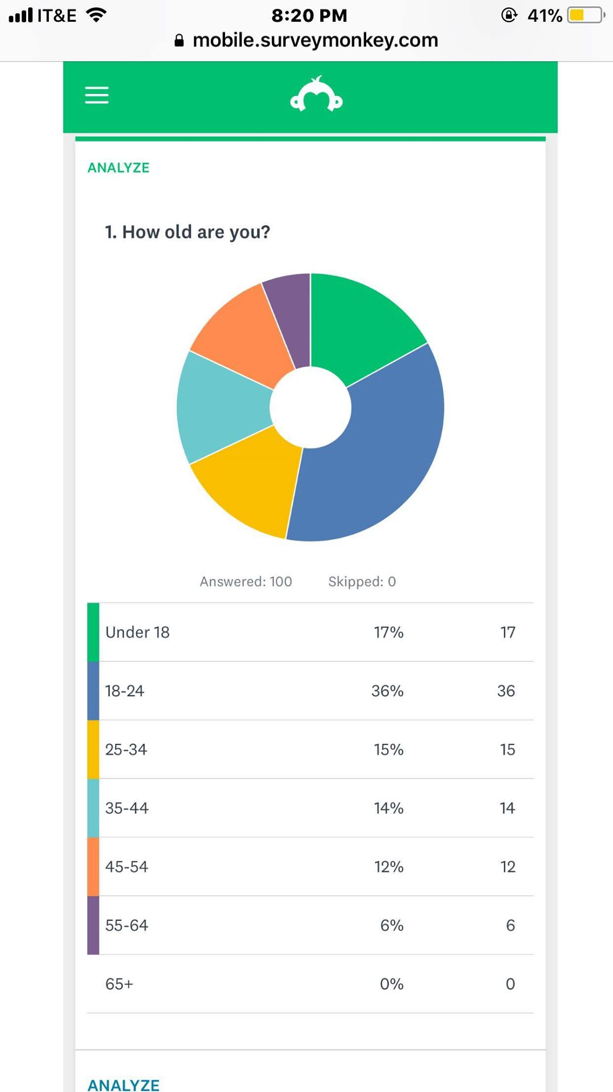
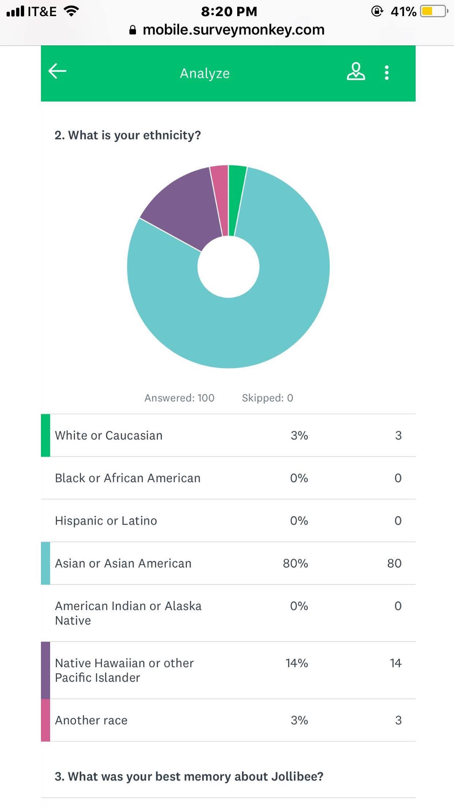
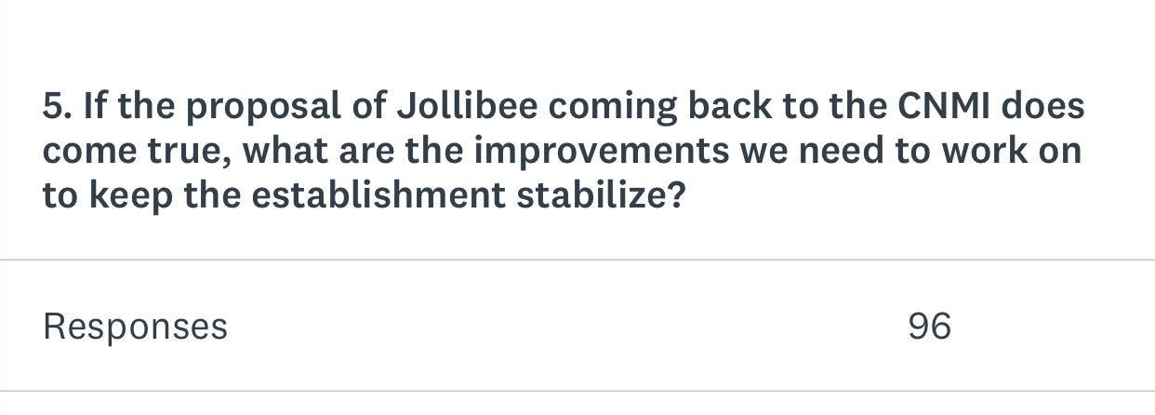
The Analyze Process:

Slide 13
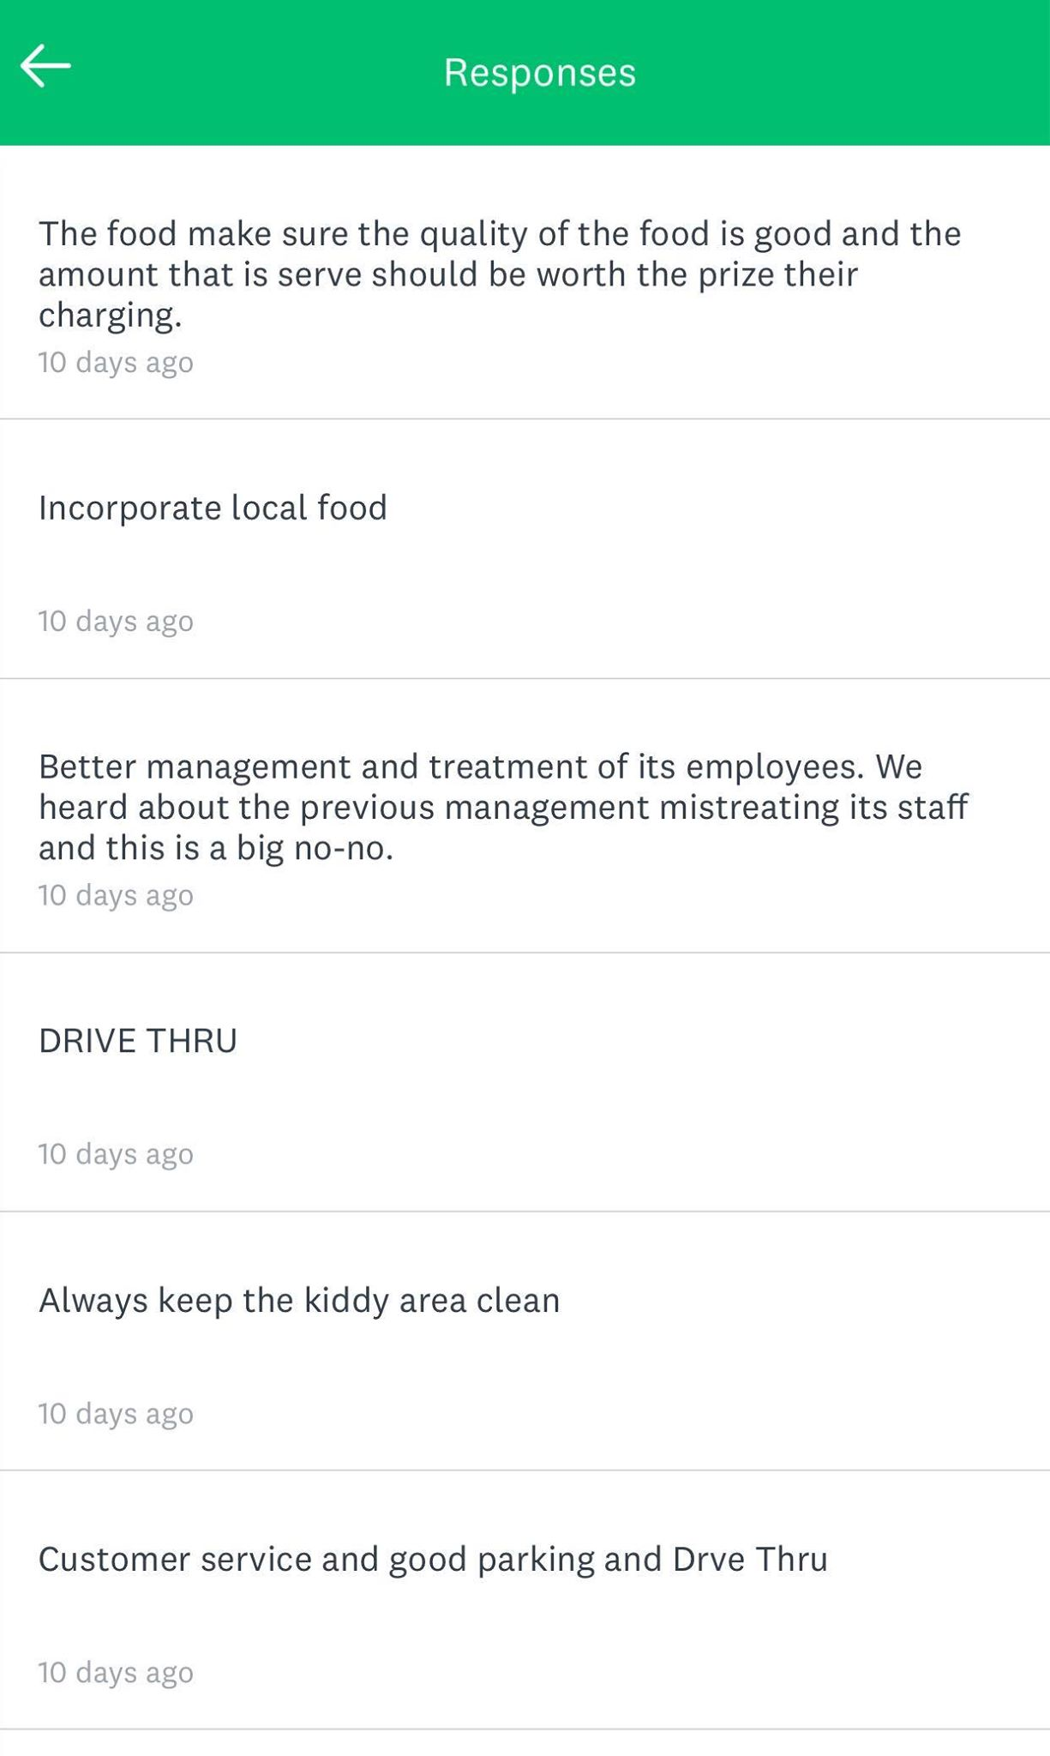
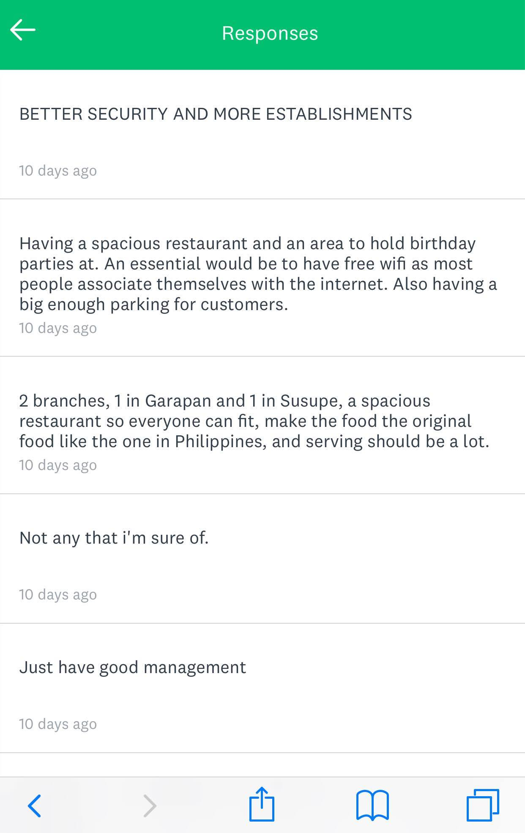
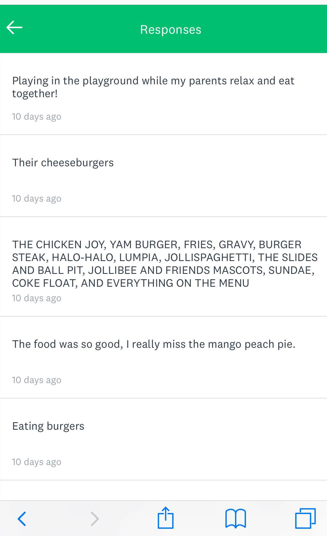
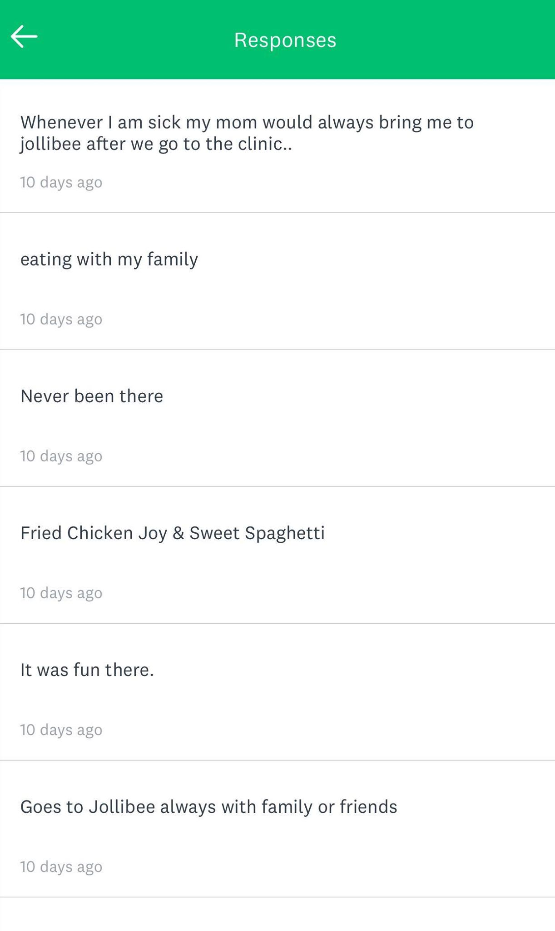
Anonymous Responses
At first, I was reluctant how similar the responses are but as I kept scrolling down, these people really have the heart and soul for Jollibee. While some wants to know what the hype of Jollibee is truly about? That makes the process of the project significant!

Slide 14
The Learning Process
Throughout my research project, I will be honest with you right now, it was a struggle trying to even find an idea or a purpose in writing this paper. Most especially with the recovery occurring with Typhoon Yutu. At first, I thought to myself, what can I do to make this work?
What can inspire me to do this research project?
What is one thing that can benefit my home and I?
What makes me happy that I can keep talking about it with everyone?
With all the ideas coming forward, I think the Jollibee Corporation deserves a second chance, and for all your responses it is a must to have the new and improved Jollibee back on island.

Slide 15
What did I learn about Academic Writing?
What I have learned about Academic Writing is that…
I have written a lot about my theories and opinions a lot.
I have read many articles as I should have before, just to gather enough information for my research project.
I have learned to go deep and beyond to show my results are worth it in the end for example, surveys, interview questionnaires, and letters to experts.
I have also learned to reinforce my ideas at the most professional process.
I have learned to share my topic to any type of audience. Whether it is informal or formal audience.
I learn and I live. I lived to write and that is what I want to continue in my studies.

Slide 16
What I could have done differently...
Ask random participants in person what they think about Jollibee and their thoughts of having Jollibee back on our island of paradise.
Share my survey with other classes other than my own as a way to get the word out about the Jollibee Corporation Inc.
Create and send my surveys and interview questionnaires to my experts as early as possible.
Create a timeline for each project with a BACK-UP plan, just in case if another Typhoon or Emergency comes along the way.
(Recommended by people: Ask tutors for help in pitching ideas for my research project.)

Slide 17
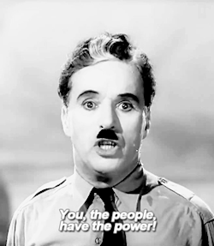
How will I disseminate my results?
With the results given, I have always wanted to do something out of my luck. With over 300 responses, I do believe that I can make this possible. With the help of each survey taken by each and one of you, I will use these results as my petition. As I gather all my data together, I will present my idea over an interview with Jollibee Philippines to help me make our island dreams come true. Because…

Slide 18
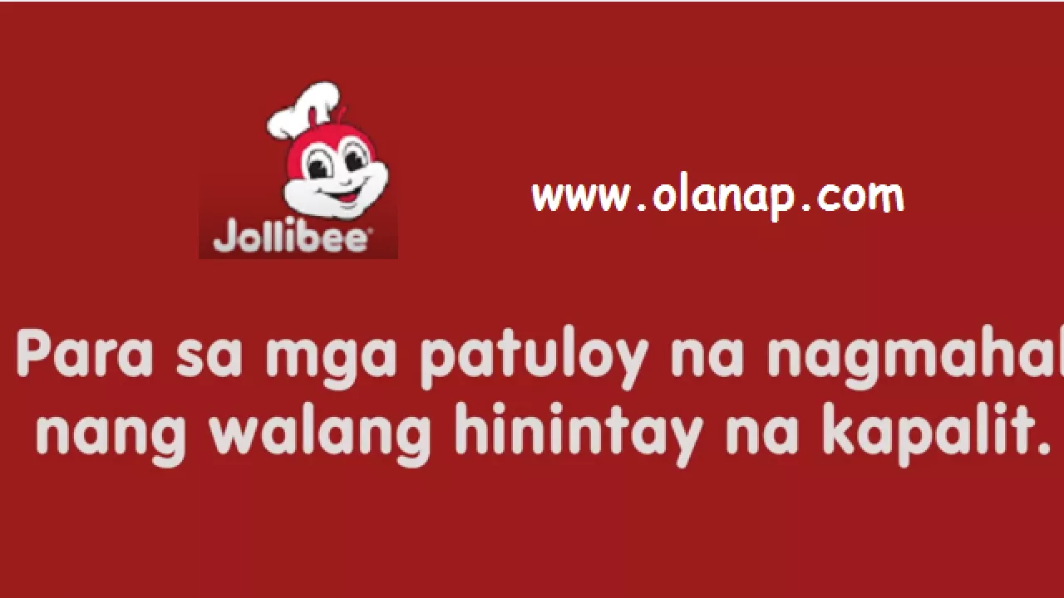
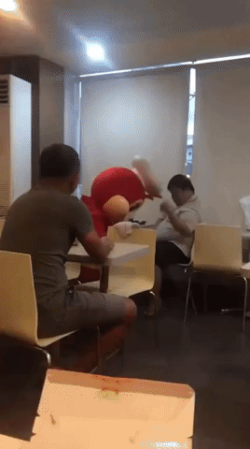
Please continue to take my survey, it will be greatly appreciated and sent to to the U.S and the Gov.

