Slide 1
Business in the cnmi
Andrea S. Camacho
Dr.Kimberly Bunts-Anderson
EN101-ON01
Spring 2016

Slide 2
What is the term ‘business’
A place, building, location or group
Main purpose: to provide goods and services
In exchange for other goods, services or money
Although, there are non-profit organizations, state owned enterprises and various volunteer organizations that make a big impact around the globe as well.
All the many parts and levels of a business are what make them successful or not, such as: -ownership –management –location –community –staff
“Purpose, product, people, profit”

Slide 3
The topic that had been discussed, ‘Business in the CNMI’, turned out great. By expanding one’s knowledge and understanding of the business world, big or small. A business is a place, location or group who’s intention is to provide goods and services in exchange for other’s goods, services and money. Small businesses are especially significant because of what is being valued. If a small business were to fail (or not do so well) it would lose less money, time and value then, if a big business were to fail. Propose, product, people and profit are what make the business successful or not. All that’s been documented states that: how the business is being ran and what makes it a business, what makes it special/significant, not whether how large or small it may be. Small businesses are all over the CNMI and all over the world; they impact people just as much. It was a great topic to research and explore and possibly, study further

Slide 4
Primary research question: Do the small,
Independent businesses have a future in the
CNMI?
Secondary questions:
- What makes these smaller businesses special?
How do businesses like Best Sunshine affect
the smaller businesses?
-What are the pros and cons of small businesses to big businesses?

Slide 5
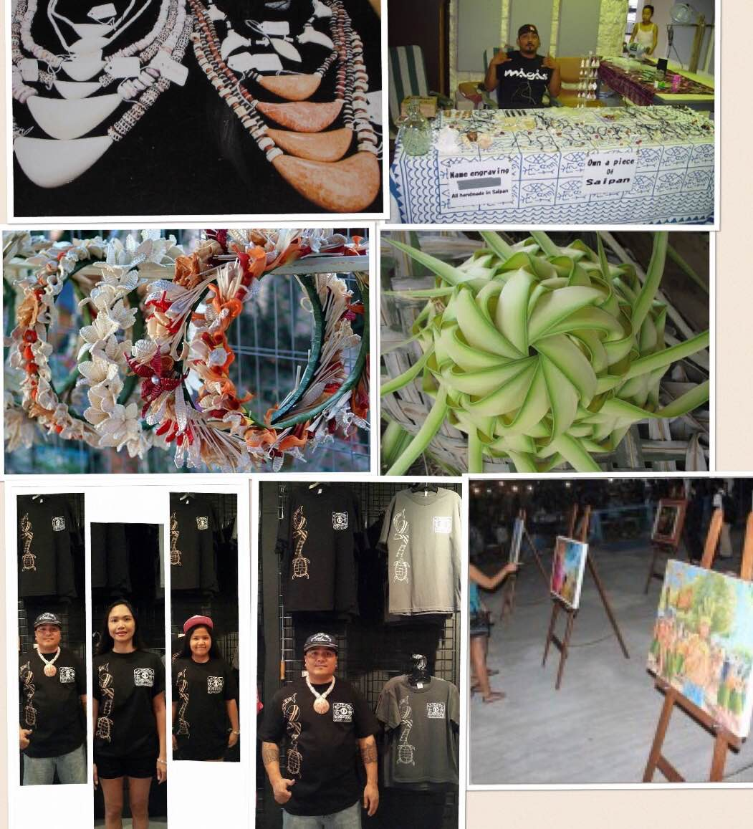
Examples of small businesses

Slide 6
Goals/intentions
Read online and learn more about the business world.
Read and learn about the pros/cons for small to big businesses
Find small, independent businesses that have bloomed into big ones or have stayed small yet successful.
Get various perspectives on what makes a small, independent business important and special.

Slide 7
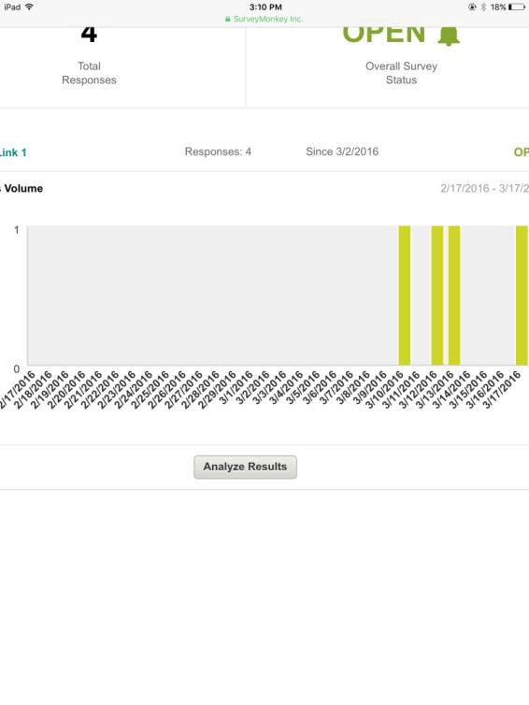
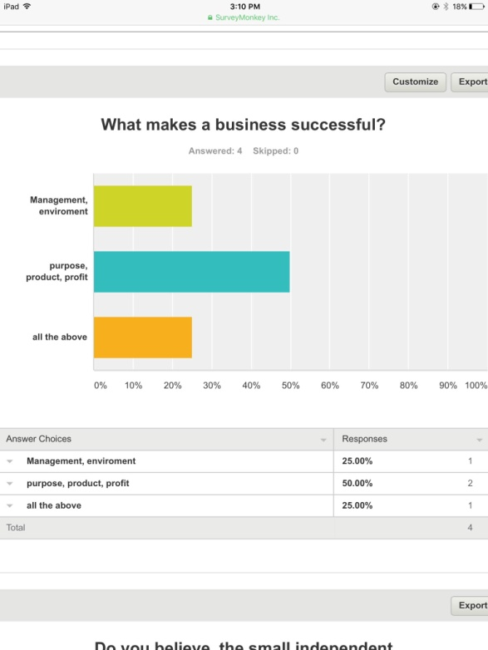
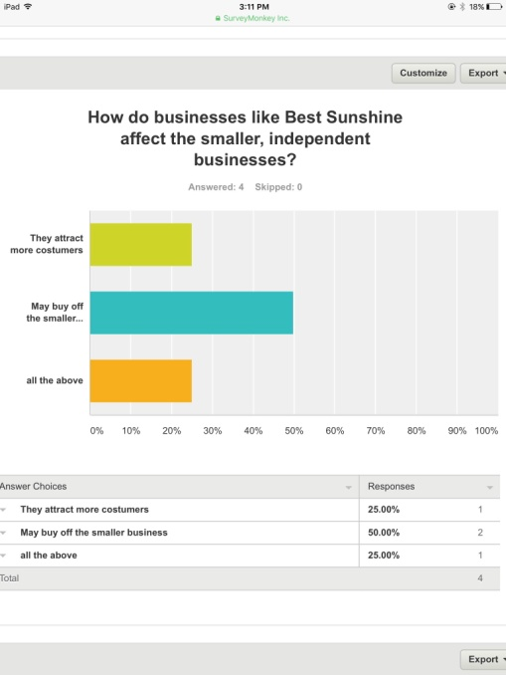
Survey results

Slide 8
reflection
The whole semester consisted of one research project. This project expanded my knowledge in specific types of essays and academic writing, how to answer primary/secondary questions and search for information, how to cite resources and then, transform them all into APA format. I chose the topic of ‘Business in the CNMI’.
In the duration of this project, we had covered four different types of essays: proposal draft, which is an illustrative essay introducing your topic, a cause and effect essay, which discuses both sides to the subject (pros and cons), an argumentative essay, which specifies your findings and points of view, and a process essay, which is on what you did during the project (the step by step process/schedule). I prefer this method for the research project and the course. It has helped me break down my project more, that made me comprehend everything. The textbook for this course had helped a lot with APA formatting and descriptions of each essay.
I chose the topic of Business in the CNMI mostly because; I wanted to expand my knowledge on it. It felt important as I have just begun taking classes and majoring in Business. There are many topics that I know would have interested me as well, but I’m glad I stuck with this one and yes, I would like to learn much more to study it further. Academic writing is very important in a Business career, you would never quite know how little or how plentiful you would be doing, so
2
it’s important to master. I’d admit I still have much to work on with essays and academic writing, but I have started to see my mistakes and hopefully, improving on them. One thing I’ve learned is that it really helps to get feedback, good or bad. Also, organization is key, in the future I will organize my time and findings more appropriately to improve my work.
My overall research project has taught me great things. Could I have done a few things differently to make it better, maybe so, but I did all I could do for now. I’m glad I have been able to turn as much in and hopefully, get a good grade! Business in the CNMI has had its ups and downs for many years, but in hopes, in the future the small, independent businesses remain significant. In this short amount of time, I have learned my faults in writing and comprehending certain things, and had a great time taking this online course.

Slide 9
Academic resources:
https://discussanddo.co.uk/index.php
www.converstaion.org/climate
https://www.nrdc.org/globalwarming
www.pacificrisa.org/places/commonwealth-of-the-northern-mariana-islands
www.sba.gov
InBusiness magazine
National Geographic magazine
- Personal interviews

