Slide 1
Crime and Casino
Quina Mae Viana
Northern Marianas College
EN101-ON1
Dr. Kimberly Bunts-Anderson

Slide 2
Research Questions
Primary Question?
Does the presence of Best Sunshine (Grand Mariana Resort and Casino) would increase crime rate in Saipan?
Secondary Question?
In general, do you think casinos are linked with the increase of crime in the community?
Notes:
Because there has been no actual research on the assumption that bringing the casino on the island would be followed by an increase in crime rate, this research aims to identify the negative impact of the casino in the community emphasizing the relationship between increase in crime rate and gaming industry. Particularly, this paper would identify the opinions of the residents towards the casino.

Slide 3
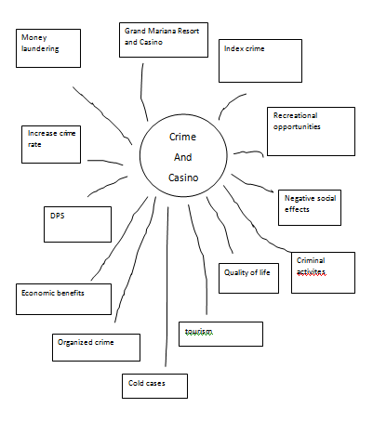
Brainstorm
Explore ideas
Effective at generating ideas
Don’t have to worry about other people’s egos or opinions
Freer and more creative
Notes:
Evaluate ideas at the end of the session – this is the time to explore solutions further, using conventional approaches. When you brainstorm on your own, you don't have to worry about other people's egos or opinions, and you can be freer and more creative. For example, you might find that an idea you'd hesitate to bring up in a group develops into something special when you explore it on your own. effective when you need to solve a simple problem, generate a list of ideas, or focus on a broad issue.

Slide 4
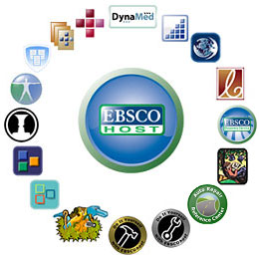
Research Approach: Online Articles
The first step that I did was to gather information regarding my topic on Ebsco and other online journals articles.

Slide 5
Research Approach: Survey
To answer the questions regarding the issue, I need to identify the concerns of the residents by giving out survey questionnaires. This will be the most important source to support my topic.
I created the questionnaires using Surveymonkey and distributed them randomly

Slide 6
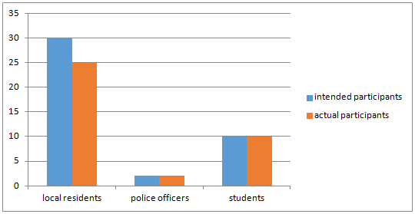
Results
This shows the difference between the number of intended participants vs the actual participants

Slide 7
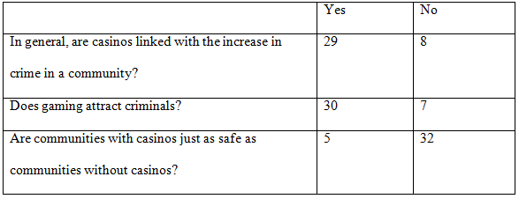
Results
This table shows that survey participants strongly believes that casino are link with the increase of crime

Slide 8
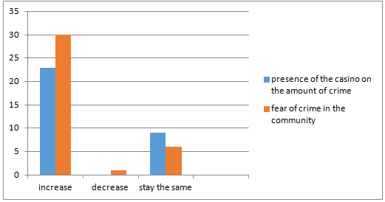
Results
This graph weighs the influence of casino on the amount and fear of crime in the community

Slide 9
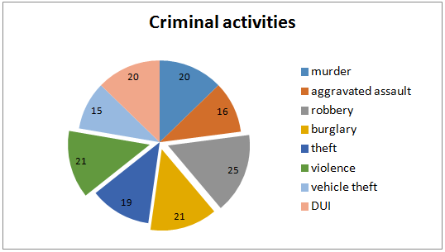
Results
The graph shows what criminal activities or violations are likely to increase

Slide 10
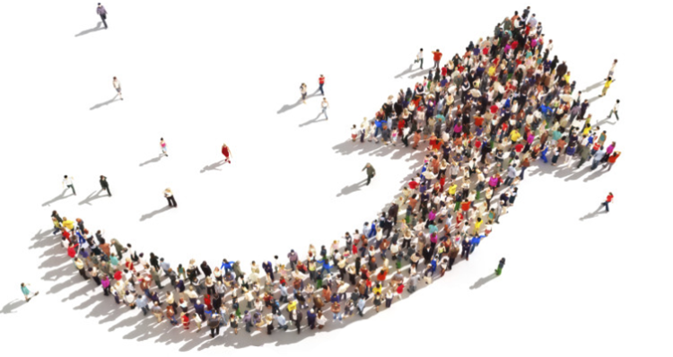
Results Discussion
My findings suggest that the presence of Grand Mariana Resort and Casino would increase crime on the island.

Slide 11
Survey limitations
I would get more accurate survey results if I increase the number of people who participated in the survey and if I consistently followed the timeline for data gathering.

Slide 12
Summary
There’s no doubt that the casino enhances tourism, increases employment rate and income, and provides recreational opportunity in the community, however, casino may also cause negative impacts like violence and crime. The casino environment may also act as a magnet to potential criminal activities.

Slide 13
Interesting findings

