Slide 1
Casinos in saipan
By: jacky lou pestillos

Slide 2
Research questions
Primary Research Question: What are some of the long-term effects of the casinos being established here on the island of Saipan?
Secondary Research Question: How do leaders of the CNMI react to this casino project being on island?

Slide 3
Data and Sources Support for Research
Academic literature review
Local newspaper
Survey Monkey
Purposeful Sampling

Slide 4
Academic Literature
Online academic sources have been used to write this research paper. In fact, most of the academic sources used to support this research paper are studies published by college universities. Below are some literature contents that have been used to support this research paper:
- Research on the Social Impacts of Gambling -Final report prepared with the Scottish Centre for Social Research by Dr. Gerda Reith
- The Social, Economic, and Environmental Impacts of Casino Gambling on the Residents of Macau and Singapore by Shou-Tsung Wu and Yeong-Shang Chen

Slide 5
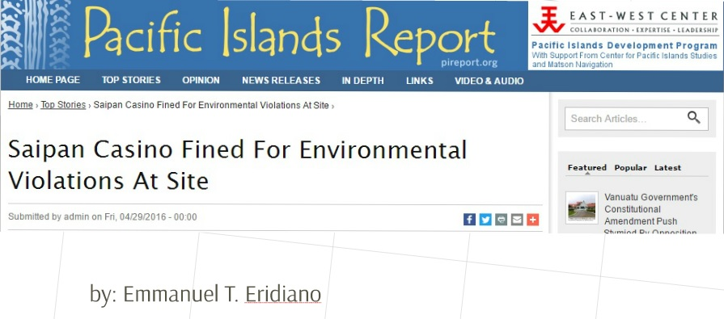
Local Newspaper

Slide 6
Survey monkey
The survey that was created to support this research paper was created through the website Survey Monkey. The survey was then uploaded to the writer's personal Facebook profile. Results were drawn from it before the last essay for the course was submitted. 150 people had taken the survey, and results are as follows:

Slide 7
Survey results
Increase
Continue investment
Planning to Sell/Sold it
Resident
Economically
Decision affected
Will NOT increase
18-25
Increase
Have family inherit
Decision NOT affected
Discontinue investment
Non-resident
In Favor
Not in Favor
26-40
Will NOT increase
Socially
Agree close by
Disagree close by
Unsure
Environmentally
Will not affect anything
41-60
Don’t Care
Don’t Care
Don’t Care
Other
61-85

Slide 8
Access to survey
To access the survey please use this link: https://www.surveymonkey.com/r/JBTYPXY

Slide 9
Purposeful sampling
In this course, the instructor had the students write letters to experts. This writer wrote to three experts: CEO of Best Sunshine International, a politician, and a college educator.

Slide 10
Findings in Relation to Research Questions
Findings show that despite what this writer felt about how the casino industry having a long-term negative effect on the island, the survey results as well as the feedback from the experts had reflected how people generally are for the casinos to continue their investment here on island. The results had also swayed this writer as well, but not completely. This writer does feel, however, that this casino establishments be given a chance to make improvements on the island.

Slide 11
Successes With this Project
The use of technology was greatly used to collect the information for this research paper. Survey was distributed through a social media, and email interviews were conducted for the purposeful sampling.

Slide 12
Possible Improvements
There is always room for improvement. One of the other ways to expand data collection was through passing out printed surveys at public events like the local street market or at DFS Galleria. The surveys could have been dropped off to local businesses as well and left a drop box for it to be collected at the end of every week throughout the course. Purpose sampling could have been improved by doing an in-person interview for a more personal feel of the answers. Interviewees would have also probably felt the writer to be more involved in their writing, and more letters to experts could have been collected that way.

