Slide 1
CHILD ABUSE BY PARENTS

Slide 2
Physical
Others

Slide 4
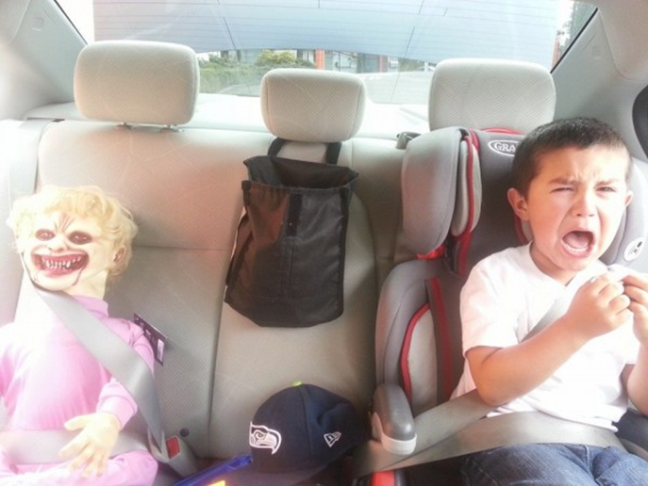
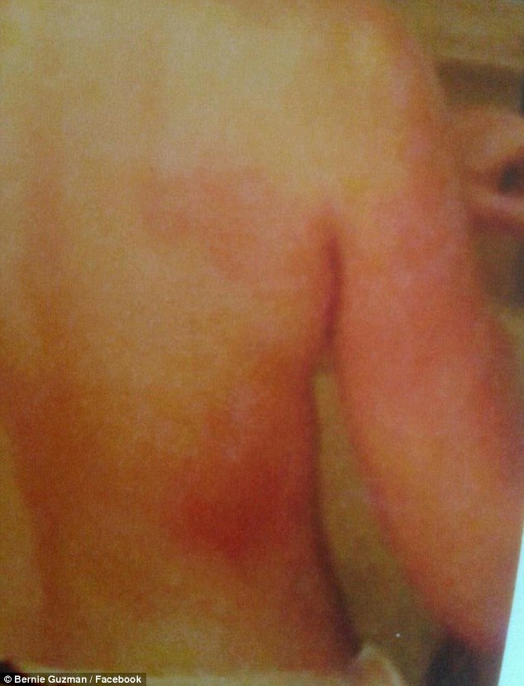
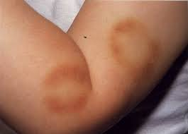
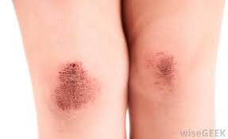

Slide 5
Parent Abuse Impact On Children
Self Harm & Suicidal Act
Insecurities
Feeling Unwanted
Education

Slide 6
Why A Parent Abuses Their Children
Childhood
Unrealistic Expectations
Drugs Or Alcohol Use

Slide 7
Children Survey
CHILDREN SURVEY
1.Have you ever been abused by your parent?
a.Yes
b.No
2. Do you think that abuse by parents makes a child feel unwanted
and think of suicidal act?
a.Yes
b.No
3. Does abuse by parents affect a child’s education? Why?
4. How does child abuse affect you?
5. In what ways do you think child abuse can be prevented?

Slide 8
Parent Survey
Parent Survey
Have you been abused by your parent as a young kid?
What do you think causes a parent to abuse their child?
Have you ever experience or encounter any child abuse caused by use of Alcohol or Drugs?
What do you think every parent need to do to prevent child abuse?

Slide 9
SURVEY RESULTS
5 out of 15 – Suicidal Act ( Child)
13 out of 15- Education( Child)
10 out of 15- Trouble Parenting ( Parent)
3 out of 15 – Alcohol and Drugs ( Parent)

Slide 10
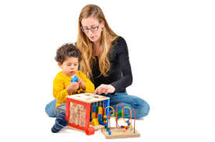
Parent Therapy

