Slide 1
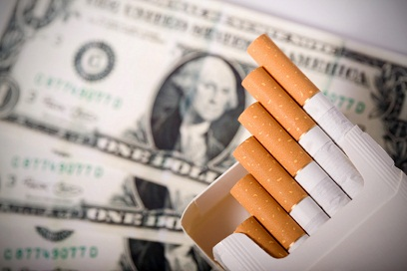
Cigarette Tax Increase Study
Lorein Angelique B. Soriano

Slide 2
Research Questions
Primary: What are the plausible effects if the Healthcare Impact Tax Act bill gets approved?
Secondary:
Will the tax reduce the consumption of cigarettes?
What will be the bill’s impact to the economy?
Will the revenue generated go to CHCC?

Slide 3
Methods
Surveys:
Tax Hike Bill Survey: 22 respondents
Smokers Only Survey For Tax Hike Bill: 10 respondents
Significant questions:
For SC#1: Will the frequency of people decrease if the tax/price of cigarette increases?
I will decrease my consumption of cigarette if the tax increases.
ForSC#2: Will the tax increase have a positive, negative, or neutral effect to the economy?
For SC#3: Do you think the revenue generated go to CHCC?

Slide 4
Interview Experts
Economist: Dave Guerrero
Via e-mail
Questions asked:
regarding the efficiency of the bill to decrease people’s consumption of cigarette.
Effect to the economy
Tobacco and Control Prev. Prog. of CHCC: Rebecca Robles
Conducted in an office
Questions asked:
Will it decrease the people’s frequency of smoking (thus decreasing NCDs)
Will the proceeds go to CHCC?

Slide 5
Findings
Survey question: There will be a decrease in people’s frequency of smoking if the tax is approved.
45% reported they “strongly agree” and 36% said they “agree”. On the second survey intended for smokers only, 20% of respondents “strongly agree” and 50% “agree” with the same statement given in the first survey.
Dave Guerrero: “Simply, an increase in price of an additional 70% on cigarettes and tobacco will undoubtedly reduce its consumption”

Slide 6
Negative impact on economy
Unintended consequences
Encourages low quality products
Emergence of cigarette black market (smuggling)
Survey question: whether or not an increase in smuggling of cigarettes would become an issue or already an issue,
a majority answer had prevailed. In the first survey, 50% answered “yes it’s already an issue” and 40% said “yes it will be an issue”; in the smokers-only survey, 70% answered “yes it’s already and issue” and 30% said “yes, it will be an issue.”
Ad valorem is costly to collect
Spending money to solve black market problem

Slide 7
Uncertainty in the proceeds going to CHCC.
Rebecca Robles: “the idea of the revenue going to CHCC and public health, not hundred percent sure that it’s going there; no hundred percent guarantee”
The majority of respondents answered “yes” when asked if they believe that the revenue generated from the HITA would actually go to CHCC; in the first survey, 61.1% said “yes”. As opposed to this, the smokers-only survey indicated that 88.89% answered “no” to the similar question that was asked in the first survey.

Slide 8
Strengths
Smokers insight in effect of tax hike in cigarette consumption
Experts and literature coincide with findings
Effect in economy in the perspective of a credible economist
New knowledge acquired by student researcher: type of tax matter

Slide 9
Weaknesses
Small number of experts
Failed to interview bill’s author
Failure to manage time

Slide 10
Would have’s
Larger people to survey
At least three sets of expert in each field chosen (gov’t, business, healthcare)
More time
Interview at least 5 smokers and analyze their answers

Slide 11
Funny

Slide 12
Knowledge Gained
Conducting a primary research
Academic Writing
APA format
Writing an academic thesis statement :)

