Slide 1
Community Issues
Presented By Yi HUANG
CO 210 - VR03 Fundamentals of Speech Community
Dr. Kimberly Bunts Anderson

Slide 2
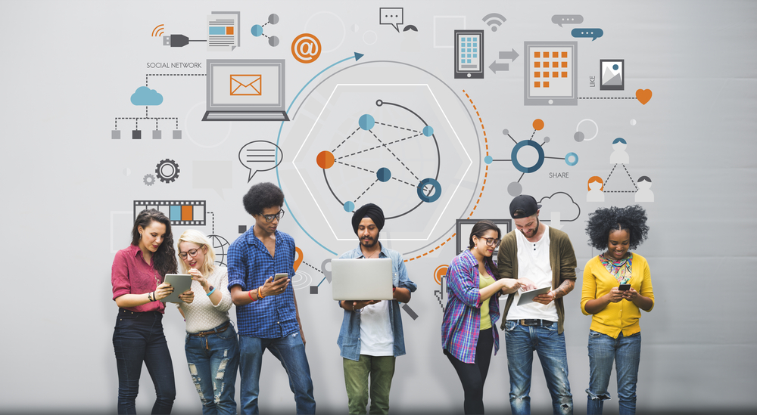

Slide 3
Internet Safety
The Influence of Social Media
Strategies to Protect Personal Data
What Internet Privacy Is

Slide 4
Are you aware that you are in danger because of privacy disclosure?

Slide 5
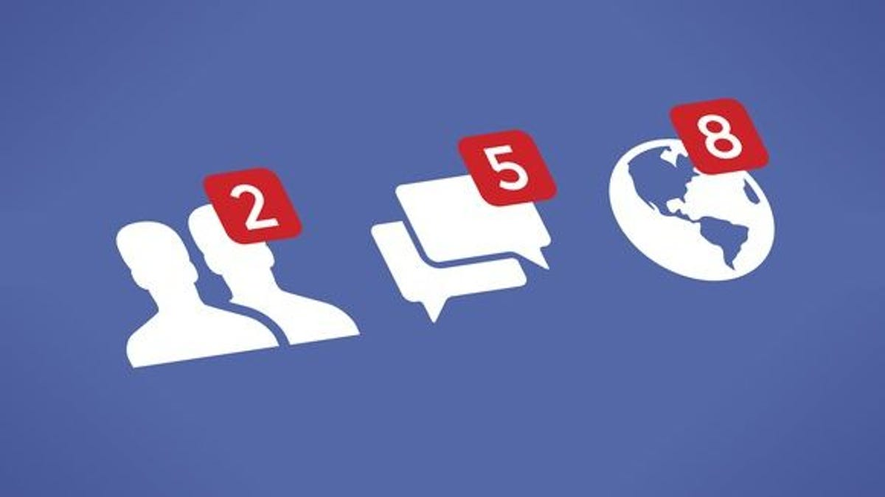
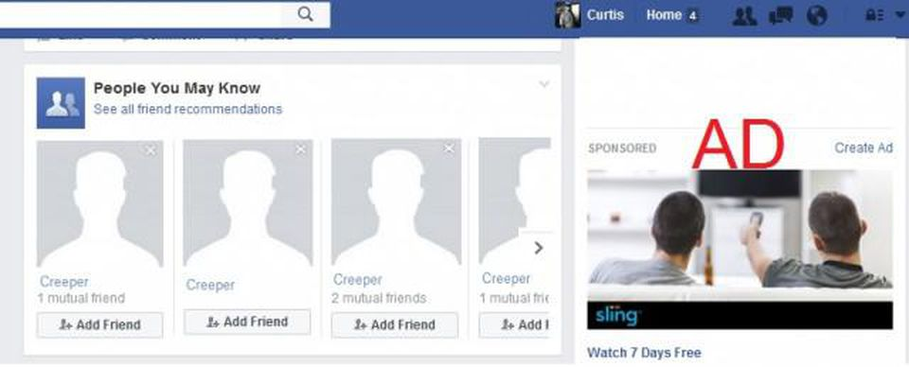

Slide 6
Experiences about internet fraud

Slide 7
What we can do to protect ourselves?
Use strict privacy settings
keep passwords private and complex
be careful when sharing your personal information
update your software regularly
use antivirus software
Build strong awareness

Slide 8
References
Pictures found on Google
Nyoni, P., & Velempini, M. (2018). Privacy and user awareness on Facebook. South African Journal of Science, 114(5/6), 27–31. https://doi.org/10.17159/sajs.2018/20170103
Commerce: Lock down your assets. (2016, April 6). Commerce: Lock down your assets, secure your data. Saipan Tribune. https://www.saipantribune.com/index.php/commerce-lock-assets-secure-data/.
IT&E on scam calls: Personal info is safe. (2020, May 12). IT&E on scam calls: Personal info is safe. Saipan Tribune. https://www.saipantribune.com/index.php/ite-on-scam-calls-personal-info-is-safe/.
Shahid, H. (2020, June 6). What Is Internet Privacy & Why It Matters so much in 2020? PureVPN Blog. https://www.purevpn.com/blog/what-is-internet-privacy-scty/.

