Slide 1
Clay Modeling
By Chad Merfalen

Slide 2
3 steps of Clay Modeling
Buy a Model Clay at a School art supplies store
Pick out your Pictures or objects
Picture the image of what you want to create

Slide 3
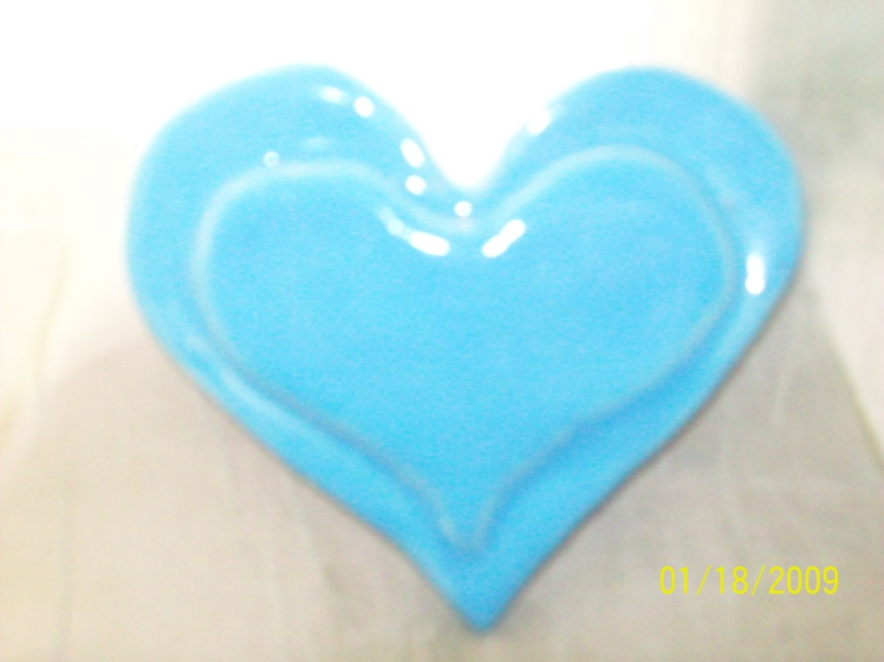
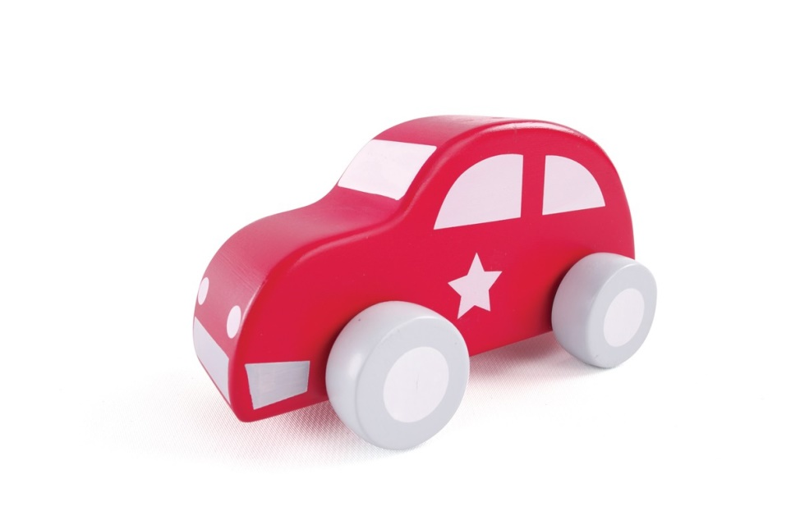
Simple Model Figures
Heart
Toy Car

Slide 4
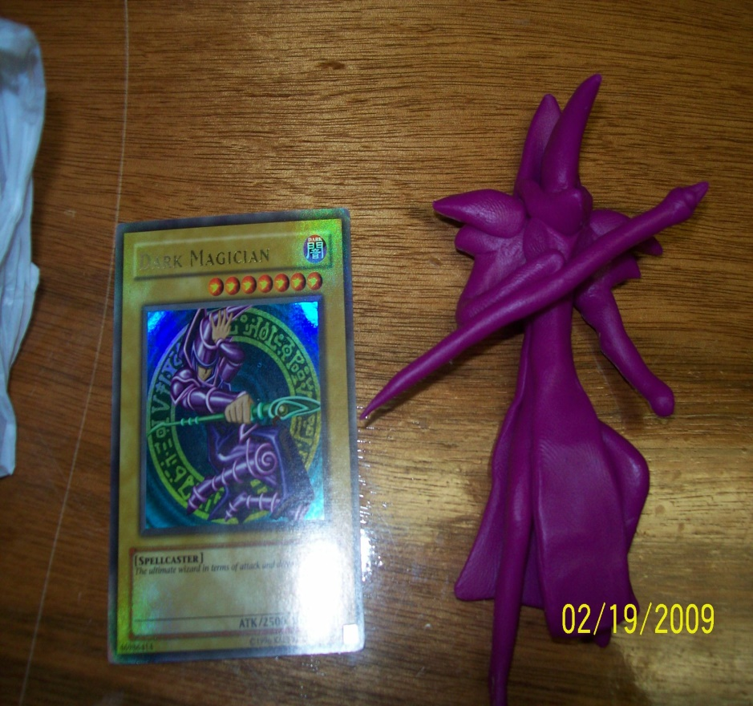
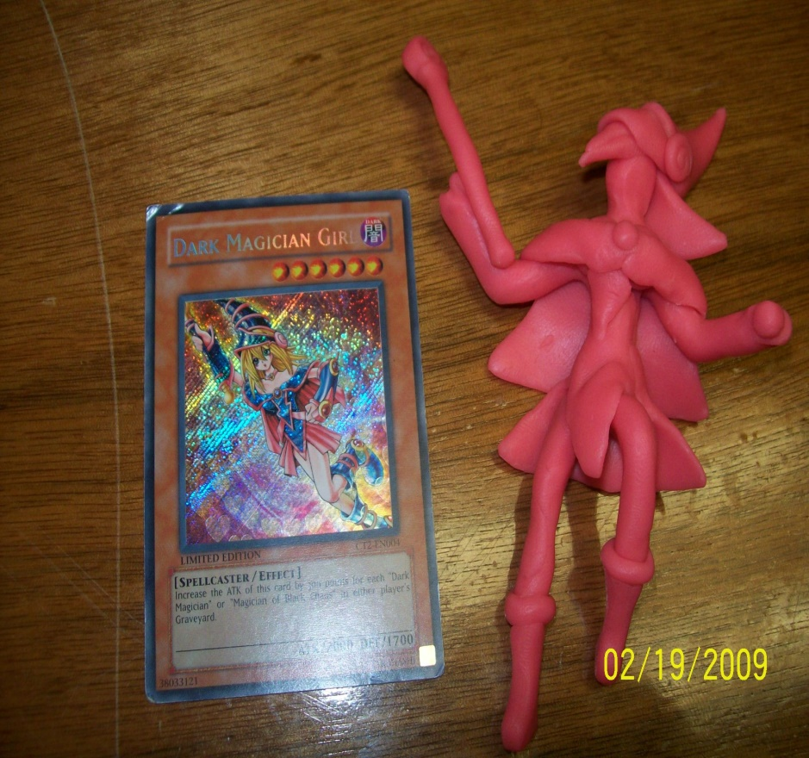
My Clay Model’s
Dark Magician
Dark Magician Girl

Slide 5

Any Question

Slide 6
Thank You

