Slide 1
Leche Flan
Janette Orosco
CO210-05

Slide 2
Ingredients
10 large eggs
1 can condense milk (14 oz.)
1 cup fresh milk or evaporated milk
1 cup sugar
1 teaspoon vanilla extract or lemon zest (optional)

Slide 3
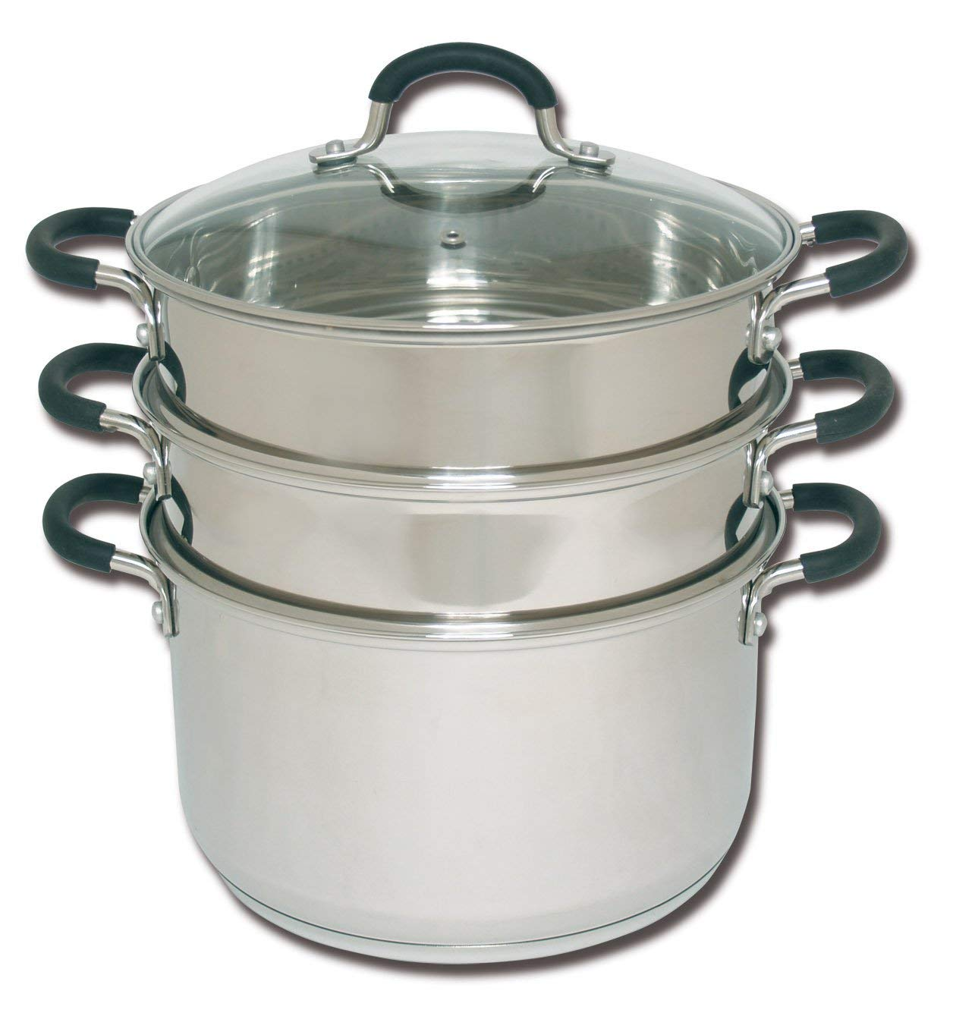
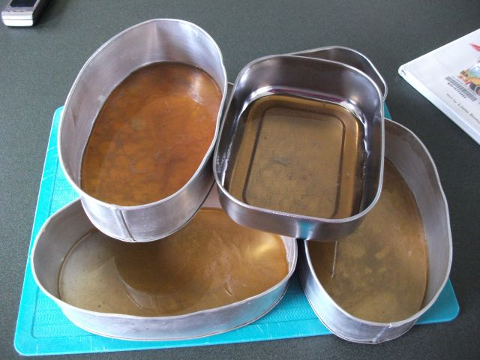
Equipment
Steamer
Ilanera (flan mold)
Measuring cup and spoon
Whisk or hand mixer
Strainer
Aluminum foil
Mixing bowl
Toothpick (optional)
Knife

Slide 4
Directions
1. Place 3 tablespoons in each aluminum mold. Place mold on top of the stove. Turn on stove and heat using low fire.
2. Mix thoroughly until the solid sugar turns into liquid (caramel) having a light brown color for 45 seconds.
3. Use the tong to hold the container and spread the caramel evenly on the flat side. Set aside for 5 min.

Slide 5
4. Separate the yolks from the egg whites. Place in a medium size mixing bowl and beat them with a whisk or a hand mixer.
5. Add condense milk and mix thoroughly. Then add the fresh milk and the vanilla extract. Mix well.

Slide 6
6. Use the strainer and pour in mixture into the mold containers then cover with a foil on top.
7. Place containers inside the steamer. Steam for about 30 to 35 minutes.
8. Let the flan cool and refrigerate to set.
9. To serve, run a knife around the mold and turn upside down onto a serving plate.

