Slide 1
How to Make Paper Snowflake in Two Different Ways
Alyssa Jean Pantaleon
CO210-05
Dr. Kimberly Bunts-Anderson

Slide 2
Materials
Paper
Duct tape (for outlining the circle)
Pencil
Scissors

Slide 3
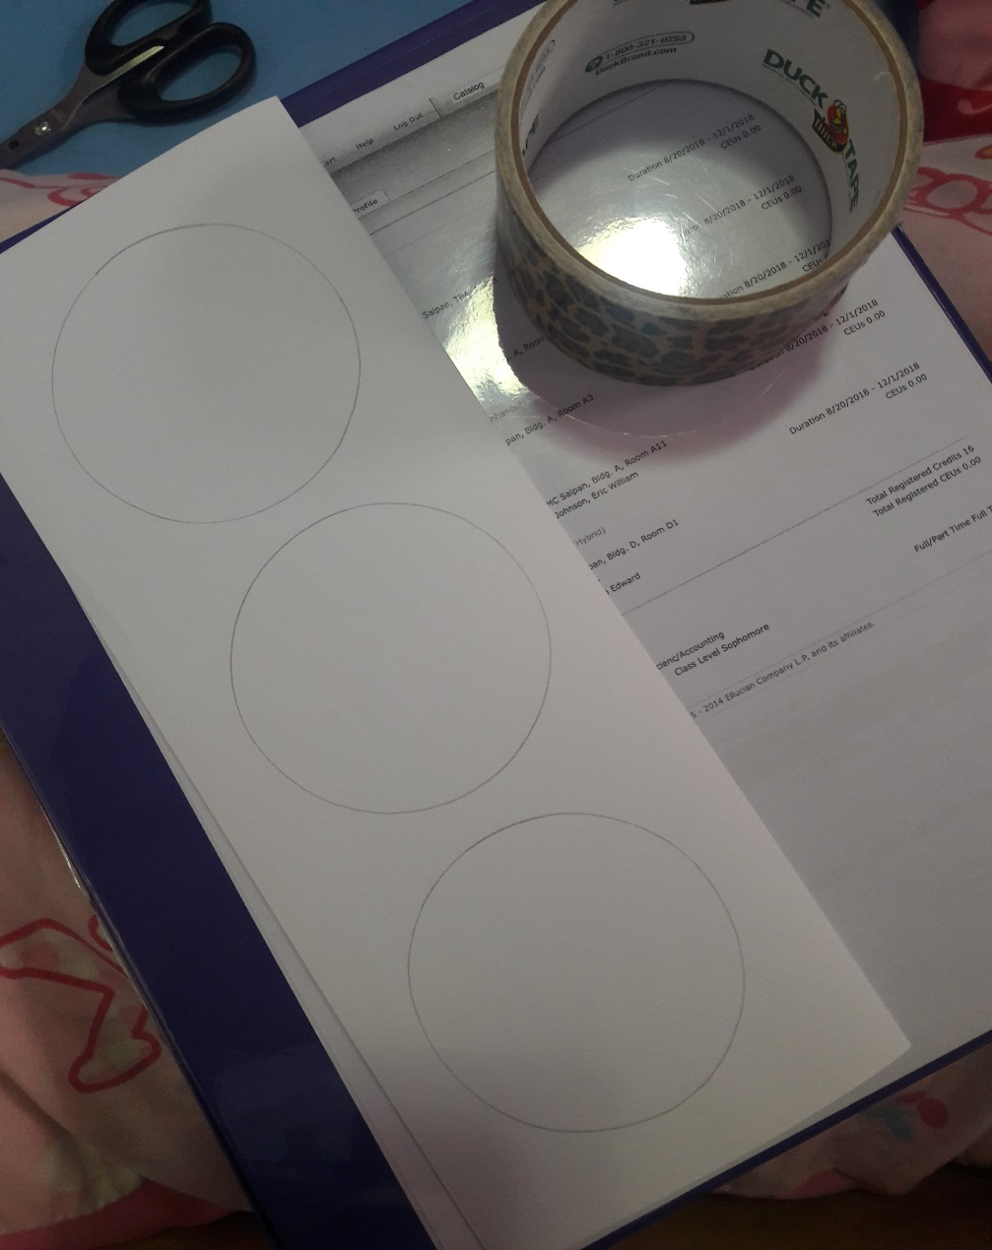
If you’re using a circular paper…
Step 1: Outline circles using a duct tape and pencil.

Slide 4
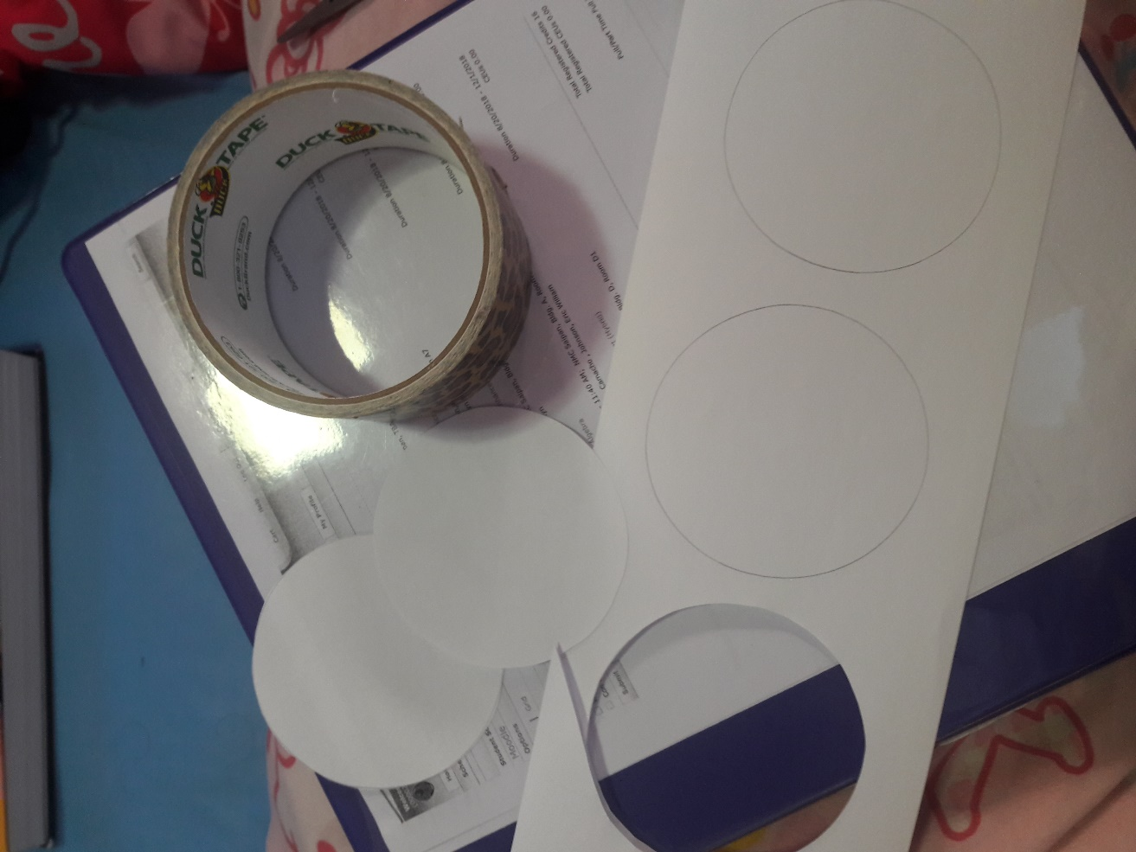
Step 2: Cut out the circles.

Slide 5
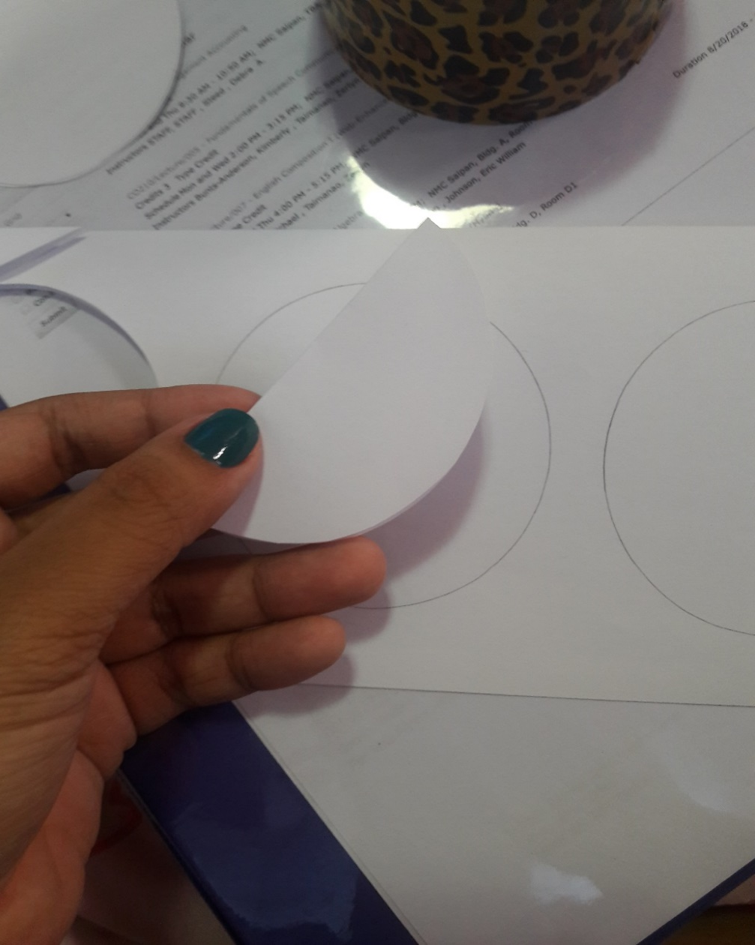
Step 3: When you’re done cutting out the circle, fold it in half.

Slide 6
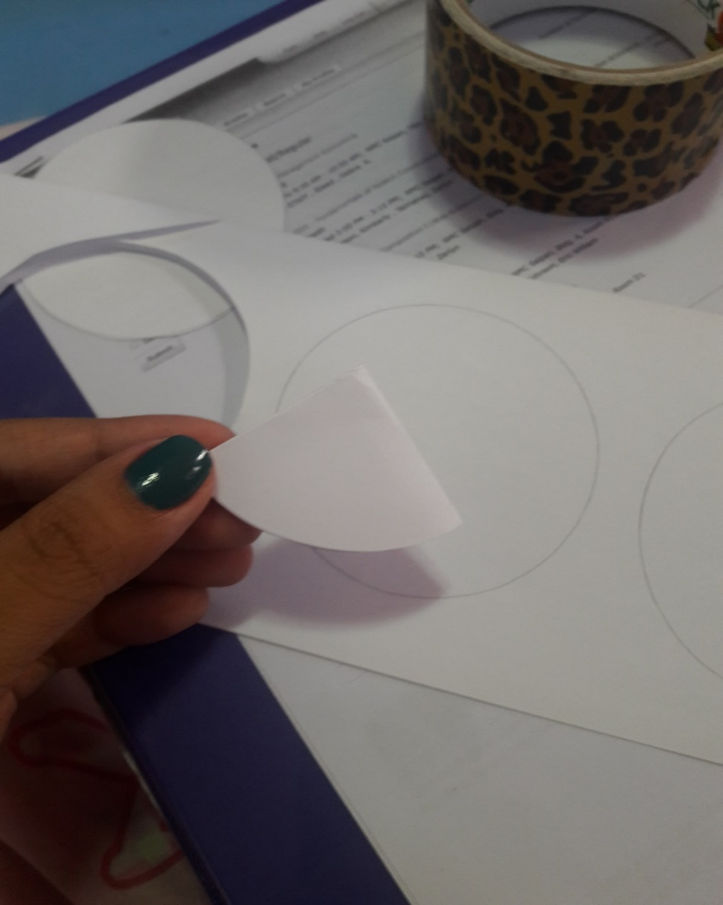
Step 4: Fold the circle in half again so it will look like a triangle shape.

Slide 7
Now for the fun part ☺
Step 5: You can cut out any shapes you like. If you want triangle designs, basically just cut out triangles on the side of the paper.

Slide 8
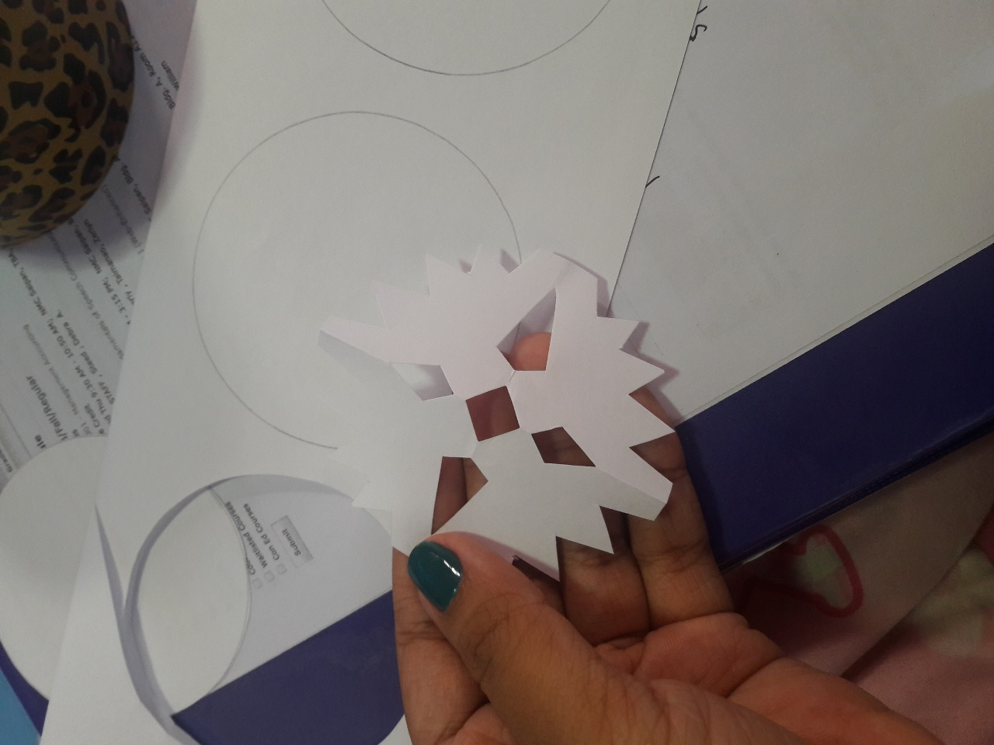
Step 6: When you’re done cutting out the shapes you like, unfold the triangle. After that, you have your own snowflake.

Slide 9
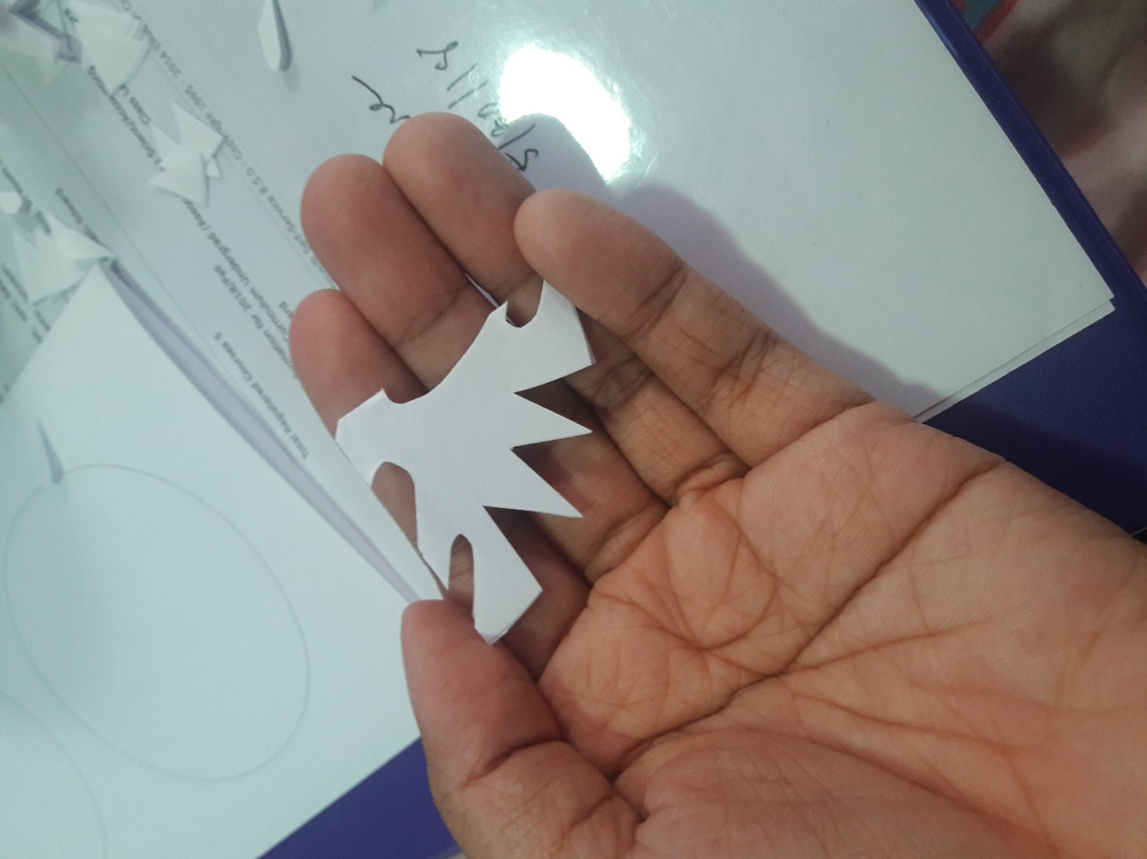
If you want a heart shape design, just repeat the first four steps. Then, cut a half heart shape on the sides, but be careful with the edges.

Slide 10
And…there you have it.

Slide 12
Question and Answer
What are some ways to make a paper snowflake?
What was the duct tape used for? (Hint: It’s not used for taping stuff.)
Name all the materials you need to make a snowflake.

Slide 13
Any Questions???

