Slide 1
CNMI’s Financial Situation WHAT DO YOU KNOW? SURVEY
Ryan Reyes
CO 210 - 04

Slide 2
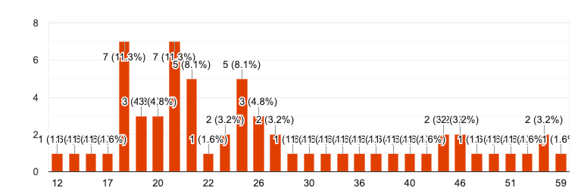
Age Results

Slide 3
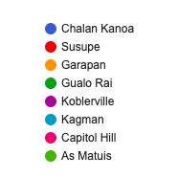
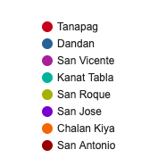
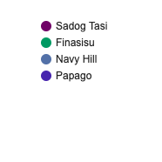
Village Results

Slide 4
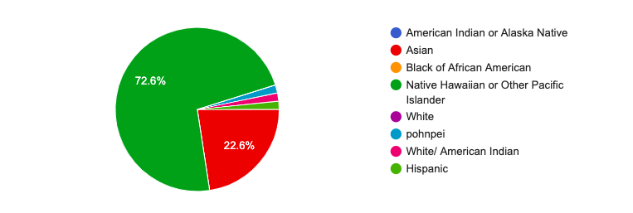
Ethnic Background Results

Slide 5
What do you know about the CNMI's current financial situation?
“It’s corrupt”
“Pay cuts and loss of overtime for government workers”
“The CNMI is broke because of spending money on unnecessary things.”
“Economy is taking a bit of a hit due to a number of factors including after effects of Super Typhoon Yutu and few visitors due to decreased visitor arrivals.”
“I guess we're barely floating above water hence, the Austerity measure.”

Slide 6
How do you feel about the government taking austerity measures?
“I feel that the government should not only take austerity measures but they should cut all spending at this time until the government can't figure out its financial situation. All unnecessary expenditure should halt at this time.”
“I feel confused because the current administration claimed to have the biggest budget in history but where did it all go to. This is the reason we are in this situation. It was all greed.”
“I think it's the right thing to do. It's a necessary cost cutting measure. I think there should be more hours cut from all agencies. CHCC can reduce all non-life threatening departments for the meantime. Services that can be provided by private clinics should be cut also. This gives revenue to private clinics. DPS can also cut hours. It's true that safety of the people cannot be compromised, but most of the time police officers are doing personal errands and work with no sense of urgency. Of course there are a few good ones. PSS keeps demanding for more...I think PSS are too spoiled. The raise they got was too excessive.”

Slide 7
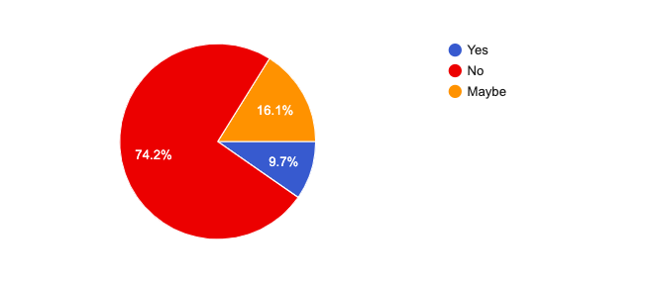
Do you believe that the government is transparent and honest about the CNMI's current financial situation?

Slide 8
What do you think is the best or suitable to rectify the CNMI's situation?
“Vote for people who have visions for the country. And stop re-electing candidates that had a bad reputation.”
“Have better plans for tourism and also add more for businesses.”
“I think that certain businesses should be taxed (casino), and the money should be allocated to much more important things such as the education of our students.”
“The Governor should suspend all official trips, stop hiring new Directors and paying certain individuals over the cap salary, they should also look at time and attendance of staff so that they can do some furlough.”
“Start investing in U.S companies and less of Chinese. The administration should grow some balls and stop being a lap dog for the casino....especially the gaming commission.”

Slide 9
How is the CNMI’s current financial situation affecting you?
“Family and friends who work in the government not getting paid on time or for all hours paid including the typhoon overtime pay.”
“Well, there are cuts being made on the budget that affects PSS, and this affects my learning environment.”
“I am not affected but I know many families who are.”
“As a graduating student this will affect me when looking for a job. If our government is cutting the budget there is a guarantee there will be no jobs available at the moment.”
“It's not only affecting me, it's affecting the whole people of this great CNMI!!... austerity, and medicaid.”

