Slide 1
Coffee vs. Energy Drinks
Jefferson Mateo
EN202-02
May 8,2018

Slide 2
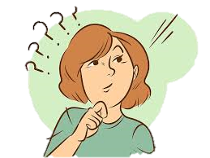
Research Question
Which beverage: coffee or energy drinks, helps a student stay awake in class?
Which beverage is a healthier choice?

Slide 3
Literature Sources
Scholarly Articles
Medical News Today
Healthline
Psychology Today

Slide 4
Methodology
Interview with an expert
Survey for students
Read online articles

Slide 5
Interview with an expert
Dr. Jessica Delos Reyes
Registered dietitian for 14 years
Graduated from Michigan State University with her B.S. in Dietetics and received her Masters of Public Heath with a concentration in Prevention Science from Emory University in Atlanta, GA.
7 questions were asked.
Interview via email.

Slide 6
Survey
Quantitative Research
Google Forums
122 Respondents
23 Questions
8 demographic questions
8 questions for who prefer coffee
6 questions for who prefer energy drinks
1 bonus question

Slide 7
Online Articles
Qualitative Research
Compared survey responses to literature.

Slide 8
Findings
Coffee
Energy Drinks
Popular, psychoactive drug
Lowers the risk of diseases
300 mg a day
Self-made or made
Black = 2 calories
Water, 2-Ethylphenol,quinic acid, Dicaffeoylquinic acid, Niacin, Trigonelline, Putrescine, Acetylmethylcarbinol, and Dimethyl disulfide
Targeted to children and college students
Improve brain function
Help people function when tired
Possible cause of heart problems
Lots of sugar = increase in blood sugar
drinks are sodium compounds, guarana, sugars, taurine, glucuronolactone, B-vitamins, ginseng, gingko biloba, antioxidants, and trace minerals.

Slide 9
Discussion

Slide 10
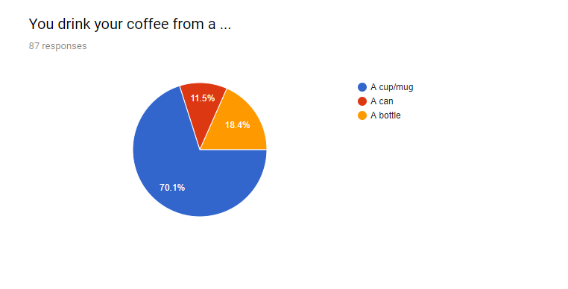
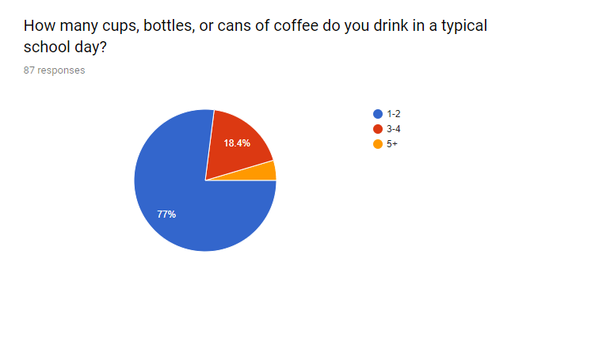
According to Catherine Paddock, a moderate amount of coffee would be 3-4 cups of ground roasted coffee, and 5 cups for instant coffee mix a day.

Slide 11
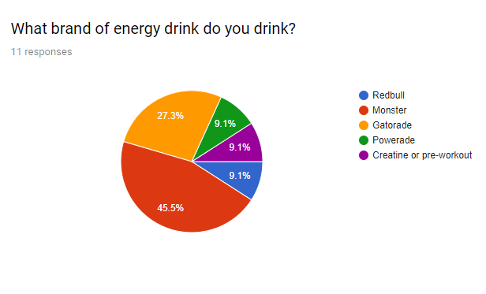
“Despite how popular energy drinks are, the term “healthy energy drink” is still an oxymoron,” say RD, Natalie Bulter.

Slide 12
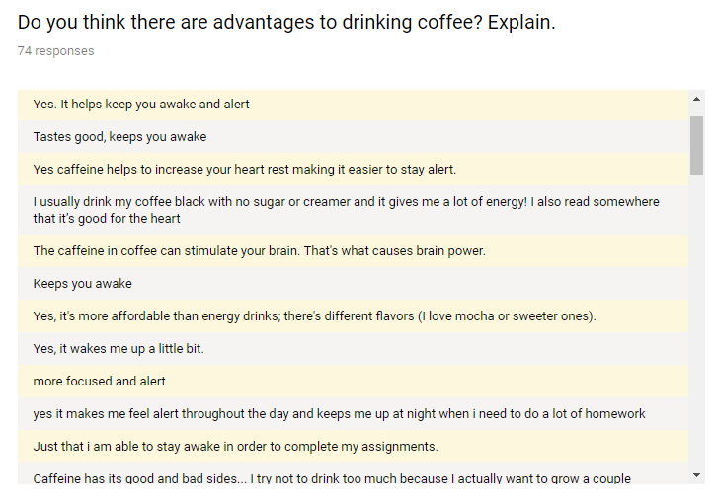
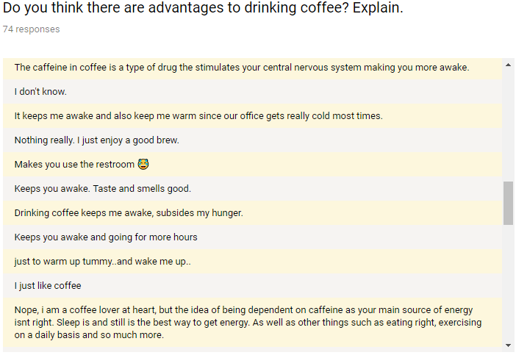
“Keeps you awake”
“Yes, it’s affordable…”
“Makes you use the restroom”
“I don’t know”
“Nothing”

Slide 13
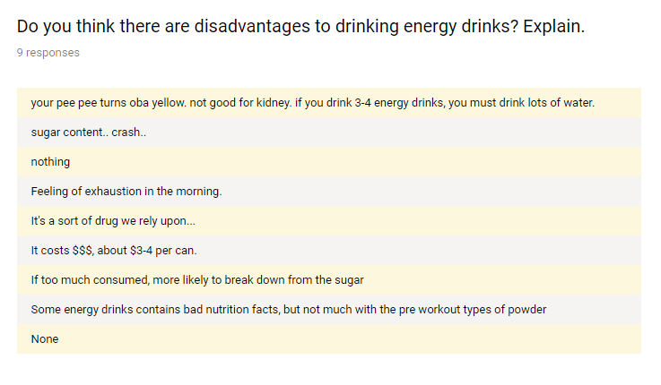
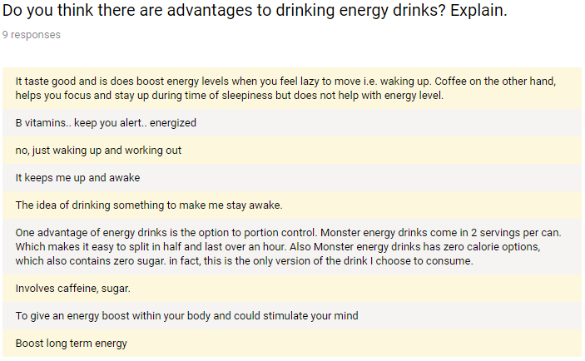

Slide 14
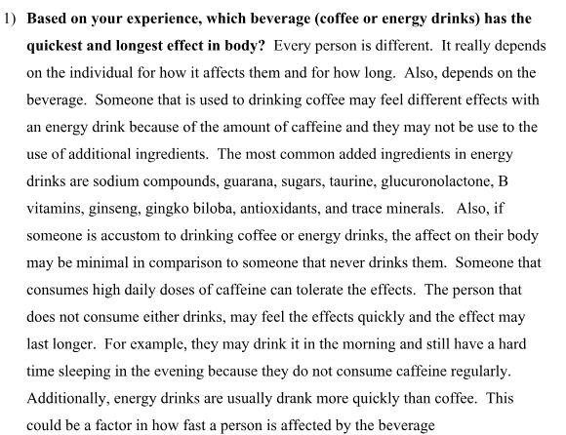
Conclusion
THERE IS NO PROVEN STUDY !!!
!
!

Slide 15
Conclusion
Energy drinks seem to be the most effective stimulant, but energy drinks have less caffeine in it. That is because energy drinks do not only contain caffeine, but other nasty ingredients. Coffee on the other hand is natural. The data collected was a success, but also a fail. More respondents would support this research study more. The literature was more than enough, and the interview responses helped a bit, putting new perspectives in mind. Overall, the researcher gained knowledge with experience in conducting an effective survey with a big population. Also, the researcher learned new interesting information that he can later share with others.

