Slide 1
Community Issues Project (Fish Canning Alternative)
Ainah Lizave Tomokane Chargualaf
Fundamentals of Speech: CO210-VR03
Northern Marianas College
Dr. Kimberley Bunts-Anderson
12/09/2020

Slide 2
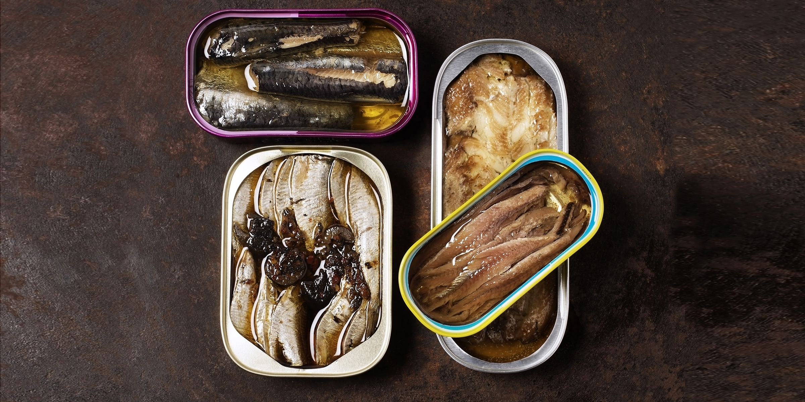

Slide 3
Heavy Reliance on Tourism
History of Tourism in the CNMI
Proposed fish canning industry alternative for Saipan
How much the economy has lost with the tourism industry because of COVID-19

Slide 4
Did you know that the CNMI has a $40-million loss in revenue from tourism?

Slide 5
Additional Alternatives

Slide 6
References
Carreon-Brooks, B. (2020, June 8). Small-scale tuna canning training in Palau starts next week. FFA's TunaPacific: Fisheries news and views. https://www.tunapacific.org/2019/09/20/small-scale-tuna-canning-training-in-palau-starts-next-week/.
Del Rosario, J. S. (2020, March 5). Effects of coronavirus. Saipan Tribune. https://www.saipantribune.com/index.php/effects-of-coronavirus-2/.
Todiño, J. B. (2019, December 29). Coronavirus outbreak bad for tourism. Marianas Variety. https://www.mvariety.com/cnmi-local/73-local/1302-coronavirus-outbreak-bad-for-tourism.
Villanueva-Dizon, Frauleine S. (2016, February 11). MVA Celebrates 40 Years of Tourism Industry. Saipan Tribune. www.saipantribune.com/index.php/mva-celebrates-40-years-of-tourism-industry/.

