Slide 1
We Should Legalize Marijuana in the CNMI
Lin Zhou and Rachelle Manlapaz
CO210-02
Instructor: Dr. Kimberly

Slide 2
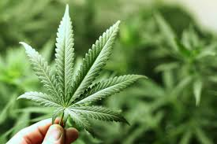
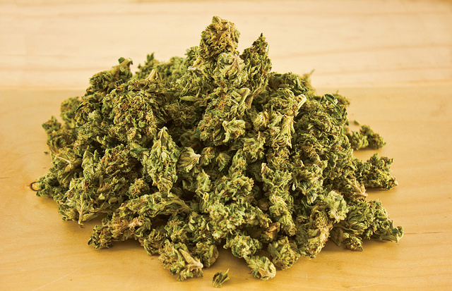
Marijuana

Slide 3
Advantage to workers in the Department of Public Safety

Slide 4
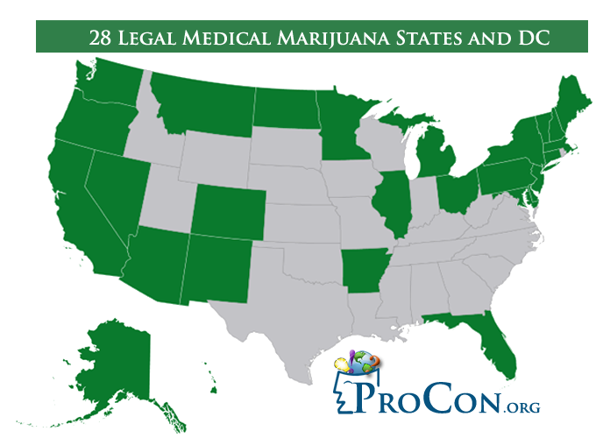
Opportunity of increase in revenues

Slide 5
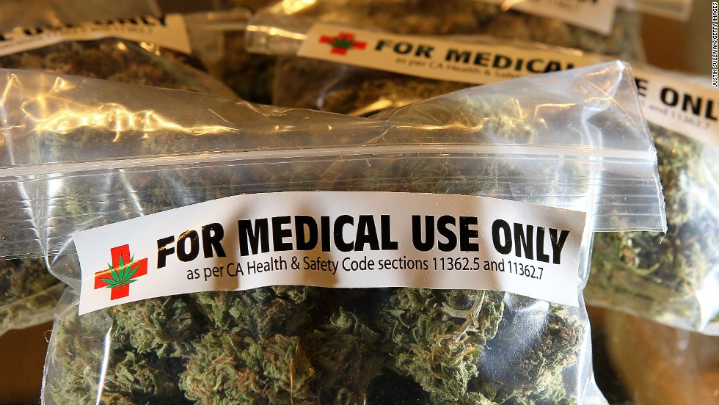
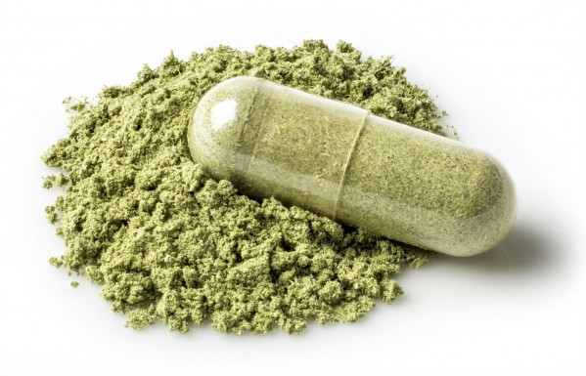
Medicinal use

Slide 6
SAY YES TO LEGALIZING MARIJUANA. SAY YES TO SENATE BILL 19-106.

Slide 7
References
28 Legal Medical Marijuana States and DC Laws, Fees, and Possession Limits – Pro Con (n.d.). Retrieved October 25, 2016) from http://medicalmarijuana.procon.org/view.resource.php?resourceID=000881&print=true
Marijuana (Cannabis): Facts, Effects, and Hazards – Medical News Today (n.d.). Retrieved October 25, 2016 from http://www.medicalnewstoday.com/articles/246392.php
Zimmer, L. E., & Morgan, J.P. (1997). Marijuana myths, marijuana facts: A review of the scientific evidence. New York: Lindesmith Center. October 25, 2016

Slide 8
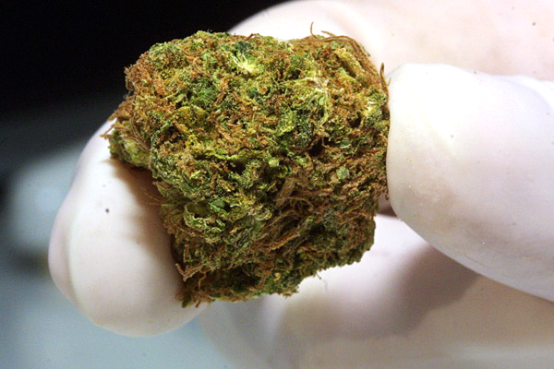
What is Marijuana?
"Marijuana refers to the dried leaves, flowers, stems, and seeds from the hemp plant, Cannabis sativa. The plant contains the mind-altering chemical delta-9-tetrahydrocannabinol (THC) and other related compounds" (Zimmer & Morgan, 21). These are the words from the book Marijuana Myths Marijuana Facts.

Slide 9
Reasons of Legalizing Marijuana

Slide 10
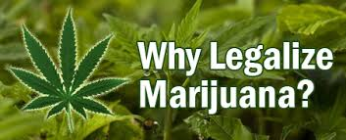

Slide 11
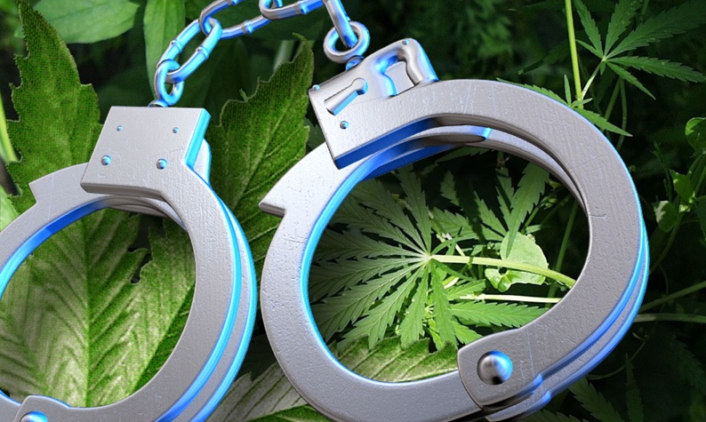
Reduce Crime Rate

Slide 12
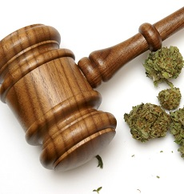
Boost Revenue

Slide 13
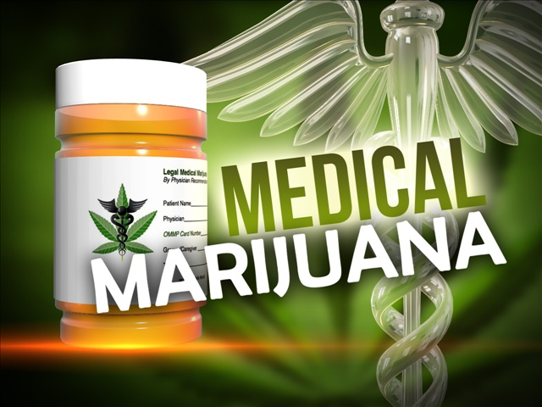
Medical Use

Slide 14
Reference
"Drug Facts: Mariana." (2016, March/April). National Institute on Drug Abuse.
“Impact of weeds.” (n.d.). Australian Government.
Zimmer, L. E., & Morgan, J. P. (1997). Marijuana myths, marijuana facts: A review of the
scientific evidence. New York: Lindesmith Center.

