Slide 1
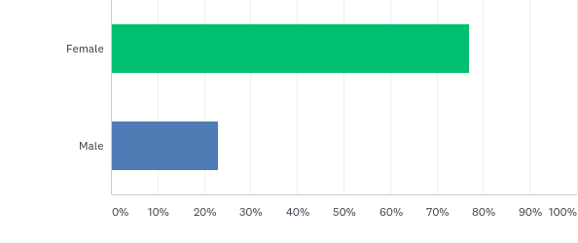
Q1: What is your gender?
Answered: 13 Skipped: 0

Slide 2
Q1: What is your gender?
Answered: 13 Skipped: 0

Slide 3
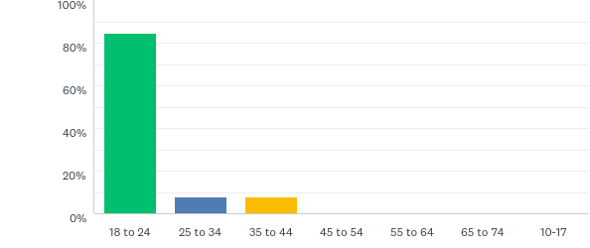
Q2: What is your age?
Answered: 13 Skipped: 0

Slide 4
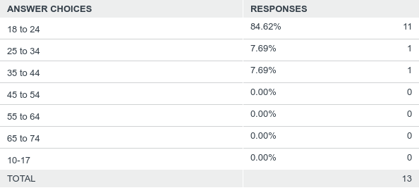
Q2: What is your age?
Answered: 13 Skipped: 0

Slide 5
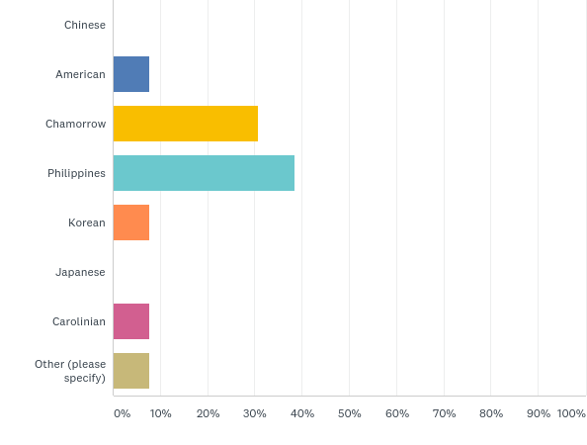
Q3: What is your nationality
Answered: 13 Skipped: 0

Slide 6
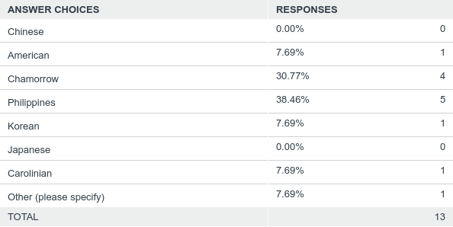
Q3: What is your nationality
Answered: 13 Skipped: 0

Slide 7
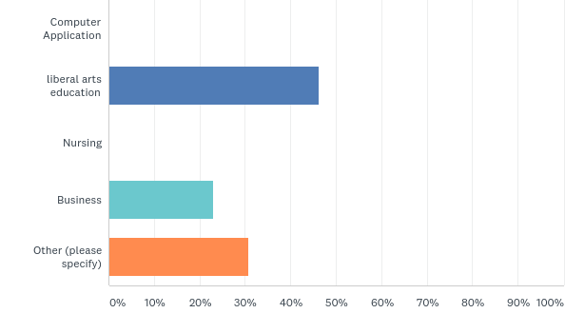
Q4: What is your Major?
Answered: 13 Skipped: 0

Slide 8
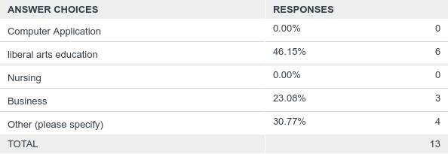
Q4: What is your Major?
Answered: 13 Skipped: 0

Slide 9
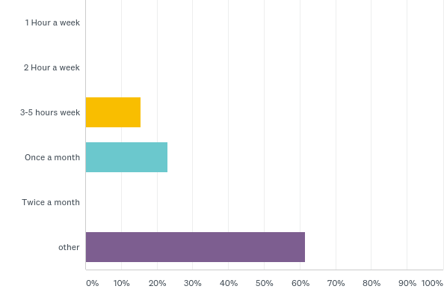
Q5: How much time do you spend in the computer lab?
Answered: 13 Skipped: 0

Slide 10
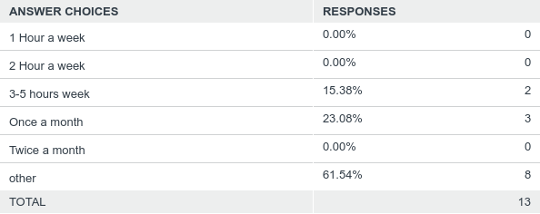
Q5: How much time do you spend in the computer lab?
Answered: 13 Skipped: 0

Slide 11
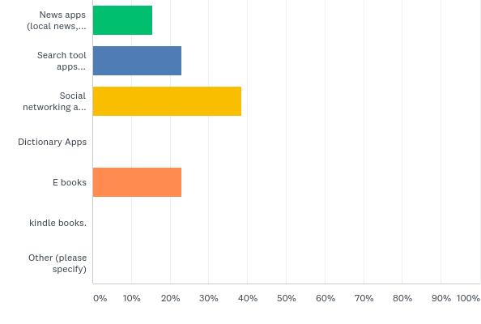
Q9: Which types of apps do you use on your digital devices (computer, tablets, phones, etc.) most often?
Answered: 13 Skipped: 0

Slide 12
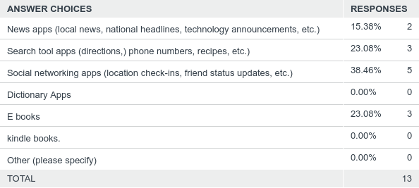
Q9: Which types of apps do you use on your digital devices (computer, tablets, phones, etc.) most often?
Answered: 13 Skipped: 0

Slide 13
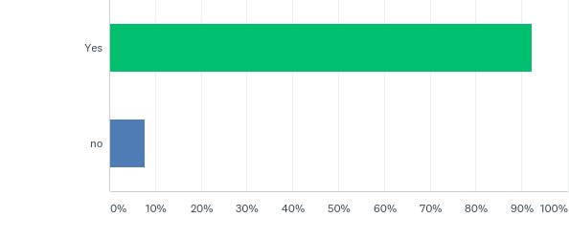
Q11: Do you have a computer at home?
Answered: 13 Skipped: 0

Slide 14
Q11: Do you have a computer at home?
Answered: 13 Skipped: 0

Slide 15
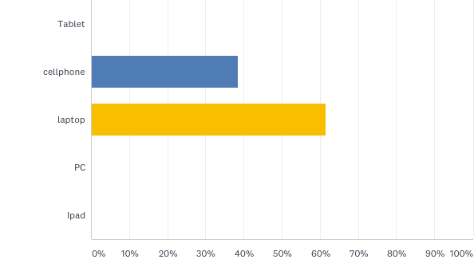
Q14: What type of technology device do you use?
Answered: 13 Skipped: 0

Slide 16
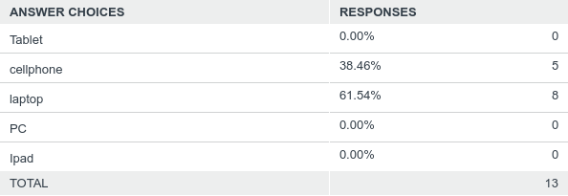
Q14: What type of technology device do you use?
Answered: 13 Skipped: 0

