Slide 1
How to make fried oreos
Niomi deleon guerrero
Co210-04

Slide 2
Ingredients:
2 quarts vegetable oil for frying
1 large egg
1 cup milk
2 teaspoons vegetable oil
1 cup pancake mix
1 (18 ounce) package of Oreos (vanilla, chocolate, etc.…)

Slide 3
Step 1:

Slide 4
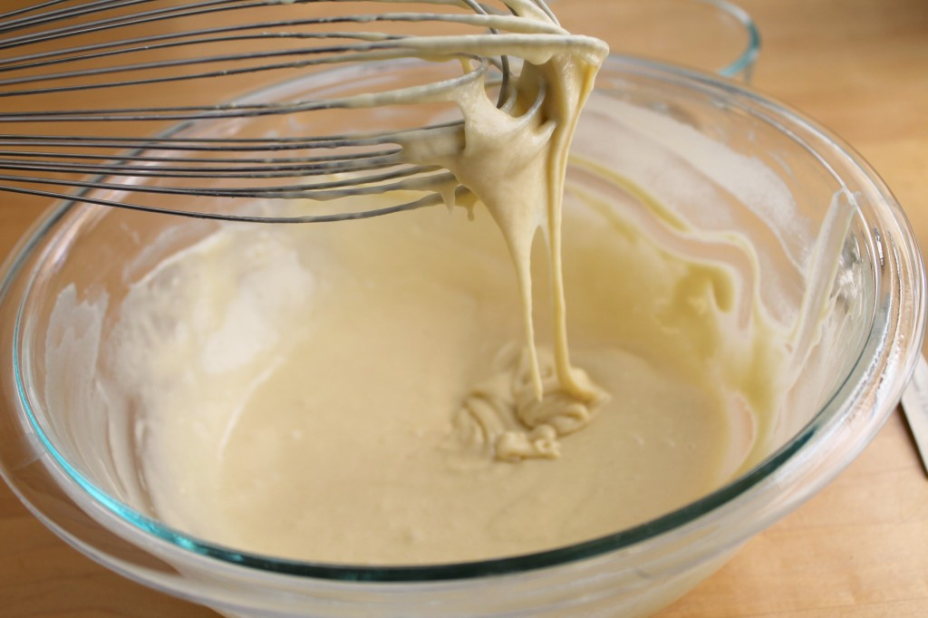
Step 2:

Slide 5
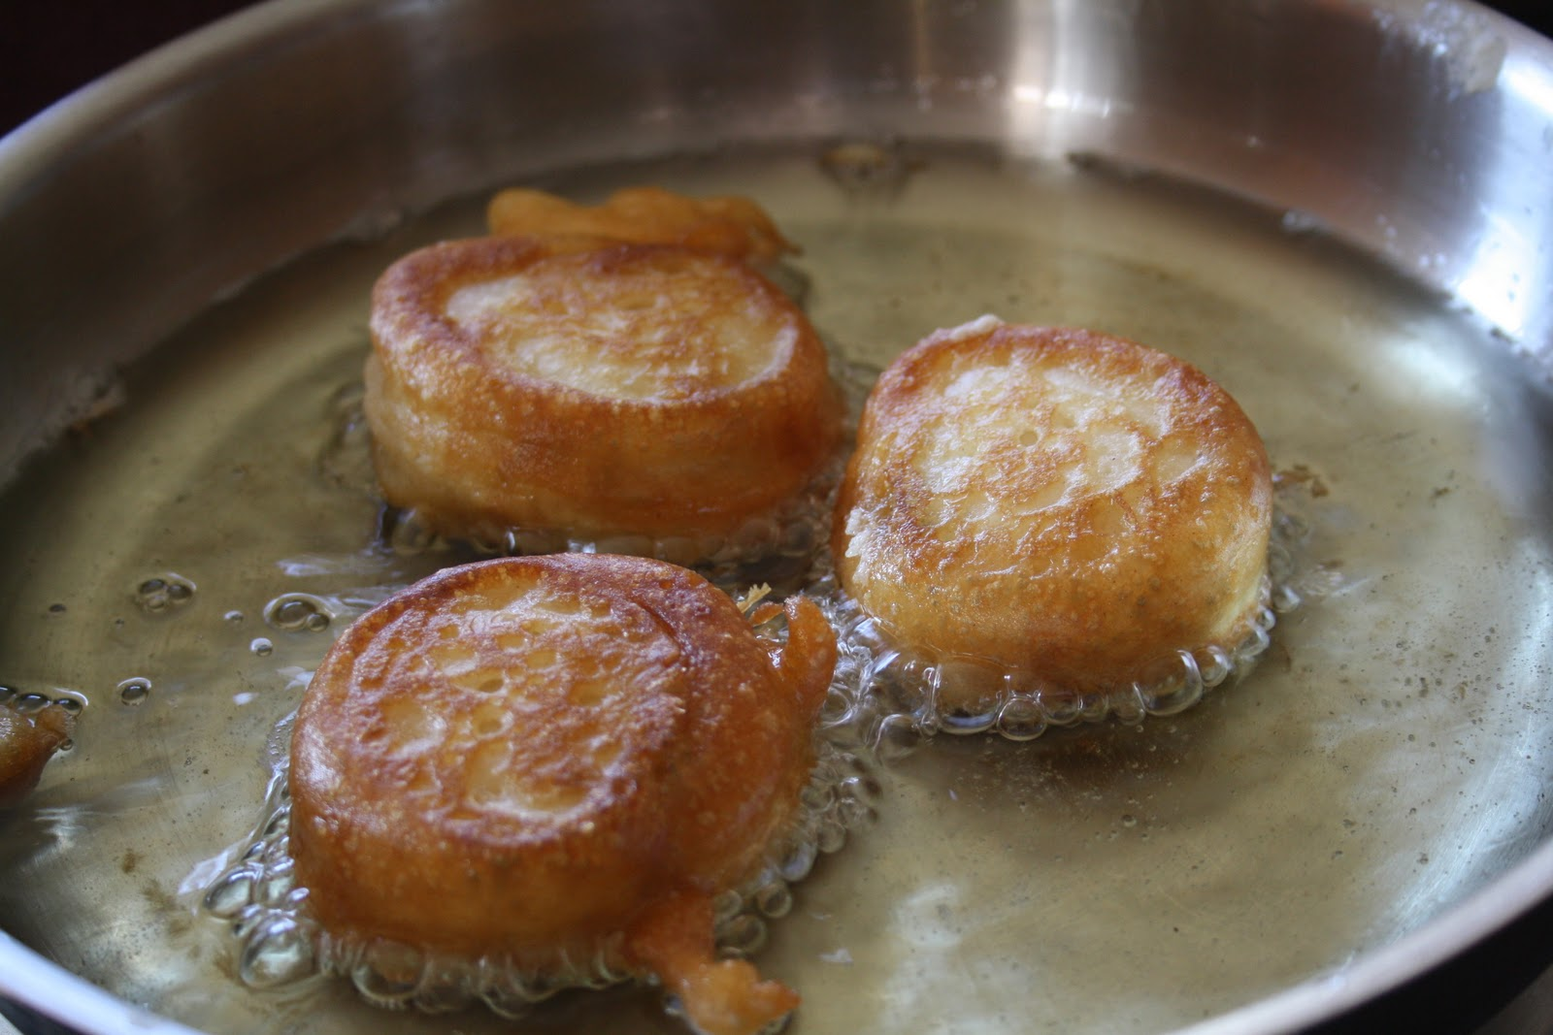
Step 3:

Slide 6
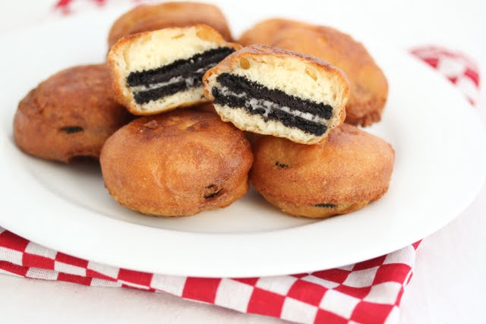
Step 4:

