Slide 1
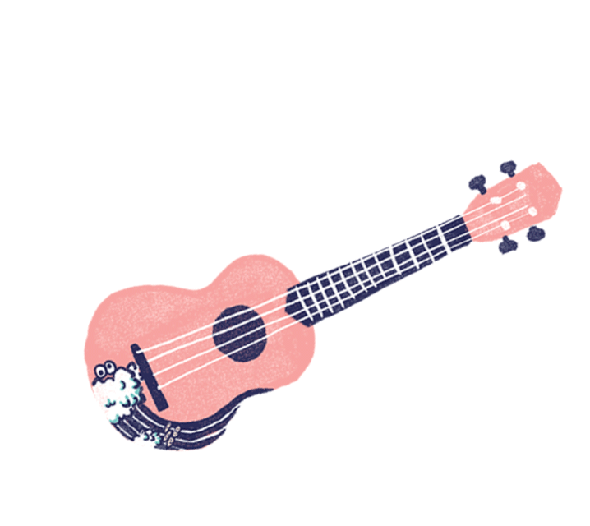
HOW TO PLAY
4 SIMPLE CHORDS ON THE UKULELE
Notes:
And today I will be demonstrating, how to play 4 simple chords on the ukulele

Slide 2
100+ SONGS
4 CHORDS
Notes:
What if I told you that you could learn how to play hundreds of songs on the ukulele with just 4 chords?
today, I will be teaching you guys just how to do that.
BRIEF EXPLANATION
-We will be learning how to play four easy ukulele chords and and how to play this chord progression along with many popular songs.

Slide 3
THE UKULELE
Notes:
Alright so first things first, the ukulele
You have here the head, neck, and body
And on the neck you have the fretboard CHANGE SLIDE

Slide 4
STRING 1
STRING 2
STRING 3
STRING 4
FRETS: 1 2 3 4 5 ~
Notes:
Which contains the frets and the strings
So the frets are spaces between these bars, this is where you place your fingers to play the chords
And here you have your 1st, 2nd, 3rd, 4th String
Finger placement for playing chords is also important, its also very easy once you get the hang of it,
ALSO So when you play the uke, we call this finger your 1st finger, 2nd finger, and 3rd finger.
LIKE FOR EXAMPLE

Slide 5
3
STRING 1
STRING 2
STRING 3
STRING 4
FRETS: 1 2 3 4 5 ~
Notes:
For example: the C Chord - To play this you place 3rd finger on the first string of the 3rd fret
just like graphing points in math class.

Slide 6
G D Em C
Notes:
Okay so, The 4 chords i will be teaching you guys today are
G chord (play chord)
D chord (play chord)
Em chord (play chord)
C chord (play chord)
As we go along I’d like you guys to copy the rest of these chords onto your chord charts that I’ve handed out previously as notes

Slide 7
G
1
2
3
Notes:
This is how the g chord looks like
You place your first finger on the 3rd string of the 2nd fret, 2nd on the first string of the 2nd fret, and 3rd finger on the 2nd string of the 3rd fret
It sounds like this

Slide 8
D
1
2
3
Notes:
This is the D chord
You bar the 4th, 3rd, and 2nd string of the 2nd fret
This is how it sounds like

Slide 9
Em
1
2
3
Notes:
This is the E MINOR chord
1st finger on the 1st string of the 2nd fret, 2nd finger on the 2nd string of the 3rd fret, and 3rd finger on the 3rd string of the 4th fret

Slide 10
C
3
Notes:
Finally this is the C Chord
You place your 3rd finger, or any finger actually, it doesnt really matter for this chord, on the 1st string on the 3rd fret

Slide 11
G
D
Em
C
Notes:
This is called a chord progression and this is how it sounds like all together.
You can strum however you want. It doesn’t really matter because all songs have different beats and tempos, so just go with the flow.
Now that Ive shown you the chords, Im going to test you guys a little bit just to see if you guys got it. You can use your notes, but try not to.

Slide 12
Notes:
G

Slide 13
Notes:
D

Slide 14
Notes:
C

Slide 15
Notes:
Em

Slide 16
NOW YOU CAN PLAY THESE SONGS!
Where is the Love - The Black Eyed Peas
Forever Young - Alphaville
I’m Yours - Jason Mraz
Hey Soul Sister - Train
Best Friend - Jason Chen
Marry Your Daughter - Brian Mcknight
Say You Won’t Let Go - James Arthur
In My Head - Jason Derulo
So Sick - Neyo
FourFiveSeconds - Rihanna, Kanye, McCarthy
Marry Me - Jason Derulo
Lost In Japan - Shawn Mendes
Sit Still Look Pretty - Daya
Don’t Matter - Akon
Perfect - One Direction
Can You Feel the Love Tonight - Lion King
Walks Like Rihanna - The Vamps
1 SIDED LOVE - blackbear
Not a Bad Thing - Justin Timberlake
Paparazzi - Lady Gaga
One Number Away - Luke Combs
Don’t Stop Believin’ - Journey
Take Me Home, Country Roads - John Denver
25 Minutes - Michael Learns to Rock
Photograph - Ed Sheeran
She Will Be Loved - Maroon 5
If I Were a Boy - Beyonce
No One - Alicia Keys
Right Here Waiting - Richard Marx
Someone Like You - Adele
California King Bed - Rihanna
Young, Dumb & Broke - Khalid
Kissin U - Miranda Cosgrove
No Scrubs - TLC
Girls Like You - Maroon 5
AND MANY MORE!
Notes:
Now that you know how to play these 4 simple chords, you can play all these songs and many more!
SUMMARY
So again the only 4 chords you need to know are the G, D, Em, and C Chords. These 4 chords can be played in different ways as well, so don’t feel limited to play however you want to
So it doesnt matter if youre a beginner or a pro, knowing how to play these 4 chords will make you the LIFE OF THE PARTY!
ASK FOR QUESTIONS

Slide 17
THANK YOU!

