Slide 1
How to pick the right Computer
Zachary Joshua Bocboc Tomokane

Slide 2
What are the Differences?
Some computers or devices, in-general, are not created equal. Each computer has different types of components, some computers are built differently, and some computers cost differently.
However, everyone is different, and as such, there are different kind of computers for every individual. From the different models of desktops & laptops to the amount of money you might consider or be spending on your ideal computers.
For my ideal computer, the computer would cost around $1,000 for something that would suit my needs as an artist, a student, and a gamer.
I am not going to talk about mobile devices like tablets and such because those don’t count in my world!

Slide 3
Before anything, consider yourself first.
What are my needs?
Am I on the go at all times or do I work at the comfort of my own home?
What am I expecting to do with my computer?
Do I even have the budget to afford my ideal computer?

Slide 4
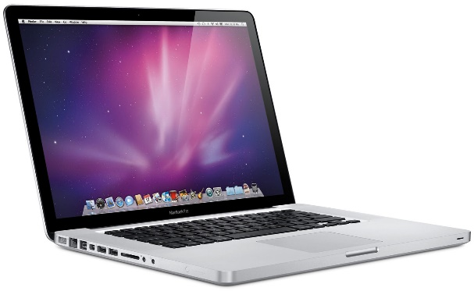
Desktop? or Laptop?
Desktops are the behemoths of technology. In my mind, these computers are the overall best.
Laptops are the brave foot soldiers of technology.
Desktops generally last longer while being great for anyone who enjoys working at home.
Laptops can be carried around even on your own arms while being practical for almost everyone.

Slide 5
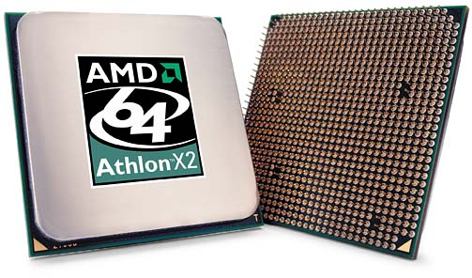
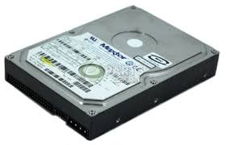
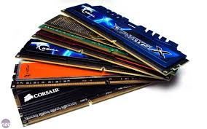
System Specs
System Specs are like the brains, muscle, and blood of computers.
Or in this case the Processor (CPU), the hard drive, and the memory (RAM).
The memory or RAM is the capabilities of the computer. The memory determines the effectiveness of the computer. The better the memory, the more effective the computer is while doing multiple tasks at once. The lowest memory is around 4 GB while the highest is around 16 to 32 GB.
The processor is the brain of the computer. The processor gives instructions to the computer to tell it what to do whatever the user wants it to do.
The hard drive is the storage unit of the computer. The hard drive stores and receives data, software and files. The minimum hard drive size is 500GB while the maximum size is around 2 TB.

Slide 6
Your Budget
Because you need money to buy the computer.
Prices may vary depending on the model of the computer, the system specs, and the brand from the company.
The cheapest from a brand company such as Dell, Asus, and Toshiba range around $500 while the most expensive range around $1000 or $2000 possibly more.

Slide 7
Just Remember…
Like people, every computer is different.
You just need to find the one that is right for you.
Consider what build you need most, what specs you want in your computer, and would you be able to afford it?

