Slide 1
KNOW THE DIFFERENCE!
Systolic BP
Diastolic BP
The highest arterial blood pressure of a cardiac cycle occurring immediately after systole of the left ventricle of the heart
The FIRST THUMP!!
The minimum arterial pressure during relaxation and dilatation of the ventricles of the heart when the ventricles fill with blook
The LAST THUMP!!
EX:
A/B
120/80

Slide 2
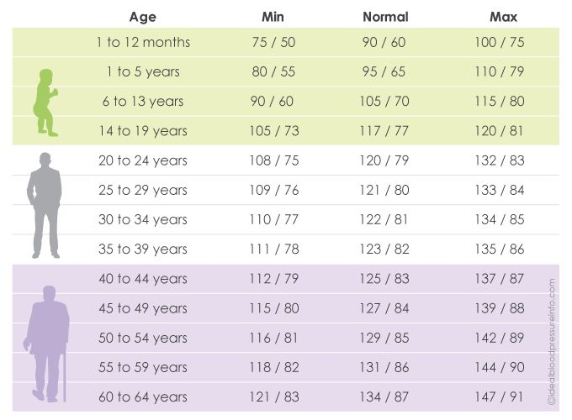
Normal BP within Ages:

