Slide 1
Domestic Violence Prevention Awareness
(Presentation II)
By: John David Reyes

Slide 2
Primary Research Question
How well do citizens in the CNMI understand domestic violence and methods in preventing domestic violence?
Everyone should know how to prevent domestic violence in the community

Slide 3
Secondary Research Questions
How many households are affected by domestic abuse? Why is domestic abuse not being reported? How long does domestic abuse go on for before being reported?
I chose these questions as my secondary questions because they will go further into detail of the topic without straying too far away from the main question.

Slide 4
Methodology
The main method of research used in this research project was using surveys
The survey conducted included 45 participants
10 Questions were included in the survey
The average time for completion on the survey was 3 minutes and 48 seconds
Questions were asked to the participants on the topic of domestic violence and prevention methods to see whether they understood what was the correct thing to do and if they were aware of how domestic violence starts.

Slide 5
Question Types
There were a total of 10 questions asked on the survey, however one out of the 10 asked for their gender and age.
Four out of the 10 were focused on domestic violence and whether the participants understood what it was.
The last five focused on domestic violence prevention and whether the participant understood what starts domestic violence

Slide 6
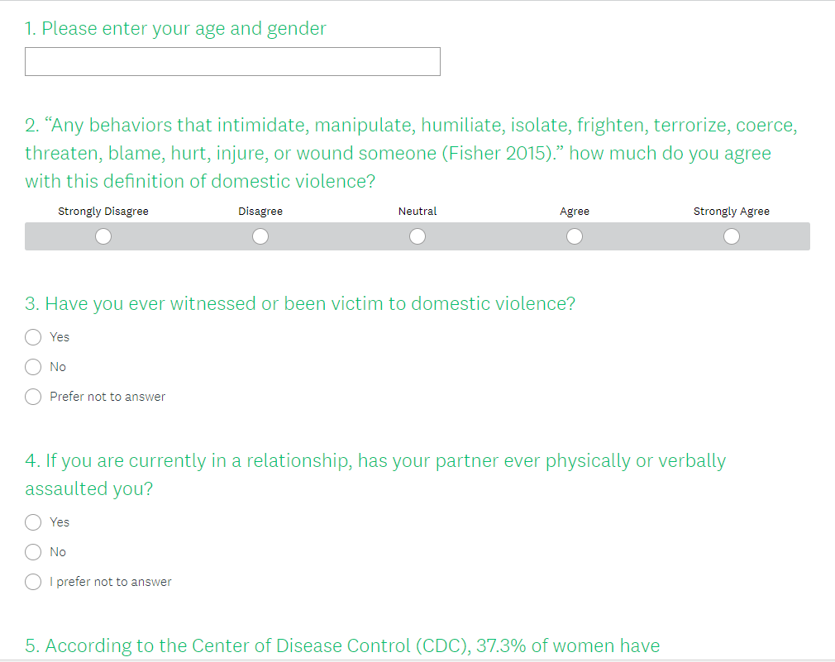
Survey Questions

Slide 7
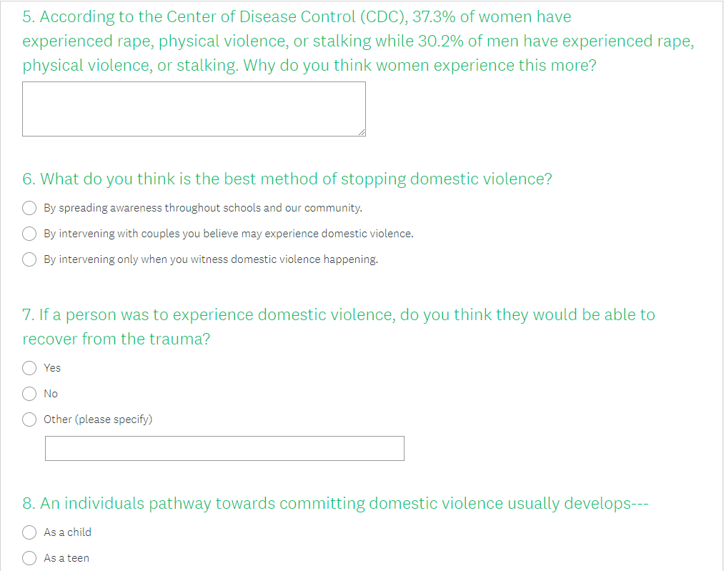
Survey Questions Cont.

Slide 8
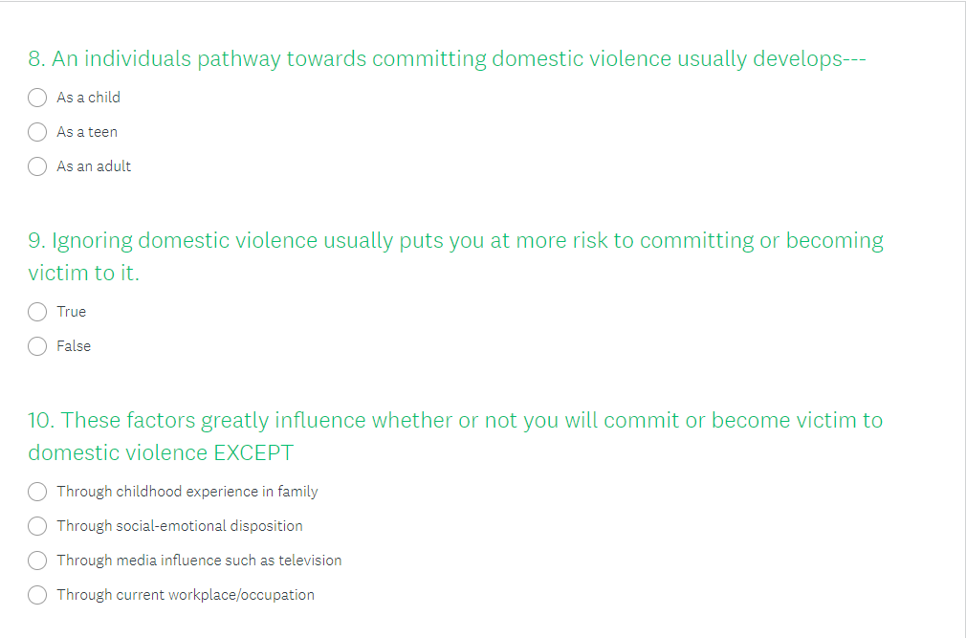
Survey Questions Cont.

Slide 9
Suggestions
Increase in the number of questions
Increase variety of questions (Not all secondary questions answered)
Use more methods in order to create more data for analyzation
Interviews
Observations
Letters to experts

Slide 10
Findings
When asked direct questions about domestic violence towards their personal lives, 8% of the participants chose not to answer while the other 92% proceeded to answer the questions. Due to the anonymity of the survey, participants felt more comfortable to reveal personal experiences with the researcher through the survey.
When asked for a written response as to why the participants feel like women experience rape, physical violence, or stalking more than men, most of the participants wrote mainly on “physical build” or “mental manipulation.”
The participants’ knowledge of domestic violence prevention had a weighted average of correct responses towards domestic violence prevention methods was 62.91%. This number is more than expected from the beginning of the research report with an estimation of ~20%.

Slide 11
Findings Cont.
After thorough analyzation and evaluation of the results, it can be implied that the people of the CNMI are somewhat aware of ways to prevent domestic violence
An average of 62.91% of the participants had understood the concept of domestic violence and how to prevent it, however this number could be improved through various future research and policy implementation.

Slide 12
Analysis
In the article, Preventing Intimate Partner Violence Across the Lifespan: A Technical Package of Programs, Policies, and Practices, written by Phyllis Niolon et al., it strongly emphasizes that the pathway towards domestic violence starts in most cases as a child.
As seen in the survey, 75% of the participants chose the correct answer which is that the pathways towards domestic violence does indeed start as a child.

Slide 13
Analysis Cont.
In the article Preventing Intimate Partner Violence Across the Lifespan: A Technical Package of Programs, Policies, and Practices, written by Phyllis Niolon et al., it specifically states that all of these factors affects domestic violence EXCEPT for media influences.
Only 20% of the participants answered this question correctly, most of those answered through workplace/occupation.

Slide 14
Analysis Cont.
In the article written by Constance Massey-Hight, Characteristics of Domestic Violence: The Controversy over Age or is It Something Else?, it states that those who ignore domestic violence going on in the community will make other feel like it is an okay thing to do.
The participants answered this question with an average of 70% answering the question correctly.

Slide 15
Strength and Weakness of Approach
Strengths
A lot of data collected
Very little cost to resources (Money, Time, etc.)
Easy to get a lot of participants through sharing online
Weaknesses
Participants anonymity (Hard to connect data with actual cases)
Difficult to think of good questions for the survey

Slide 16
Post Research Thoughts

Slide 17
Suggestions
What I would do differently in this research report would be to add more questions on my survey in order to add more data and collect more results
Only 5 of my questions were aimed at my actual research questions (Adding more would significantly change the weighted average)
I would explore into different methods of research on domestic violence
Instead of just using a survey it would add more data if I were to conduct interviews with victims or experts in the field of domestic violence

Slide 18
Learning Experiences
Coming into this research project, I had very little knowledge on domestic violence except from personal experience. I learned many different methods to preventing domestic violence and statistics on who has experienced it (Approximately 1 in 4 women)
After research had been done, I had learned that there should be more than just one way to go into researching a topic. More methods should be used in order to have good qualitative data.
I had only used APA once before this class, so transitioning from MLA to APA was a bit hard, however the final product looks so much better than in the MLA format.

Slide 19
Final Thoughts
If I were to redo this research project, I would spend more time on researching, collecting data, analyzing results, and organizing my report more properly. I had only ever read articles online to create essays, however in this class you had to create the information yourself which was a very great experience. Analyzing your results and data in order to put it into words was frustrating however, it is key to understand how to do these things for the future.
Thank you for reading my research report!

Slide 20
THANK YOU!
END

