Slide 1
EN101-06 E-Portfolio
ReavenJei T. Cruz
Northern Marianas College
Kimberly Bunts-Anderson

Slide 2
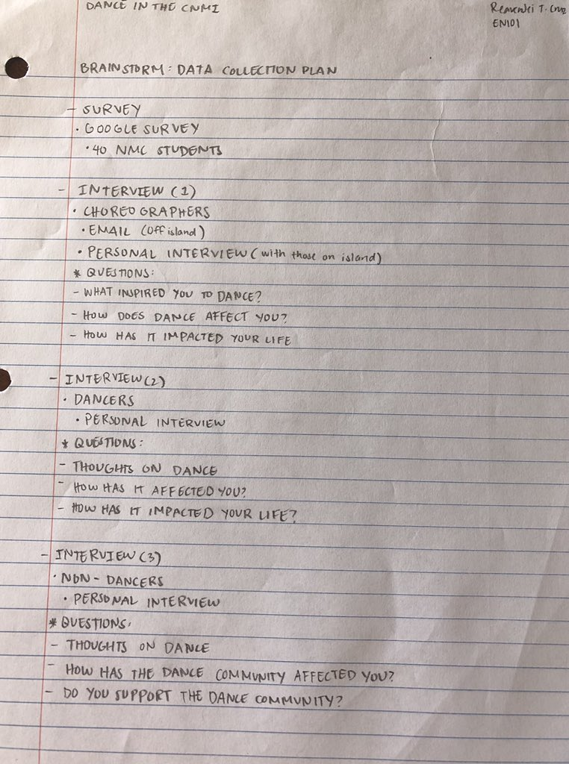
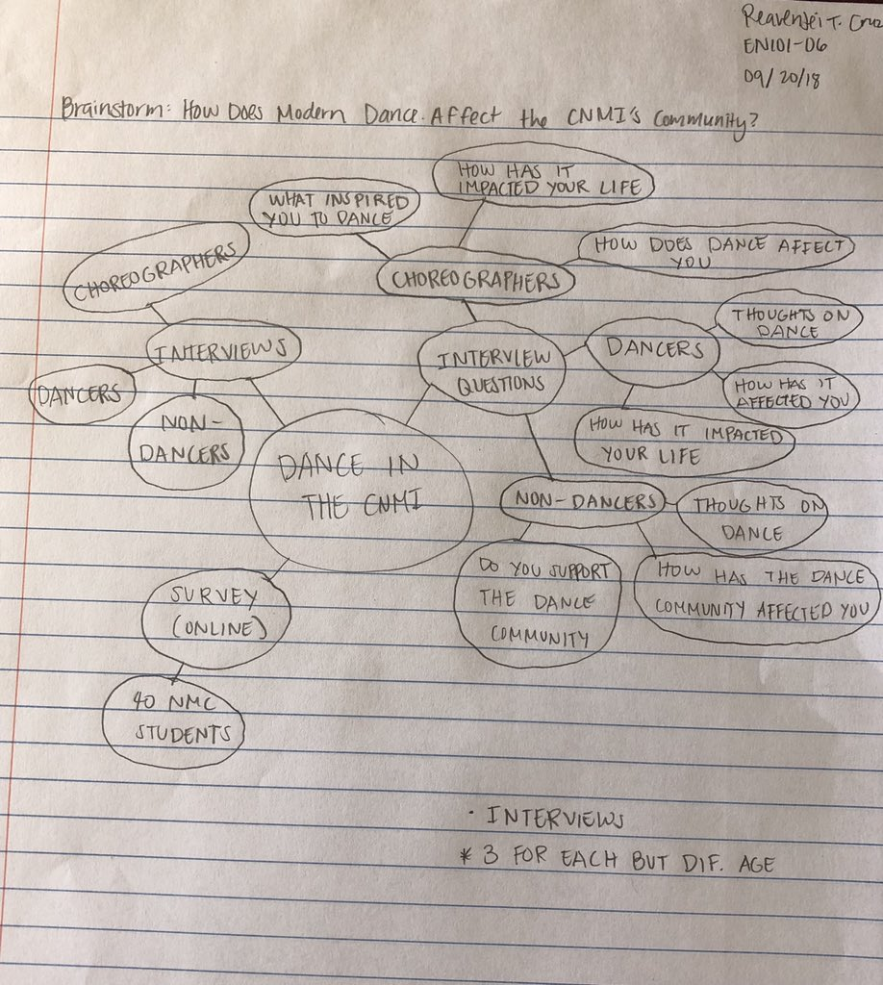
Brainstorm

Slide 3
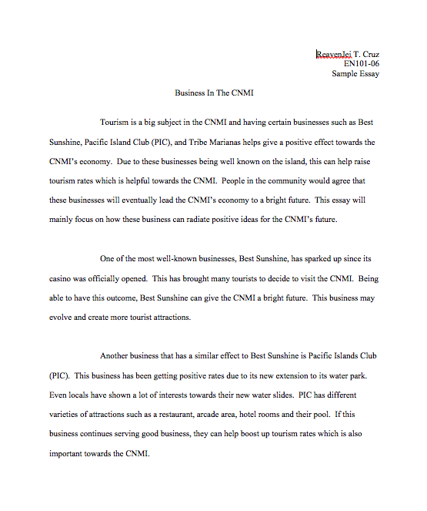
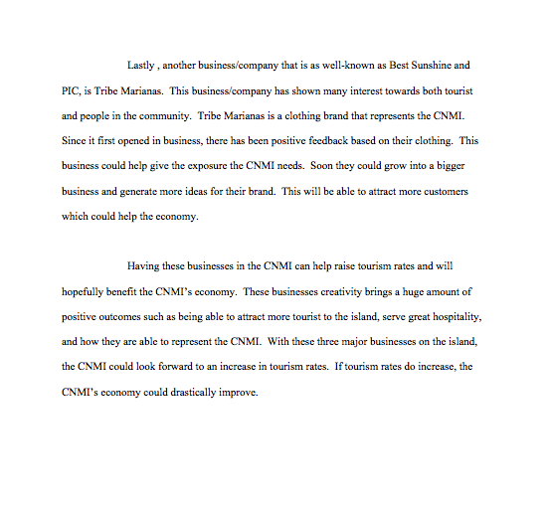
Essay 1 : Business in the CNMI

Slide 4
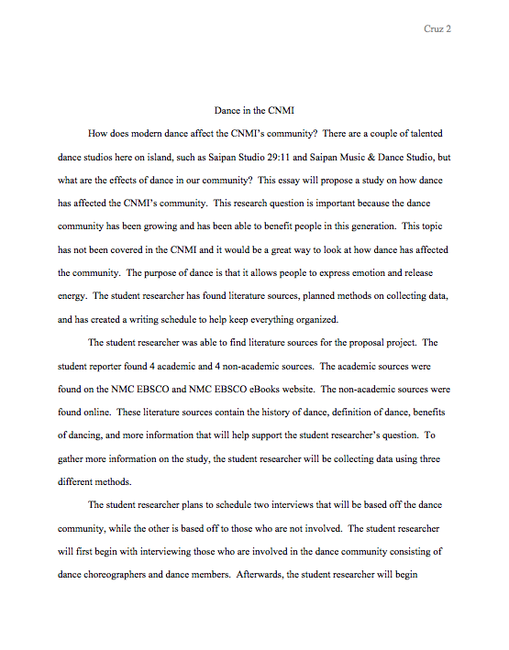
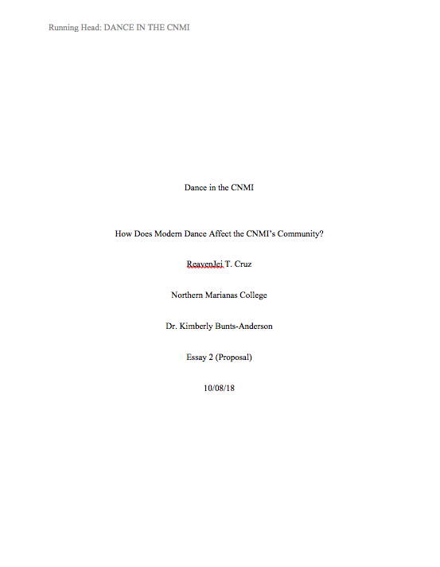
Essay 2 : Proposal Essay

Slide 5
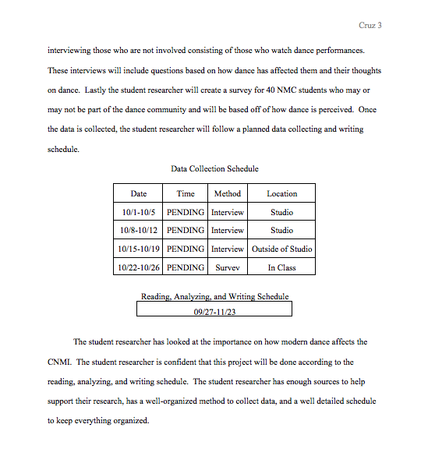
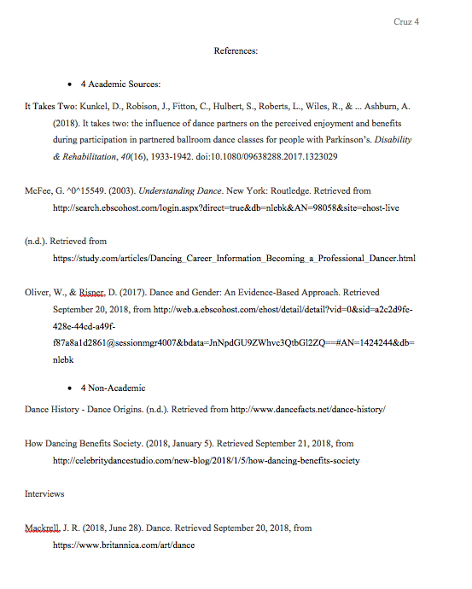

Slide 6
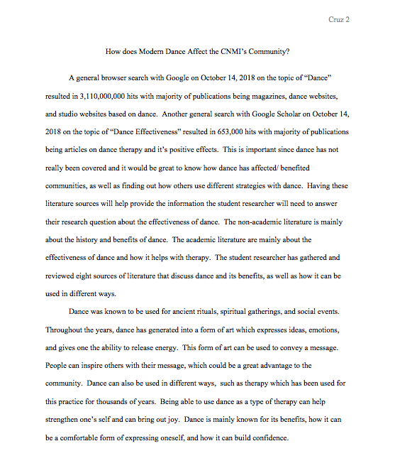
Essay 3 : Literature Review

Slide 7
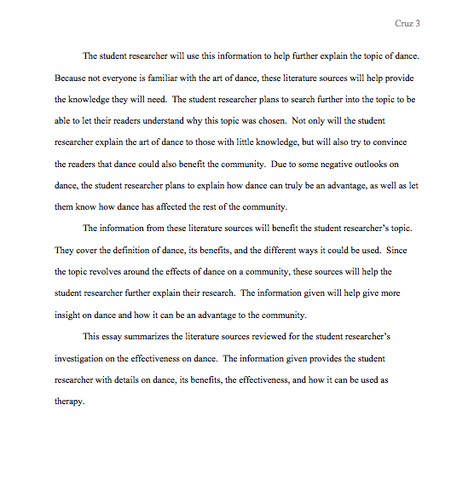
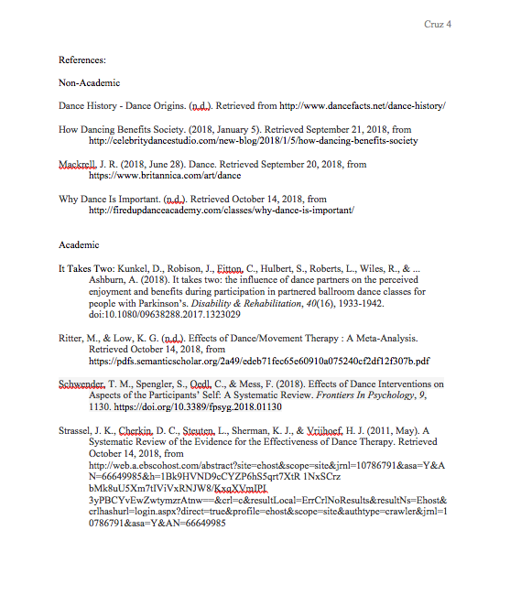

Slide 8
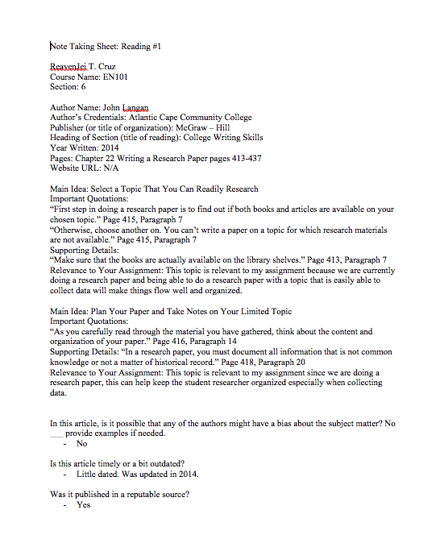
Reading Notes 1

Slide 9
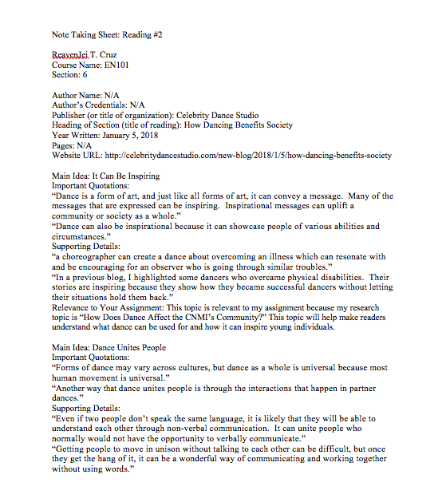
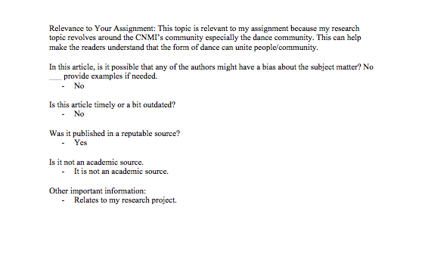
Reading Notes 2

Slide 10
Hyperlink to All Sources
Non-Academic
Dance History - Dance Origins. (n.d.). Retrieved from http://www.dancefacts.net/dance-history/
How Dancing Benefits Society. (2018, January 5). Retrieved September 21, 2018, from http://celebritydancestudio.com/new-blog/2018/1/5/how-dancing-benefits-society
Mackrell, J. R. (2018, June 28). Dance. Retrieved September 20, 2018, from https://www.britannica.com/art/dance
Why Dance Is Important. (n.d.). Retrieved October 14, 2018, from http://firedupdanceacademy.com/classes/why-dance-is-important/

Slide 11
Academic
It Takes Two: Kunkel, D., Robison, J., Fitton, C., Hulbert, S., Roberts, L., Wiles, R., . . . Ashburn, A. (2018). It takes two: the influence of dance partners on the perceived enjoyment and benefits during participation in partnered ballroom dance classes for people with Parkinson's. Retrieved from https://www.ncbi.nlm.nih.gov/pubmed/28482703
Ritter, M., & Low, K. G. (n.d.). Effects of Dance/Movement Therapy : A Meta-Analysis. Retrieved October 14, 2018, from https://pdfs.semanticscholar.org/2a49/edeb71fec65e60910a075240cf2df12f307b.pdf
Schwender, T. M., Spengler, S., Oedl, C., & Mess, F. (2018). Effects of Dance Interventions on Aspects of the Participants’ Self: A Systematic Review. Frontiers In Psychology, 9, 1130. https://www.frontiersin.org/articles/10.3389/fpsyg.2018.01130/full
Strassel, J. K., Cherkin, D. C., Steuten, L., Sherman, K. J., & Vrijhoef, H. J. (2011, May). A Systematic Review of the Evidence for the Effectiveness of Dance Therapy. Retrieved October 14, 2018, from http://web.a.ebscohost.com/abstract?site=ehost&scope=site&jrnl=10786791&asa=Y&AN=66649985&h=1Bk9HVND9cCYZP6hS5qrt7XtR 1NxSCrz bMk8uU5Xm7tIViVxRNJW8/KxqXVmIPI 3yPBCYvEwZwtymzrAtnw==&crl=c&resultLocal=ErrCrlNoResults&resultNs=Ehost&crlhashurl=login.aspx?direct=true&profile=ehost&scope=site&authtype=crawler&jrnl=10786791&asa=Y&AN=66649985

Slide 12
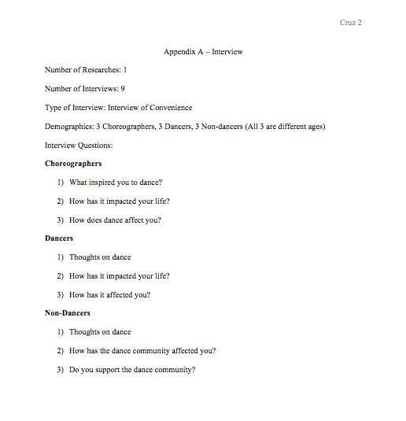
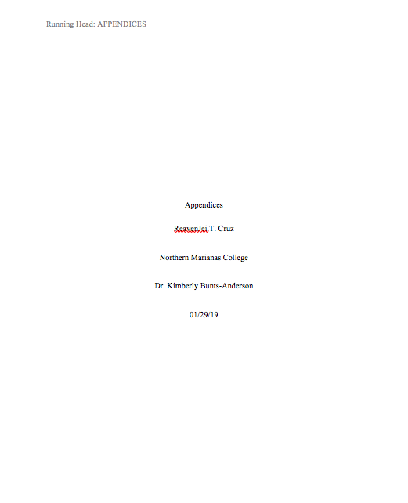
Appendices

Slide 13
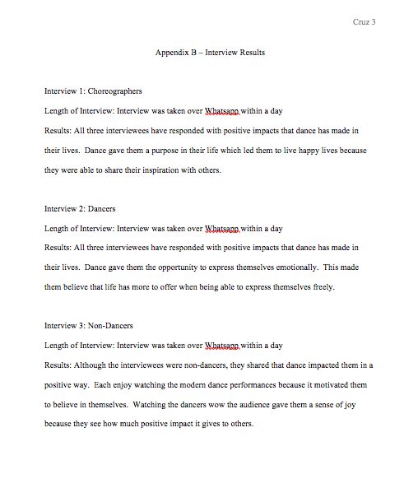
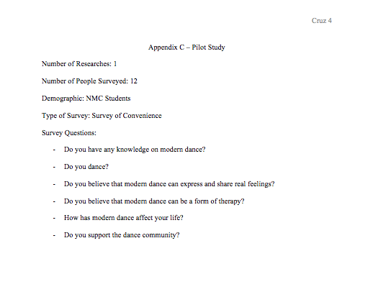

Slide 14
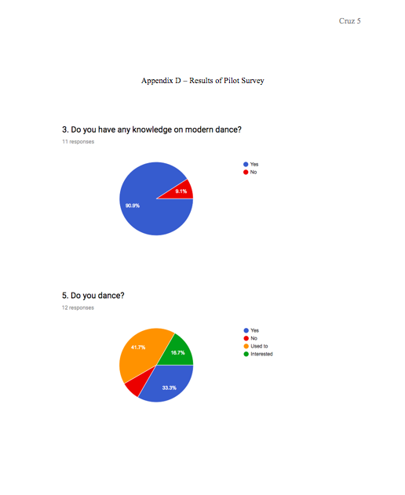
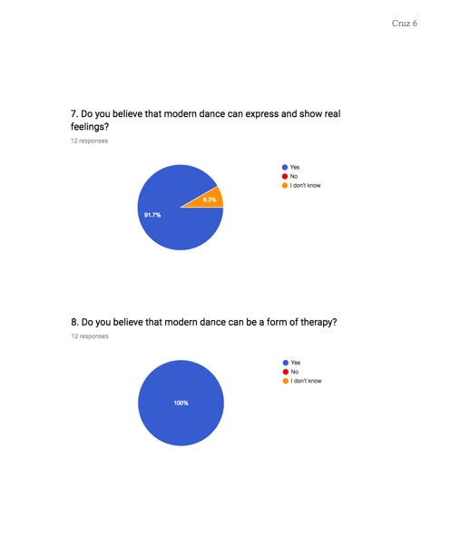

Slide 15
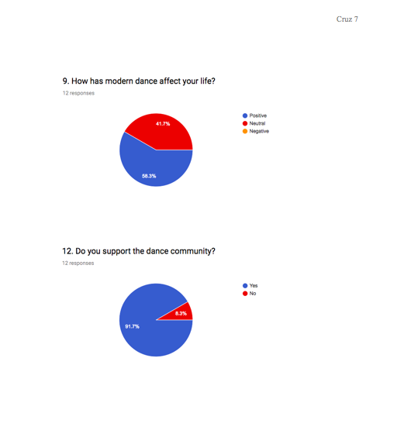

Slide 16
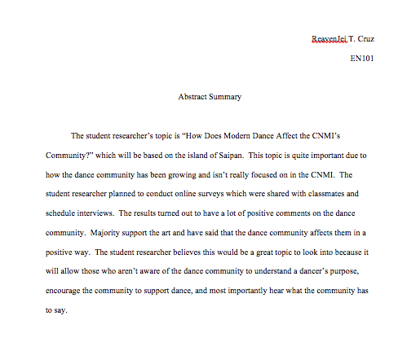
Abstract Summary

