Slide 1
E-Portfolio
Support System of Teenage Mothers
Diana Joy S. Aquino
EN101-06
Instructor: Dr. Kimberly Bunts - Anderson

Slide 2
Contents:
Abstract ……………….……………….……………….……………….………………3
Introduction ……………….……………….……………….……………….…………..4
Literature Review ……………….……………….……………….……………….. 5 - 6
Methodology ……………….……………….……………….……………….……..7 - 8
Research Questions ……………….……………….……………….…………... 9 - 10
Conclusion ……………….……………….……………….……………….……..….. 11
Appendix A ……………….……………….……………....……………….………..... 12
Appendix B ……………….……………….……………….……………….……….... 13
Appendix C ……………….……………….……………….……………….……....... 14
References …..……………….……………….……………….……………….……...15

Slide 3
Abstract
The research is based on the support system of teenage mothers in the CNMI and how it affects them and their family. The research student used literature resources and methodology to support the research question. The research student conducted several interviews with teenage mothers and their family members. The researcher also did a survey for NMC students. Overall the research process took about two months and the writer has enough information to answer the research question

Slide 4
Introduction
There have been thousands of teenage pregnancies for the past 10 years. Many teen mothers are engaging in unprotected sex which results in being pregnant. Sex education isn’t being taught enough in school, which could be a huge help with educating the teens who are sexually active. The purpose of this study is to look at the struggles of teenage pregnancy and the kind of support they receive through conducting an interview and surveys with new teen mothers and previous teen mothers who are now adults.

Slide 5
Literature Review
The list of causes of teenage pregnancy is endless. The list includes drugs and alcohol usage. A number of teens are unaware of the effects of alcohol and drugs, and the actions it causes them to do. According to one online sources, “Teens, however, do not realize the impacts alcohol and drugs have on the functioning of their brain, especially the effects of binge drinking which is consuming large amounts of alcohol during one sitting. Drinking excessively as well as experimenting drugs may lead to unwanted and unintentional pregnancy” (University of British Columbia, April 2016). Another part of the list of causes is, peer pressure. Close friends that teens hang out with everyday may influence them to have sex because it will make them look cooler only because they do it as well.

Slide 6
Literature Review Cont...
“Females may be pressured or forced by an older male partner to engage in sexual activity. These young females out of fear may feel forced to engage in unprotected sex without a choice” (University of British Columbia, April 2016). Last one, is the influence of the media. The media tends to make every pregnancy look easily manageable. They even have shows that showcases teens during the pregnancy and after giving birth. University of British Columbia states, “The media has a large effect on teen pregnancy, especially shows such as "Teen Mom" and "16 and Pregnant". These shows often glamorize pregnancy and hide the true hardships associated with pregnancy which encourages these teens to become pregnant” (University of British Columbia, April 2016). The page also states that teenage girls only get pregnant to dropout of school and to force their partners into a deeper commitment.

Slide 7
Methodology
The research student searched for evidence from a person who is or was a teen mother age (15 - 19). One teen mother said, they had friends and family members who helped them throughout their entire pregnancy. (See Appendix A.) “They helped provide some of the necessities that I needed at that time, like buy the diapers and the formula when my baby ran out.” “They also threw a big baby shower for me, and that helped me get some of the my babies things like, a diaper bag, baby bottles, a lot of clothes, and toys.” The teen mother also mentioned that she had to juggle school and taking care of her newborn, just so she could help out with providing for what her chil needed.

Slide 8
Methodology Cont...
In the US alone 3 out of 10 teenage girls will get pregnant at least once in their teenage life. According to the statistics provided by the Department of Public Health, a total of 513 pregnancies have been recorded in the years 2000 -2003. The research student interviewed a teen mother who mentioned that her parents wanted her to take full responsibility and continue going to school and working full time to fully provide for her newborn.

Slide 9
What type of support do teen mothers receive from their family or friends?

Slide 10
What type of struggles do teen mothers go through?

Slide 11
Conclusion
Gathering all the information helped answer the research students research question. For the past 10 years there have been hundreds of teenage pregnancy recorded. Overall there are many good effects of teen pregnancy not only for the mother of the baby but also the family of the teen. What I have found is that the baby may bring the family closer and make their bond between each other much stronger. Also, teen mothers become more responsible and mature. I also found out that mothers become more motivated to work harder because the mother wants a better future for her baby. Overall there are many positive aspect of teen pregnancy and that will benefit the mother, the baby, and the family of the teen mother.

Slide 12
Appendix A

Slide 13
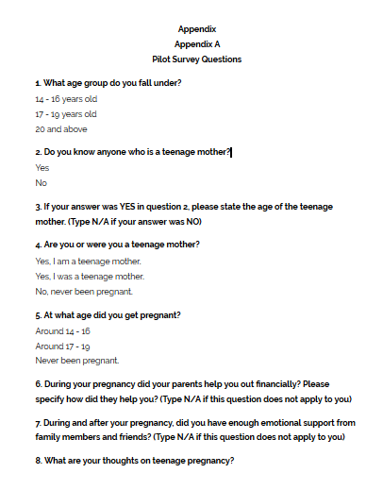
Appendix B

Slide 14
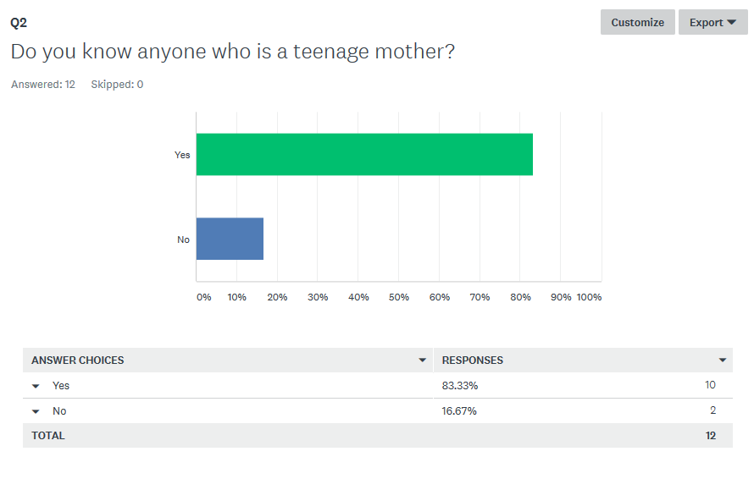
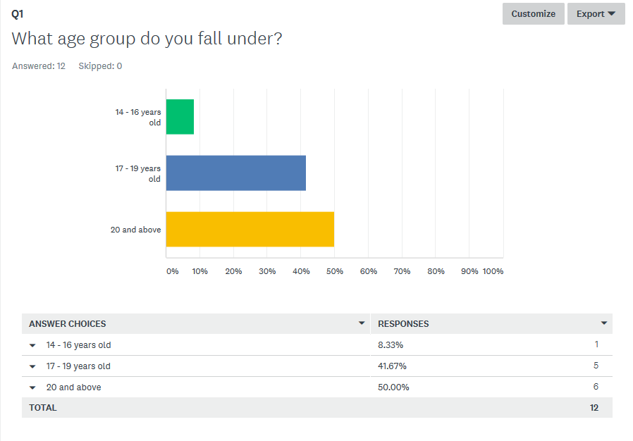
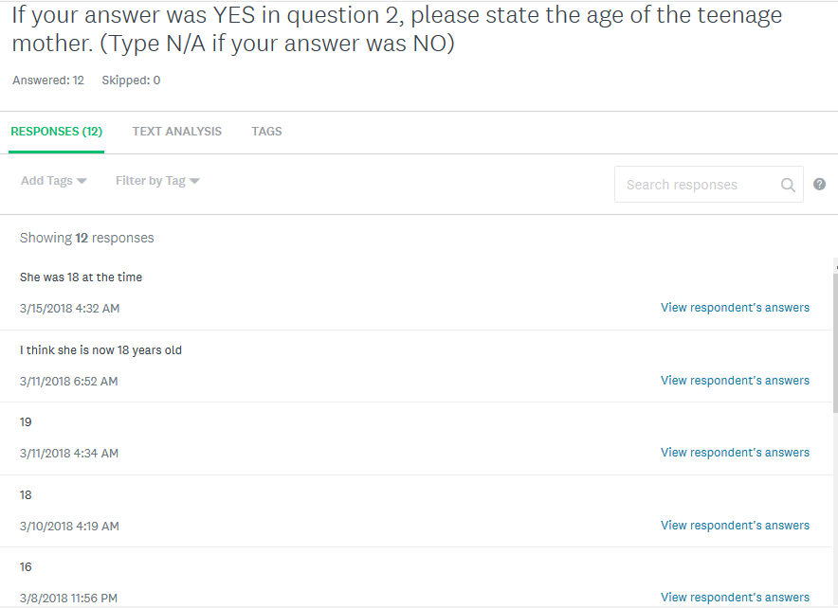
Appendix C

Slide 15
References
Health Research Funding. (2014). Pros and Cons of Teenage pregnancy, Retrieved from https://healthresearchfunding.org/pros-cons-teenage-pregnancy/
Ruddock, V. (2017). Statistics on Teen Pregnancy, Retrieved from http://pregnancy.lovetoknow.com/wiki/Pregnancy_Statistics_Teens
Teen pregnancy rate remains high. (-0001, November 29). Retrieved February 02, 2018, from https://www.saipantribune.com/index.php/a105b312-1dfb-11e4-aedf-250bc8c9958e/.
Woodward, L. J., & Fergusson, D. M. (1999). Early conduct problems and later risk of teenage pregnancy in girls. Development and psychopathology, 11(1), 127-141.

