Slide 1
E-Portfolio
Angela Francisco Bernal
EN202-ONL-01
Dr. Kimberly Bunts-Anderson

Slide 2
Table of Contents
Brainstorm…………………………. 3
Essay 1……………………………….4
Essay 2……………………………….5
Essay 3……………………………….6
Essay 4……………………………….7
Final Research Report…………...8
Reading Notes 1 & 2……………..9
Reading Notes 3 & 4……………..10
Reading Notes 5 & 6……………..11
Reading Notes 7 & 8……………...12
Hyperlinks…………………………….13
Cont. of Hyperlinks………………...14
Appendix A……………………………15
Appendix B……………………………19
Appendix C……………………………22

Slide 3
Brainstorm

Slide 4
Essay 1: Illustrative Essay

Slide 5
Essay 2

Slide 6
Essay 3

Slide 7
Essay 4

Slide 8
Final Research Report

Slide 9
Reading Notes 1 & 2

Slide 10
Reading Notes 3 & 4

Slide 11
Reading Notes 5 & 6

Slide 12
Reading Notes 7 & 8

Slide 13
Hyperlinks of All Papers
Brainstorm: https://docs.google.com/document/d/1JmQXU963Ot4C0gfeAYj67uv0AFMBtyOzHViHsIfg7po/edit?usp=sharing
Essay 1: https://docs.google.com/document/d/11UGWpAPk6p-UlL8zIR8dqYOIj-ZQ1bltmBb75obLP50/edit?usp=sharing
Essay 2: https://docs.google.com/document/d/13VXUIDezg22ES9-3RXinm5zUecZXkjGd3S9KLsXBW24/edit?usp=sharing
Essay 3:
https://docs.google.com/document/d/1-ZlSsK7agGjgMLTUNFysVCY06NAOpEc7y8HXt0yoxaA/edit?usp=sharing
Essay 4:https://docs.google.com/document/d/1bMqIITVodyFE0DVhpJNMm6ZXB32ZNcBYQ5Qozu3XqJ4/edit?usp=sharing

Slide 14
Continuation of Hyperlinks of All Papers
Final Research Report: https://docs.google.com/document/d/1Y9eJfFJfgZCeyQj9al4vS8rrWqgJYfglArRO9HrcGXM/edit?usp=sharing
Reading Notes 1 & 2: https://drive.google.com/file/d/0B9I_DLgtIbMwV2hzVmlZTk1MeXdiYk44WnZCTlRMaVVLekJJ/view?usp=sharing
Reading Notes 3 & 4: https://docs.google.com/document/d/1tLoTTBHE_23p9GM5P4889bRCDNg8KmWT1R5LW5tIli0/edit?usp=sharing
Reading Notes 5 & 6:https://drive.google.com/file/d/0B9I_DLgtIbMwNEpWekY1Q3k0d0laaHUzaENHZG01RjdXbnVr/view?usp=sharing
Reading Notes 7 & 8: https://docs.google.com/document/d/19VqjaPSCGsaBwdQyjLL2j_8czvWRYJJnjYzCDfy84-Q/edit?usp=sharing

Slide 15
Appendix A
Survey

Slide 16
A.Survey

Slide 17
A. Survey

Slide 18
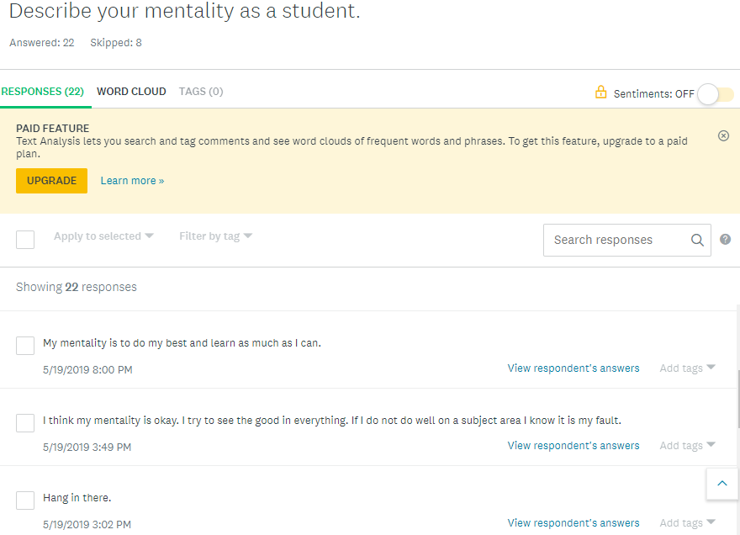
A. Survey

Slide 19
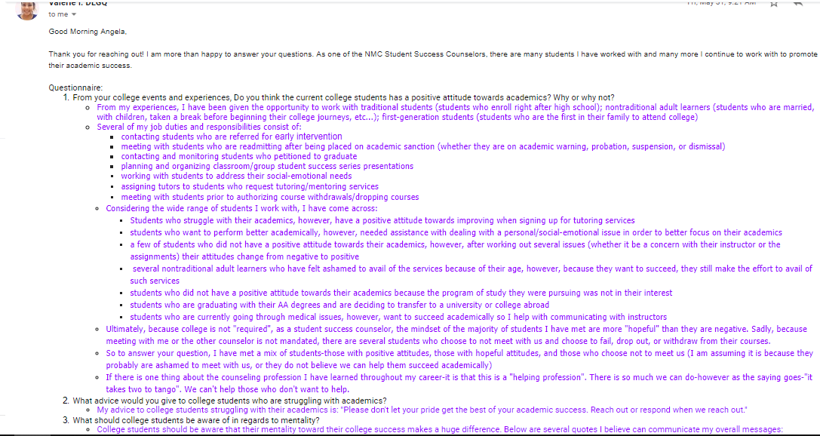
Appendix B
B. Replies from Experts (From Ms. Quitano Counselor at NMC)

Slide 20
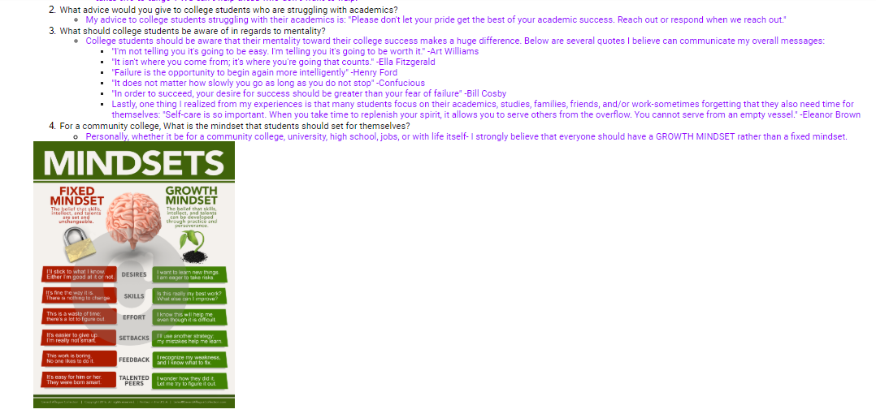
B. Replies from Experts (From Ms. Quitano Counselor at NMC)

Slide 21
B. Replies from Experts (Ms. Demapan Counselor at NMC)

Slide 22
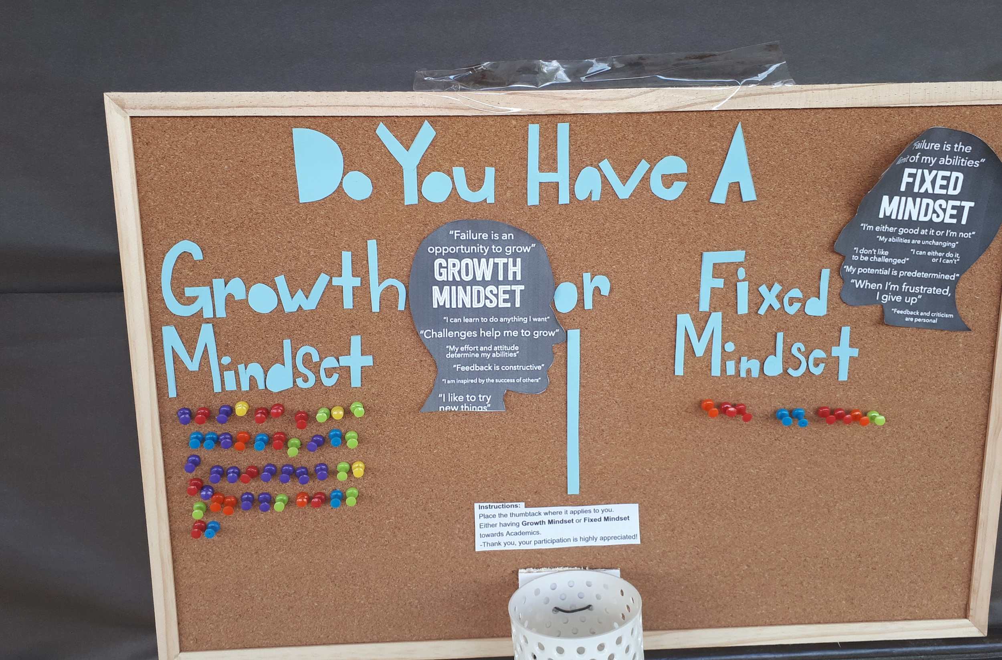
Appendix C
C. Second Survey

