Slide 1
Divonne Hosono
EN101-01
Mrs. Kimberly Bundts-Anderson

Slide 2
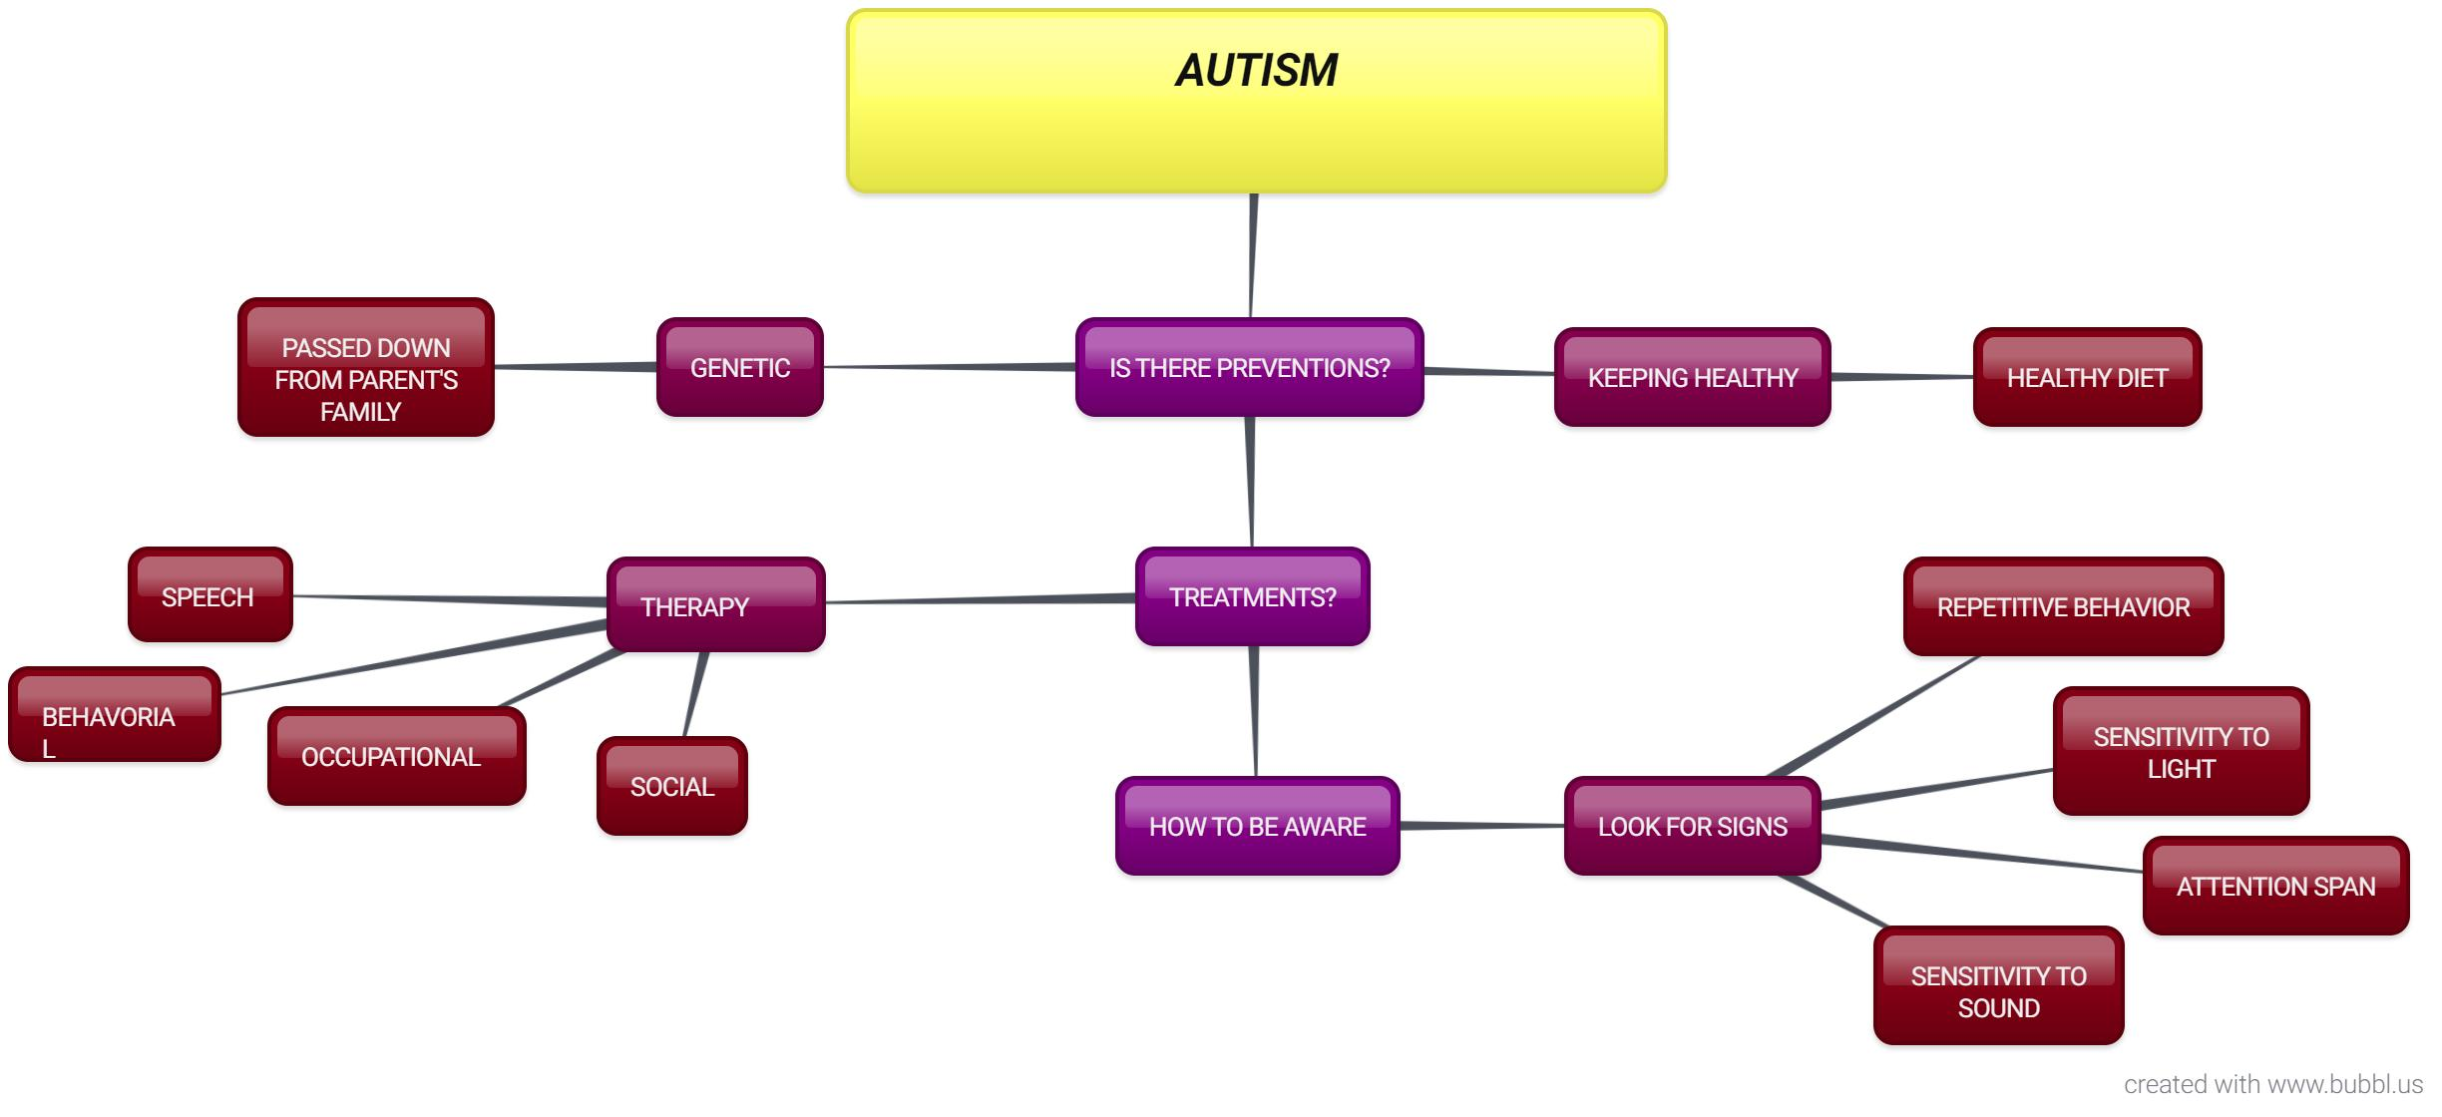
BRAINSTORM

Slide 3
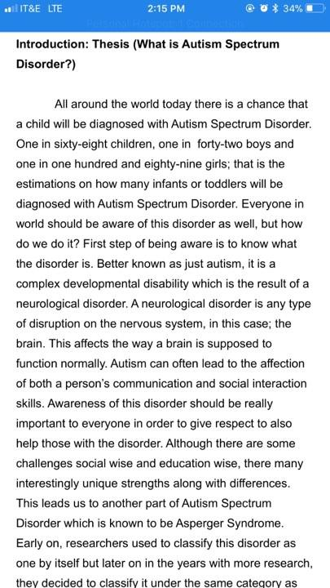
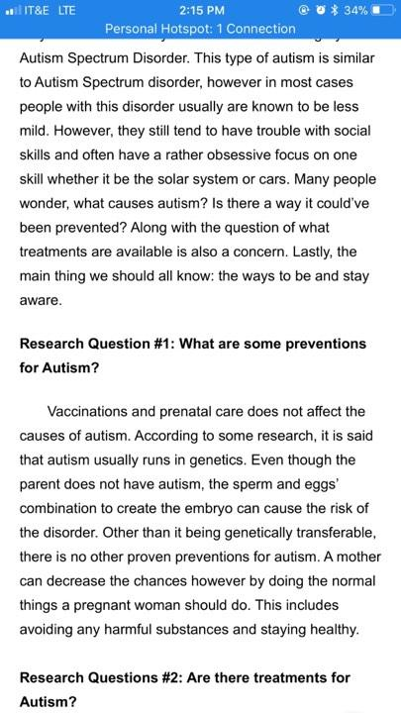
Research Draft

Slide 4
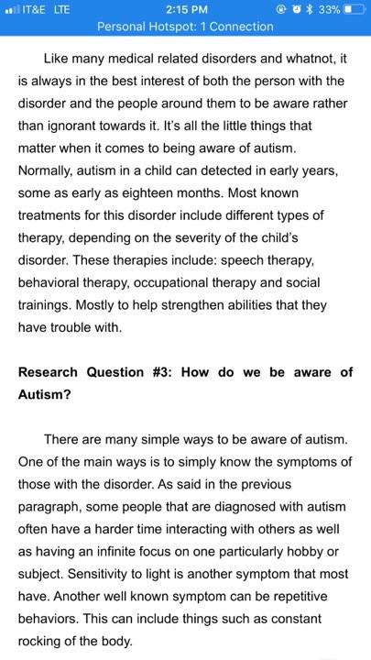
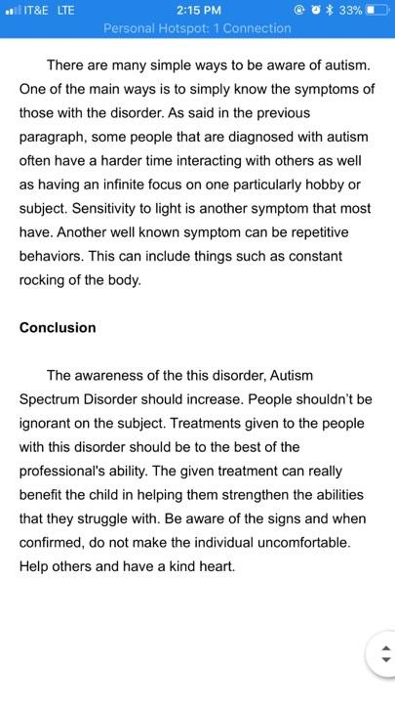
CONT’D

Slide 5
AUTISM
RESEARCH PROPOSAL
EN101-01
MRS. KIMBERLY BUNDTS-ANDERSON

Slide 6
Often times people get confused when people speak of autism, and they think it is just a childhood disorder. The reason why people think it is just a childhood disorder is because numerous studies focus primarily on educating autistic children, since it is very hard to do so.
It is good to be aware and stay aware of autism around us. It is reasonable to do so to respect those that have it. The reason for this is because they are not so different from us. They posses some unique qualities but that does not mean they are any less than human.
This research will give reasons as to how and why we can be more aware. It will help enlighten people more about their understanding of autism and what it is. Most people think they know all they need to know when they actually don’t.

Slide 7
Tentative Schedule
September 18-September 30 | Discussion with teachers that assist kids in school with this disorder.
October 1-October 25 | Research
October 25-November 10 | Writing Process
November 12 - November 20 | Revision
November 21-November 30 | Sharing

Slide 8
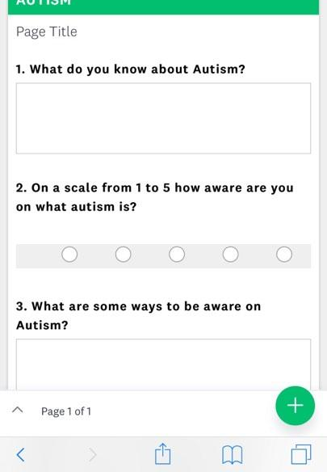
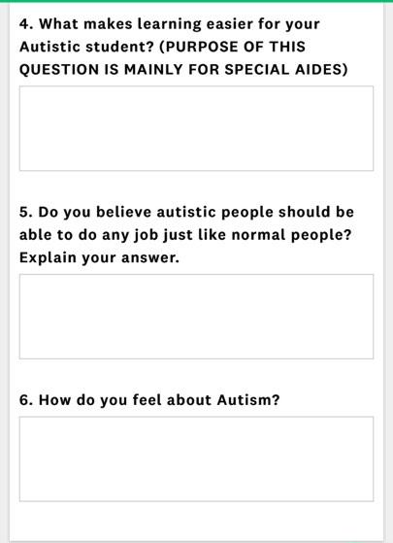
SURVEY

Slide 9
FINAL

Slide 10
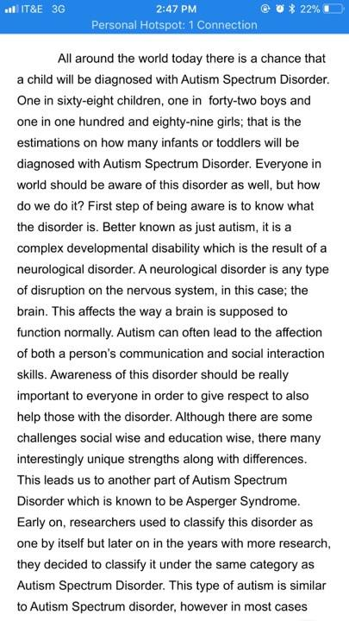
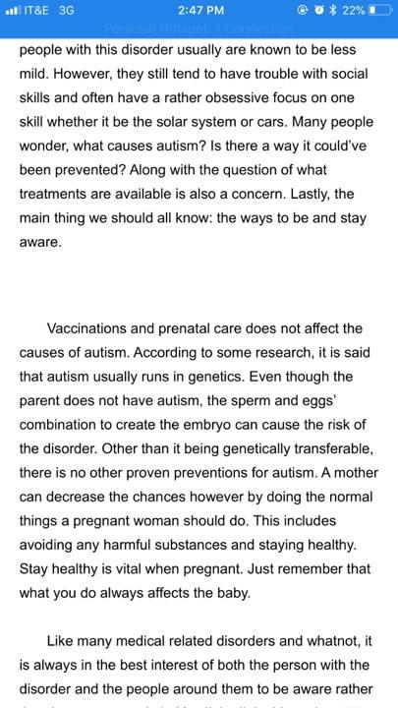

Slide 11
