Slide 1
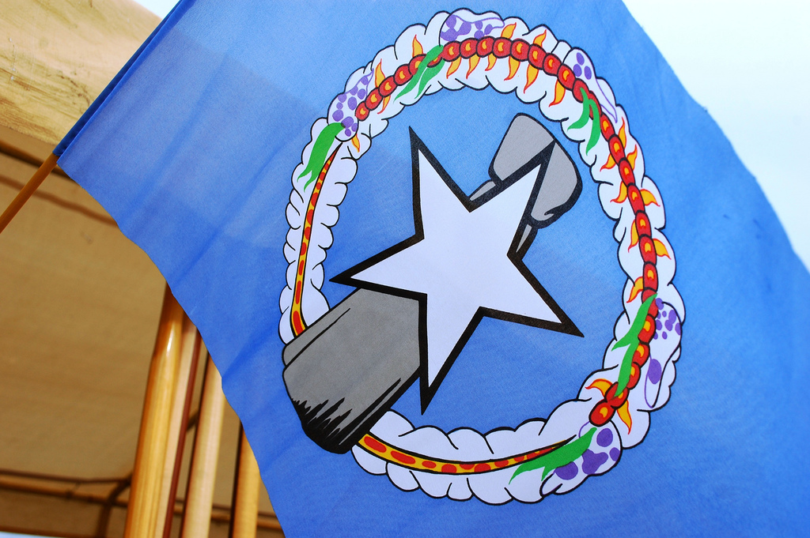
Oral Cancer in the
N. Marianas Islands
Luis C. Ogo
EN101-06

Slide 2
Beginning
Question: Will adding different sources to chewing betel nut increase a person’s chance in obtaining oral cancer?

Slide 3
Brainstorming:
My first step was to brainstorm on what my topic needed.
As I did this I went to the library and looked up what related to my topic.
Along with researching at the library I found it best to review the archives room.

Slide 4
N. Marianas College Library:
It was good to research the study of oral cancer (my topic) in the CNMI.
This allowed me to view how far back oral cancer was introduced in the CNMI.
I found the information needed to move forward with my project

Slide 5
Mid way:
Online Research:
- I obtained a lot of my information from the internet, specifically from the University of Hawaii research program done by one of the people I interviewed.
- This information was on a research done on the cnmi called the betelnut project.
- it was conducted to get the amount of people in the cnmi whol chew betelnut.
- this project was extremely helpful because it also worked in favor of trying to see if anyone show early signs of oral cancer.

Slide 6
SURVEY:
- Survey questions resulted in a feedback that helped gather enough data to classify a persons perspective of the topic.
- the survey included questions that were based on research done from other parties.
- the result not only confirmed my essay, but had introduced a better format to follow for my final draft

Slide 7
The Interviews
Research partners

Slide 8
Last step
Total Data:
- On my interviews with experts all three of them stated that males were more likely to contract oral cancer.
- People are who do not chew are still able to get oral cancer either from smoking, economic reason or by genetics.
- All three experts told me that people who chew betel nut frequently are stating that they chew because it is their culture.
- The experts said that the stages of oral cancer is usually found is on stage 3, because people are to scared to get a sore in their mouth checked because they don’t want to be told that they have oral cancer.
Interviewing professionals

Slide 9
Oral Cancer is a growing concern for the people of the CNMI.

Slide 10
Thanks!
Contact:
Luis C. Ogo
EN101-06
Oral Cancer
Luis.ogo@my.marianas.edu

