Slide 1
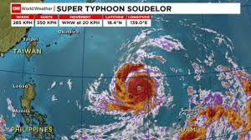
The effects of Typhoon Soudelor on people’s lives..
Rayburn Espangel
EN202-1
Instructor Dr. Kimberly Bunts-Anderson

Slide 2
Research Questions
Research Question: What are the effects of Typhoon Soudelor on people’s lives?
Sub questions:
How easy/hard for you to obtain the necessities such food, gas, water, batteries, etc.?
Was your house totally damaged?
How long did it take for you to rebuild?
Rate how stressed you were from July to October?

Slide 3
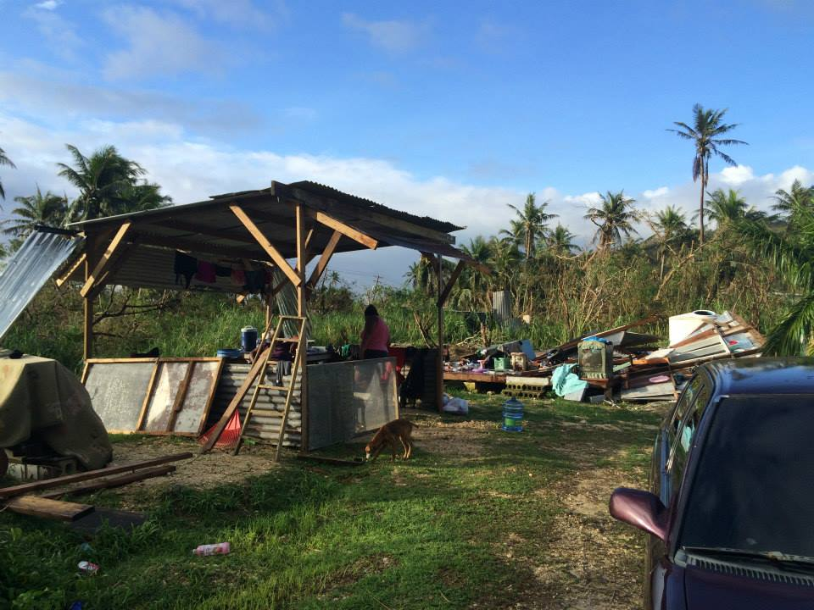
Methods of Collecting Data
Primary Research
Interviews
Surveys
Observations
Secondary Research

Slide 4
Results of Surveys and Interviews
90% rated 5 (as being really hard) to obtain gas, food, water/ice, battery.
2/15 had health issues
85%Could not stand not having electricity, had to temporary relocate to hotels/motels
All respondents said that the typhoon really affected their finances
Had hard time cleaning afterwards
From July to October; August and July rated the most stressful

Slide 5
Stress Graph
Stress level: 0= Stress Free 10= Oba stressed

Slide 6
Any Questions

