Slide 1
The Psychological Effects of Video Gaming and Violence and Violent Behavior
By John Fabian

Slide 2
Importance and Relevance:
Crime Rate Analysis/ Prevention
Interesting Topic
To Understand the Cause of crime.

Slide 3
Literature Sources
Violent Video Games and Aggression: A review of the Literature (1998, December 7)
DeLisi, M., Vaughn, M.G, Gentile, D.A, Anderson, C.A., & Shook, J.J. (n.d), Violent Video Games, Delinquency
Delinquency, Youth Violence: New Evidence – Matt Delisi, Michael G. Vaughn, Douglas A. Gentle
The Effect of Video Game Violence on Physiological Desensitization to Real-Life Violence. (2006, July 17)
A Longitudinal Test Of Video Game Violence Influences On Dating and Aggression: A 3 Year Longitude Study of Adolescents.

Slide 4
Primary And Secondary Questions
What are the psychological impact of video games towards the development of violent behavior?
What types of video game genres has a significant psychological impact towards the development of violent behavior?
How Much hours is needed for games to have a psychological impact?

Slide 5
Method of Gathering Data
Analyzing the National Crime rate of and Comparing the Crime rate to our local Crime ate rate. Finding those age range to 18-25 and making an estimate of those who play video games.
Conducting the DiSC Behavioral Analysis before and after an experiment of 20 People both 10 for "Hardcore Gamers” and 10 “Casual Gamers”
Seeking opinions from Psychologist both locally from the private sectors and public sectors, as well as Psychologist from off-island.

Slide 6
Data ANALYSIS Volunteer 1 Before Experiment
Buss Perry Aggression Questionnaire
Volunteer 1 (The Aggression scale consists of 4 factors ranked from 0 to 1, with 1 being the maximum.)
Age: 18
Gender Male
Physical aggression: 0.43
Verbal aggression: 0.20
Hostility: 0.22
Anger: 0.27

Slide 7
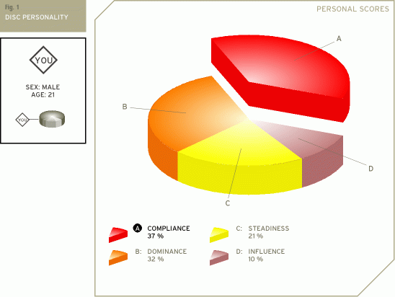
Data ANALYSIS Volunteer 1 DISC Before Experiment Volunteer 1
Dominance | Describes the way you deal with problems, assert yourself and control situations.
Influence | Describes the way you deal with people, the way you communicate and relate to others.
Steadiness | Describes your temperament - patience, persistence, and thoughtfulness
Compliance | Describes how you approach and organize your activity, procedures and responsibilities.

Slide 8
Data ANALYSIS Volunteer 1 After
Buss Perry Aggression Questionnaire
Volunteer 2 (The Aggression scale consists of 4 factors ranked from 0 to 1, with 1 being the maximum.)
Age: 19
Gender Male
Physical aggression: 0.21
Verbal aggression: 0.36
Hostility: 0.30
Anger: 0.38

Slide 9
Data ANALYSIS Volunteer 2 Before
Buss Perry Aggression Questionnaire
Volunteer 2 (The Aggression scale consists of 4 factors ranked from 0 to 1, with 1 being the maximum.)
Age: 19
Gender Female
Physical aggression: 0.21
Verbal aggression: 0.22
Hostility: 0.14
Anger: 0.52

Slide 10
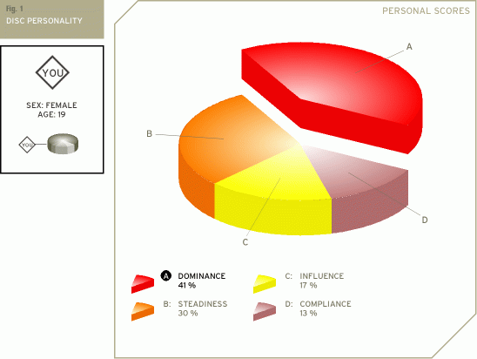
Data ANALYSIS Volunteer 2 Before Experiment DISC
Dominance | Describes the way you deal with problems, assert yourself and control situations.
Influence | Describes the way you deal with people, the way you communicate and relate to others.
Steadiness | Describes your temperament - patience, persistence, and thoughtfulness
Compliance | Describes how you approach and organize your activity, procedures and responsibilities.

Slide 11
Data ANALYSIS Volunteer 2 After
Buss Perry Aggression Questionnaire
Volunteer 2 (The Aggression scale consists of 4 factors ranked from 0 to 1, with 1 being the maximum.)
Age: 19
Gender Female
Physical aggression: 0.22
Verbal aggression: 0.32
Hostility: 0.15
Anger: 0.31

Slide 12
Data ANALYSIS Volunteer 3 Before
Buss Perry Aggression Questionnaire
Volunteer 2 (The Aggression scale consists of 4 factors ranked from 0 to 1, with 1 being the maximum.)
Age: 19
Gender Female
Physical aggression: 0.26
Verbal aggression: 0.25
Hostility: 0.18
Anger: 0.22

Slide 13
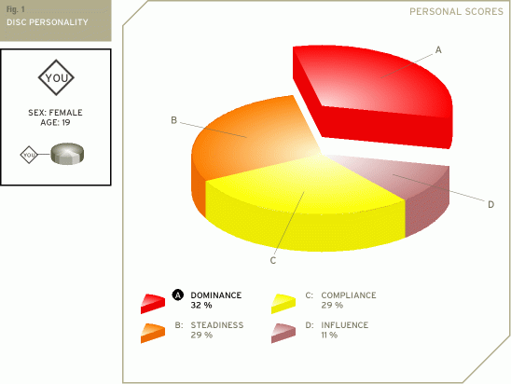
Data ANALYSIS Volunteer 3 Before Experiment DISC
Dominance | Describes the way you deal with problems, assert yourself and control situations.
Influence | Describes the way you deal with people, the way you communicate and relate to others.
Steadiness | Describes your temperament - patience, persistence, and thoughtfulness
Compliance | Describes how you approach and organize your activity, procedures and responsibilities.

Slide 14
Data ANALYSIS Volunteer 3 After Experiment DISC
Dominance | Describes the way you deal with problems, assert yourself and control situations.
Influence | Describes the way you deal with people, the way you communicate and relate to others.
Steadiness | Describes your temperament - patience, persistence, and thoughtfulness
Compliance | Describes how you approach and organize your activity, procedures and responsibilities.

Slide 15
Data ANALYSIS Volunteer 3 After
Buss Perry Aggression Questionnaire
Volunteer 2 (The Aggression scale consists of 4 factors ranked from 0 to 1, with 1 being the maximum.)
Age: 19
Gender Female
Physical aggression: 0.27
Verbal aggression: 0.38
Hostility: 0.14
Anger: 0.37

Slide 16
Data ANALYSIS Volunteer 4 Before
Buss Perry Aggression Questionnaire
Volunteer 2 (The Aggression scale consists of 4 factors ranked from 0 to 1, with 1 being the maximum.)
Age: 21
Gender Female
Physical aggression: 0.45
Verbal aggression: 0.32
Hostility: 0.21
Anger: 0.22

Slide 17
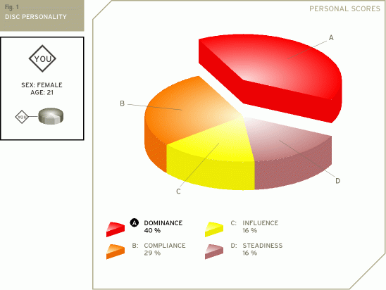
Data ANALYSIS Volunteer 4 Before Experiment DISC
Dominance | Describes the way you deal with problems, assert yourself and control situations.
Influence | Describes the way you deal with people, the way you communicate and relate to others.
Steadiness | Describes your temperament - patience, persistence, and thoughtfulness
Compliance | Describes how you approach and organize your activity, procedures and responsibilities.

Slide 18
Data ANALYSIS Volunteer 4 After
Buss Perry Aggression Questionnaire
Volunteer 2 (The Aggression scale consists of 4 factors ranked from 0 to 1, with 1 being the maximum.)
Age: 19
Gender Female
Physical aggression: 0.17
Verbal aggression: 0.28
Hostility: 0.23
Anger: 0.29

Slide 19
Data ANALYSIS Volunteer 4 After Experiment DISC
Dominance | Describes the way you deal with problems, assert yourself and control situations.
Influence | Describes the way you deal with people, the way you communicate and relate to others.
Steadiness | Describes your temperament - patience, persistence, and thoughtfulness
Compliance | Describes how you approach and organize your activity, procedures and responsibilities.

Slide 20
Data ANALYSIS Volunteer 5 Before
Buss Perry Aggression Questionnaire
Volunteer 2 (The Aggression scale consists of 4 factors ranked from 0 to 1, with 1 being the maximum.)
Age: 19
Gender Male
Physical aggression: 0.32
Verbal aggression: 0.45
Hostility: 0.29
Anger: 0.10

Slide 21
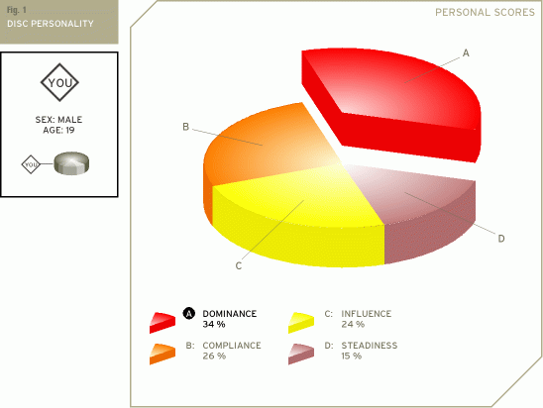
Data ANALYSIS Volunteer 5 Before Experiment DISC
Dominance | Describes the way you deal with problems, assert yourself and control situations.
Influence | Describes the way you deal with people, the way you communicate and relate to others.
Steadiness | Describes your temperament - patience, persistence, and thoughtfulness
Compliance | Describes how you approach and organize your activity, procedures and responsibilities.

Slide 22
Data ANALYSIS Volunteer 5 After
Buss Perry Aggression Questionnaire
Volunteer 2 (The Aggression scale consists of 4 factors ranked from 0 to 1, with 1 being the maximum.)
Age: 19
Gender Male
Physical aggression: 0.34
Verbal aggression: 0.28
Hostility: 0.24
Anger: 0.16

Slide 23
Data ANALYSIS Volunteer 5 After Experiment DISC
Dominance | Describes the way you deal with problems, assert yourself and control situations.
Influence | Describes the way you deal with people, the way you communicate and relate to others.
Steadiness | Describes your temperament - patience, persistence, and thoughtfulness
Compliance | Describes how you approach and organize your activity, procedures and responsibilities.

Slide 24
Data ANALYSIS Volunteer 6 Before
Buss Perry Aggression Questionnaire
Volunteer 2 (The Aggression scale consists of 4 factors ranked from 0 to 1, with 1 being the maximum.)
Age: 22
Gender Female
Physical aggression: 0.35
Verbal aggression: 0.34
Hostility: 0.20
Anger: 0.65

Slide 25
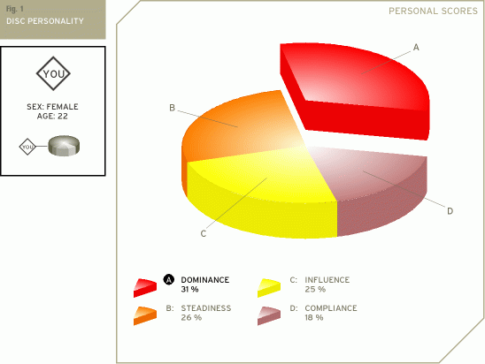
Data ANALYSIS Volunteer 6 Before Experiment DISC
Dominance | Describes the way you deal with problems, assert yourself and control situations.
Influence | Describes the way you deal with people, the way you communicate and relate to others.
Steadiness | Describes your temperament - patience, persistence, and thoughtfulness
Compliance | Describes how you approach and organize your activity, procedures and responsibilities.

Slide 26
Data ANALYSIS Volunteer 6 After
Buss Perry Aggression Questionnaire
Volunteer 2 (The Aggression scale consists of 4 factors ranked from 0 to 1, with 1 being the maximum.)
Age: 22
Gender Female
Physical aggression: 0.22
Verbal aggression: 0.32
Hostility: 0.15
Anger: 0.31

Slide 27
Data ANALYSIS Volunteer 6 After Experiment DISC
Dominance | Describes the way you deal with problems, assert yourself and control situations.
Influence | Describes the way you deal with people, the way you communicate and relate to others.
Steadiness | Describes your temperament - patience, persistence, and thoughtfulness
Compliance | Describes how you approach and organize your activity, procedures and responsibilities.

Slide 28
Data ANALYSIS Volunteer 7 Before
Buss Perry Aggression Questionnaire
Volunteer 2 (The Aggression scale consists of 4 factors ranked from 0 to 1, with 1 being the maximum.)
Age: 18
Gender Male
Physical aggression: 0.26
Verbal aggression: 0.27
Hostility: 0.45
Anger: 0.85

Slide 29
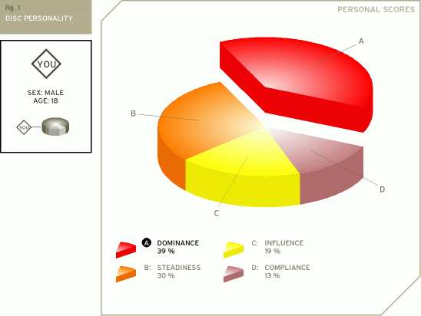
Data ANALYSIS Volunteer 7 Before Experiment DISC
Dominance | Describes the way you deal with problems, assert yourself and control situations.
Influence | Describes the way you deal with people, the way you communicate and relate to others.
Steadiness | Describes your temperament - patience, persistence, and thoughtfulness
Compliance | Describes how you approach and organize your activity, procedures and responsibilities.

Slide 30
Data ANALYSIS Volunteer 7 After Experiment DISC
Dominance | Describes the way you deal with problems, assert yourself and control situations.
Influence | Describes the way you deal with people, the way you communicate and relate to others.
Steadiness | Describes your temperament - patience, persistence, and thoughtfulness
Compliance | Describes how you approach and organize your activity, procedures and responsibilities.

Slide 31
Data ANALYSIS Volunteer 7 After
Buss Perry Aggression Questionnaire
Volunteer 2 (The Aggression scale consists of 4 factors ranked from 0 to 1, with 1 being the maximum.)
Age: 18
Gender Male
Physical aggression: 0.22
Verbal aggression: 0.32
Hostility: 0.15
Anger: 0.31

Slide 32
Data ANALYSIS Volunteer 8 Before
Buss Perry Aggression Questionnaire
Volunteer 2 (The Aggression scale consists of 4 factors ranked from 0 to 1, with 1 being the maximum.)
Age: 23
Gender Female
Physical aggression: 0.35
Verbal aggression: 0.34
Hostility: 0.45
Anger: 0.35

Slide 33
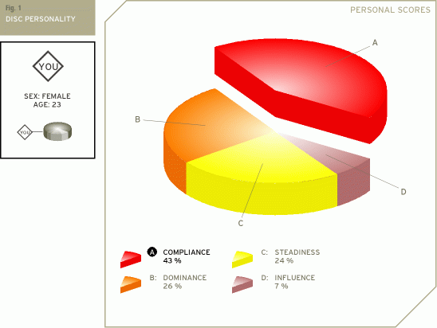
Data ANALYSIS Volunteer 8 Before Experiment DISC
Dominance | Describes the way you deal with problems, assert yourself and control situations.
Influence | Describes the way you deal with people, the way you communicate and relate to others.
Steadiness | Describes your temperament - patience, persistence, and thoughtfulness
Compliance | Describes how you approach and organize your activity, procedures and responsibilities.

Slide 34
Data ANALYSIS Volunteer 8 After
Buss Perry Aggression Questionnaire
Volunteer 2 (The Aggression scale consists of 4 factors ranked from 0 to 1, with 1 being the maximum.)
Age: 23
Gender Female
Physical aggression: 0.15
Verbal aggression: 0.25
Hostility: 0.16
Anger: 0.18

Slide 35
Data ANALYSIS Volunteer 8 After Experiment DISC
Dominance | Describes the way you deal with problems, assert yourself and control situations.
Influence | Describes the way you deal with people, the way you communicate and relate to others.
Steadiness | Describes your temperament - patience, persistence, and thoughtfulness
Compliance | Describes how you approach and organize your activity, procedures and responsibilities.

Slide 36
Data ANALYSIS Volunteer 9 Before
Buss Perry Aggression Questionnaire
Volunteer 2 (The Aggression scale consists of 4 factors ranked from 0 to 1, with 1 being the maximum.)
Age: 22
Gender Male
Physical aggression: 0.45
Verbal aggression: 0.54
Hostility: 0.23
Anger: 0.22

Slide 37
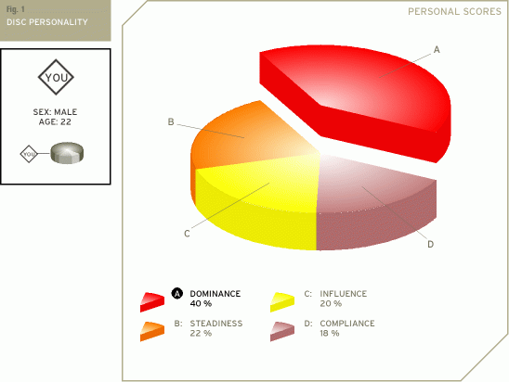
Data ANALYSIS Volunteer 9 Before Experiment DISC
Dominance | Describes the way you deal with problems, assert yourself and control situations.
Influence | Describes the way you deal with people, the way you communicate and relate to others.
Steadiness | Describes your temperament - patience, persistence, and thoughtfulness
Compliance | Describes how you approach and organize your activity, procedures and responsibilities.

Slide 38
Data ANALYSIS Volunteer 9 After
Buss Perry Aggression Questionnaire
Volunteer 2 (The Aggression scale consists of 4 factors ranked from 0 to 1, with 1 being the maximum.)
Age: 22
Gender Male
Physical aggression: 0.12
Verbal aggression: 0.22
Hostility: 0.24
Anger: 0.14

Slide 39
Data ANALYSIS Volunteer 9 After Experiment DISC
Dominance | Describes the way you deal with problems, assert yourself and control situations.
Influence | Describes the way you deal with people, the way you communicate and relate to others.
Steadiness | Describes your temperament - patience, persistence, and thoughtfulness
Compliance | Describes how you approach and organize your activity, procedures and responsibilities.

Slide 40
Data ANALYSIS Volunteer 9 After
Buss Perry Aggression Questionnaire
Volunteer 2 (The Aggression scale consists of 4 factors ranked from 0 to 1, with 1 being the maximum.)
Age: 19
Gender Female
Physical aggression: 0.22
Verbal aggression: 0.32
Hostility: 0.15
Anger: 0.31

Slide 41
Data ANALYSIS Volunteer 10 Before
Buss Perry Aggression Questionnaire
Volunteer 2 (The Aggression scale consists of 4 factors ranked from 0 to 1, with 1 being the maximum.)
Age: 18
Gender Female
Physical aggression: 0.16
Verbal aggression: 0.46
Hostility: 0.45
Anger: 0.22

Slide 42
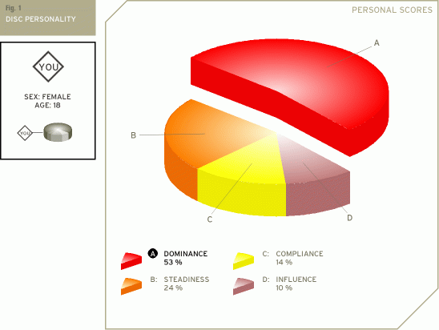
Data ANALYSIS Volunteer 10 Before Experiment DISC
Dominance | Describes the way you deal with problems, assert yourself and control situations.
Influence | Describes the way you deal with people, the way you communicate and relate to others.
Steadiness | Describes your temperament - patience, persistence, and thoughtfulness
Compliance | Describes how you approach and organize your activity, procedures and responsibilities.

Slide 43
Data ANALYSIS Volunteer 10 After
Buss Perry Aggression Questionnaire
Volunteer 2 (The Aggression scale consists of 4 factors ranked from 0 to 1, with 1 being the maximum.)
Age: 18
Gender Female
Physical aggression: 0.22
Verbal aggression: 0.32
Hostility: 0.15
Anger: 0.31

Slide 44
Data ANALYSIS Volunteer 10 After Experiment DISC
Dominance | Describes the way you deal with problems, assert yourself and control situations.
Influence | Describes the way you deal with people, the way you communicate and relate to others.
Steadiness | Describes your temperament - patience, persistence, and thoughtfulness
Compliance | Describes how you approach and organize your activity, procedures and responsibilities.

Slide 45
Conclusion to Data
There is little/ insignificant data between the tendency or violence and anger and video games. Whatever anger or violence tendency was observed was noted that the volunteers themselves admitted it was mostly due to the difficult content, puzzling challenges that they faced, and the competitive nature of the video games.

Slide 46
Time Table: Of Gathering Data
DiSC Behavioral Analysis : September 30, 2019 – October 25, 2019
Opinions and Articles from Psychologist: September 30, 2019
Analysis of National and Local Crime rate: September 30, 2019 – October 18, 2019

