Slide 1
EN202-ON01
PRESENTATION II
Dolores Deena Sablan
Northern Marianas College
Dr. Kimberly Bunts-Anderson

Slide 2
In what ways do job satisfaction affect the performance and productivity of employees?
What percent of surveyed employees are satisfied with their jobs?
What do most workers value/desire in their job?

Slide 3
Process
In terms of collecting data, the student researcher planned on sending out online surveys to approx. 40 NMC students, letters to a possible of 10 experts , a 3 week observation, and about 5 electronic interviews. Out of the proposed methodology, the researcher was not able to collect data from 2 methods. The student researcher was only able to collect data through the online survey and electronic interviews.

Slide 4
Methodology
The student researcher created an online survey through surveymonkey.com and pasted the link on a shared google page for all students to complete. The survey consisted of ten questions that includes demographics, open & closed questions in addition to opinion based questions. The type of survey was a survey of convenience.
The researcher also sent out an electronic survey to employees of different jobs. The interview included about 6 questions regarding personal experience and opinions about their jobs. The researcher aimed for about 5 different employees, but will only state their positions and identities will remain anonymous.

Slide 5
Analysis
Through the online survey, the researcher was able to collect 16 responses from NMC students. Out of the 16 responses, there were 5 male respondents and 11 female respondents. The age of respondents ranged from 18-26 years old. 7 of them being employed and the other 8 being currently unemployed. The analysis was able to determine that although there are less male respondents than females, majority of the males are currently employed and majority of the females have previously worked but are currently unemployed. In addition, these males have a much longer work experience of about 3 years and majority of the females have been employed only for less than a year.

Slide 6
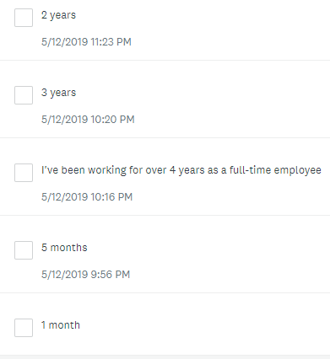
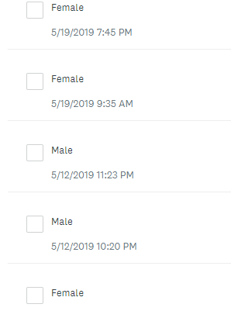
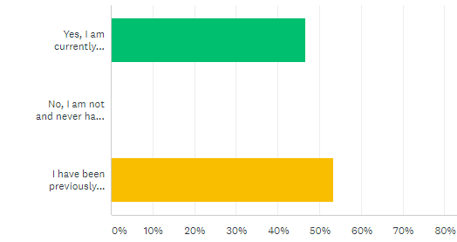

Slide 7
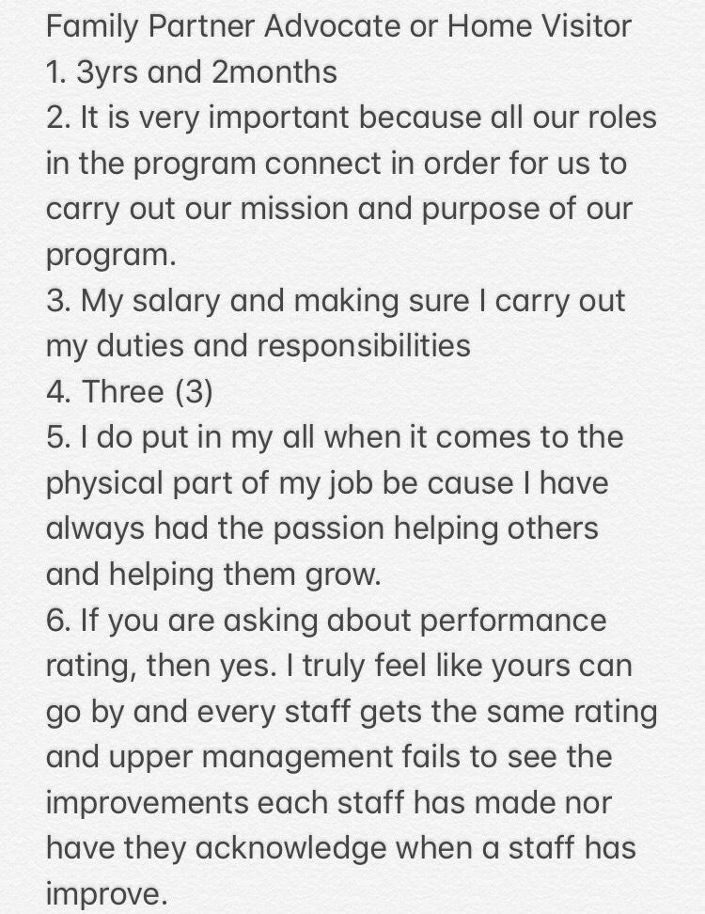
As for the electronic interviews, the researcher was able to collect 5 responses. The positions of these employees include a market stocker, librarian assistant, Air Force airman, polynesian dancer, and a family partner advocate. ⅘ of these respondents have been employed for more than a year.

Slide 8
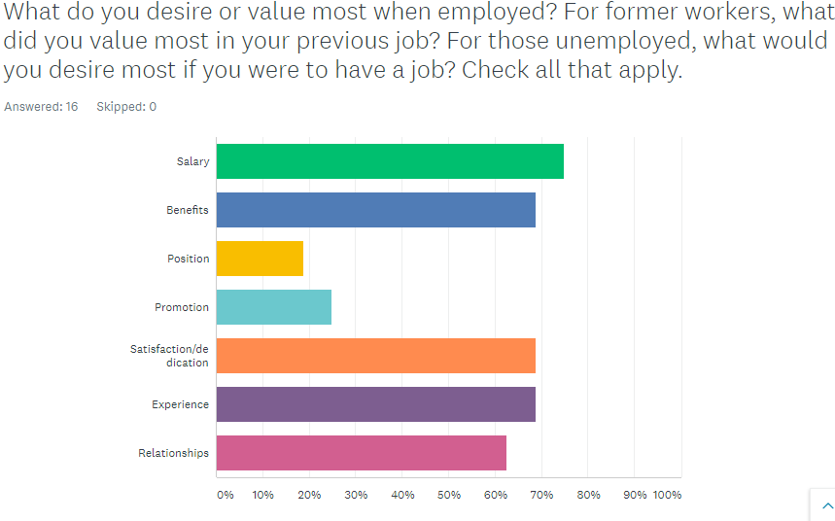
Findings
The least valued in a job are position and promotion. The highest desires are salary, benefits, satisfaction, experience and relationships. According to Douglas McGregor’s Theory of Motivation, majority of these respondents fall under the Satisfaction Theory and the Incentive Theory based on their desires/values.
-The Satisfaction Theory proposes a satisfied worker who obtains an utmost motivation and proves his loyalty to his job. Satisfaction as a motivator.
-The Incentive Theory states that an individual is motivated to obtain rewards and values finance, increasing his efforts and performance to achieve them.

Slide 9
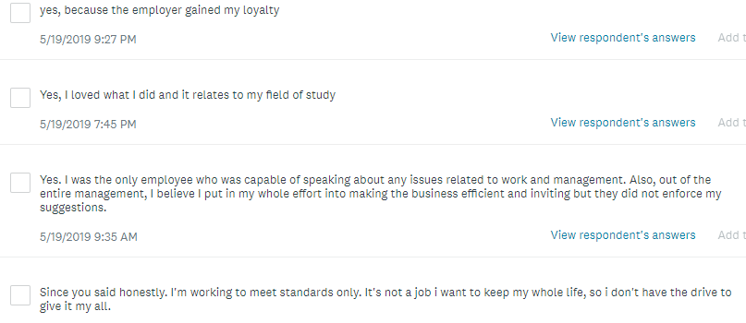
The survey and interviews included a question regarding whether one feels they are hardworking or puts in all the effort in their job. Another of McGregor’s Theories includes the X and Y Categories that display an individual’s different perspective of their performance. The X category is said to be an individual who needs a lot of controlling and directing in order to get the job done. The Y category never sees work as wearisome and always commits to the goals that are set. Because majority of responses agree that they are hardworking, the mindset of these respondents fall under the X category.
An interesting response that stated pure honesty and differed from majority of the other responses.

Slide 10
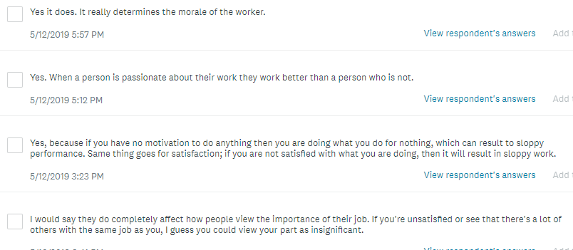
When asked if they believe that satisfaction affects employee performance and productivity, all answered in agreement and some are:

Slide 11
Conclusion
Overall, it is believed that job satisfaction affects employee performance and productivity in terms of motivation, the mindset in a job, the different goals and desires, relationships with those you work with, and the attitude towards the job. Majority of the time, one can’t carry out their job to the best of their ability if they lack satisfaction and motivation. It was found that people possess different attitudes that affect their performance, relating to the X and Y categories. Based on the findings, majority of respondents believe that they are hardworking in their jobs. Because of this, they seem to fall under the Y category. Also, the data collected indicated that majority of respondents desire and value similar factors such as salary, benefits, satisfaction, experience and relationships. The researcher was able to compare this finding with Douglas McGregor’s Theory of Motivation. This also indicated that majority of respondents fall under The Satisfaction Theory and The Incentive Theory based on their desires. Lastly, the researcher found that majority of surveyed respondents and employees are not fully satisfied with their jobs, instead averagely satisfied. There were only 5 that stated they are 100% satisfied, but no one indicated that they are NOT at all satisfied. It was found that possible reasons of dissatisfaction was the management and salary.

Slide 12
About this research project
Possible reasons on improving this project are time management, planning ahead, a better and useful methodology, finding better sources, and overall the presentation of this topic. The strengths in approaching this topic was finding participants because employment is a part of everyone’s lives. It was successful obtaining experiences and opinions from different people. The weaknesses of this topic was locating useful literature sources to support my topic. Another weakness was locating possible experts regarding the topic. What was not successful in this project was receiving responses from experts and conducting the observations. A suggestion to others interested in the same area is to plan ahead, find reputable sources and think thoroughly how to better present this topic. What I learned about the topic is that everyone will always view their job differently. In addition, everyone has different motivators, goals, desires, attitudes and behavior for a job. What I learned about research are the different ways to approach a topic, planning different methodologies and finding literature to support the topic. The skills that I believed I’ve improved on is asking accurate questions in my survey and interviews.

