Slide 1
EN202: E-Portfolio
Jerric Conde
EN202 - 02 English Composition II
Spring 2019
Dr. Kimberly Bunts-Anderson

Slide 2
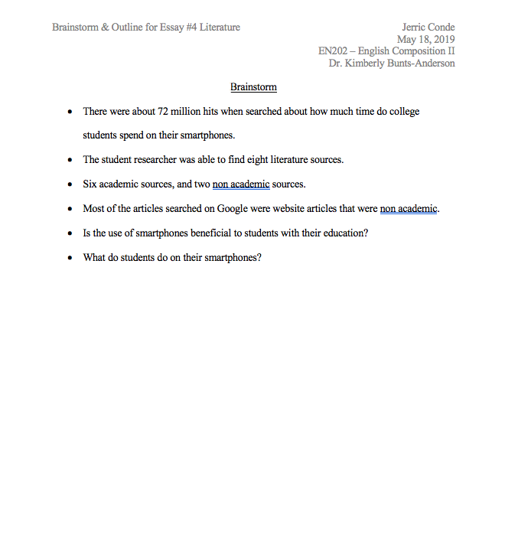
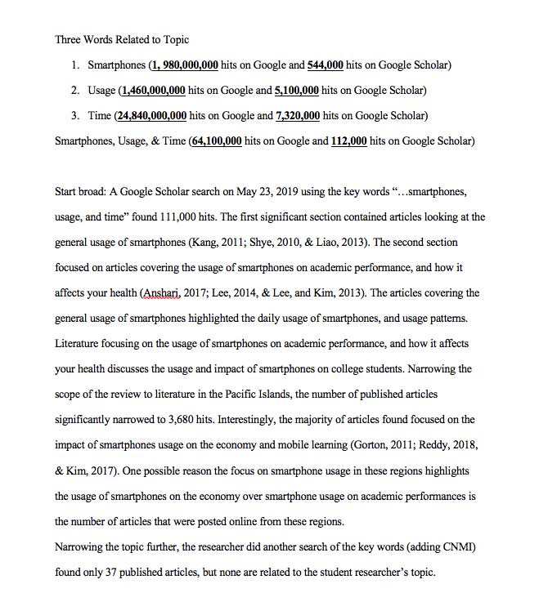
Brainstorms

Slide 3
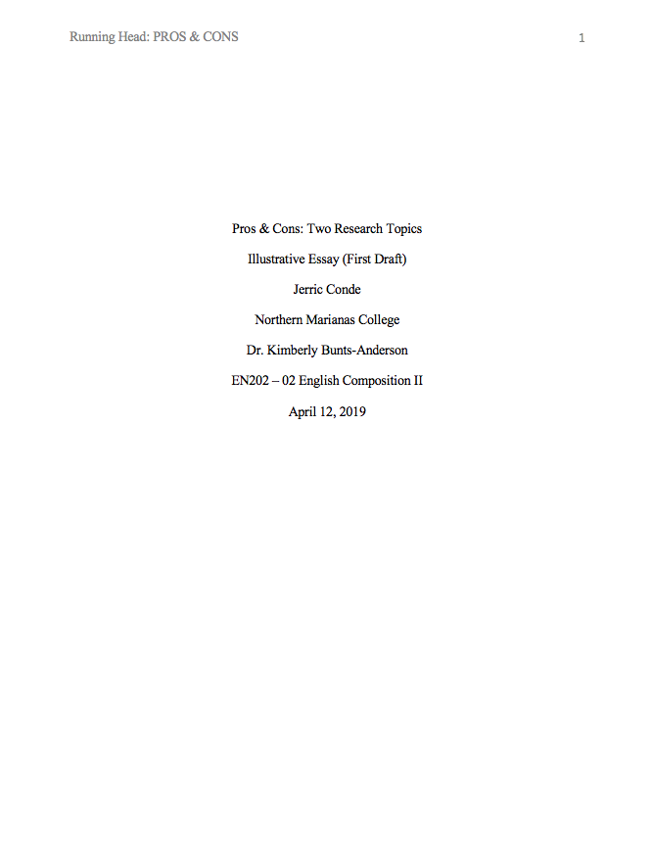
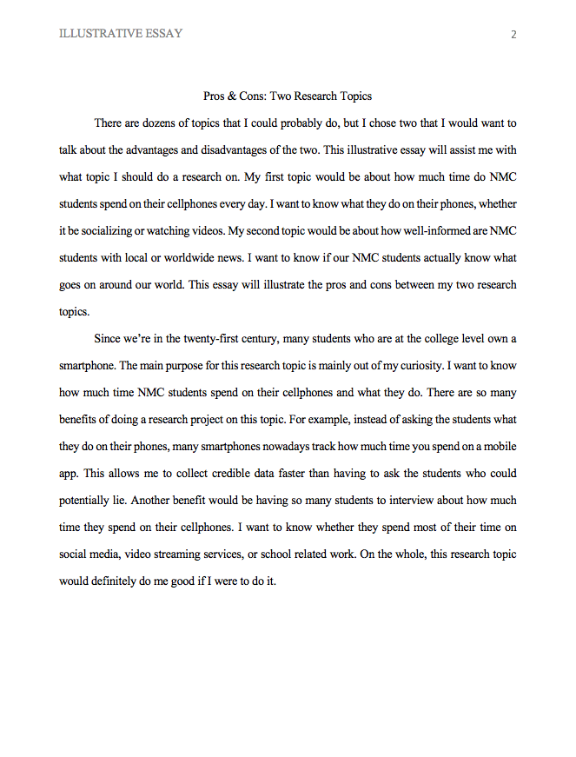
Essay #1 – Illustrative Essay

Slide 4
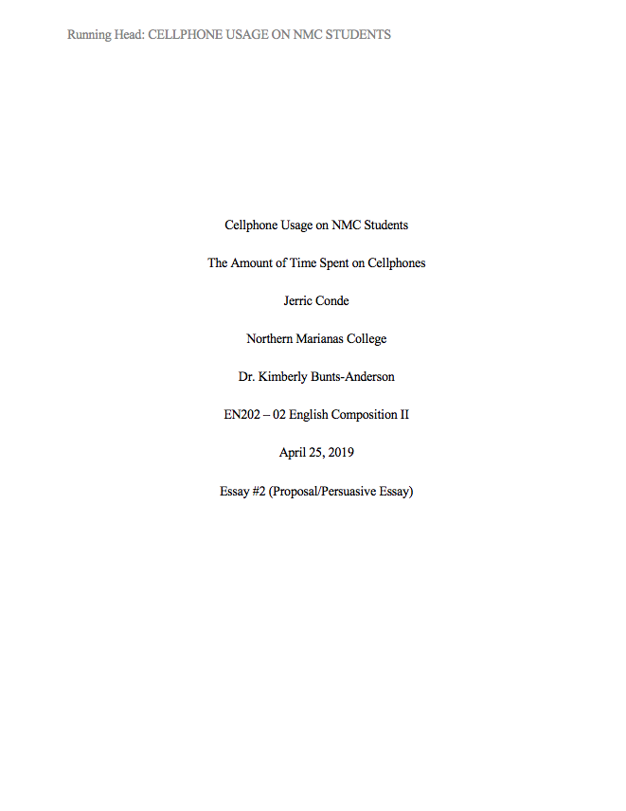
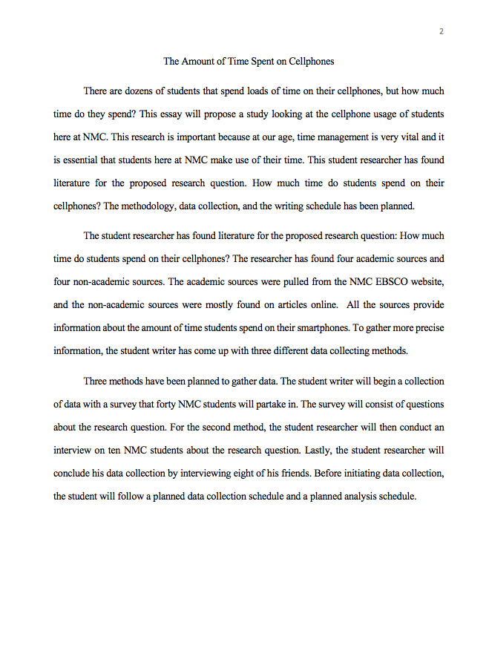
Essay #2 – Proposal Essay

Slide 5
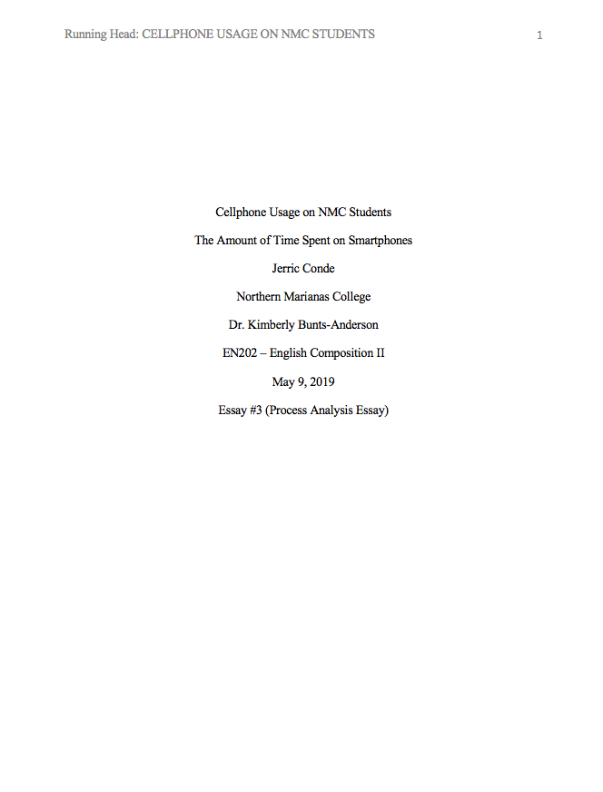
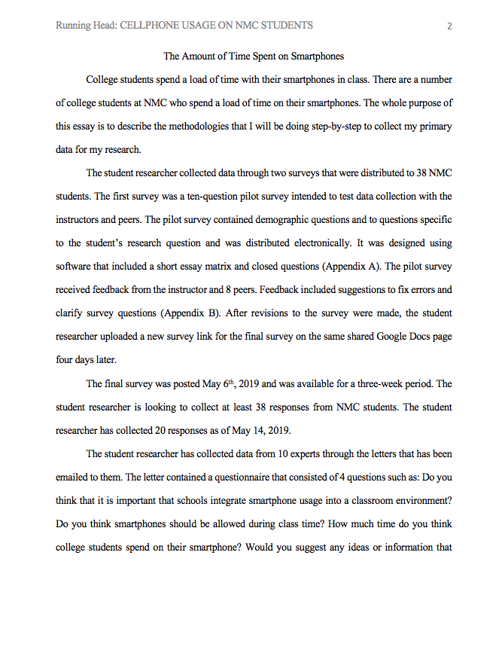
Essay #3 – Process Essay

Slide 6
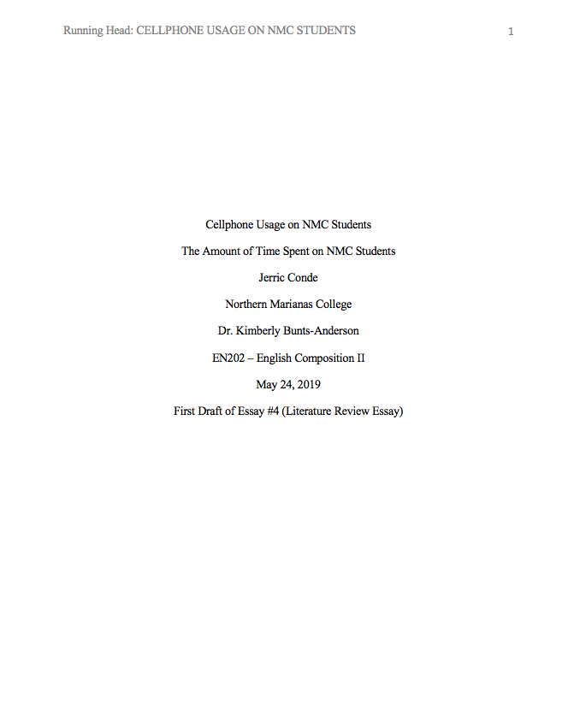
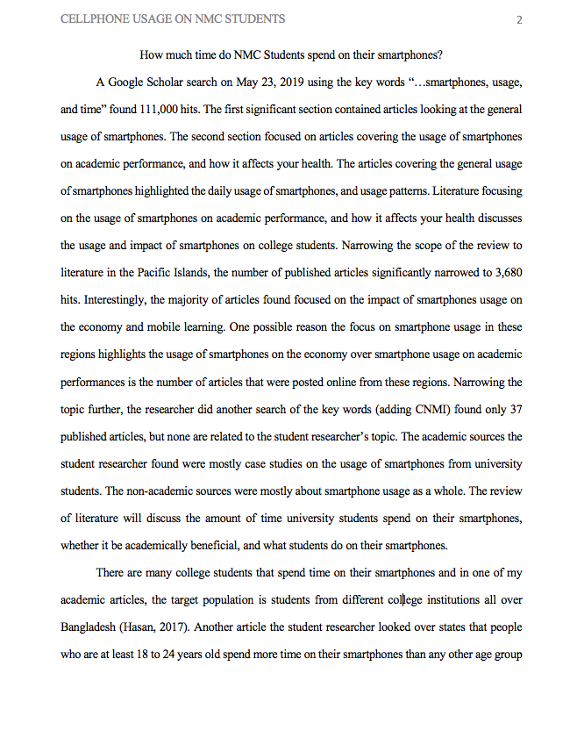
Essay #4 – Literature Review Essay

Slide 7
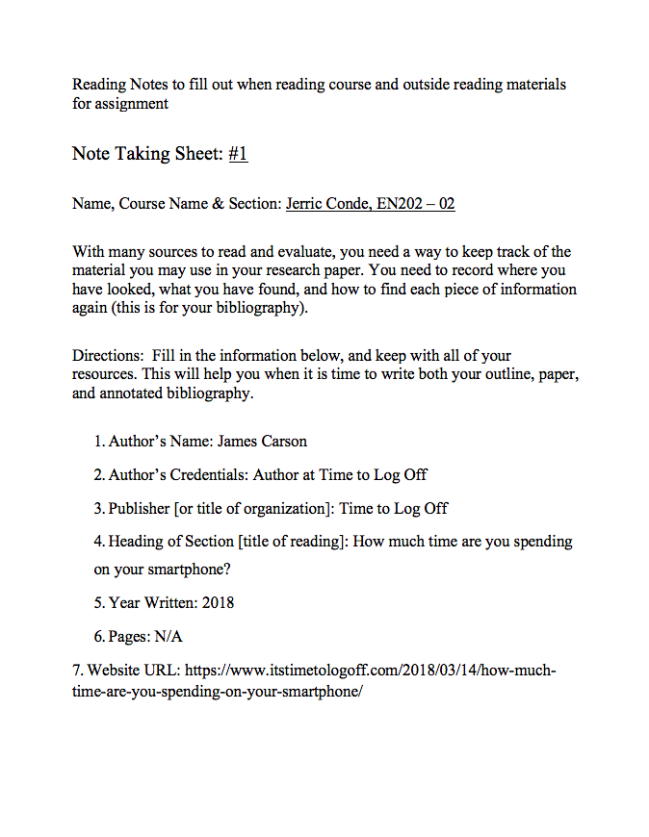
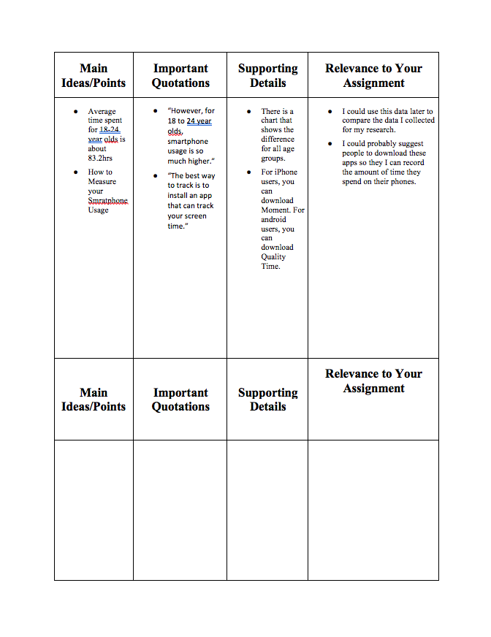
Reading Notes #1

Slide 8
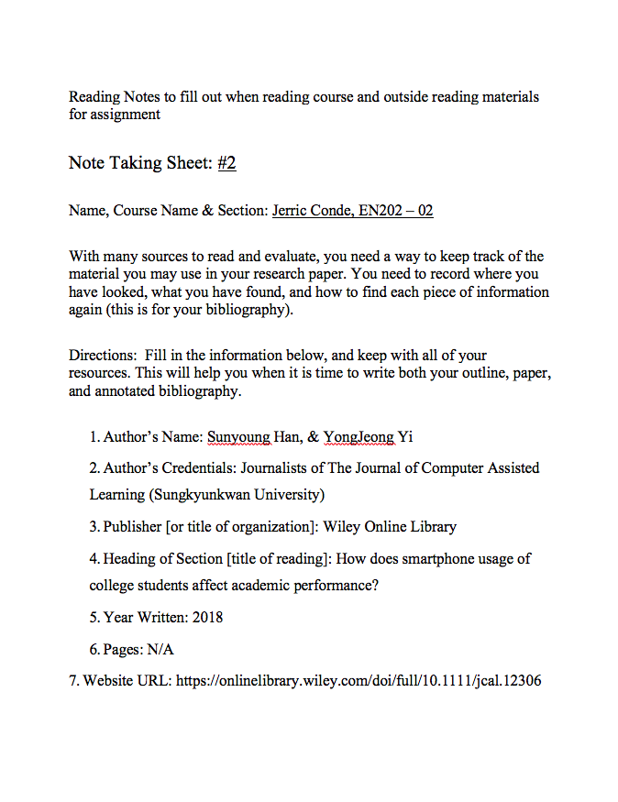
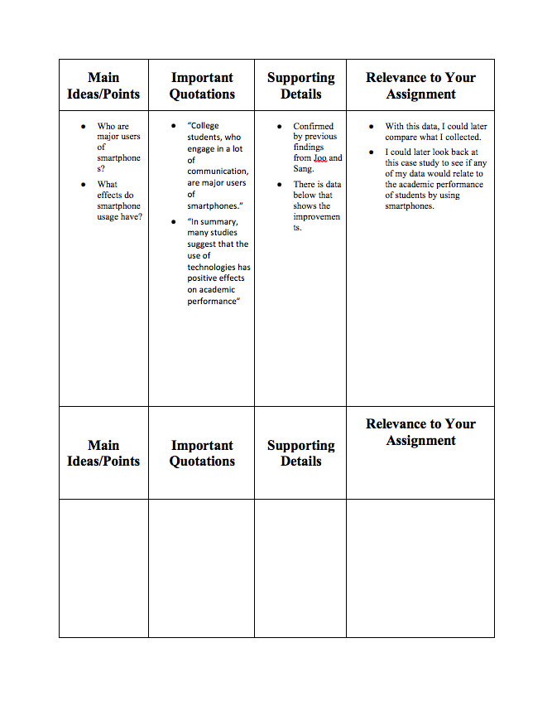
Reading Notes #2

Slide 9
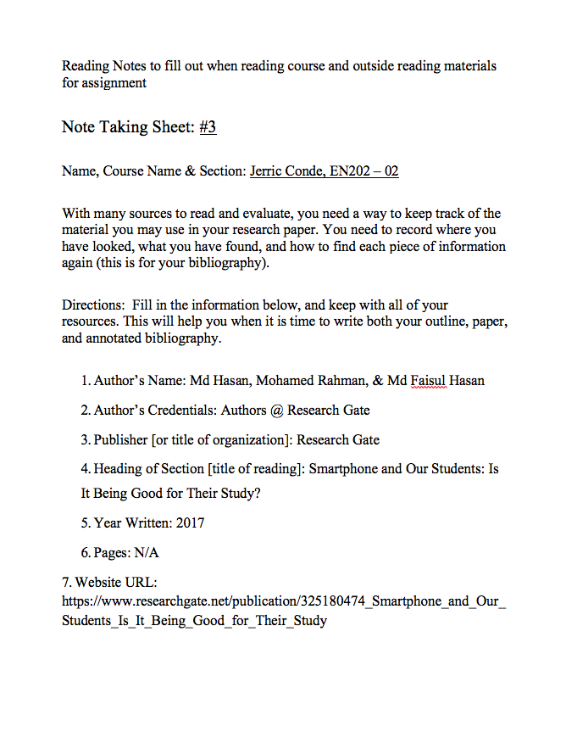
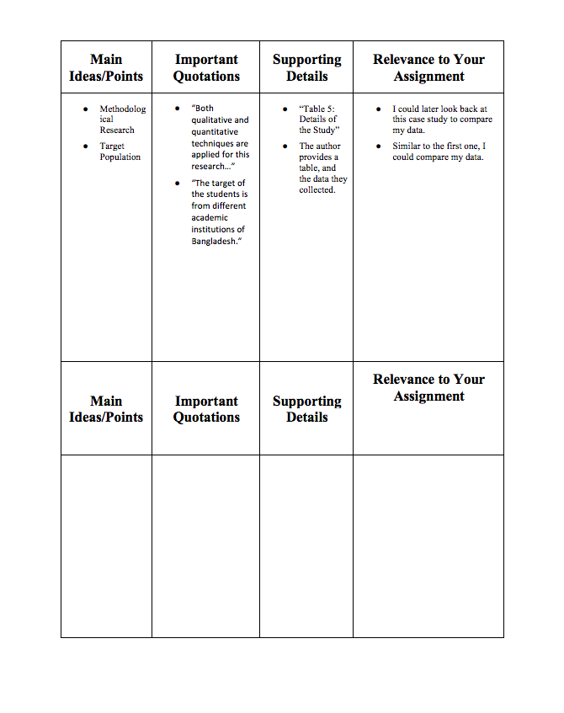
Reading Notes #3

Slide 10
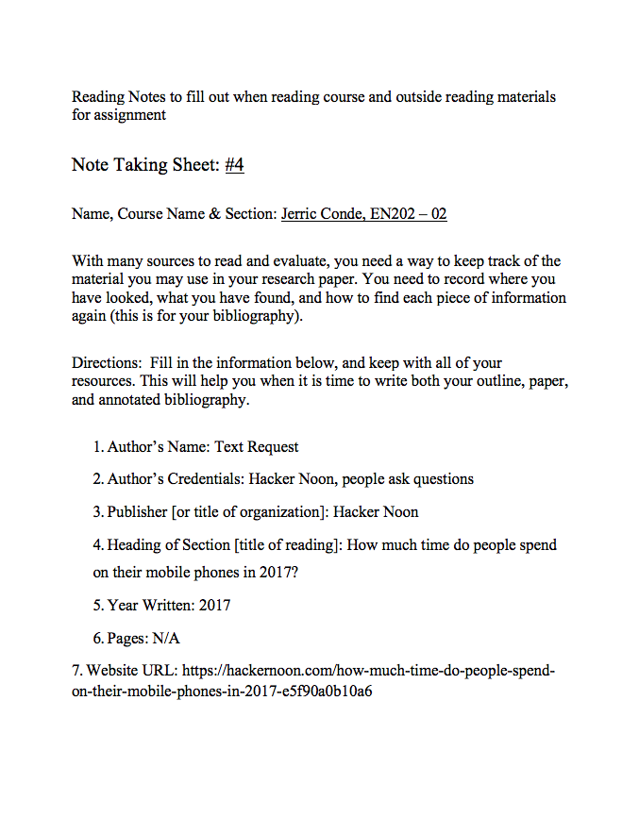
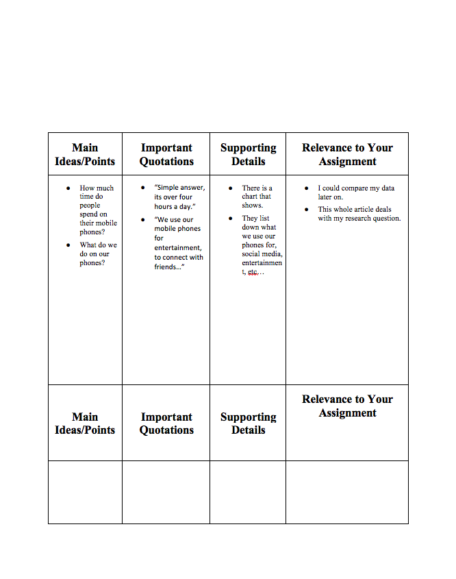
Reading Notes #4

Slide 11
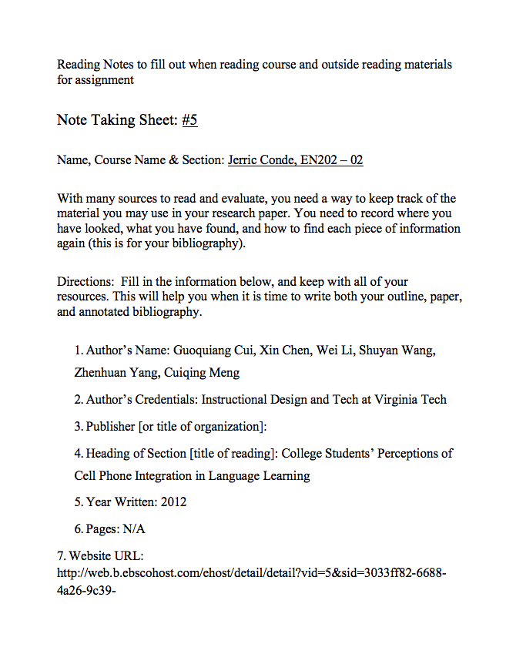
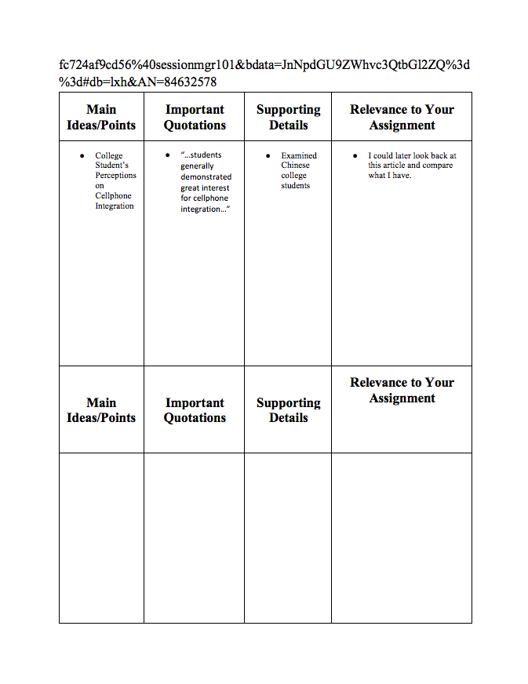
Reading Notes #5

Slide 12
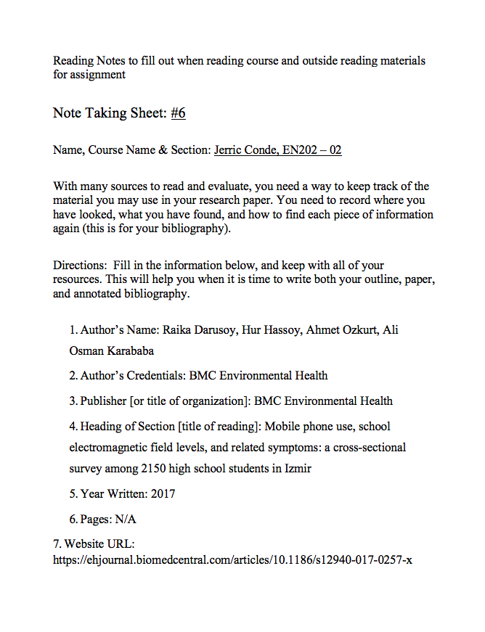
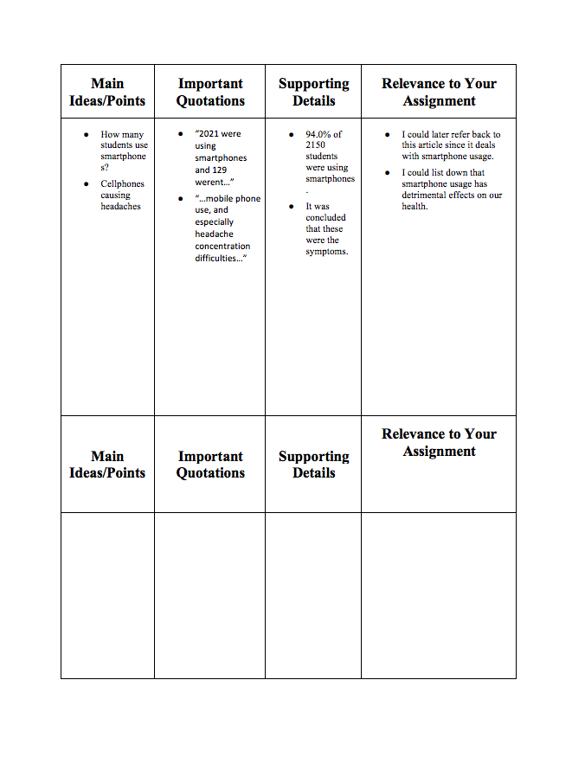
Reading Notes #6

Slide 13
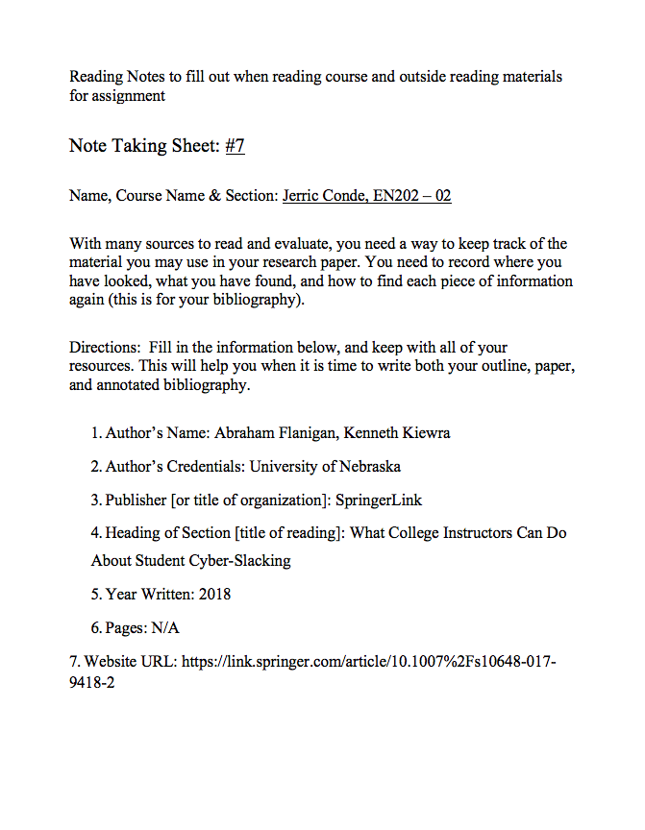
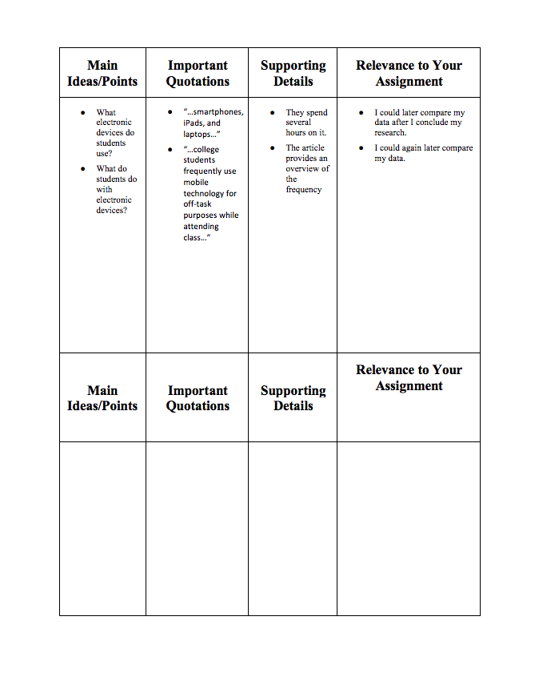
Reading Notes #7

Slide 14
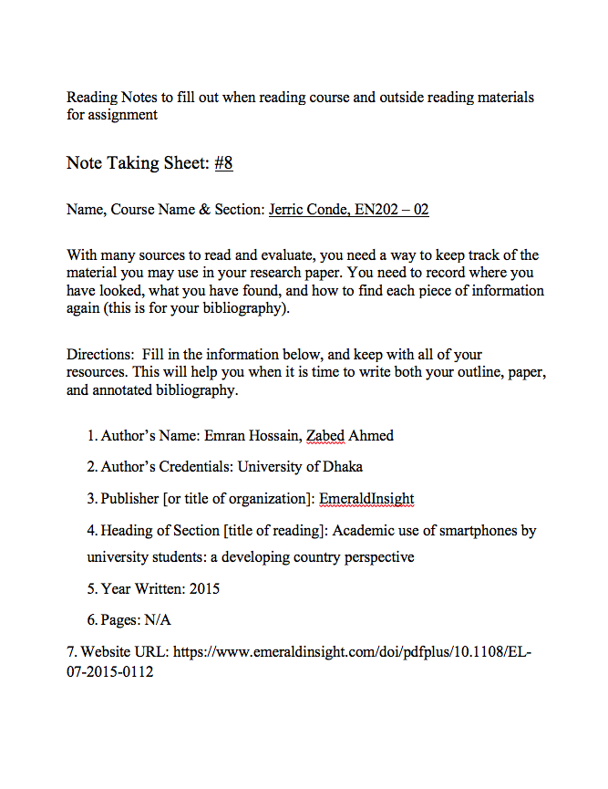
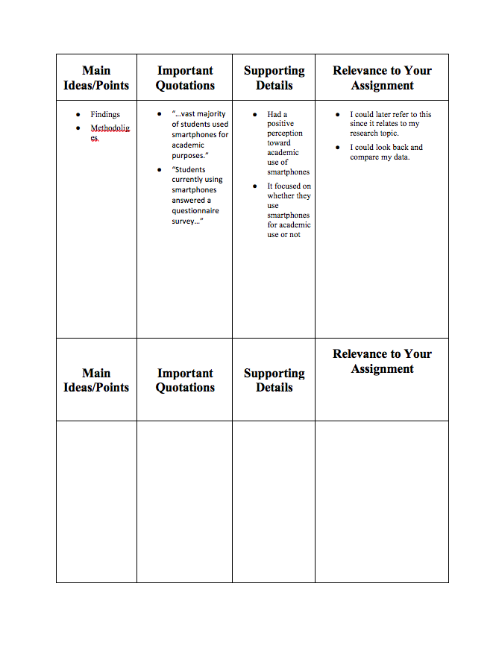
Reading Notes #8

Slide 15
Hyperlink of All Sources
References
Carson, J. (2018, November 24). How much time are you spending on your smartphone? Retrieved April 25, 2019, from https://www.itstimetologoff.com/2018/03/14/how-much-time-are-you-spending-on-your-smartphone/
Cui, G., Chen, X., Li, W., Wang, S., Yang, Z., & Meng, C. (2012). College Students’ Perceptions of Cell Phone Integration in Language Learning. International Journal of Information & Communication Technology Education, 8(4), 11–28. Retrieved on April 25, 2019 from NMC EBSCO, https://doi.org/10.4018/jicte.2012100102
Durusoy, R., Hassoy, H., Özkurt, A., & Karababa, A. O. (2017). Mobile phone use, school electromagnetic field levels and related symptoms: a cross-sectional survey among 2150 high school students in Izmir. Environmental Health: A Global Access Science Source, 16, 1–14. Retrieved on April 25, 2019 from NMC EBSCO, https://doi.org/10.1186/s12940-017-0257-x
Flanigan, A. E., & Kiewra, K. A. (2018). What College Instructors Can Do About Student Cyber-slacking. Educational Psychology Review, 30(2), 585–597. Retrieved on April 25, 2019 from NMC EBSCO, https://doi.org/10.1007/s10648-017-9418-2
Han, S., & Yi, Y. J. (2018, September 19). How does the smartphone usage of college students affect academic performance? Retrieved April 25, 2019, from https://onlinelibrary.wiley.com/doi/full/10.1111/jcal.12306
Hasan, Md & Rahman, Mohammad Saidur & Tariqul Islam, Mohammad & Hasan, Md. (2017). Smartphone and Our Students: Is It Being Good for Their Study?. Retrieved April 25, 2019, from https://www.researchgate.net/publication/325180474_Smartphone_and_Our_Students_Is_It_Being_Good_for_Their_Study
Hossain, M. E., & Ahmed, S. M. Z. (2016). Academic use of smartphones by university students: a developing country perspective. Electronic Library, 34(4), 651–665. Retrieved on April 25, 2019 from NMC EBSCO, https://doi.org/10.1108/EL-07-2015-0112
Request, T. (2017, May 09). How Much Time Do People Spend on Their Mobile Phones in 2017? Retrieved April 25, 2019, from https://hackernoon.com/how-much-time-do-people-spend-on-their-mobile-phones-in-2017-e5f90a0b10a6

Slide 16
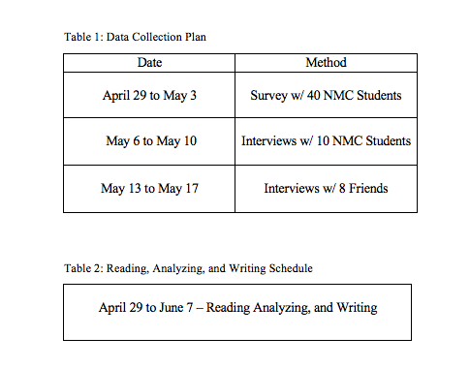
Schedule & Log

Slide 17
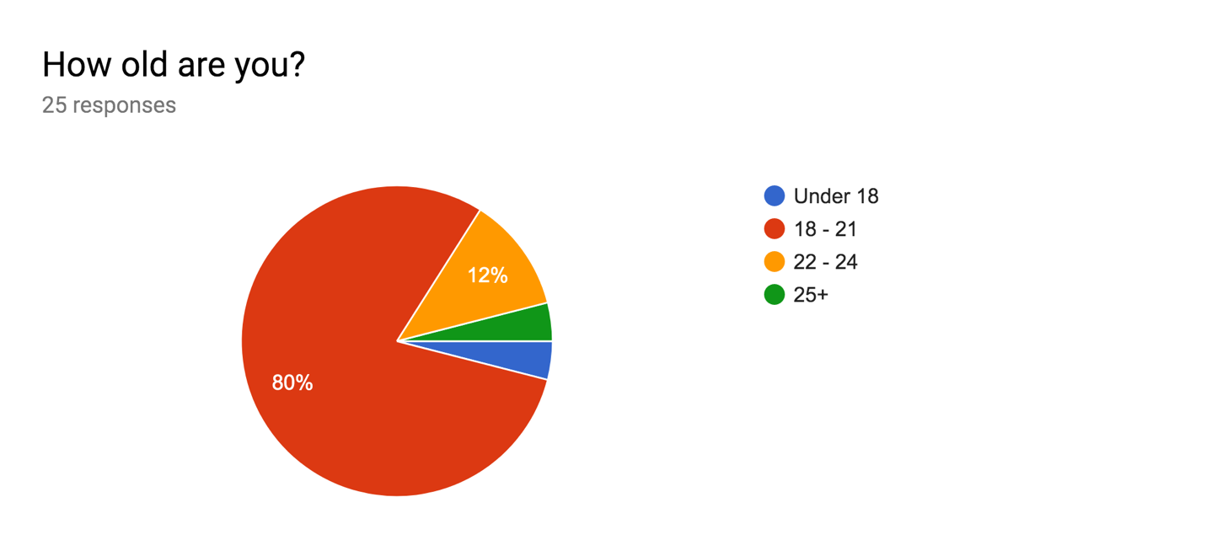
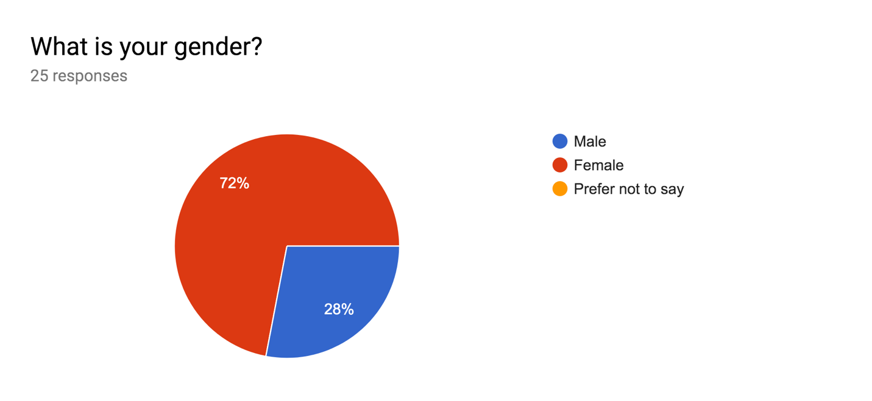
Appendices

Slide 18
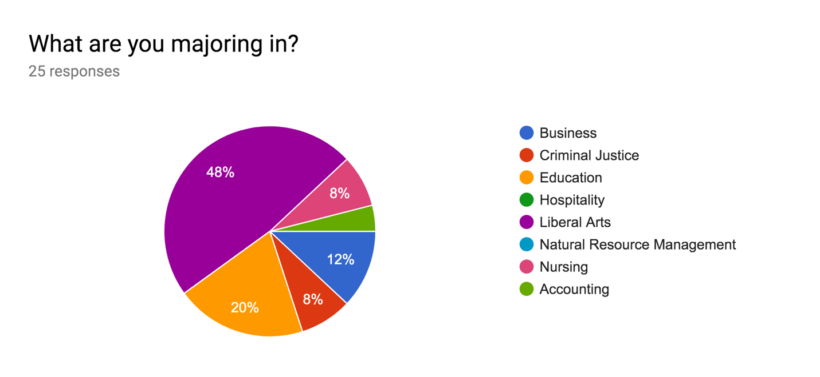
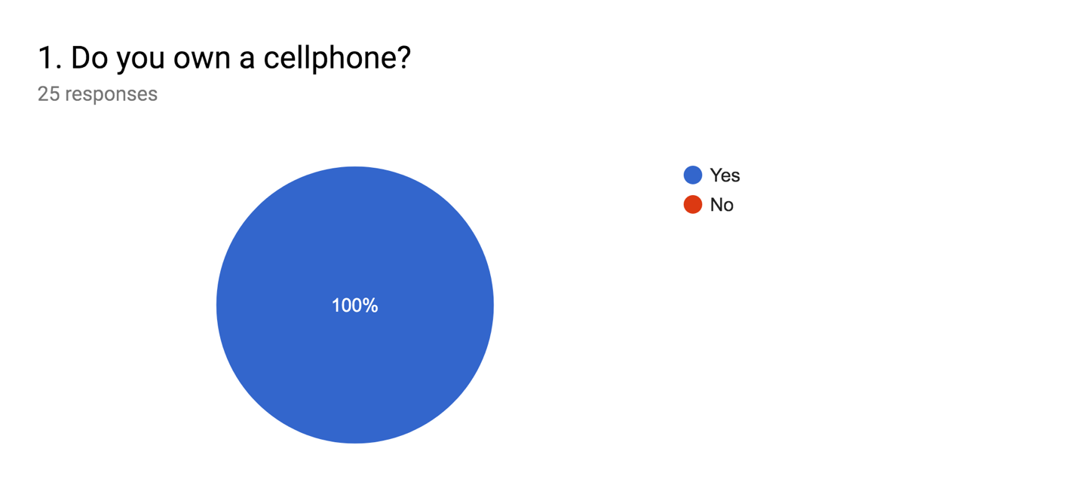
Appendices

Slide 19
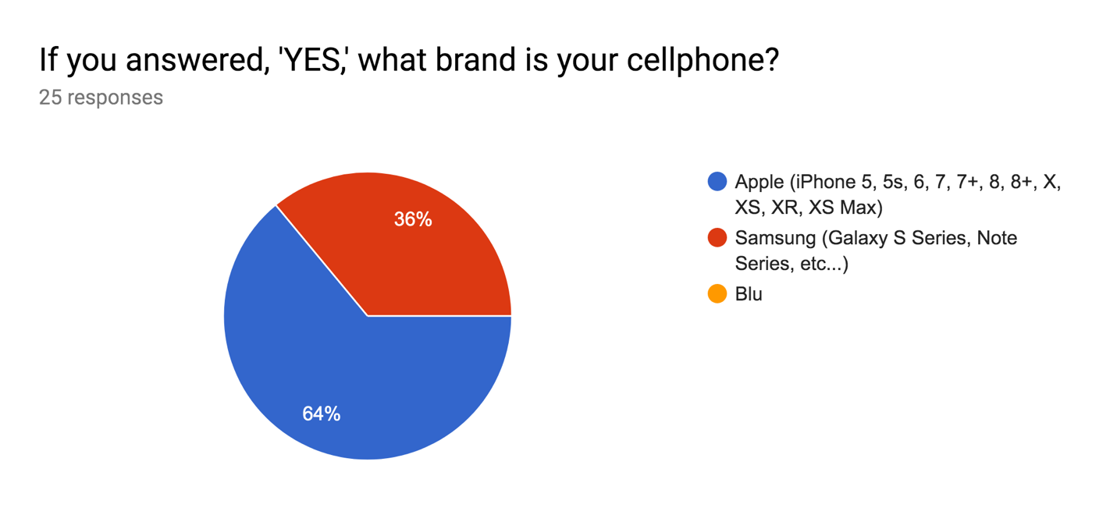
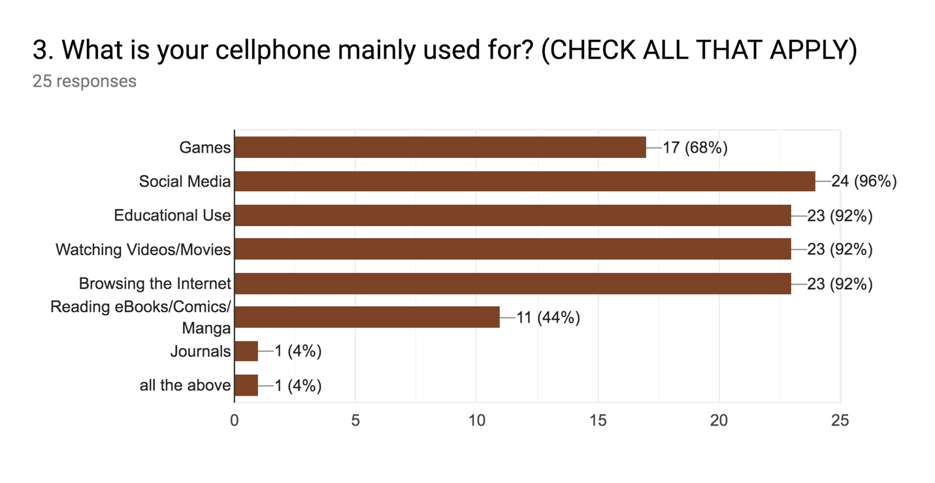
Appendices

Slide 20
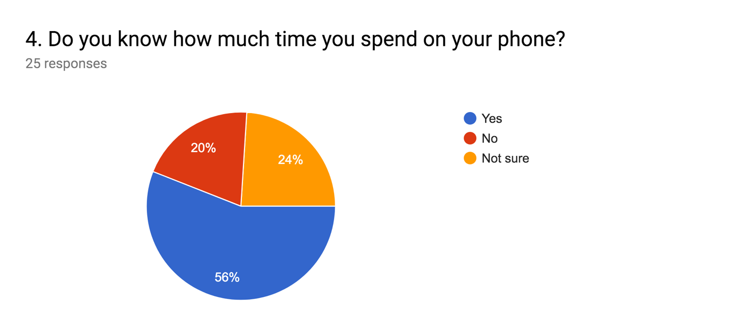
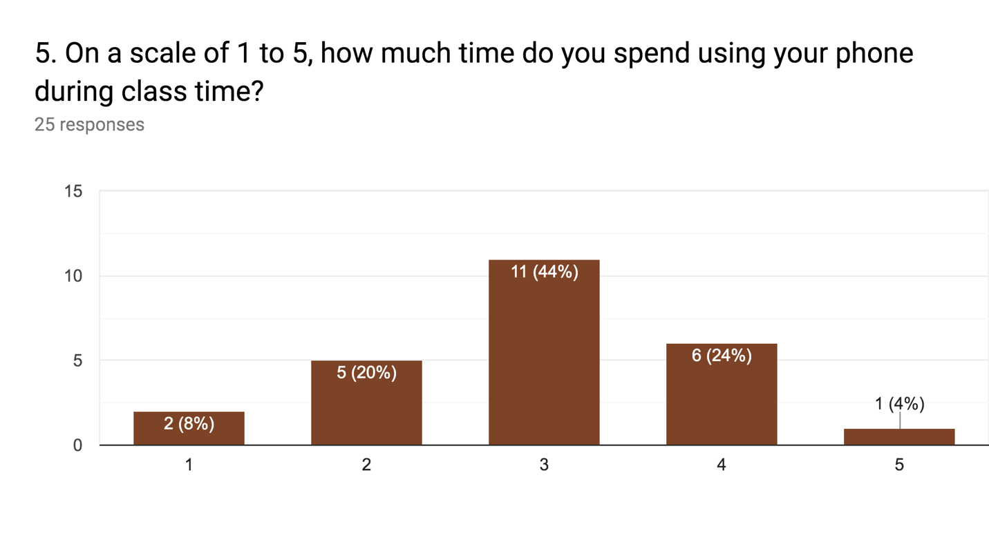
Appendices

Slide 21
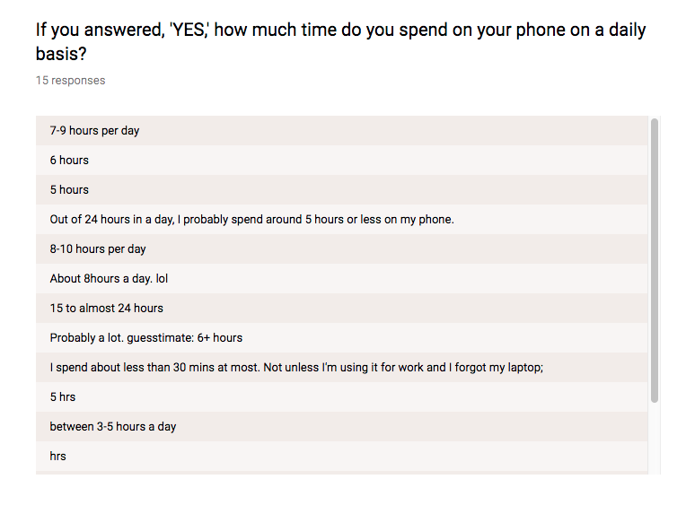
Appendices

Slide 22
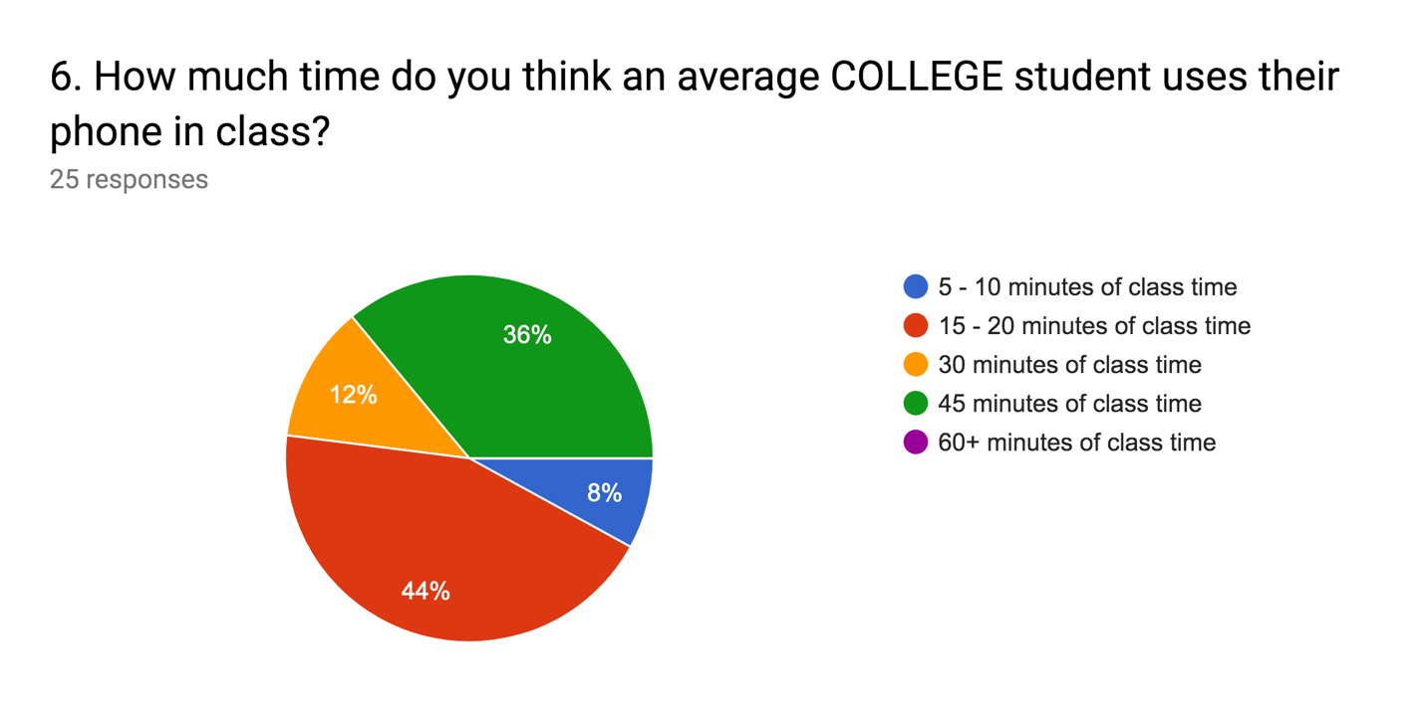
Appendices

Slide 23
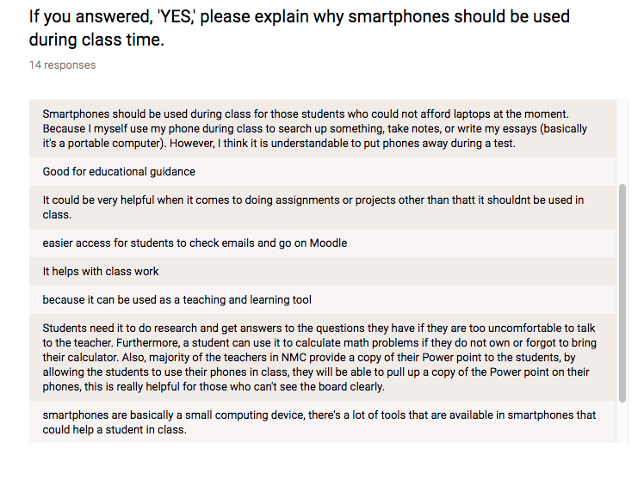
Appendices

Slide 24
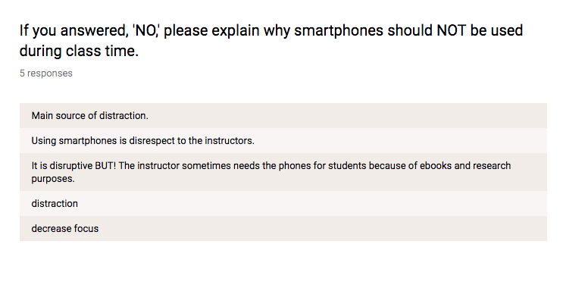
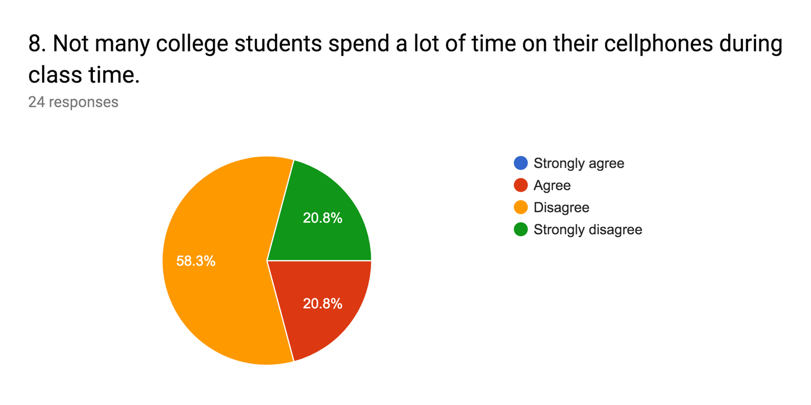
Appendices

Slide 25
Appendices

