Slide 1
EN202-ON01
E-PORTFOLIO
Dolores Deena Sablan
Northern Marianas College
Kimberly Bunts-Anderson

Slide 2
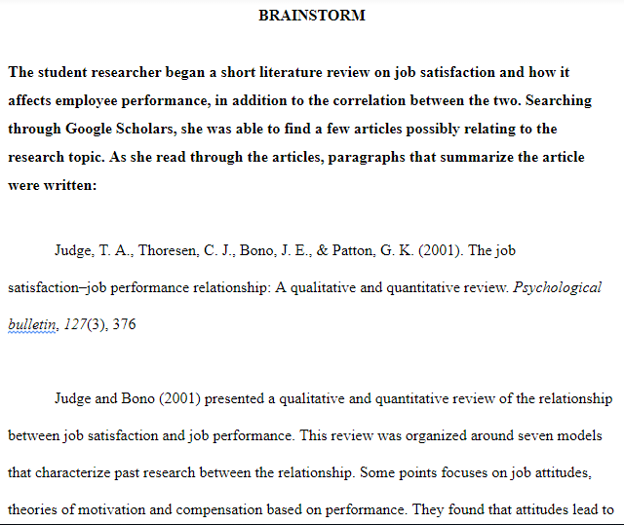
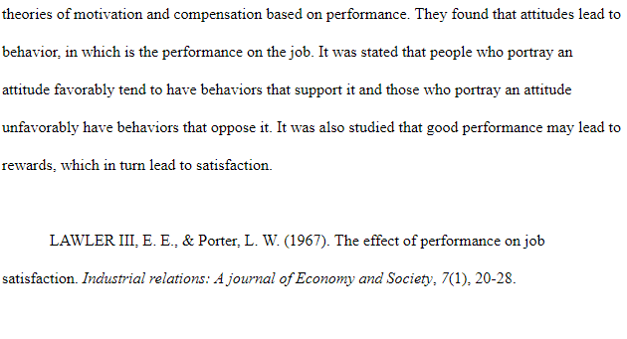
Brainstorms

Slide 3
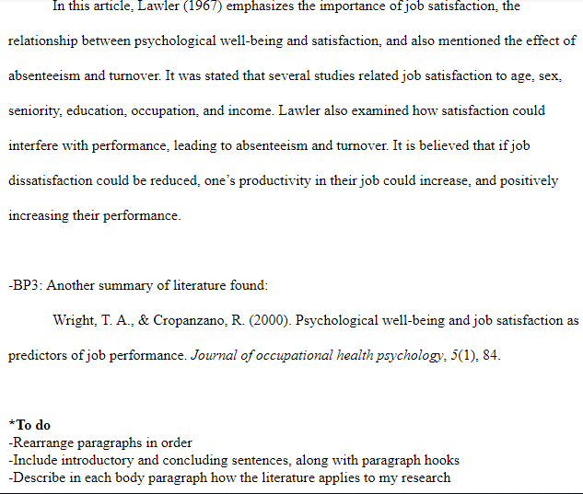
Link:
https://docs.google.com/document/d/1OzgL3N2HGXI4LUbW4W5c84fLMqEK6h1xAuJCtXdcnpQ/edit?usp=sharing

Slide 4
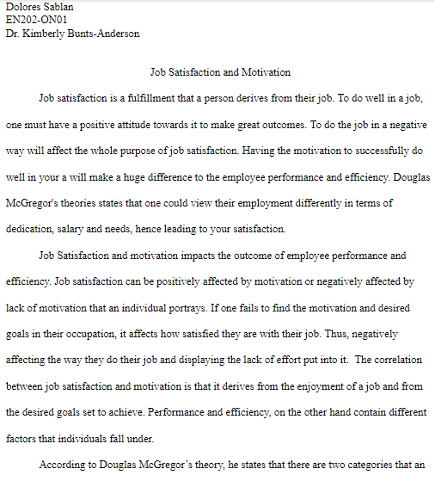
Essay 1 Illustrative
Link:
https://docs.google.com/document/d/1OVdCRvoUdjMJC1B11tvC1NECoJdJstYAwVcjMc6sGmk/edit?usp=sharing

Slide 5
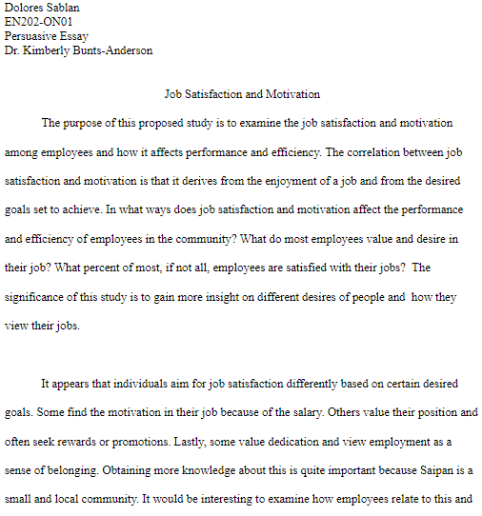
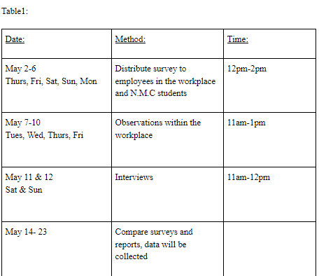
Essay 2 Persuasive
Link:
https://docs.google.com/document/d/1HeiD4rVkqyTH4roESyADghs607UTViYzRsyJAEBAD8k/edit?usp=sharing

Slide 6
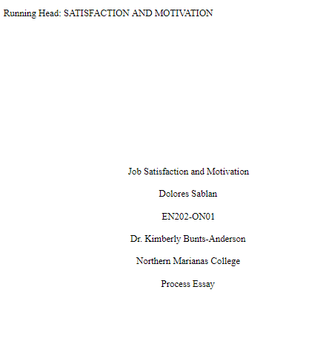
Essay 3 Process
Link:
https://docs.google.com/document/d/1EkBav4WSuirJSNPIF7-BjnjV8kAZ6_YBxnlHMtf0fRw/edit?usp=sharing

Slide 7
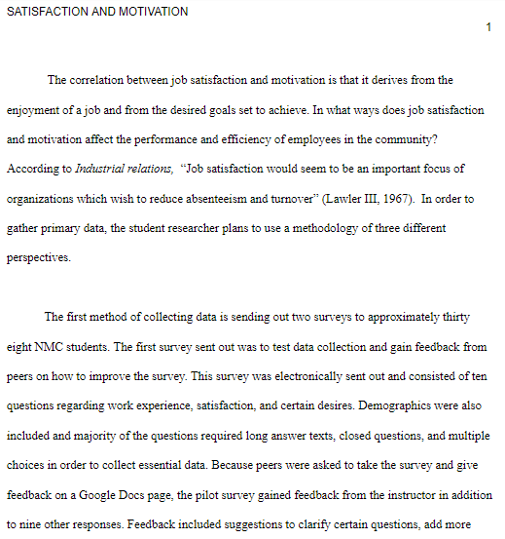

Slide 8
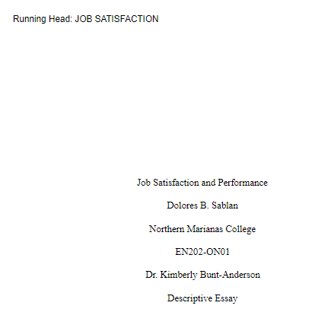
Essay 4 Descriptive
Link:
https://docs.google.com/document/d/14cLv6dj8q03aHPanEHmjFYy1mk3AIHKLKKAUpAakLtI/edit?usp=sharing

Slide 9
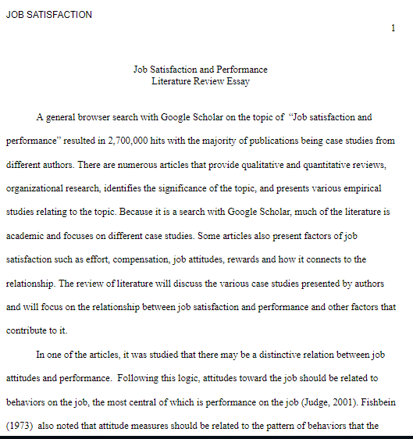
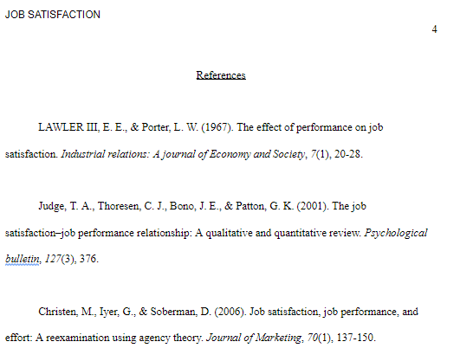

Slide 10
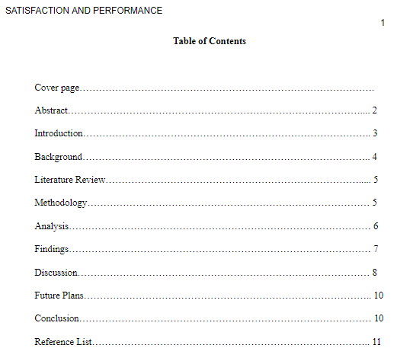
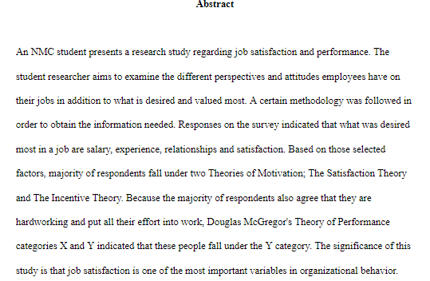
Final Research Report
Link:
https://docs.google.com/document/d/10nlGrA0rQjgMJz5rLydz5qG6hYJhdaSxPl0NE2sTMSg/edit?usp=sharing

Slide 11
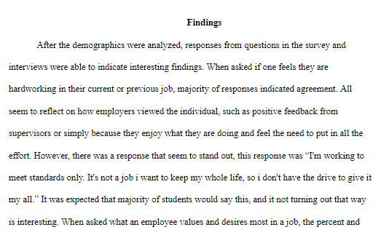
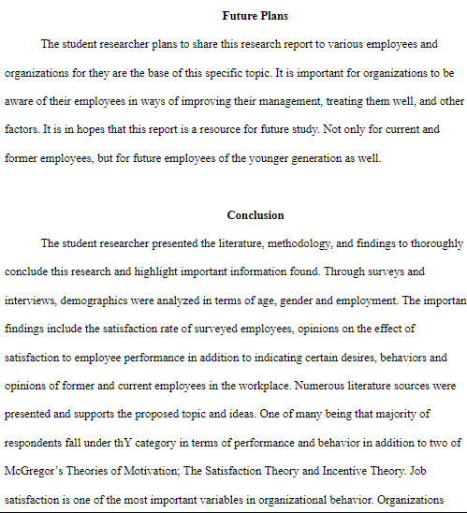

Slide 12
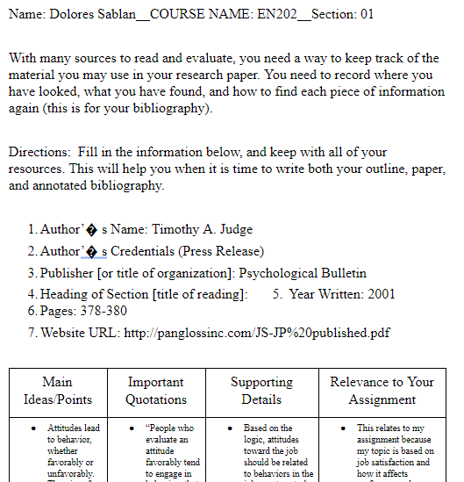
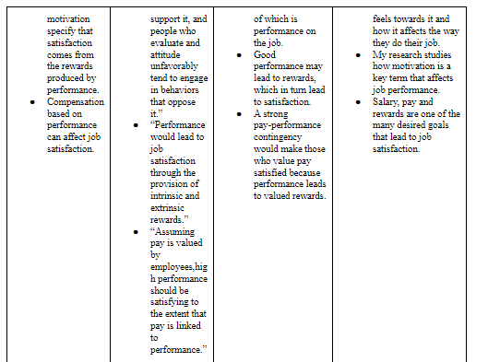
Reading Notes 1&2
https://docs.google.com/document/d/1gG977omJWwiQ_EfHUDzwym76FQwzrLyXxF1lTh4Mgxc/edit

Slide 13
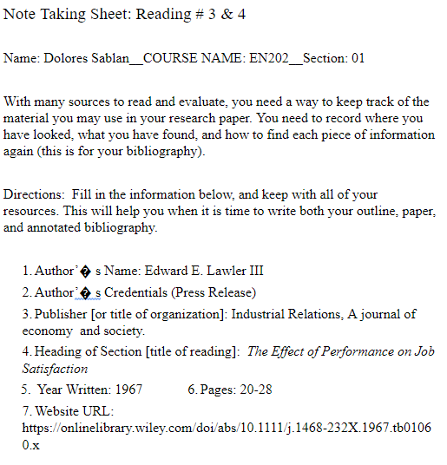
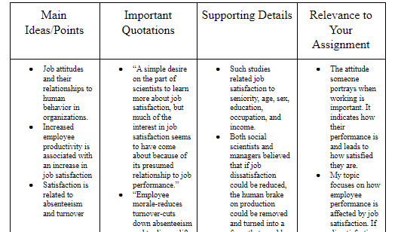
3&4
https://docs.google.com/document/d/1Jy-azXOnsMSATT_2A7Gs3te0UJB39DbOYaTHt8TZfbI/edit

Slide 14
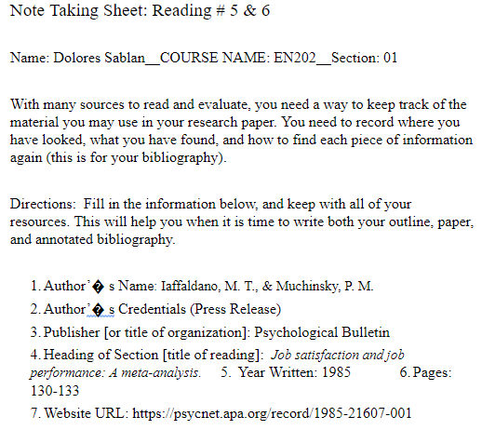
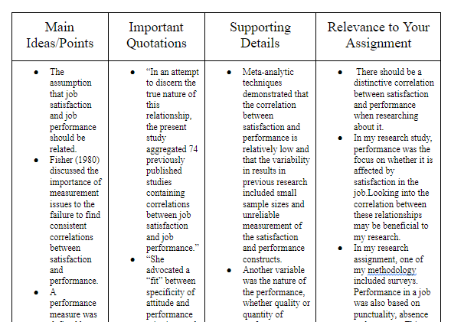
5&6
https://docs.google.com/document/d/184WDMidXTibeQX8HxFKOY9ZphI7Dd0NvLaooO3X-pQY/edit

Slide 15
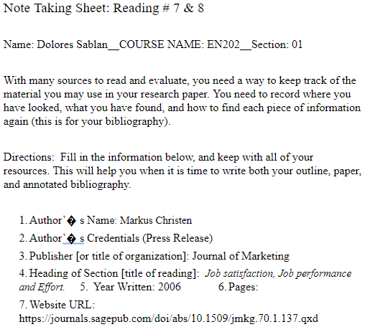
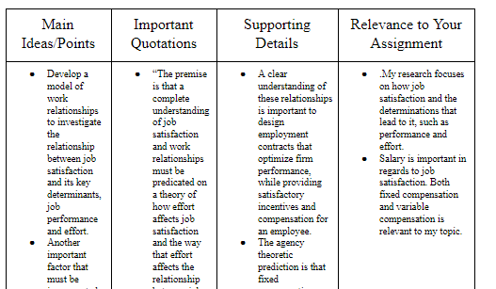
7&8
https://docs.google.com/document/d/1Tbob8eOdrWi4wb1dnJmFNtCK8YGGv1UrLO2aZSAaZ5Q/edit

Slide 16
Hyperlink of
all Sources
Judge, T. A., Thoresen, C. J., Bono, J. E., & Patton, G. K. (2001). The job satisfaction–job performance relationship: A qualitative and quantitative review. Psychological bulletin, 127(3), 376. Retrieved from http://dx.doi.org/10.1037/0033-2909.127.3.376
Wright, T. A., & Cropanzano, R. (2000). Psychological well-being and job satisfaction as predictors of job performance. Journal of occupational health psychology, 5(1), 84. Retrieved from http://dx.doi.org/10.1037/1076-8998.5.1.84

Slide 17
LAWLER III, E. E., & Porter, L. W. (1967). The effect of performance on job satisfaction. Industrial relations: A journal of Economy and Society, 7(1), 20-28. Retrieved from
https://doi.org/10.1111/j.1468-232X.1967.tb01060.x
Coomber, B., & Barriball, K. L. (2007). Impact of job satisfaction components on intent to leave and turnover for hospital-based nurses: a review of the research literature. International journal of nursing studies, 44(2), 297-314. Retrieved from 10.1016/j.ijnurstu.2006.02.004
Essays, UK. (November 2018). Effect of Job Satisfaction on Employee Performance. Retrieved from https://www.ukessays.com/essays/management/employee-job-satisfaction-and-motivation-impact-on-organisational-performance-management-essay.php?vref=1

Slide 18
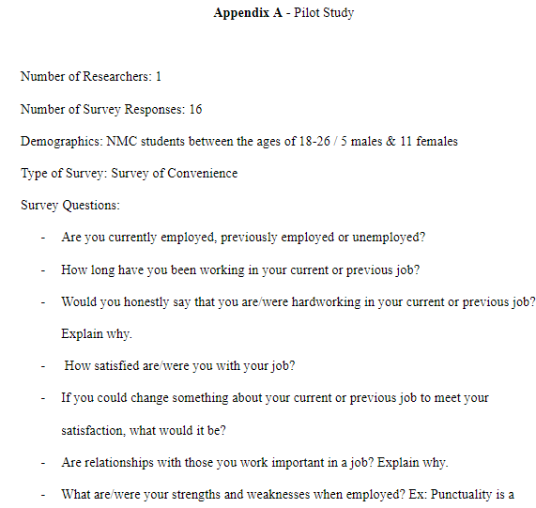
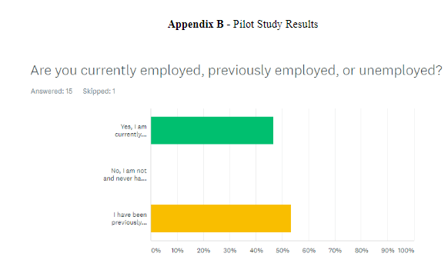
Appendices
Link:
https://docs.google.com/document/d/1HFNLWR9LIzS0VtcB0B9Ut8NgincCqovek1KQ4qG6SgI/edit?usp=sharing

Slide 19
