Slide 1
Sleep Habits Among NMC Students
Joanne Orosco
EN202 – 01
Dr. Kimberly Bunts-Anderson

Slide 2
Primary Question
How do sleep habits affect NMC College students?
Secondary Questions
What are the differences of working and non-working student’s sleep hygiene? How about students taking AM or PM classes?
Does it affect academic performances?

Slide 3
Literature Review
Two research studies
Brown’s (2010) study: relationship between college students’ course schedules, sleep-wake variation, sleep quality, and health status
Herrmann’s (2018) study: sleep habits and their perception regarding its effects on college students

Slide 4
Literature Findings
Students with early classes during the week had greater sleep variations than those that had classes later in the day (Brown studies)
Students overwhelmingly disagreed that caffeine negatively affected their sleep habits (Herrmann studies)
Caffeine or consuming alcohol was demonstrated to interfere with sleep quality (Brown studies)

Slide 5
Methodology
Survey
Surveymonkey.com
10 questions containing sub questions
Demographics, open ended, star scale, multiple choice
42 NMC student respondents
Group Experiment
One week sleep diary
5 questions
Record sleep time, rating energy level, sleep, daily activities,
7 NMC Student participants
Collected 4 participant sleep diary
Letters to Expert
Three experts from psychology, neuroscience, and a family sleep specialist
3 questionnaires
Sent by emails on Feb. 25th 2019
Received “inbox full reject mail” from one of the expert
No responses from two other experts

Slide 6
Survey Findings
qualitative data

Slide 7
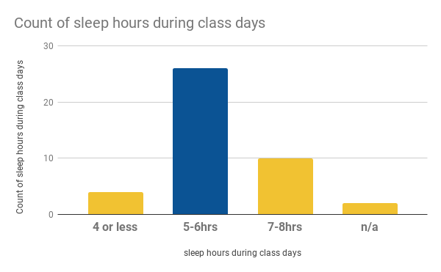
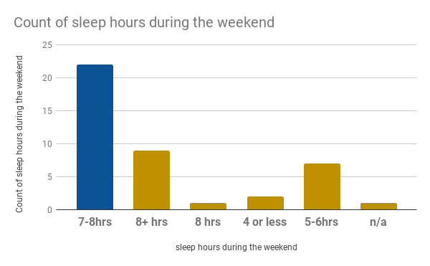
Less sleep on class days Slept more on weekends

Slide 8
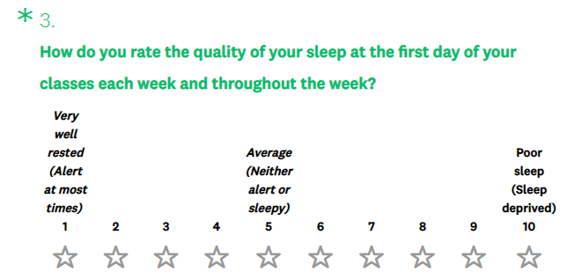
“Would you say typically you feel tired during the week?”
30 students said yes
6 said no
6 didn’t answer
4
3
3
9
4
5
1
1
2
10
Number of Students

Slide 9
Significant Findings
NMC Students…
That took naps once or twice in a week goes to bed at an irregular times which causes them to feel daytime sleepiness.
Who worked in jobs goes to bed at an irregular time three to five times in a week
With AM classes (as their first class) tend to experience daytime sleepiness almost everyday in a week
With PM classes (as their first class) that slept past 12 AM (Midnight) rarely has trouble listening to class lectures during the week

Slide 10
Despite various sleep habits of NMC students, majority of them are satisfied with their academic progress

Slide 11
Group Studies
Findings: 4 of the participants were able to maintain a regular sleep and wake schedule.
Wasn’t able to find any significant data due to short amount of time.

Slide 12
Overall
This research project has been a great challenge towards my writing process and academic journey. Because of the recent typhoon (Typhoon Yutu), I was not able to analyze enough data with the given amount of time. Although the amount of responses on my survey did “saved” my research, one thing I would do differently is reaching out to experts on the island for qualitative research.
New: Able to read and identify literature studies

Slide 13
Thanks!
Any questions?
©SlidesCarnival

