Slide 1
The Benefits and Side Effects of Chewing Betel Nut
Joy Celis
EN202-03
May 5, 2015

Slide 2
Schedule
Library book search and studies search | February 17-19, 2015
Introduction and background | February 20, 2015
Draft (Meet with instructor) | February 23, 2015
Start on Literature Review | February 23, 2015
Start on Methodology | February 24, 2015
Draft (Meet with instructor) | February 25, 2015
Finding Analysis | February 28, 2015
Conclusion | March 01, 2015
Draft (Meet with instructor) | March 02, 2015
Revise, Revise, Revise! | March 03-15, 2015
Approval for Interview and Survey Questions | February 17, 2015
Analyze data | May 2015

Slide 3
Research Question:
Causes and effects of continued betel nut chewing

Slide 4
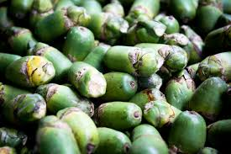
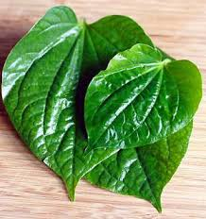

Slide 5
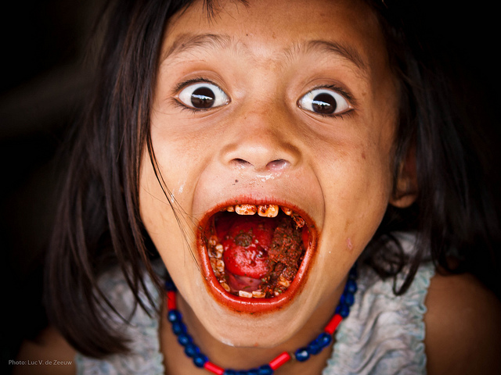

Slide 6
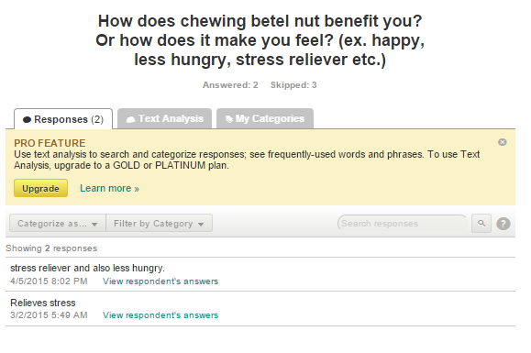
Positive Effects
According to Nai Shin Chu’s study he stated that “it has been claimed that the chewing of betel nut produces a sense well-being, euphoria, heightened alertness, sweating, salivation, a hot sensation in the body and an increased capacity to work” (Shin, 2000).

Slide 7
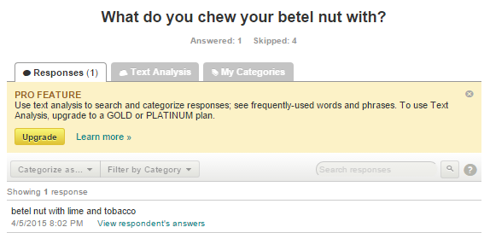
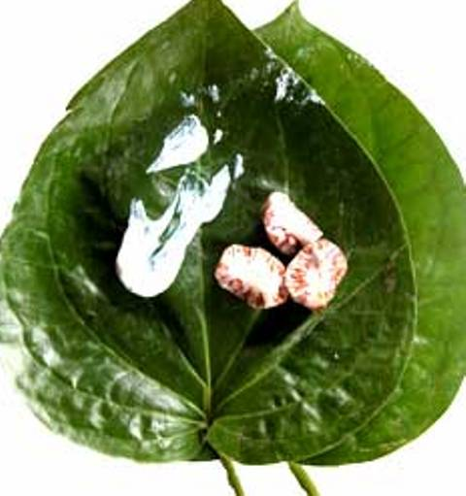
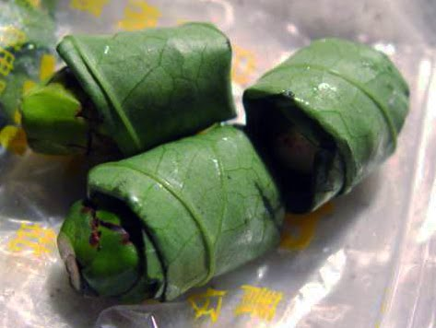
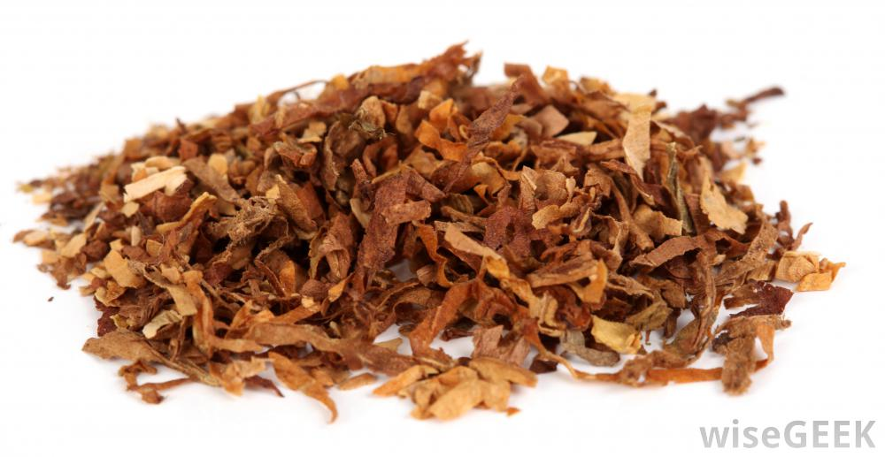

Slide 8
A book entitle, “Ancient Chamorro Society”, written by Lawrence J. Cunningham in 1992. According to the book, chewing betel nut is a custom that is spread from India to Southeast Asia and from there it reached here in the Marianas (Cunningham, p. 138). And chewers consider it a courtesy to offer another person betel nut (Cunningham, p. 7). Also, the ancient Chamorros chewed their betel nut with substances such as, quicklime; which they say makes the betel nut much stronger. Betel pepper leaf; gives a person’s breath a fragrant smell and eliminates bad breath. In addition, chewing betel nut back then helped them kill stomach worms and intestinal parasites, also the staining of the teeth were considered beautiful (Cunningham, p. 7).

Slide 9
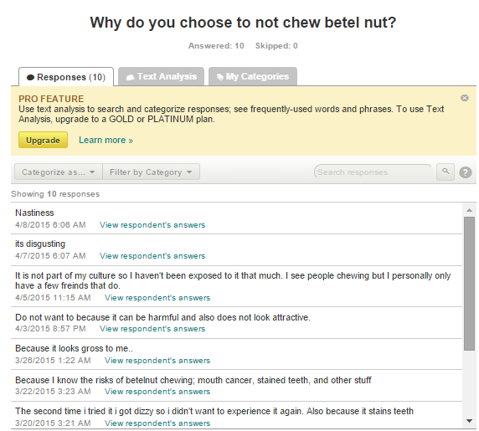
Why we do not chew betel nut…

Slide 10
Are you aware of the side effects of chewing betel nut?
Yes: NBC:9 BC:3 = 12 total
NO: NBC: 1 BC: 2 SKIPPED ?

Slide 11
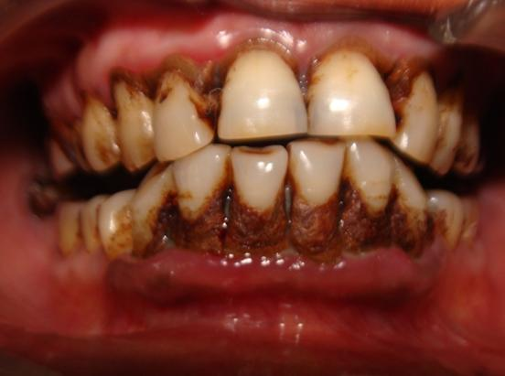
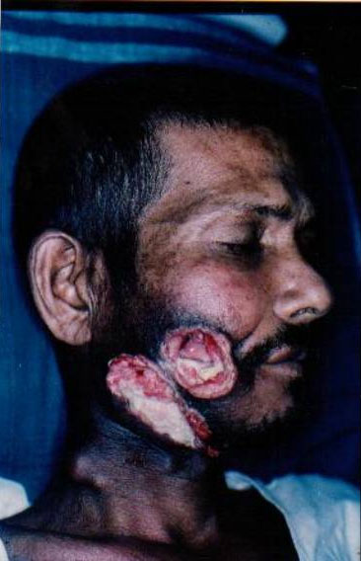
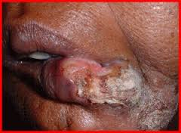
Side Effects that will last for a LIFE TIME

Slide 12
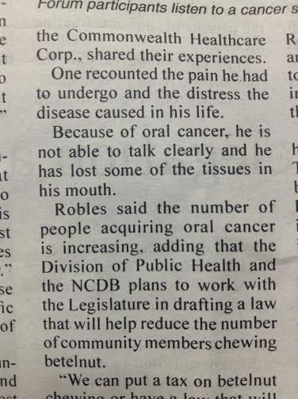
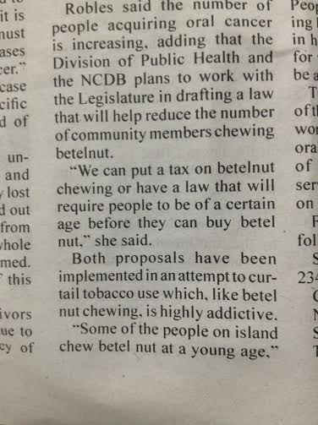
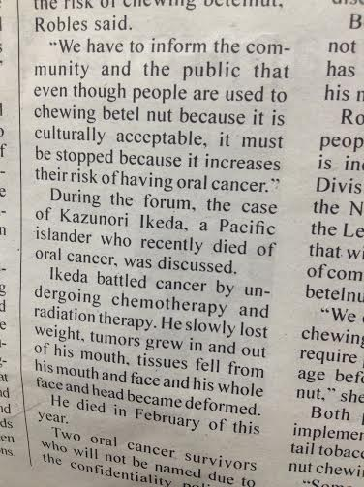
Local News…

Slide 13
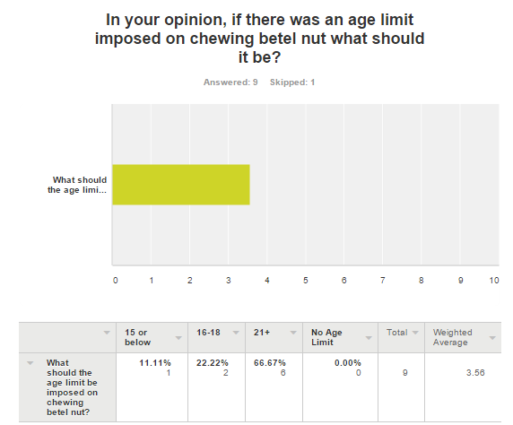

Slide 14
Thank you ☺

