Slide 1
LORNA c. cRUZ Northern Marianas college
Presentation 2

Slide 2
Ms. Kimberly anderson may 2016
ENG101 – on01 Sp16

Slide 3
TOPIC

Slide 4
THESIS Question
Does It Really
Help?

Slide 5
TERMS - MENTORS

Slide 6
BENEFITS
Students
Workplace

Slide 7
Benefits … in Business

Slide 8
RESOURCES
Retrieved from: https://en.wikipedia.org/wiki/Mentorship
Retrieved from: http://search.ebscohost.com/login.aspx?direct=true&db=voh&AN=111883285&site=src-live">The Power & Pleasure of Mentoring.</a>
Retrieved from: http://search.ebscohost.com/login.aspx?direct=true&db=voh&AN=109513313&site=src-live">Mentoring for all.</a>
Retrieved from: http://www.shrm.org/publications/hrmagazine/editorialcontent/2011/0811/pages/0811grossman.aspx
Retrieved from: http://www.shrm.org/publications/hrmagazine/editorialcontent/2011/0811/pages/0811grossman.aspx
Retrieved from: http://www.shrm.org/publications/hrmagazine/editorialcontent/2011/0811/pages/0811grossman.aspx#sthash.heG0Z4a2.dpuf
Retrieved from: http://www.forbes.com/sites/lisaquast/2011/10/31/how-becoming-a-mentor-can-boost-your-career/#4add4062662a
Retrieved from: http://www.forbes.com/sites/lisaquast/2011/07/18/why-women-should-have-career-mentors/#138fe7b94b18
Retrieved from: http://www.micromentor.org/learn-more/impact
Retrieved from: https://www.business.qld.gov.au/business/business-improvement/business-mentoring
Retrieved from: http://smallbusiness.chron.com/top-10-benefits-mentoring-25779.html
Retrieved from: http://www.goodreads.com/quotes/tag/mentoring :

Slide 9
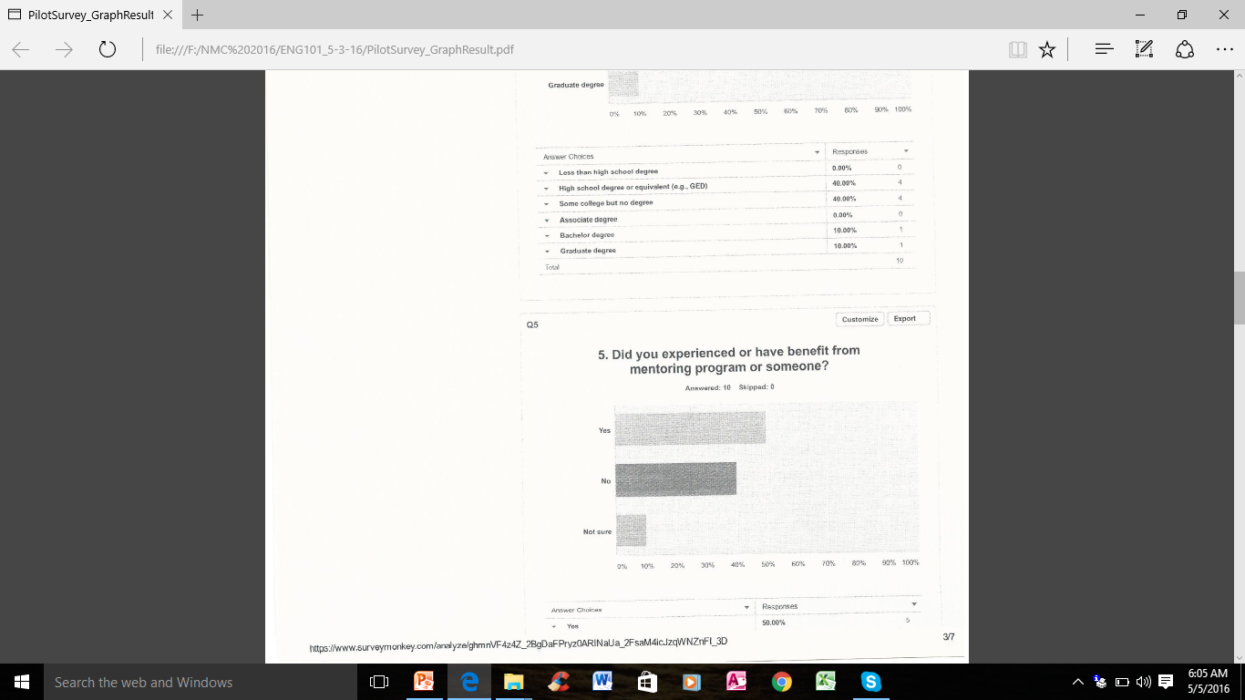
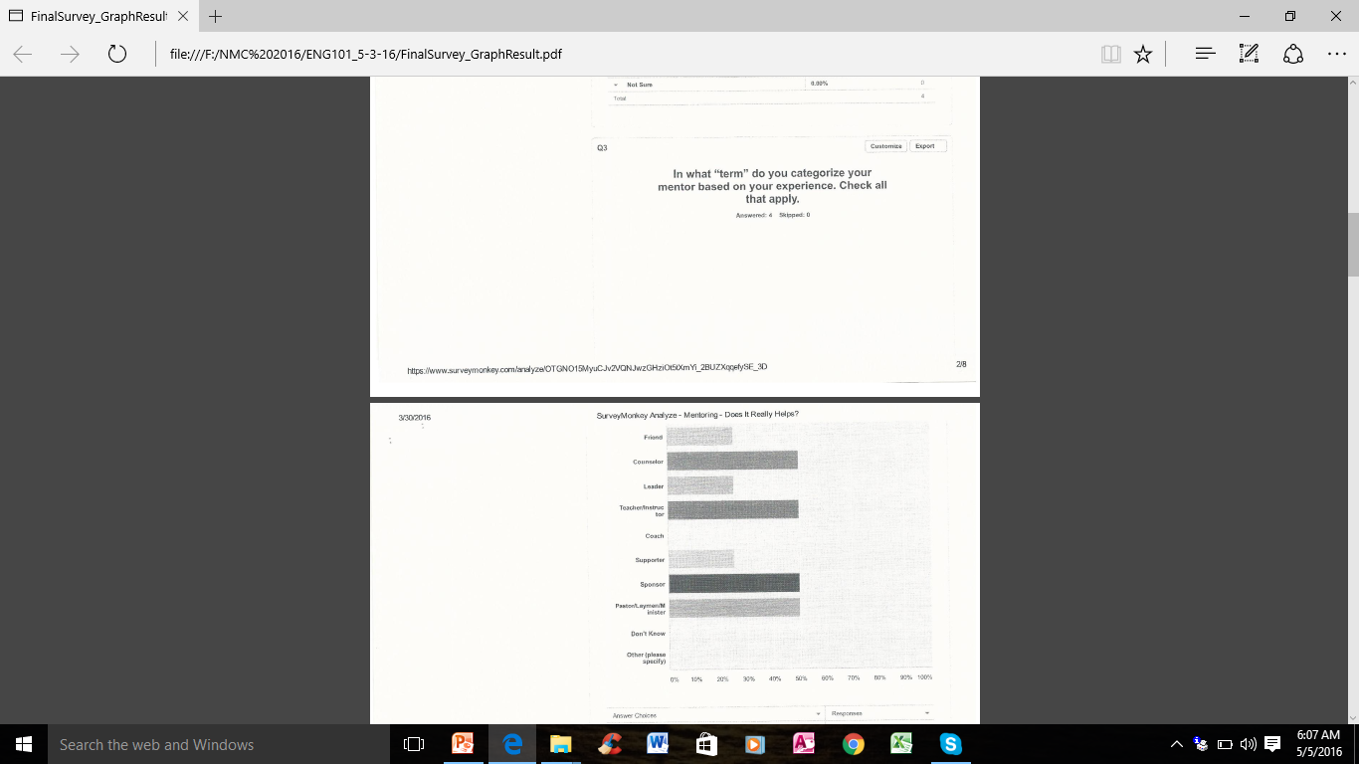
Pilot Survey Questions
Questions 5 Question 6 Question 7 - Terms

Slide 10
Pilot Survey Questions Retrieved from: https://www.surveyonkey.com/r/9BMXRDQ
SURVEY TITLE:
Does Mentoring Really Helps?
1. What is your age?
2. What is your gender?
3. What is your ethnicity? (Please select all that apply.)
4. What is the highest level of school you have completed or the highest degree you have received?
5. Did you experienced or have benefit from mentoring program or someone?
6. How do you think mentoring influence individual/business success?
7. Mentoring programs are responsible for business success around the world.(First box being the lowest and fifth box being the highest.)
8. What phase of life is mentoring most effective?
9. Are you willing to be a mentor to someone you believe needs your expertise?
10. Please specify areas of expertise?

Slide 11
Peer Review & Recommendations
ARC: Are tutors and mentors similar? I have signed up for tutoring at NMC and it was helpful for the subject I was struggling in. I’m not sure if there are any suggestions to make but I hope you get the information you need. Your question number 8 is a good one!
AL: Good format but there are some minor grammatical errors. I also got a little confused in your matrix question (strongly agree/disagree type question), I was a bit confused on where to click and sometimes it allowed more than one option to be chosen. Perhaps you can also add some N/A (not applicable or no opinion) options.
JC- I've noticed some grammatical errors so just correct them. Also, some questions seem a bit confusing like #10, I'm not sure what you were asking there. You might want to fix #6 and #7 format.

Slide 12
Peer Review & Recommendations
TS: Your survey was right on point. I think you might want to ask more on how their experience with a mentor was like? or even How it has helped them with their future lives?
YC - Your questions are well-defined and focused, but I recommend to revise format for a few questions, including matrix about the level of importance and question on area of expertise (probably, a multi-options format or a drop-down list?)
LD: Question 6 was confusing, Instead of a checkbox matrix, I think a simple multiple choice answer (with the same choices) would be more easier. Question 10 was also confusing, and again I think multiple choice would work for it. I think you have great questions, but some questions’ answer choices are in the wrong format.

Slide 13
Peer Review & Recommendations
JP: This is a really informative survey, though at most times I was left confused. Some questions need more clarity and some needs more explanation. Questions 6 and 7 needs some editing because the check boxes are confusing, do you mean, to rate each of the options from 1 to 5 or do you choose one option (e.g. agree) and then rate it from box 1 to 5 or do you have to check mark other options like “somewhat agree” as well? Also for question #10, it needs more explanation, what exactly do you mean by expertise with the options given. For example, in education do I say what is my major, or do I say “fair knowledge”. Clarity is key! But other than that, I totally like your topic about mentorship because from experience, I had a mentor that was a big help to me.

Slide 14
Peer Review & Recommendations
JP: This is a really informative survey, though at most times I was left confused. Some questions need more clarity and some needs more explanation. Questions 6 and 7 needs some editing because the check boxes are confusing, do you mean, to rate each of the options from 1 to 5 or do you choose one option (e.g. agree) and then rate it from box 1 to 5 or do you have to check mark other options like “somewhat agree” as well? Also for question #10, it needs more explanation, what exactly do you mean by expertise with the options given. For example, in education do I say what is my major, or do I say “fair knowledge”. Clarity is key! But other than that, I totally like your topic about mentorship because from experience, I had a mentor that was a big help to me.

Slide 15
Instructors Review & Recommendations
KBA- This is a good start but the survey needs more development. The questions asking to rate things are difficult because they are not numbered and there are too many boxes making them difficult to answer.
The rating options should be on the top and the things you are rating should be listed in a column on the left side.
For example how would you describe the following foods.
unappealing yummy great crave
chocolate
ice cream
coffee
liquor
cheese
chilli
eggs
spinach
eggs

Slide 16
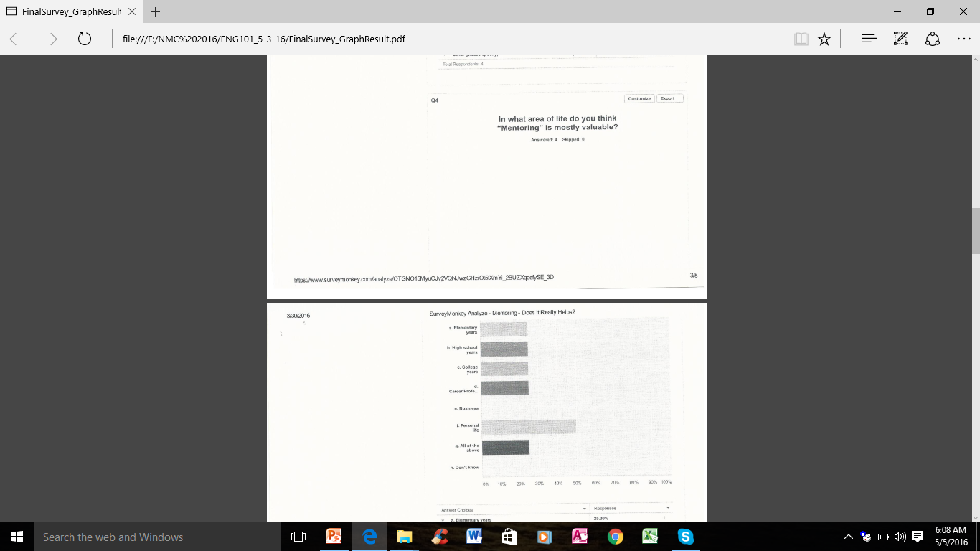
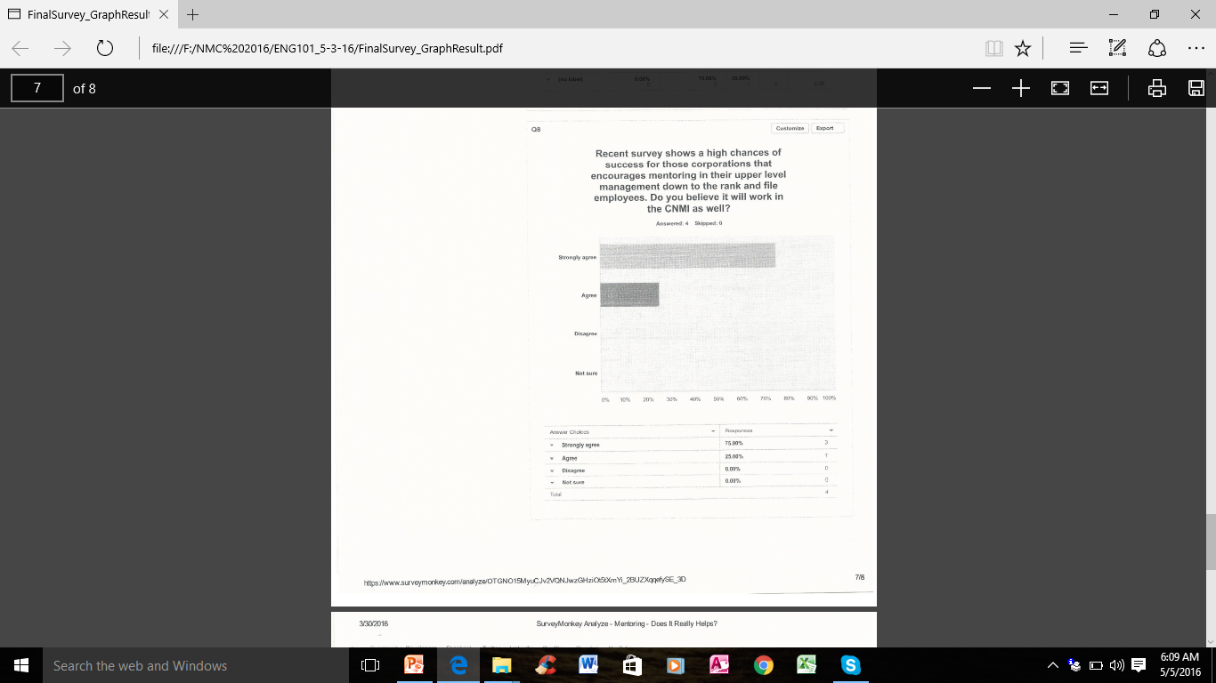
Final Survey Questions
Questions 4 Question 6 Question 8

Slide 17
FINAL Survey Questions Retrieved from: https://www.surveymonkey.com/r/SZKLHHW
SURVEY TITLE:
Mentoring – Does It Really Helps?
1. Have you tried having a mentor?
2. How do you rate your experience with a mentor?
3. In what “term” do you categorize your mentor based on your experience. Check all that apply.
4. In what area of life do you think “Mentoring” is mostly valuable?
5. How do you rate your community in terms of mentoring efforts.
6. In what areas in the community do you recommend mentoring can be of benefit.
7. How do you recommend mentoring in CNMI business sectors?
8. Recent survey shows a high chances of success for those corporations that encourages mentoring in their upper level management down to the rank and file employees. Do you believe it will work in the CNMI as well?
9. How do you describe yourself in the area of mentoring?
10. If there is any funding approved to create mentoring in your community will you be willing to: (choose answer that apply)

Slide 18
STATISTICS Response
Participants
Classmates - 5
Mentors - 3
Business Owners – 2
Gather Data
Survey Monkey Link - 5
Personal Interview - 5

Slide 19
Pilot Survey Results

Slide 20
Final Survey Results

Slide 21
Analysis
This research has proven that Mentoring has an important role in success, whether it is education, career, personal life and even in business. A person who experienced being mentored can someday be a mentor to the next generation and pass on the legacy of those individuals who lead the way in the area of these “passing of torch” for the benefit of humanity. Community involvement and encouragement should be magnified if not overemphasize for the business community to be actively including in their agenda to take the time and create programs that deals with mentoring apprentice or employees.

Slide 22
Proposed Information Dissemination Outlet
Email survey link to classmates in ENG101 course (if possible other courses as well ☺)
Conduct Personal Interview
(Printed Survey) in NMC – Tinian, Private Businesses, Government Agencies etc.
Facebook Page

Slide 23
Lesson Learned and “Not To’s”
Doing the survey on personal approach basis. Like interviews, and print-out questionnaires for records.
Not to rely on just posting the survey in Survey Monkey only.
Be aggressive in getting participants in your survey.
Do not put off work. No procrastination.

Slide 24
RESOURCES
Creecy, Jr. R.(2007) Personal Interview
Perez, B. (2016) Personal Interview
Hofschneider, F. (2016) Personal Interview
Retrieved from: “http://search.ebscohost.com/login.aspx?direct-true&db=voh&AN=109513313&site=src-live”Mentoring for all.</a>
Retrieved from: “http://search.ebscohost.com/login.aspx?direct-true&db=voh&AN=111883285&site=src-live”The Power & Pleasure of Mentoring.</a>
Hofschneider, F. (2016) Personal Interview
Retrieved from: http://goodreads.com/quotes/tag/mentoring
Retrieved from: https://wikipedia.org/wiki/Mentorship
Retrieved from: https://www.business.qld.gov.au/business/business-improvement/business-mentoring
Retrieved from:www.goodreads.com/quotes/tag/mentoring

Slide 25
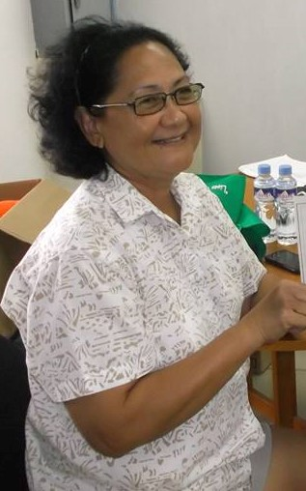
My Personal Mentors 2007- Present

Slide 26
Decide to be a Mentor to Someone
SYETP & Library Staff Mentor
Your Area of Mentoring:
Place your picture here:

Slide 27
TESTIMONIES FROM EXPERTS
* “Mentorship is simply learning from the mistakes and mastery of a successful person in his/her field.” ― Bernard Kelvin Clive
* “If you're not reaching back to help anyone then you're not building a legacy.”
― Germany Kent
* “The mediocre leader tells. The good leader explains. The superior leader demonstrates. The great leader inspires.” ― Gary Patton

Slide 28
TESTIMONIES FROM EXPERTS
* “In what is known as the 70/20/10 learning concept, Robert Eichinger and Michael Lombardo, in collaboration with Morgan McCall of the Center for Creative Leadership, explain that 70 percent of learning and development takes place from real-life and on-the-job experiences, tasks, and problem solving; 20 percent of the time development comes from other people through informal or formal feedback, mentoring, or coaching; and 10 percent of learning and development comes from formal training.”
― Marcia Conner, The New Social Learning: A Guide to Transforming Organizations Through Social Media

Slide 29
CONCLUSION
Is
Worth
The
Effort?
“An employee made a mistake that cost the company $10 million, he walked into the office of Tom Watson, the C.E.O., expecting to get fired. “Fire you?” Mr. Watson asked. “I just spent $10 million educating you.”
- Mr. Adam Grant,
Organizational Psychologist

Slide 30
Thank You for Watching ☺

