Slide 1
English Research Portfolio
Magic and education
Victor cabrera

Slide 2
Cycle
Drawing Board
Proposal
Question/Topic
Data Collection
Literature Review

Slide 3
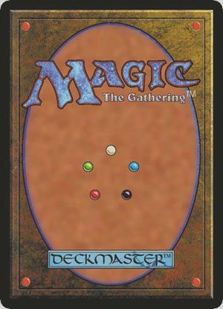
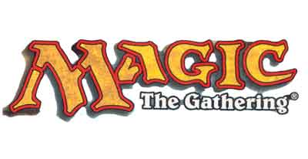
Drawing Board
Did not want to discuss about Typhoon Soudelor
Wanted to do something that interested me
Magic: The Gathering

Slide 4
Proposal
Why does it matter?
Is it relevant?
Should you care?

Slide 5
Question/Topic
Does it matter if you play?
Should you play to enhance learning?
Is it helpful?

Slide 6
Data Collection
Some forms:
Experiments
Interviews

Slide 7
Participants
Magic Players
Played for both significant amount of time or short amount of time.
College students with varying ages
Non Players
Either have heard of the game or limited knowledge of the game.
College students varying ages

Slide 8
Interviews
Small interviews with Magic players to get personal ideas about their experience of game

Slide 9
Experiment
Both groups were tested using a sample Graduate Management Admission Test (GMAT) exams
Both groups were assigned same time limit for both exams
Areas tested are participants Critical Thinking Skills and Problem Solving Skills.

Slide 10
Notable Results
Players
Non Players
Time to finish exams are mostly similar.
Scored quite high for exams.
Had a variety of times for all participants to finish exams.
Scores were not as high compared to players

Slide 11
Literature
Majority of literature that was found and used supported the topic.
Most sources usually did not talk about it being a bad use for education.
Majority are from blogs since there are barely relatable sources of educational sources.
Aside from internet blogs, there are scholarly sources as well.
All sources are weighed equally

